Slide 1



Constructing Subtle Faults Using Higher Order Mutation Testing
Higher Order Mutation Testing
Yue Jia, Mark Harman
King’s College London
CREST
Notes:
Good Morning Every one, I’m yue jia, from king’s college London, crest centre.
I am a first year phd student, and my phd topic is mainly about mutation testing.
Well I am very excited to be here, because this is my first publication
You can see the title of my talk this very long, I can help you with it, if you can take remenber one thing, please this , this is the idea behand this tool, which we believe there will be a strong believe that may have a greate impact on testing community.
My topic today is about how to apply EA to generate subtle fault and possible approach to unveil the test case that can kill these subtle fault.
This talk is actural about how can me is about testong.
This is a joint work with mark harman, he is also here today. So as dagsthl is an discussion seminar, So if there please just stop me.
Testing is not all about finding fault
You looking for criticium

Slide 2
Agenda
Background
Problems
Solution
Empirical Study
Summary
Background
Problems
Solution
Empirical Study
Summary
Mark Harman and Yue Jia King’s College London, CREST Centre
Notes:
Scince not everyone is from testing background, I will start from introducing the basic idea of mutation testing, then explain the main problems that prevent mutation testing become a useful practice in the real world.
After that I will propose our EA solution to these problem, and show the result with a real case.
At last I will talk about the my current work about test case generation.

Slide 3
Mutation Testing
Background
Problems
Solution
Empirical Study
Summary
Mark Harman and Yue Jia King’s College London, CREST Centre
Notes:
Let’s take testing a car as an example to see how can mutation

Slide 4
Mutation Testing
Which test case is better?
Background
Problems
Solution
Empirical Study
Summary
Mark Harman and Yue Jia King’s College London, CREST Centre
Notes:
We have many ways to test a car, for example we can run it on a strght road, or we can it run it on a winding bending road. Let take these two road as two test case,
However, Suppose we can only choose one from them, Then we have to decide which one with better.

Slide 5
Mutation Testing
Background
Problems
Solution
Empirical Study
Summary
Mark Harman and Yue Jia King’s College London, CREST Centre
Notes:
To do mutation testing, we first of all deliberately generate a faulty version of orig…`
In our example we can simply fidle with a lug nut then we woun;t notice then done it on the straight road

Slide 6
Mutation Testing
Background
Problems
Solution
Empirical Study
Summary
Mark Harman and Yue Jia King’s College London, CREST Centre

Slide 7
Mutation Testing
Generate Mutants
------------------------------------------------------------------------------------------------------
------------------------------------------------------------------------------------------------------
------------------------------------------------------------------------------------------------------
+
>
Original Program
First Order Mutant
Background
Problems
Solution
Empirical Study
Summary
Mark Harman and Yue Jia King’s College London, CREST Centre
Notes:
Mutation analysis is the most common form of software fault-based testing. A fault model is used to produce hypothetical faulty programs by creating variants of the program under test. Variants are created by "seeding" faults, that is, by making a small change to the program under test following a pattern in the fault model. The patterns for changing program text are called mutation operators, and each variant program is called a mutant.

Slide 8
Mutation Testing
Generate Mutants
------------------------------------------------------------------------------------------------------
------------------------------------------------------------------------------------------------------
------------------------------------------------------------------------------------------------------
------------------------------------------------------------------------------------------------------
------------------------------------------------------------------------------------------------------
+
+
>
>
Original Program
First Order Mutant
Higher Order Mutant
Background
Problems
Solution
Empirical Study
Summary
Mark Harman and Yue Jia King’s College London, CREST Centre
Notes:
Mutation analysis is the most common form of software fault-based testing. A fault model is used to produce hypothetical faulty programs by creating variants of the program under test. Variants are created by "seeding" faults, that is, by making a small change to the program under test following a pattern in the fault model. The patterns for changing program text are called mutation operators, and each variant program is called a mutant.

Slide 9
Mutation Testing
Generate Mutants
------------------------------------------------------------------------------------------------------
------------------------------------------------------------------------------------------------------
------------------------------------------------------------------------------------------------------
------------------------------------------------------------------------------------------------------
------------------------------------------------------------------------------------------------------
------------------------------------------------------------------------------------------------------
------------------------------------------------------------------------------------------------------
-----------------------------------------------------------------------------------------------------
------------------------------------------------------------------------------------------------------
+
+
+
+
>
>
>
>
Original Program
First Order Mutant
First Order Mutant
Higher Order Mutant
Higher Order Mutant
Background
Problems
Solution
Empirical Study
Summary
Mark Harman and Yue Jia King’s College London, CREST Centre
Notes:
Mutation analysis is the most common form of software fault-based testing. A fault model is used to produce hypothetical faulty programs by creating variants of the program under test. Variants are created by "seeding" faults, that is, by making a small change to the program under test following a pattern in the fault model. The patterns for changing program text are called mutation operators, and each variant program is called a mutant.

Slide 10
Problem 1970s
Computational cost
Background
Problems
Solution
Empirical Study
Summary
Mark Harman and Yue Jia King’s College London, CREST Centre
Notes:
In order to understand why the mutation testing community has not previously used higher order mutants we need to rewind history to the 1970s.

Slide 11
Problem 1970s
Computational cost
e.g. Triangle
LoC 50
FOM 500
HOM 2⁵⁰⁰
Background
Problems
Solution
Empirical Study
Summary
Mark Harman and Yue Jia King’s College London, CREST Centre

Slide 12
Problem 1970s
Computational cost
e.g. Triangle
LoC 50
FOM 500
HOM 2⁵⁰⁰
Background
Problems
Solution
Empirical Study
Summary
Mark Harman and Yue Jia King’s College London, CREST Centre

Slide 13
Problem 1970s
Computational cost
e.g. Triangle
LoC 50
FOM 500
HOM 2⁵⁰⁰
cost
Background
Problems
Problems
Solution
Empirical Study
Summary
Mark Harman and Yue Jia King’s College London, CREST Centre

Slide 14
Solution 1980s
Coupling effect hypothesis
cost
Background
Problems
Solution
Empirical Study
Summary
Mark Harman and Yue Jia King’s College London, CREST Centre

Slide 15
Solution 1980s
Coupling effect hypothesis
cost
Background
Problems
Solution
Empirical Study
Summary
Mark Harman and Yue Jia King’s College London, CREST Centre
Notes:
Lets look at this graph to see how it works

Slide 16
Solution 1980s
Simple Complex
cost
If a test set kills simple faults, it also kills the complex faults
Background
Problems
Solution
Empirical Study
Summary
Mark Harman and Yue Jia King’s College London, CREST Centre

Slide 17
Solution 1980s
Coupling effect hypothesis
cost
Background
Problems
Solution
Empirical Study
Summary
Mark Harman and Yue Jia King’s College London, CREST Centre

Slide 18
Solution 1990s
Selective mutation / Mutation sampling
cost
Background
Problems
Solution
Empirical Study
Summary
Mark Harman and Yue Jia King’s College London, CREST Centre
Notes:
How harnd will be to design the test case to designe a test case to discovers you changed + into minus
It also reduce the qulity of clude

Slide 19
Selected First Order Mutants
+
-
>
<
a
b
Trivial Fault
Background
Problems
Solution
Empirical Study
Summary
Mark Harman and Yue Jia King’s College London, CREST Centre
Notes:
Let’s take testing a car as an example to see how can, In the casr example it lok like just remove the wheel rather jus the lugnut
mutation

Slide 20
Subtle Fault
90% of the real faults are complex faults (Purushothaman and Perry)
----------------------------------------------------------------------------------------------------------------------------------------------------------------------------------------------------------------------------------------------------------------------------------------------------------
HOMs -> Subtle faults
Background
Problems
Solution
Empirical Study
Summary
Mark Harman and Yue Jia King’s College London, CREST Centre
Notes:
So what I am trying to convice you so far is

Slide 21
Subtle Fault
Solution Programmer
Background
Problems
Solution
Empirical Study
Summary
Mark Harman and Yue Jia King’s College London, CREST Centre
Notes:
Let me pich up a simple example to illstrate this idea
Sopposese, conceptually

Slide 22
Subtle Fault
Solution Programmer
1
Background
Problems
Solution
Empirical Study
Summary
Mark Harman and Yue Jia King’s College London, CREST Centre

Slide 23
Subtle Fault
Solution Programmer
2
Background
Problems
Solution
Empirical Study
Summary
Mark Harman and Yue Jia King’s College London, CREST Centre

Slide 24
Subtle Fault
Solution Programmer
3
Background
Problems
Solution
Empirical Study
Summary
Mark Harman and Yue Jia King’s College London, CREST Centre

Slide 25
Subtle Fault
Solution Programmer
4
Background
Problems
Solution
Empirical Study
Summary
Mark Harman and Yue Jia King’s College London, CREST Centre

Slide 26
Solution 1990s
Selective mutation / Mutation sampling
cost
Background
Problems
Solution
Empirical Study
Summary
Mark Harman and Yue Jia King’s College London, CREST Centre
Notes:
Let we rewind, let go back in history to before I was born

Slide 27
Solution 1980s
Coupling effect hypothesis
cost
Background
Problems
Solution
Empirical Study
Summary
Mark Harman and Yue Jia King’s College London, CREST Centre

Slide 28
Problem 1970s
Computational cost
cost
Background
Problems
Solution
Empirical Study
Summary
Mark Harman and Yue Jia King’s College London, CREST Centre

Slide 29
Solution
Higher order mutation testing
cost
Background
Problems
Solution
Empirical Study
Summary
Mark Harman and Yue Jia King’s College London, CREST Centre
Notes:
Now we can The miracle indegreadiation is the search, back In 1970s people ddi’t think about use not know EA to apply to software engineering,

Slide 30
Solution
Higher order mutation testing
cost
…Search Based Optimization
Background
Problems
Solution
Empirical Study
Summary
Mark Harman and Yue Jia King’s College London, CREST Centre
Notes:
Now we can The miracle indegreadiation is the search, back In 1970s people ddi’t think about use not know EA to apply to software engineering,

Slide 31
Higher Order Mutation Testing
Increase the subtlety
Reduce the Oracle effort
Reduced number of equivalent mutants
Background
Problems
Solution
Empirical Study
Summary
Mark Harman and Yue Jia King’s College London, CREST Centre
Notes:
n SBSE we apply search techniques to search large search spaces, guided by a fitness function that captures properties of the acceptable software artefacts we seek

Slide 32
Higher Order Mutant
Most common case
Test set T
Tc
Ta
Tb
Tabc
Background
Problems
Solution
Empirical Study
Summary
Mark Harman and Yue Jia King’s College London, CREST Centre
Notes:
Suppose Ta is the set of testcasne kill a,
What set of test cases will kill a program contains all three falut.
With this case the hom is at least easy to kill,so it’s wors
This is what intuition tells us. that is if I put two fautls into a program, it will be more likely to go wrong then if I put only one fault into the program

Slide 33
Higher Order Mutant
Uncommon case
Tc
Ta
Tb
Tabc
Background
Problems
Solution
Empirical Study
Summary
Mark Harman and Yue Jia King’s College London, CREST Centre
Notes:
However pos, althourighh this is less comon, the importance thing is is harder to kill than any of its FOMs from which is constructed

Slide 34
Higher Order Mutant
Subsuming higher order mutant
Tc
Ta
Tb
Tabc
Background
Problems
Solution
Empirical Study
Summary
Mark Harman and Yue Jia King’s College London, CREST Centre
Notes:
When we mean by sutle is

Slide 35
Higher Order Mutant
Subsuming higher order mutant
Tc
Ta
Tb
Tabc
Background
Problems
Solution
Empirical Study
Summary
Mark Harman and Yue Jia King’s College London, CREST Centre

Slide 36
Higher Order Mutant
Strongly Subsuming higher order mutant
Tc
Ta
Tb
Tabc
If a test case kills HOM Mabc, it also kills the FOM Fa, Fb and Fc
Background
Problems
Solution
Empirical Study
Summary
Mark Harman and Yue Jia King’s College London, CREST Centre

Slide 37
Higher Order Mutation Testing
Increase the subtlety
Reduce the Oracle effort
Reduced number of equivalent mutants
Background
Problems
Solution
Empirical Study
Summary
Mark Harman and Yue Jia King’s College London, CREST Centre

Slide 38
Higher Order Mutation Testing
Increase the subtlety
Reduce the Oracle effort
Mutants
Reduced number of equivalent mutants
Background
Problems
Solution
Empirical Study
Summary
Mark Harman and Yue Jia King’s College London, CREST Centre

Slide 39
Higher Order Mutation Testing
Increase the subtlety
Reduce the Oracle effort
Mutants Test cases
Reduced number of equivalent mutants
Background
Problems
Solution
Empirical Study
Summary
Mark Harman and Yue Jia King’s College London, CREST Centre

Slide 40
Higher Order Mutation Testing
Increase the subtlety
Reduce the Oracle effort
Mutants Test cases
Reduced number of equivalent mutants
Background
Problems
Solution
Empirical Study
Summary
Mark Harman and Yue Jia King’s College London, CREST Centre
Notes:
Hom ares less likely to be equvialent, tha’t accrond offutt’s stdays. We use th coevl weed out eq m
If you are insedted in this topic we can disscutss it during the coffee time.

Slide 41
Results
Mutants
LoC FOM sHOM
Triangle 50 584 47
Tcas 150 679 98
Schedule2 350 1014 78
Totinfo 500 2570 320
Printtokens 750 866 67
Space 6000 7570 522
Background
Problems
Solution
Empirical Study
Summary
Mark Harman and Yue Jia King’s College London, CREST Centre
Notes:
the largest program previously study in the litretal is about thest size, we push it by at

Slide 42
Algorithms
Greedy
Hill Climbing
Genetic Algorithm
Background
Problems
Solution
Empirical Study
Summary
Mark Harman and Yue Jia King’s College London, CREST Centre

Slide 43
Results
Background
Problems
Solution
Empirical Study
Summary
Mark Harman and Yue Jia King’s College London, CREST Centre

Slide 44
Triangle Program
Classify triangle by the lengths of the sides
Equilateral Isosceles Scalene
Background
Problems
Solution
Empirical Study
Summary
Mark Harman and Yue Jia King’s College London, CREST Centre
Notes:
I hope at this point I have already convined you t
Our search based algorithms found subsuming HOMs in all the programs we studied.
However. In order to illustrate, let’s consider the simplest example.
That is, the well-known triangle classification program.
You might think there is nothing new to be said about this simple 50 line program.
I hope convince you that there is.
Even this tiny toy program contains a potential subtle fault.
That is, our search algorithm found a strongly subsuming higher order mutant in the triangle program.

Slide 45
Strongly Subsuming HOM
a == c && a + b > c && a + c <= b
b == c && a + b > a && b + c <= a
if(trian == 1 && a + b > c)
if(trian > 1 && a + b > c)
a == b &&
a + b > c
if(trian == 1 && a + b <= c)
if(trian == 1 && a + b <= c)
a == b &&
a + b <= c
Background
Problems
Solution
Empirical Study
Summary
Mark Harman and Yue Jia King’s College London, CREST Centre

Slide 46
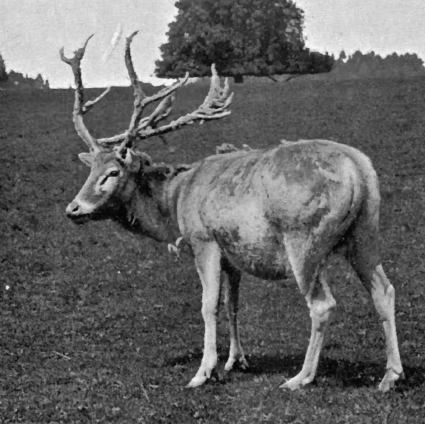
Tool
(Père David's Deer)
MiLu
Deer
Horse
Donkey
Strongly Subsuming
HOM
rare
valuable
Cow
Background
Problems
Solution
Empirical Study
Summary
Mark Harman and Yue Jia King’s College London, CREST Centre

Slide 47
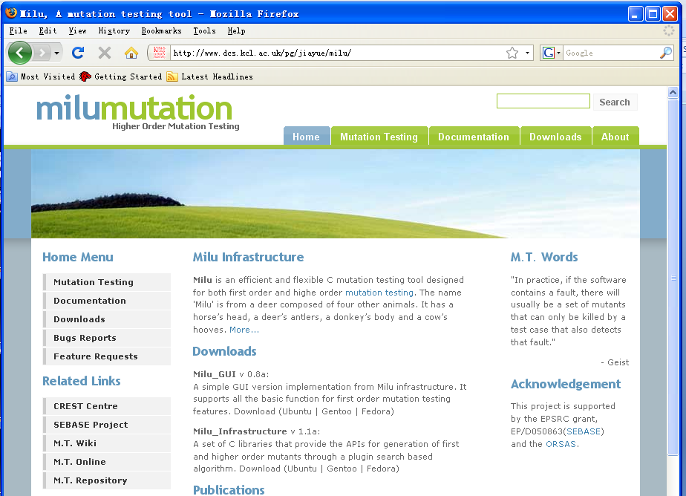
www.dcs.kcl.ac.uk/pg/jiayue/milu
Background
Problems
Solution
Empirical Study
Summary
Mark Harman and Yue Jia King’s College London, CREST Centre

Slide 48

Summary
Higher order mutation testing
Quality of mutant
Computational Cost
Question
Are real faults higher order mutants?
Thanks
Background
Problems
Solution
Empirical Study
Summary
Mark Harman and Yue Jia King’s College London, CREST Centre

