Slide 1


Optimizing Expression Selection for Lookup Table Program Transformation
Chris Wilcox, Michelle Mills Strout, James M. Bieman
Computer Science Department
Colorado State University
Source Control Analysis and Manipulation (SCAM)
Riva del Garda, Italy – September 23, 2012

Slide 2
Lookup Table (LUT) Optimization
CONTEXT: Scientific applications that are performance limited by elementary function calls that are more expensive than arithmetic operations.
PROBLEM: Current practice of applying LUT transforms limits productivity, obfuscates code, and does not provide control over accuracy and performance.
APPROACH: Improve programmer productivity by substantially automating LUT optimization through a methodology and tool support.
Notes:
CONTEXT & PROBLEM
Any code that is performance limited by this kind of math, not memory bound!
Current practice is hit and miss, requires lots of experimentation, as we found out
Our research also presents a novel approach to the LUT optimization problem

Slide 3
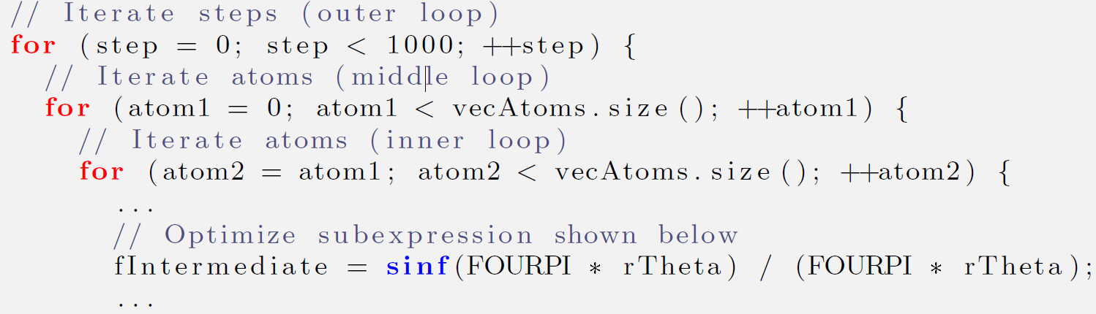
Motivation: SAXS Results
Small Angle X-ray Scattering (SAXS) is an experimental technique that we simulate using Debye’s equation.
872s (1.0X): original C++ code
128s (6.8X): lookup table added
4.66 x 10⁹ iterations
Notes:
CONTEXT:
Initially we manually tuned version of C++ code, these are the results from that
Two questions: 1) Why is this code slow?, and 2) How do we make it faster?
Similar to the context of other scientific computations: limited by elem. functions, lots of iterations
How to make it faster: use better algorithm – library already does, faster cpu – not anymore!

Slide 4
Elementary Function Bottlenecks
Elementary functions require many more processor cycles than arithmetic operations, even with hardware lookup tables.
For example, compared to an single-precision addition:
sin() is 40x slower
cos() is 45x slower
tan() is 56x slower
Elementary Function | Single Precision | Double Precision
sin | 40 ns | 51 ns
cos | 45 ns | 53 ns
tan | 56 ns | 71 ns
acos | 42 ns | 48 ns
asin | 43 ns | 47 ns
atan | 43 ns | 49 ns
exp | 32 ns | 35 ns
log | 56 ns | 61 ns
sqrt | 7.1 ns | 5.2 ns
* | 1.1 ns | 1.9 ns
/ | 2.0 ns | 3.1 ns
+ | 1.0 ns | 1.7 ns
- | 1.2 ns | 2.0 ns
Intel Core 2 Duo, E8300, family 6, model 23, 2.83GHz
Notes:
GENERAL PROBLEM:
Why do we care about elementary functions?
Because they dominate the execution time on these applications.
For example, SAXS code = 4.55b iterations * 51ns = 232s, which is > 90% of execution time
And these numbers are conservative

Slide 5
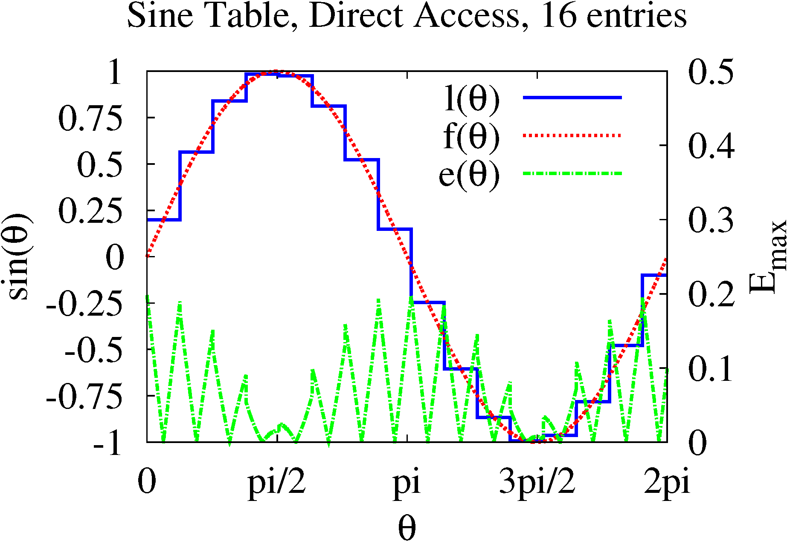
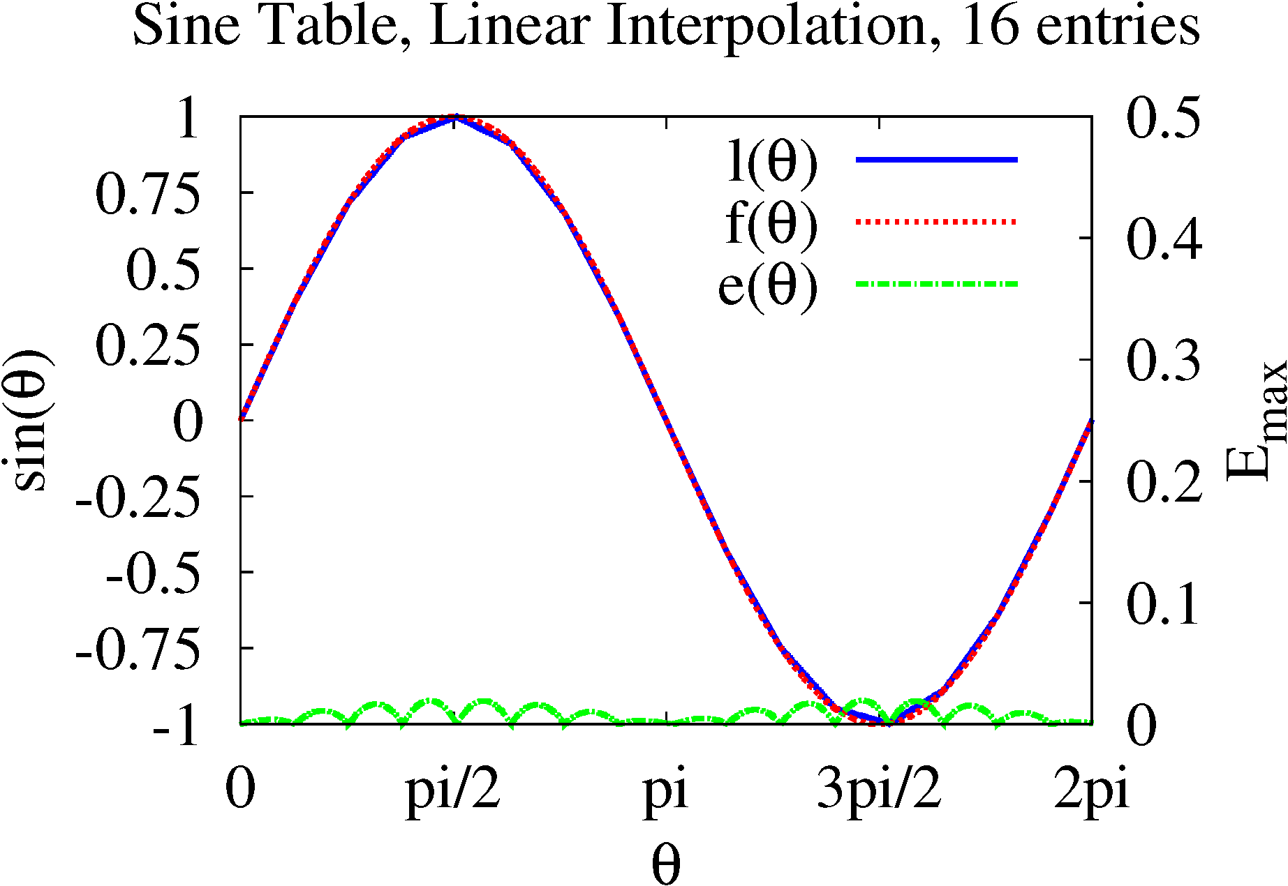
Example of a LUT Transform
Example of LUT data to replace the sine function in a computation.
Direct access sampling and linear interpolation sampling.
256KB sine table yields 6.9x speedup, 4.88x10⁻⁵ error
Table Entries | Memory Usage | Maximum Error | Average Error
256 | 1 KB | 1.25 x 10⁻² | 4.03 x 10⁻³
1024 | 4 KB | 3.12 x 10⁻³ | 1.00 x 10⁻³
4096 | 16 KB | 7.79 x 10⁻⁴ | 2.50 x 10⁻⁴
16384 | 64 KB | 1.95 x 10⁻⁴ | 6.26 x 10⁻⁵
65536 | 256 KB | 4.88 x 10⁻⁵ | 1.57 x 10⁻⁵
262144 | 1 MB | 1.23 x 10⁻⁵ | 3.92 x 10⁻⁶
Error Statistics for Sine Lookup Table
Notes:
SPECIFIC PROBLEM:
Basic idea: instead of doing the computation during program execution, look it up from a precomputed table
Call it a transformation because it replaces and expression with a table lookup from a precomputed table.
Benefit is avoidance of computation, cost is in accuracy, explain error on sine table graph and table
How LUT transformation leverages fuzzy reuse to reduce redundant computation
Concept of precise versus fuzzy reuse, why LUT transformation is an example of fuzzy reuse.
In this example, must call function 64K times instead of 4.66 billion, that’s a lot of reuse!
Great, we’re done, it goes faster, not too much error – NOT!
So why is ad hoc bad: lot of coding and experimentation, can obfuscate code, cannot control accuracy and performance.
That’s the real goal of my research, to solve these problems.

Slide 6
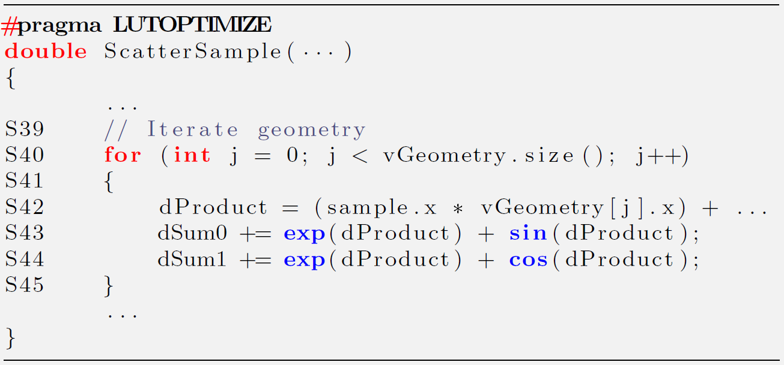
Example of a LUT Optimization
Goal is to enumerate the expressions that are the best candidates for LUT transformation.
Current heuristic picks expressions with at least one elementary function call and at most one variable.
Expression Identifier | Expression Syntax | Statement Identifier
X0 | exp() | S43
X1 | sin() | S43
X3 | exp() | S44
X4 | cos() | S44
Expression Identifier | Expression Syntax | Statement Identifier
X0 | exp() | S43
X1 | sin() | S43
X2 | exp()+sin() | S43
X3 | exp() | S44
X4 | cos() | S44
X5 | exp()+cos() | S44
X6 | exp() | S43,S44
Expression Identifier | Expression Syntax | Statement Identifier
X0 | exp() | S43
X1 | sin() | S43
X2 | exp()+sin() | S43
X3 | exp() | S44
X4 | cos() | S44
X5 | exp()+cos() | S44
Source code for optimization example.
Enumerated Expressions
Notes:
EXAMPLE:
We have to show this in the context of an example
Modified code to show some features of Mesa
Can be lots of expressions in a function, how do we decide what to evaluate for LUT transform
Basic elementary function identification (Animation 1), we can LUT transform these
Expression enumeration, including overlapping and competing expressions (Animation 2)
Expression coalescing (Animation 3)
Criteria: at least one elementary function, only one variable, possibly some associated math
Associated math only if it glues together multiple elementary functions, or reduces domain
FUNDAMENTAL IDEA: which of many expressions are the best ones to LUT transform
Can only do a limited number, constrained by cache, cannot do 50 LUTs with 10 entries each!
But, each one brings us more benefit
If we’re going to compare, we need a basis: error cost and performance benefit
So we have models, and these require certain information:
1) domain determines LUT bounds, must return a result for any input in domain
2) call frequency for performance model, benefit related to number of times called
An very expensive operation called once – not worth a LUT transform

Slide 7
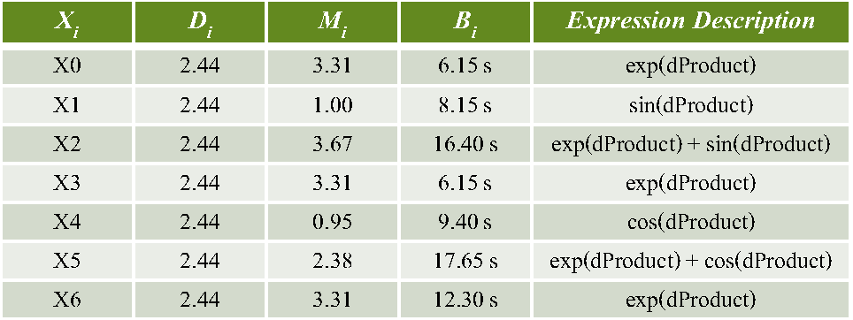
Modeling Error and Performance
Goal is to estimate the benefit and accuracy of a LUT transform for each expression.
Error Equations
Direct Access Error
Linear Interpolation Error
Performance Model
Ei: error (maximum)
Mi: error (slope)
Di: domain (extent)
Si: size (entries)
Bi: benefit (seconds)
Expressions for optimization example.
Notes:
PROBLEM:
Must compare accuracy and performance to decide which expression
Explain error equations, maximum versus average error, why linear interpolation is better
Give example of performance model
Explain variable names
Will talk about why these measures aren’t perfect later!

Slide 8
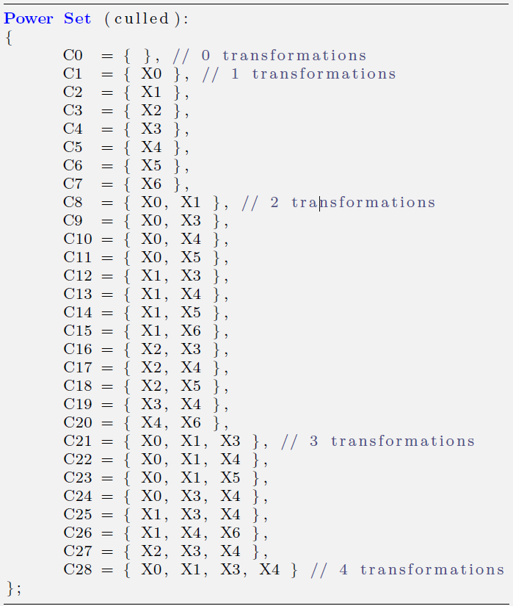
Constructing the Solution Space
Solution space is the power set of the set of expressions, with complexity O(2^{n}) for n expressions.
Expressions for optimization example.
Intersection constraints:
X0 ∩ X2, X1 ∩ X2, // original
X3 ∩ X5, X4 ∩ X5,
X0 ∩ X6, X1 ∩ X6, // coalesced
X2 ∩ X6, X5 ∩ X6, // inherited
Power set for optimization example.
Notes:
PROBLEM:
List all possible solutions for the optimization problem, based on the enumerated expressions.
Introduce intersection constraints based on overlapping expressions (previous slide)
Show how they cull the power set

Slide 9
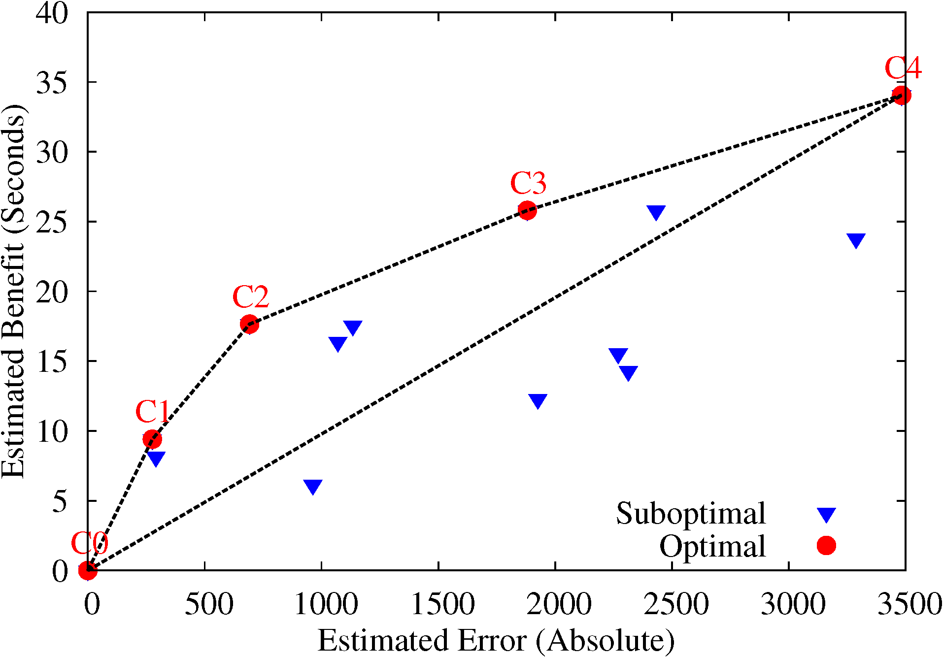
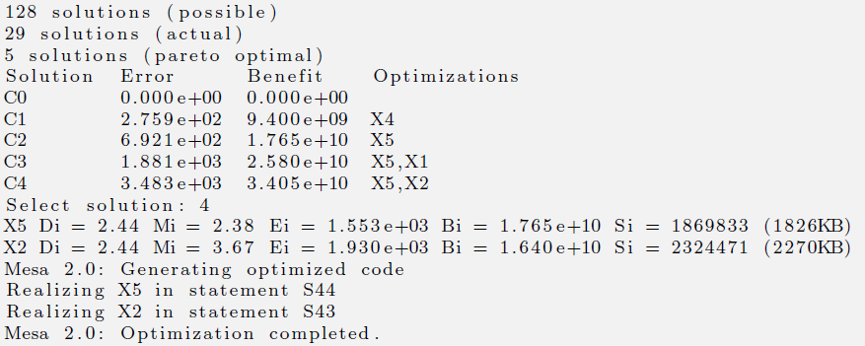
Finding Pareto Optimal Solutions
Optimal solution has more performance for equal or less error
Pareto optimal is determined by the convex hull of plot
Pareto Chart for Example Code
exp,sin,exp,cos
exp,cos,sin
exp,cos
cos
Mesa Realization of Optimization Solution
Notes:
Here’s output from Mesa and the associated “Pareto Chart”, show curve
Not very many points, many are duplicates, note cache allocation
Now ready to be turned into code
Refer to previous slides for expressions
Defer how cache is allocated

Slide 10
Case Studies
Tool Statistics
Application Results
Application Name | LOC Analyzed | Number of Expressions | Number of Solutions | Proc. Time | Perf. Speedup | Relative Error
PRMS Slope Aspect (no coalescing) | 35 | 9 | 512/384/9 | 13.7s | 4.4x | 2.67E-01%
PRMS Slope Aspect (coalescing) | 35 | 11 | 2048/425/9 | 15.5s | 4.3x | 8.21E-06%
PRMS Solar Radiation (coalescing) | 7 | 6 | 64/64/8 | 14.1s | 2.2x | 2.97E-04%
SAXS Discrete (direct access) | 60 | 3 | 8/4/3 | 11.2s | 6.8x | 4.06E-03%
SAXS Discrete (linear interpolation) | 60 | 3 | 8/4/3 | 16.5s | 3.0x | 5.55E-04%
SAXS Continuous (direct access) | 30 | 5 | 32/20/4 | 10.8s | 4.0x | 1.48E-04%
Stillinger-Weber (no coalescing) | 44 | 6 | 64/36/3 | 9.3s | 1.4x | 2.91E-02%
Neural Network (logistics) | 5 | 2 | 4/3/2 | 4.9s | 2.2x | 8.70e-02%
Neural Network (hypertangent) | 5 | 1 | 2/2/2 | 2.8s | 2.8x | 6.30e-01%
Intel Core 2 Duo, E8300, family 6, model 23, 2.83GHz
Notes:
CASE STUDIES:
Explain the columns and results, processing time does NOT include selection of transformation
Crucial questions: Did it make it faster? How much was application accuracy reduced?
What is the acceptable error in each domain? Need to ask the scientist and we have.

Slide 11
Performance and Error Model Evaluation
PRMS (Solar Radiation)
Evaluate performance model by comparing estimated benefit to actual application benefit.
Evaluate accuracy by comparing maximum absolute error against relative application error.
Performance Model Evaluation
Error Model Evaluation
Notes:
Must evaluate how well the models worked to see if we picked the right expressions!
Weakness of performance model is compiler optimization, sincos example, common subexpression elimination
Weakness of error model is error propagation through application, discuss difficult of this problem
Some variance, but the story is essentially the same for other applications, error can be worse

Slide 12
Contributions
A comprehensive methodology for applying software LUT transforms to scientific codes.
A LUT optimization algorithm that finds the most effective set of expressions for LUT transformation.
Analytic and numerical error analysis methods and a performance model to predict benefit.
Case studies that and a software tool toevaluate the effectiveness of our LUT methodology and tool.
Mesa: Automatic Generation of Lookup Table Optimizations, IWMSE, May 2011
Tool Support for Software Lookup Table Optimization, J. Scientific Programming, Dec. 2011
Notes:
METHODOLOGY:
Why this is better, just insert pragma and help domain profile and Mesa gives you solutions.
Small programmer interaction after problem is solved, must select a solution
Mesa realizes the solution, programmer must evaluate it
3 choices: keep the solution, look for another, or go back to original code

Slide 13
Questions?
http://www.cs.colostate.edu/hpc/MESA/
Notes:
LIMITATIONS
Inherent: performance limited by elementary function, error tolerant, must use cache memory
Methodology: inability to perfectly predict application benefit and error
Tool: C and C++ only, single module, unsupported syntax, only 64 expressions

Slide 14
Related Work
“Lookup tables (LUTs) are an excellent technique for optimizing the evaluation of functions that are expensive to compute and inexpensive to cache. By precomputing the evaluation of a function over a domain of common inputs, expensive runtime operations can be replaced with inexpensive table lookups.”
Pharr and Fernando, Graphics Gems 2, 2005
[Gal 86] - Proposed LUTs for elementary function evaluation.
[Tang 91] - Seminal work on hardware LUTs and error analysis.
[Zhang et al. 10] - Compiler to generate software LUTs for multicore.
[IWMSE 6/11] - Software LUT performance and cache concerns.
[Sci. Prog. 12/11] - Partial automation of LUT transform process.
Notes:
RELATED:
Cite quote, we are using LUTs to speedup function evaluation.
Of course we’re not the first to do this, there’s a long history for lookup table transformations
Amdahl made a lookup table for character conversion in the 1950’s, early assembly programmers did the same
Not much academic literature on software LUT, just ‘ad hoc’ and lots of web sites, except for Zhang
Zhang paper came out the month before my thesis proposal, we found out through a paper review
Review our results: mid-level cache, parallel scaling, multi-dimensional tables, versions of Mesa

Slide 15
Future Work
Continue to improve the estimation ability of the error model used for LUT optimization.
Extend our work by taking into account the temporal aspect of cache allocation of LUT data.
Characterize the performance if LUT transformation on multi-core systems with shared caches.
Evaluate polynomial reconstruction as a sampling technique for software LUT transformation.
Perform a case study that compares memoization versus LUT methods on varied applications.
Notes:
Successful prediction of application error would help make sure we identify the best expressions.
Possible approach: introduce some error and measure its effect on application output, fold into error model.
Could also improve performance model by taking into account compiler optimization, that’s not easy.
Temporal allocation: explain and credit Dr. Paul Hovland.

Slide 16
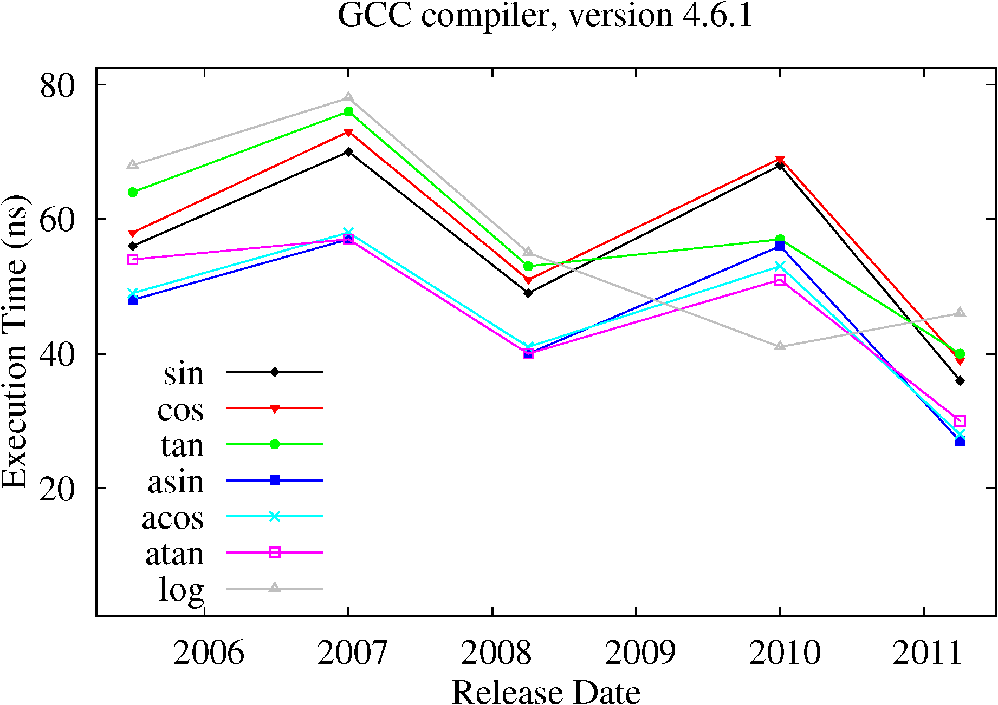
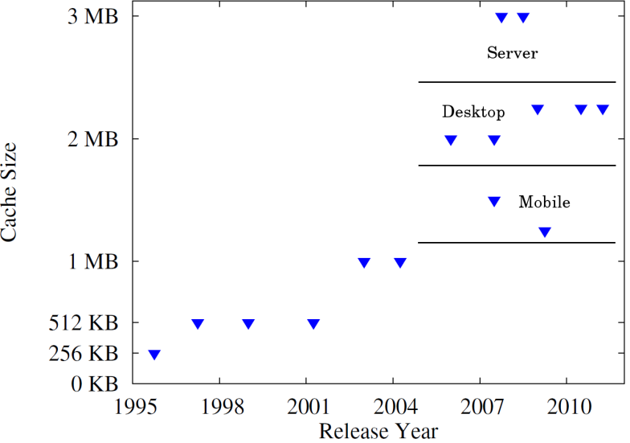
Computing Trends
Performance of elementary functions cannot count on frequency scaling.
L2/L3/L4 cache sizes remain stable on multicores, despite hierarchy changes.
Elementary Function Performance
L2/L3 Cache Size Trends
Notes:
TRENDS:
Here we argue for the continued relevance of LUT techniques.
Will be valuable for some time to come.

Slide 17
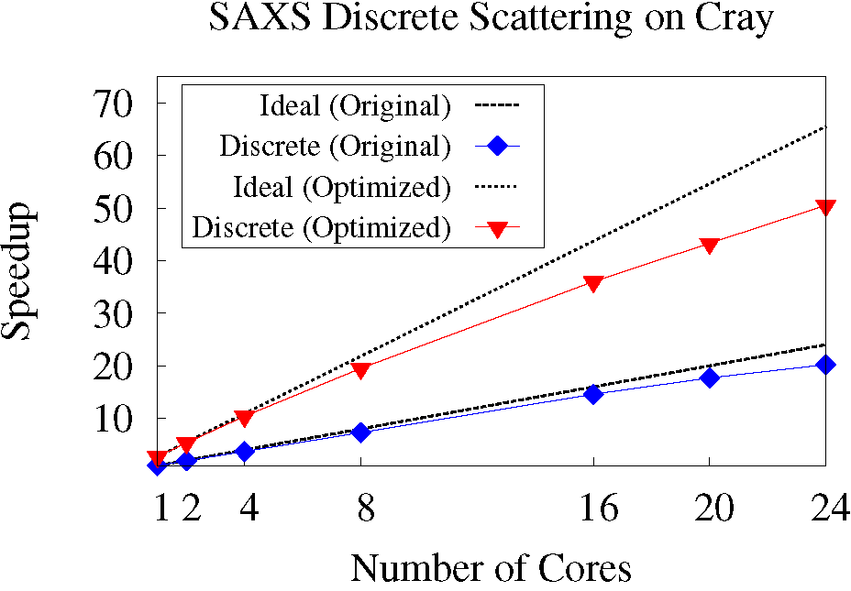
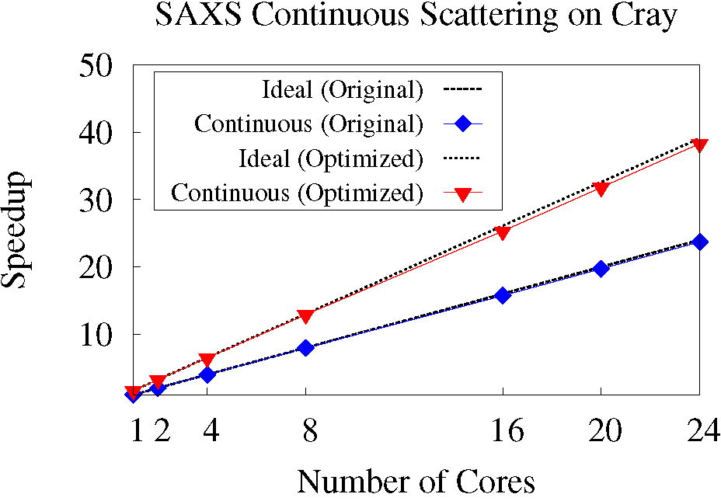
Multicore Evaluation
SHARED MEMORY
Parallel efficiency is approximately the same for LUT optimization and original code.
Performance of LUT optimization is independent from and complementary to parallelization.
SAXS Discrete Scattering
SAXS Continuous Scattering
Notes:
MULTICORE:
The Zhang paper I mentioned introduced a compiler to generate LUT code for multi-core systems
They confirmed the effectiveness of LUT techniques in software.
And so have, on our Cray computer, different compiler (Cray) and system (AMD Opteron) than other results.
But we see the same thing on Intel Core and Xeon, 2-8 cores.

Slide 18
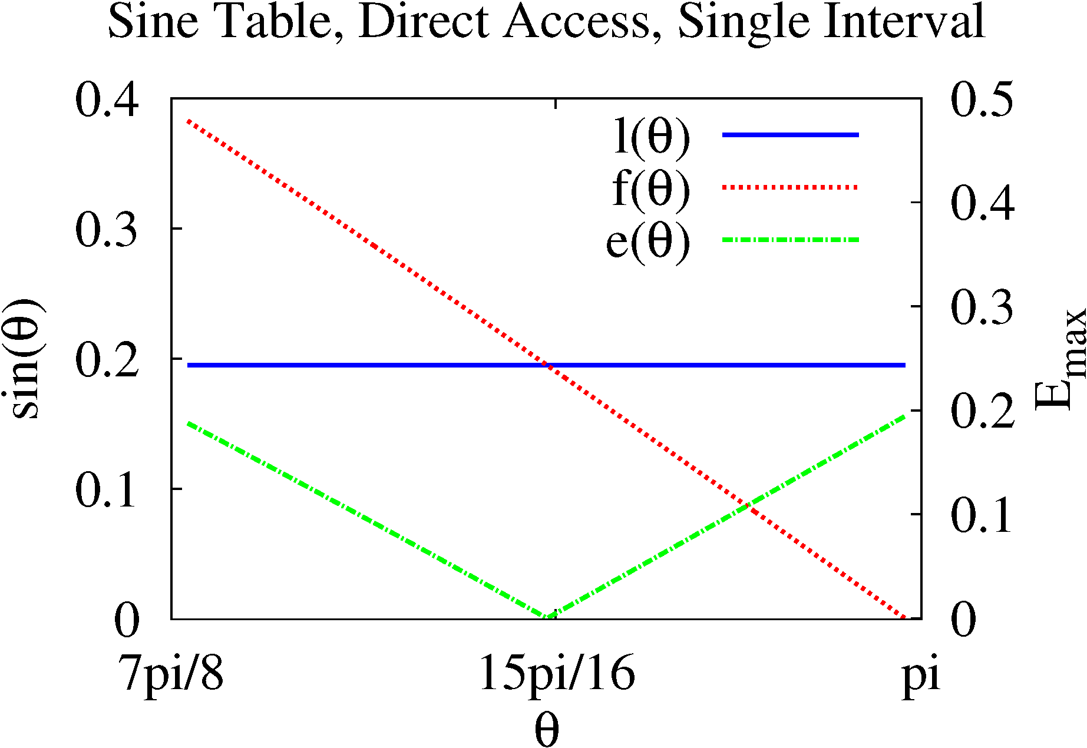
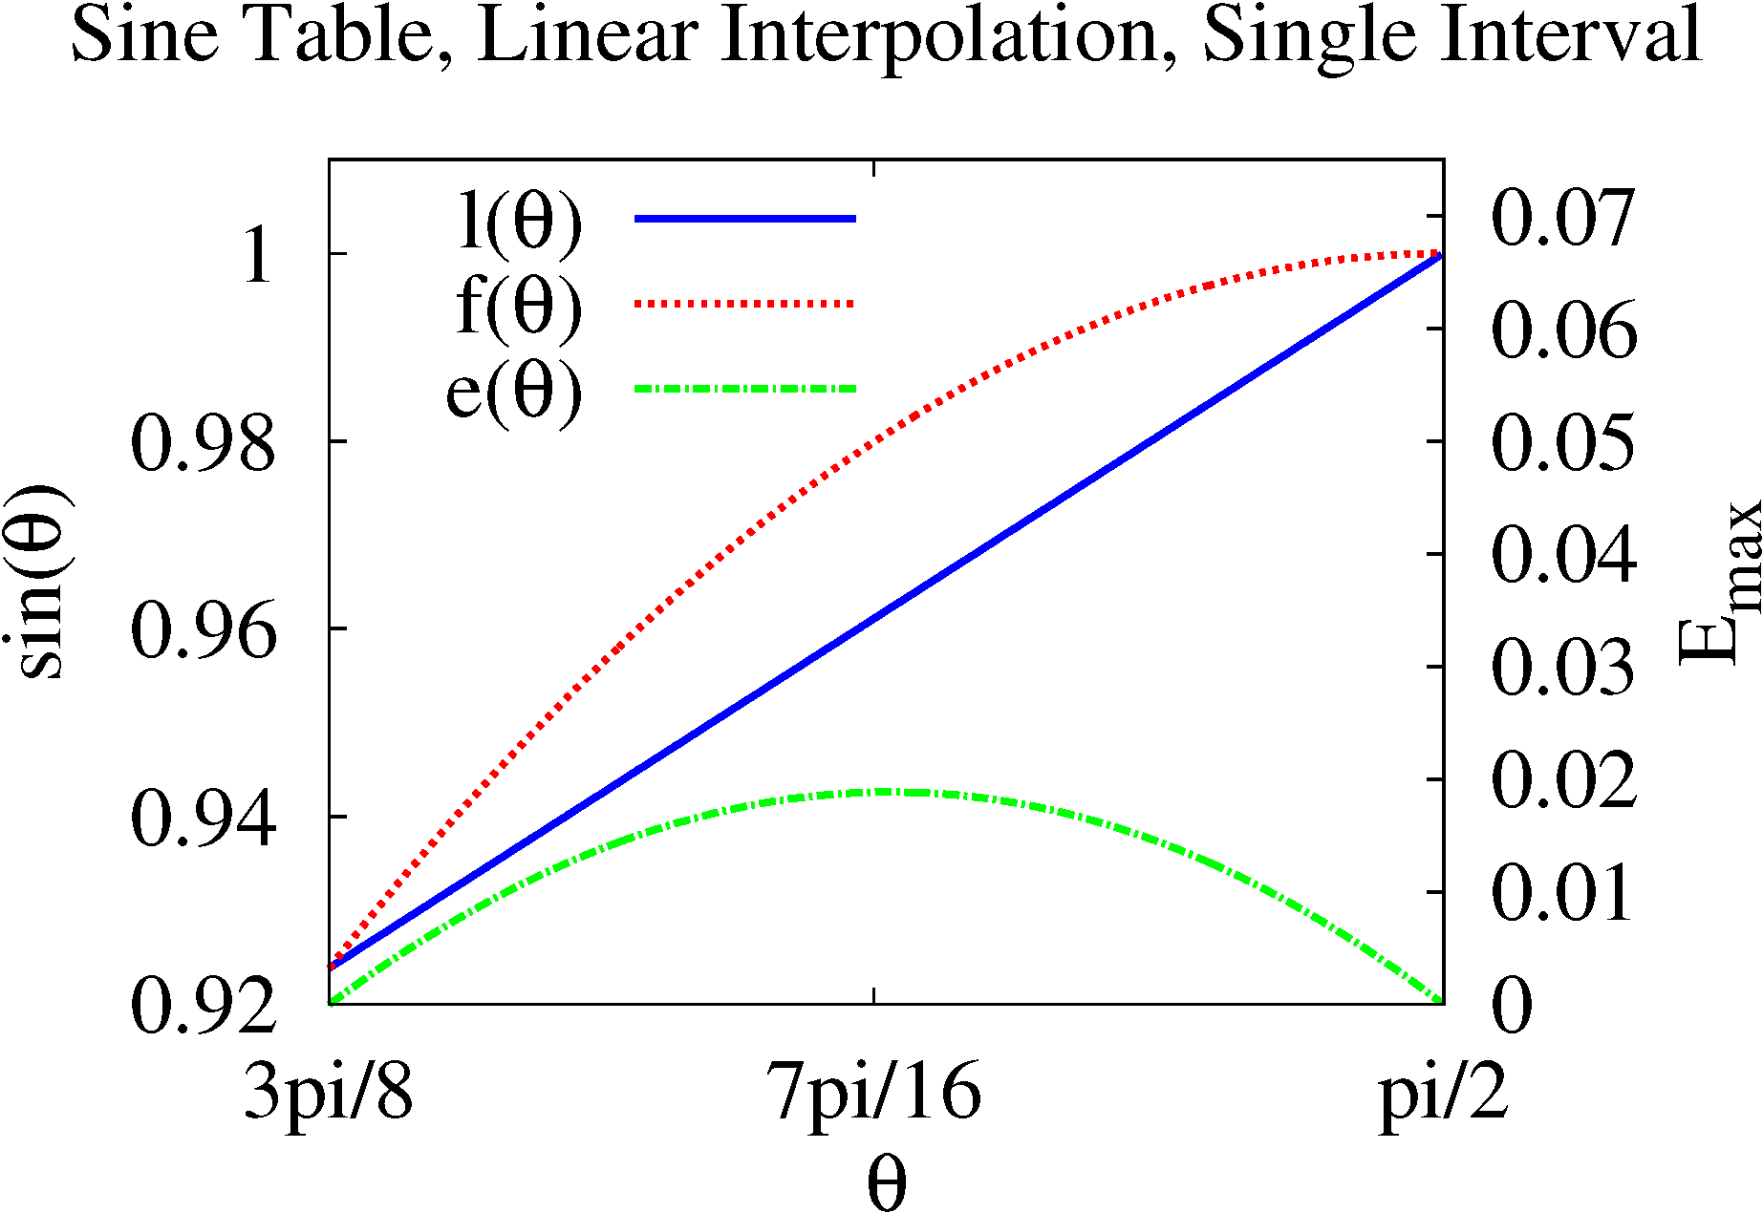
Error Analysis
Linear Interpolation Error Diagram
Direct Access Error Diagram
Notes:
ERROR:
Final criterion for LUT to be useful – the application must tolerate some error.
Covers one interval in the lookup table
Explain where maximum and minimum error are
As intervals get smaller, function is closer to linear
Direct access error shrinks by 2X for ½ the granularity or 2X the size
Linear interpolation error shrinks by 4X for ½ the granularity or 2X the size
Linear interpolation error at least order of magnitude better for reasonable sizes
You would have to look at 16 entries for a 0 to 2pi table to see otherwise, because approaching linear

Slide 19
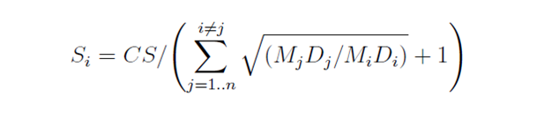
Local Optimization (Cache Allocation)
Goal is to allocate cache memory for each LUT transform to minimize error.
X5 = 1826KB
X2 = 2270KB
Cache Allocation (4MB)
X9 = 1183KB
Mesa Solution to Optimization Problem
Notes:
LOCAL:
Use the term local to differentiate from global
Problem is easier, we know which expressions, just want to optimally allocate the cache, so single objective
What we call the local optimization problem is cache allocation, a non-linear minimization problem
Will not show proof, but now we have it!
Mesa output shows both global and local optimization problem
Used another example from dissertation, because example only has 2 optimizations in solution
Ignore what expressions, it doesn’t matter
Point out why the allocation happened the way it did: X7 and X9 have same domain and maximum slope = same error

Slide 20
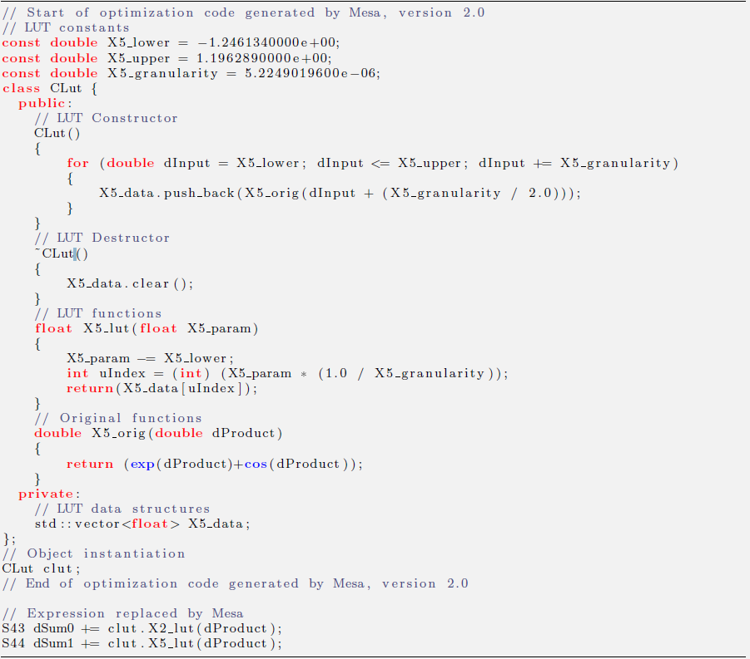
Code Generation
Mesa Generated Code for Example
Notes:
Just explain the code, one LUT only to make it fit on the screen
Self instantiation code, could just as easily be done in C or Fortran
Might need to add initialization/termination calls

Slide 21
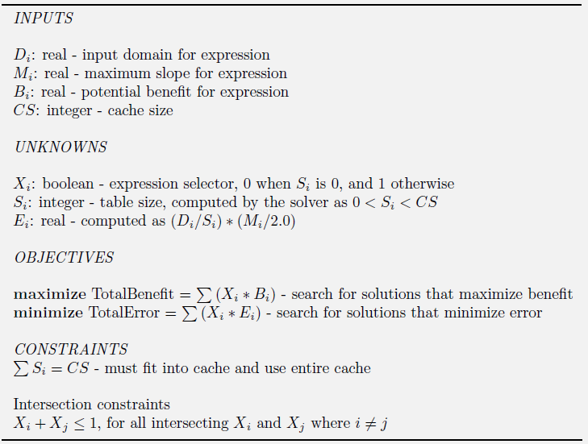
Optimization Problem
Notes:
PROBLEM (2):
Mathematical definition of the optimization problem, will not show AMPL
Non-linear (error equation and performance model!), and multiple objectives
Unknowns are selection variables (which expressions) and size (how much cache)
Error also unknown, but follows from size through the error equation
Can run local optimization, which is equivalent to all selects = 1, fixed benefit, on solvers
Cannot run global optimization on solvers (yet), at least not on any of the solvers on NEOS

