Slide 1
CAPSTONE PROJECT PRESENTATION: LOCATION RECOMMENDER SYSTEM FOR A TOURISM-BASED HOTEL CASE STUDY: LOS ANGELES

Slide 2
01
02
INTRODUCTION
DATA
03
04
METHODOLOGY
RESULTS AND CONCLUSION
Here you could describe the topic of the section
Here you could describe the topic of the section
Here you could describe the topic of the section
Here you could describe the topic of the section

Slide 3
INTRODUCTION
Location is one of the most influential factors that affect the revenue generated by a hotel.
Location is an important criterion that travelers consider when selecting a hotel and so the decision on where to site a new hotel establishment is very key.
This project aims at recommending the best neighborhoods for siting a hotel whose target market are tourists in a city.
The recommendations are made based on the kinds of venues around different neighborhoods in the city and the number of such venues

Slide 4
DATA
DATA USED
DATA SOURCES
A list of all the neighborhoods in the city (Los Angeles)
The coordinates (latitudes and longitudes) of each neighborhood
The venues around each neighborhood and their categories
Wikipedia Page
Geopy Library
Foursquare API

Slide 5
METHODOLOGY
Data Acquisition and Cleaning
Exploratory Analysis
Designing the Recommender System

Slide 6
Data Acquisition and Cleaning
The names of the neighborhoods were scraped from this Wikipedia page.
Duplicate neighborhoods were deleted. E.g. Wholesale District and Warehouse District
Some neighborhoods were renamed. E.g. “Bel Air, Bel-Air or Bel Air Estates” to just Bel Air
199 neighborhoods in the raw dataset and 198 in the cleaned dataset
The coordinates of the neighborhoods were then obtained using the geopy library and by manually sourcing for the ones that were not returned.

Slide 7
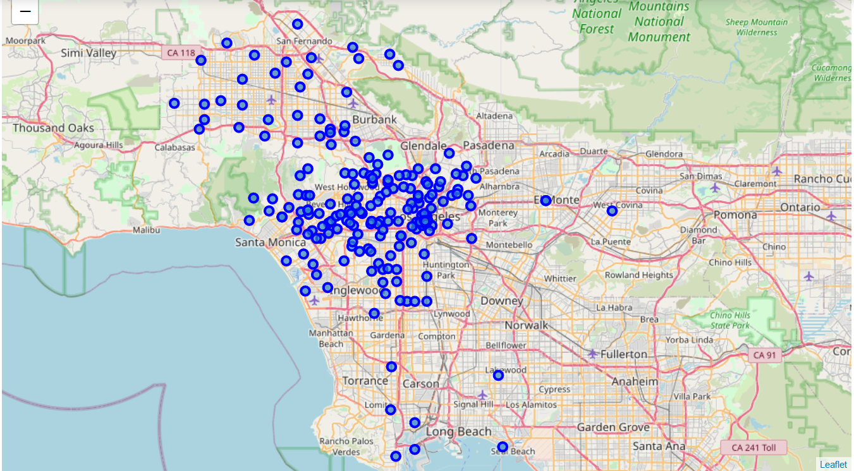
Map of LA showing all the neighborhoods

Slide 8
Exploratory Analysis
The neighborhoods were explored by leveraging the location data provided by Foursquare
The top 100 venues within a 1000 m radius of each neighborhood were returned
10, 961 venues were returned
The dataset contains 418 distinct venue categories

Slide 9
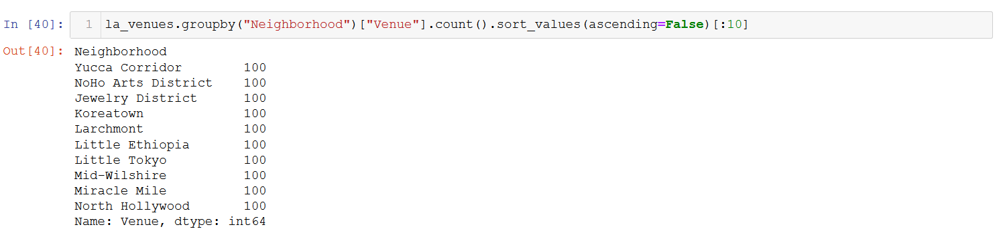
Top 10 Neighborhoods with the most venues

Slide 10
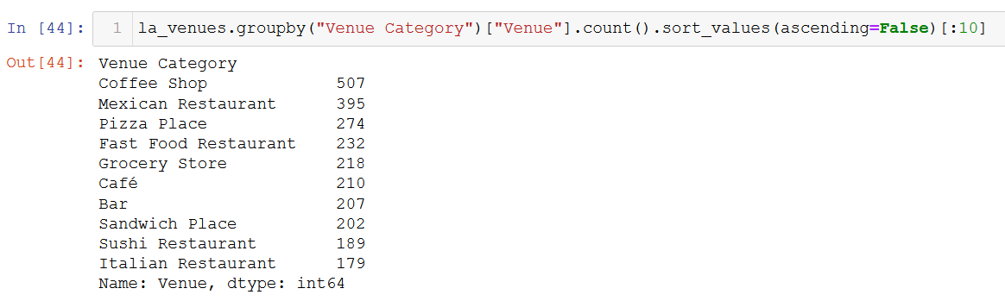
Top 10 most common venue categories

Slide 11
Designing the Recommender System
Through research, the categories of interest were identified and assigned weighting factors based on their relative importance as shown in the next slide.
The categories were then assigned to the venues based on the venue categories
A profile for recommendation based on the categories and their weights is then created.
A recommendation table is then created by taking the weighted average of each neighborhood based on the defined profile

Slide 12
Categories and their Weighting factors
Category | Weighting Factor
Attractions/Entertainments | 0.50
Food Services | 0.15
Medical Services | 0.15
Transportation | 0.20
Others | 0.00

Slide 13
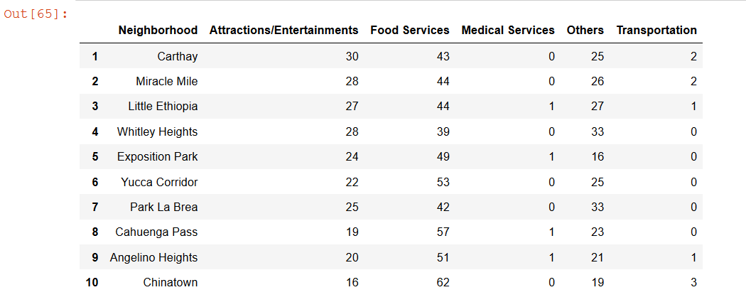
Results
Top 10 Recommendations

Slide 14
Conclusions
Carthay Neighborhood is the number one recommendation for a hotel location in Los Angeles
This project provided a blueprint for deciding on the best location for a hotel for tourists/travelers in a city
It is an objective approach for simplifying business decisions
Recommender Systems as a Machine Learning technique can help businesses make decision that can increase their profit margins.

Slide 15
THANKS!
Does anyone have any questions?
addyouremail@freepik.com
+91 620 421 838
yourcompany.com

