Slide 1
Magnetic models of molecules
Moskalenko Roman

Slide 2
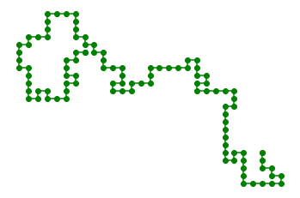
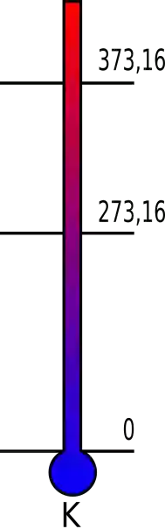

Conformation
Random walk on a regular grid
Shape depends on temperature
High temperature – unfolded
Low temperature – folded

Slide 3
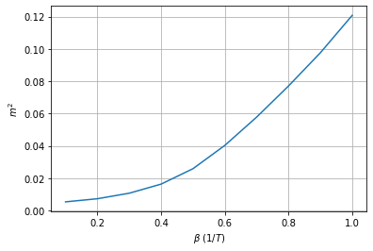
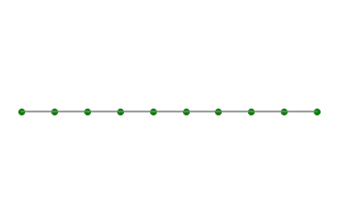
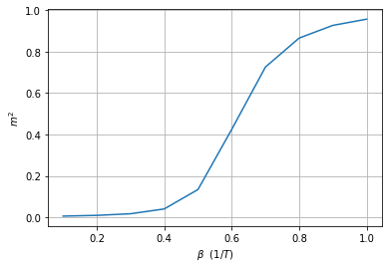
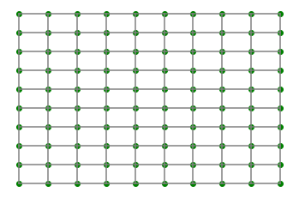
Ising model
1D
Barely magnetic at low temperatures
2D
Highly magnetic at low temperatures

Slide 4
Ising on conformation
≈

Slide 5
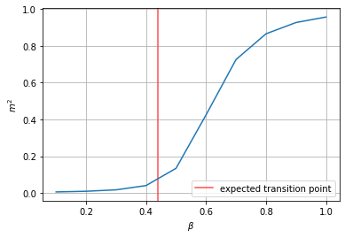
Expected results
Magnetic phase transition point for dense conformations
Where transition point disappears
?
t°

