Slide 1
National Research University "Higher School of Economics"The Moscow Institute of Electronics and Mathematics
The department of applied Mathematics
Moskow, Russia
28.03.2023
PROPERTIES OF MAGNETIC MODELS ON ENSEMBLES OF CONFORMATIONS
Student: Moskalenko Roman, rbmoskalenko@edu.hse.ru
Scientific adviser: Burovsky Evgeny

Slide 2
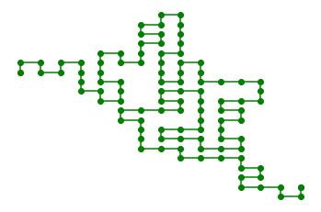
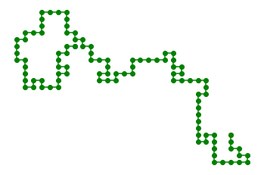
National Research University "Higher School of Economics"
The department of applied Mathematics
Moskow, Russia
28.03.2023
Conformation
Self awoiding walk
globule
coil

Slide 3
National Research University "Higher School of Economics"
The department of applied Mathematics
Moskow, Russia
28.03.2023

Slide 4
National Research University "Higher School of Economics"
The department of applied Mathematics
Moskow, Russia
28.03.2023

Slide 5
National Research University "Higher School of Economics"
The department of applied Mathematics
Moskow, Russia
28.03.2023

Slide 6
National Research University "Higher School of Economics"
The department of applied Mathematics
Moskow, Russia
28.03.2023

