Slide 1
ENTERPRISE SALES
DATA WAREHOUSE
A data engineering and analytics platform
SQL Server • SSIS • Python • Dimensional Modelling • Power BI
Data Engineering Final Capstone | 31 October 2026
1

Slide 2
Business problem
• Sales, customer, product, store, employee, returns and target information arrives from multiple source formats.
• Management needs consistent and trusted reporting across time, region, product and channel.
• The project creates a repeatable path from operational data to warehouse tables and Power BI insights.
2

Slide 3
Project objectives
• Load source extracts into SQL Server and a dedicated staging layer.
• Profile completeness, types, duplicates, business keys, numeric values and date ranges with Python.
• Model facts and dimensions for analytical queries.
• Preserve customer history with Type 2 processing and support incremental data movement.
• Publish interactive sales and target analysis in Power BI.
3

Slide 4
Tools and technologies
• SQL Server 2025 / T-SQL — source, staging and warehouse databases.
• SSIS — package-based data movement and master orchestration.
• Python, pandas and pyodbc — reusable staging-data profiler.
• SSISDB and SQL Server Agent — deployment, execution history and scheduled ETL.
• Power BI Desktop / Service — semantic model and report.
4

Slide 5
Solution architecture
A layered flow separates ingestion, quality inspection, modelling and reporting.
Source data
CSV / Excel / SQL
Source DB
src schema
Staging
stg schema
Profiling
Python / pandas
Warehouse
dw facts + dims
Power BI
semantic model
The Master ETL package orchestrates staging, Python profiling and warehouse processing. SQL Server Agent schedules the ETL; Power BI refresh is a separate schedule.
5

Slide 6
Source data profile
• Customers: 25,000 | Products: 5,000 | Stores: 250 | Employees: 1,200
• Sales transactions: 300,150 | Returns: 12,000
• Sales targets: 2,500 | Product price history: 2,978
• The provided sales file contains 120 missing CustomerID values, 100 invalid NetAmount values and 150 exact duplicate rows.
6

Slide 7
Python data profiling
• A reusable main.py iterates through eight approved staging tables.
• Reports row/column counts, data types, missing values, duplicate rows and business-key duplicates.
• Also reports unique-value counts, categorical distributions, numeric summaries and date ranges.
• Customer checks include age-range and date-order anomalies.
• Profiling identifies issues; cleaning/rejection must be verified in ETL transformations.
7

Slide 8
Warehouse model
• Dimensions: DimDate, DimCustomer, DimProduct, DimStore and DimEmployee.
• Facts: FactSales, FactReturns and FactSalesTarget.
• FactSales grain: one source sales line, identified by OrderID + SourceRecordID.
• FactReturns grain: ReturnID; FactSalesTarget grain: TargetDate + StoreID + Category.
• Customer SCD Type 2 processing and staging watermark/delta procedure definitions are included in SQL.
8

Slide 9
ETL and automation
• SSIS packages load staging, run the Python profiler and process the warehouse.
• The deployed Master ETL package was reported to run successfully through SQL Server Agent; keep SSISDB/Agent history as evidence.
• SSIS connection managers and Python executable/script paths are environment-specific and must be configured on another machine.
• Power BI refresh is independent of SQL Agent and must be scheduled after the warehouse ETL.
9

Slide 10
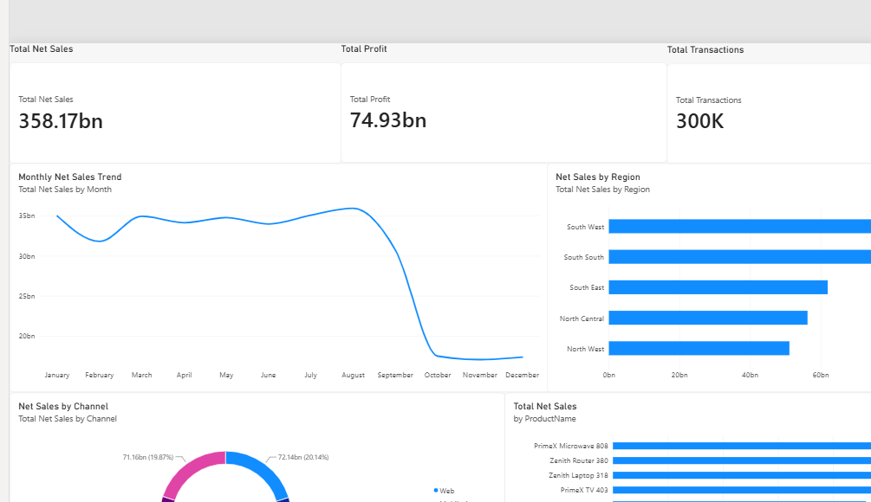
Power BI — sales performance
Report page 1: headline KPIs, trend, region, channel and product analysis.
What it helps answer
• How much net sales and profit are reported?
• How does revenue change over time?
• Which regions and channels contribute most?
• Which products lead by net sales?
Validate currency/unit formatting and the late-period trend before drawing conclusions.
10

Slide 11
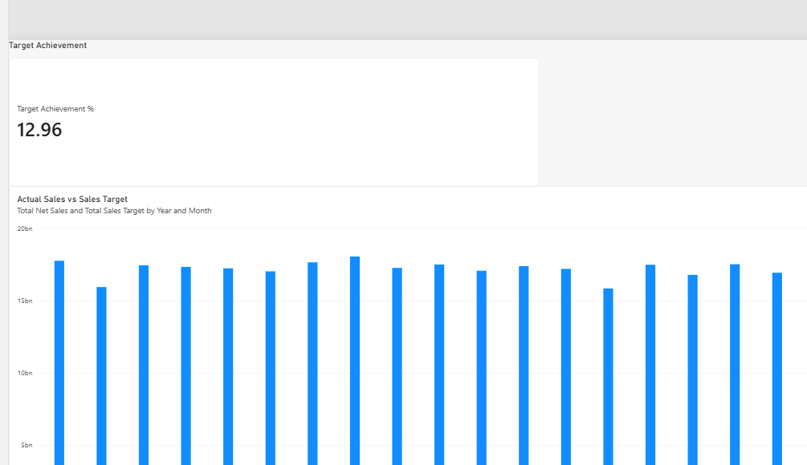
Power BI — target analysis
Report page 2: target-achievement KPI and monthly actual-versus-target comparison.
Validation needed
• KPI shows 12.96.
• Actual sales bars appear much higher than target bars.
• Check DAX, percentage formatting, target aggregation, relationships and date filters.
Do not claim target achievement until both visuals reconcile.
11

Slide 12
Quality, validation and known limits
• Starter SQL checks cover missing fact customer keys, customer current-row rules, orphan customer keys, profit arithmetic and duplicate OrderID diagnostics.
• Interpret OrderID duplicates using sales-line grain; an order can contain multiple lines.
• Power BI Service refresh still needs gateway/source credentials and a successful refresh-history test.
• Performance improvements should be claimed only with actual execution-plan or before/after timing evidence.
12

Slide 13
Conclusion and next steps
• The project links source ingestion, staging, profiling, dimensional modelling, incremental/SCD processing and business reporting.
• Validate source-to-warehouse counts, referential integrity, financial arithmetic and repeat-run behavior.
• Resolve the Power BI target KPI discrepancy and validate date completeness.
• Configure the gateway and credentials, test Refresh now, then schedule refresh after SQL Server Agent ETL.
• Publish code and documentation to GitHub after checking the staged file list for secrets and private data.
13

