Slide 1
SyriaTel Customer Churn Analysis
Data Science Project - Phase 3
Prepared by Gladys Kemunto

Slide 2
Objective
Challenge: SyriaTel is losing revenue due to customer churn, where customers end their relationship with the company.
Objective: Shift from descriptive analysis to predictive modeling to better understand and reduce churn.
Goal: Use the SyriaTel Customer Churn dataset to identify at-risk customers and develop targeted retention strategies.
Outcome: Reduce churn rates, improve customer loyalty, and boost profitability.

Slide 3
Business Understanding
Customer churn is a major challenge for SyriaTel, impacting profitability.
Previously, the company used descriptive methods to understand customer behavior, but this is no longer enough.
To address churn more effectively, SyriaTel is adopting a predictive approach, building models that forecast which customers are likely to leave by analyzing demographics, usage patterns, and service interactions.

Slide 4
Key Questions to Be Addressed
1. What is the best model for predicting customer churn?
After comparing various models, including Decision Tree, K-Nearest Neighbors (KNN), and Random Forest, the analysis will recommend the best overall performer. By factoring in accuracy, precision, recall, and ROC-AUC score, the analysis will advise SyriaTel on the most suitable model for predicting churn and implementing targeted retention strategies.
2. How accurately can the model predict customer churn?
The analysis will evaluate the performance of various models using key metrics such as accuracy, precision, recall, and the ROC-AUC score. This evaluation will determine how well the models can predict which customers are likely to churn.

Slide 5
Key Questions to Be Addressed
3. Which features are most influential in predicting customer churn?
Identifying the most impactful features, such as customer service interactions, usage patterns, and plan types, will help SyriaTel prioritize its retention efforts and design more effective interventions.
With these predictive insights, SyriaTel can move beyond merely understanding why customers churn to proactively identifying at-risk customers and intervening with targeted strategies. This shift will enable SyriaTel to not only reduce churn rates but also improve customer satisfaction and loyalty, leading to better financial outcomes for the company.

Slide 6
Methodology for Machine Learning
To develop a robust predictive model for identifying customers at risk of churning, we will follow a structured methodology that includes the following key steps:
1. Data Understanding
2. Data Cleaning
3. Exploratory Data Analysis
4. Data Preprocessing
5. Modelling
6. Hyperparameter Selection
7. Model Evaluation
8. Recommendations and Conclusion

Slide 7
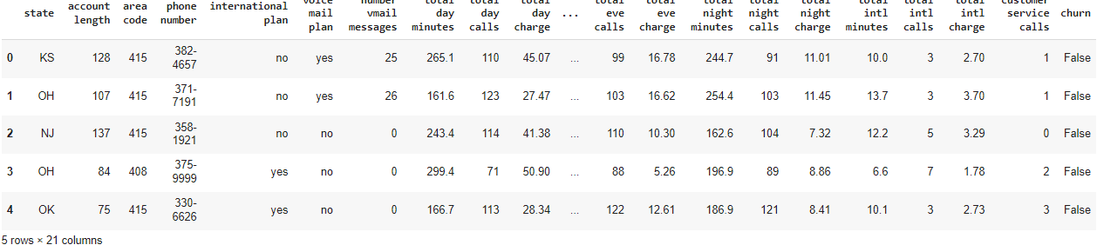
Step 1: Data Understanding
In this project, the dataset that we chose is called SyriaTel Customer Churn.

Slide 8
Observations
We observe from the above dataset that there are 21 columns, with a mix of categorical, numerical, and boolean data types. Here's a brief overview of the dataset:
Key Features:
A). Categorical Features:
1. state: Categorical variable indicating the state of the customer.
2. phone number: Categorical, the customer's phone number (likely not useful for modeling).
3. international plan: Categorical, whether the customer has an international plan (yes/no).
4. voice mail plan: Categorical, whether the customer has a voicemail plan (yes/no).

Slide 9
Observations
B). Numerical and Floating Features:
5. total eve calls: Integer, total number of calls during the evening.
6. account length: Integer, representing the duration of the customer's account in days.
7. area code: Integer, indicating the area code of the customer.
8. total day calls: Integer, total number of calls during the day.
9. total night calls: Integer, total number of calls during the night.
10. number vmail messages: Integer, the number of voicemail messages.
11. customer service calls: Integer, the number of calls to customer service.
12. total intl calls: Integer, total number of international calls.
13. total day minutes: Float, total minutes of calls during the day.
14. total day charge: Float, total charges for calls during the day.
15 total eve minutes: Float, total minutes of calls during the evening.
16. total eve charge: Float

Slide 10
Continuation..Observation
17. **total night minutes**: Float, total minutes of calls during the night.
18. **total night charge**: Float, total charges for calls during the night.
19. **total intl minutes**: Float, total minutes of international calls.
20. **total intl charge**: Float, total charges for international calls.
**C) . Boolean Features:
21. **churn**: Boolean, the target variable indicating whether the customer has churned (True) or not (False).

Slide 11
Checking for Missing Values
Identify any missing values within the dataset.
Ensuring there are no missing values is crucial, as missing data can lead to inaccuracies in the model training process. If missing values are found, they need to be addressed appropriately.
From this dataset, we can observe that there are 3,333 rows and 21 columns, from which it's distributed evenly. We can also observe that we didn't have any missing values or duplicated values in the dataset and this enabled us to conduct this project without any challenges.

Slide 12
Step 2: Data Cleaning
Now that we understand the structure of the data, we'll clean it by addressing any issues such as missing values or irrelevant columns.
2.1 Drop Irrelevant Features
Remove columns that are not useful for prediction, such as identifiers like the phone number.

Slide 13
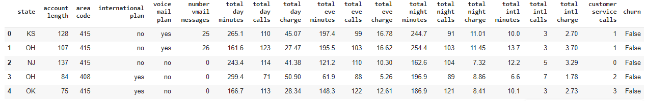
First Few Rows After Dropping Irrelevant Columns

Slide 14
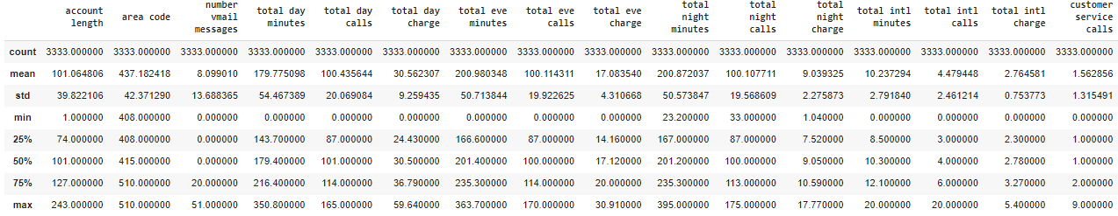
Descriptive Statistics of the Dataset
The table provides a summary of key statistics (count, mean, standard deviation, minimum, 25th percentile, median, 75th percentile, and maximum) for various features in the dataset. These statistics are crucial for understanding the distribution of the data and identifying potential outliers.

Slide 15
Key Observations
Range and Potential Outliers
number vmail messages: The maximum value is 51, while the 75th percentile is 20, indicating that a small subset of users has a much higher number of voicemail messages, potentially marking them as outliers.
total day minutes, total eve minutes, total night minutes, total intl minutes: These features have maximum values significantly higher than the 75th percentile. For example, total day minutes has a max of 350.8 minutes, whereas the 75th percentile is 216.4 minutes, suggesting the presence of outliers.
customer service calls: The maximum number of calls is 9, with a median of 1 and a 75th percentile of 2. This suggests that while most customers have 1-2 service calls, some customers are outliers with significantly higher call counts.
Conclusion:
Outliers: Several features show potential outliers, particularly in the number vmail messages, total day minutes, total eve minutes, total night minutes, total intl minutes, and customer service calls fields. These outliers could significantly impact the model’s performance if not addressed.
Next Steps: We will address outliers by capping, robust scaling, or investigating causes, and use further visualizations like box plots to confirm their impact.

Slide 16
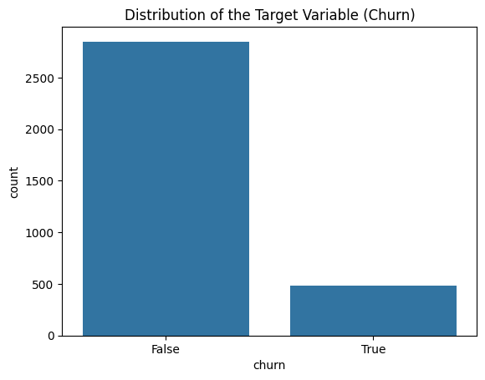
The bar chart above shows the distribution of the target variable "churn," indicating whether customers have churned (left the service) or not.

Slide 17
Interpretation
False (Non-Churners): The taller bar represents customers who have not churned. This group is significantly larger, with over 2,500 customers.
True (Churners): The shorter bar represents customers who have churned. This group is much smaller, with fewer than 500 customers.
Key Insights:
Class Imbalance: The chart highlights a clear class imbalance in the dataset. The majority of customers have not churned, while a relatively small number have. This imbalance is crucial to consider when building predictive models, as it can lead to a model that is biased toward predicting the majority class (non-churners).
Handling Imbalance: Techniques such as oversampling the minority class (using SMOTE, for example) or under sampling the majority class may be necessary to ensure that the model accurately predicts both classes.
This imbalance will be addressed during the preprocessing or model training phase to improve the model's performance in predicting customer churn.
The bar chart above shows the distribution of the target variable "churn," indicating whether customers have churned (left the service) or not.

Slide 18
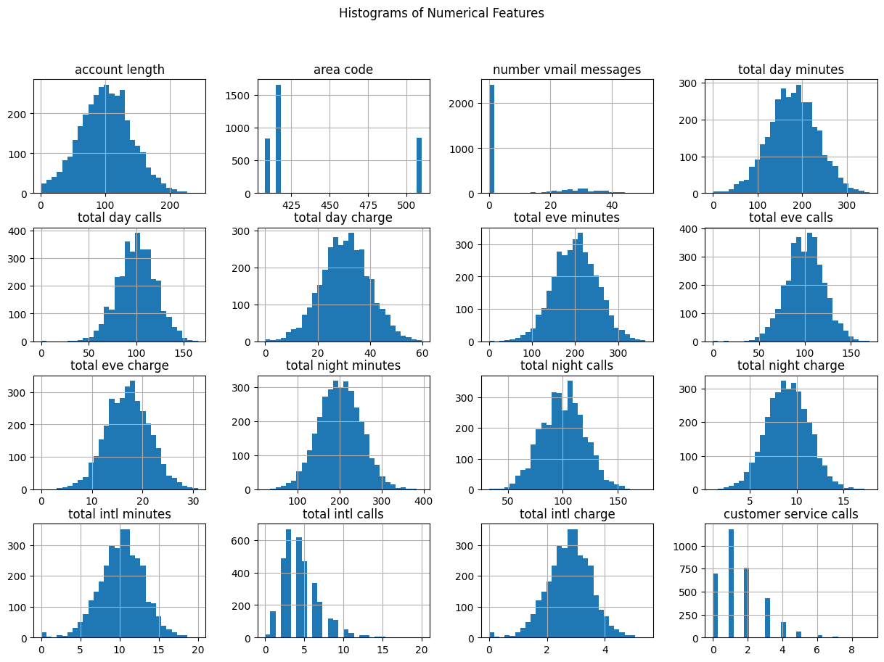
The image shows a series of histograms that represent the distribution of various numerical features in the dataset. Here’s the interpretation of each feature based on the histograms:

Slide 19
Observations
Most features are normally distributed , so log transformation is not necessary for them. However, features with Skewed Distributions like Number Vmail Messages(This feature is heavily right-skewed, with most values concentrated at zero and a long tail of higher values.); Customer Service Calls(This feature is also right-skewed, with the majority of customers making very few calls, and a smaller number making a higher number of calls.) and Total Intl Calls( This feature shows some skewness, though it is less extreme than the first two.) we may consider log transformation

Slide 20
Key Insights
Normal Distributions: Many features, such as total minutes, total calls, and corresponding charges, follow normal distributions. This suggests that most customers have similar usage patterns, with a typical range of values for these features.
Skewed Distributions: The "number vmail messages" and "customer service calls" features are skewed. Most customers do not use voicemail services much, and most do not frequently call customer service.
Area Code: The area code feature is categorical with three main groups, indicating that the dataset represents customers from three distinct regions.
Implications for Modeling:
Feature Scaling: Given the normal distribution of most features, feature scaling (e.g., standardization) will likely be beneficial for models that are sensitive to the scale of input data (e.g., logistic regression, SVM).
Handling Skewness: For skewed features like "number vmail messages" and "customer service calls," special attention might be needed. For example, you could apply log transformation to reduce skewness if using models that assume normally distributed data.
Categorical Handling: The area code, despite being numerical, is more categorical in nature and should be treated accordingly (e.g., using one-hot encoding) in the modeling process.
These insights can help in deciding which preprocessing steps to apply and in understanding the underlying patterns in the data.

Slide 21
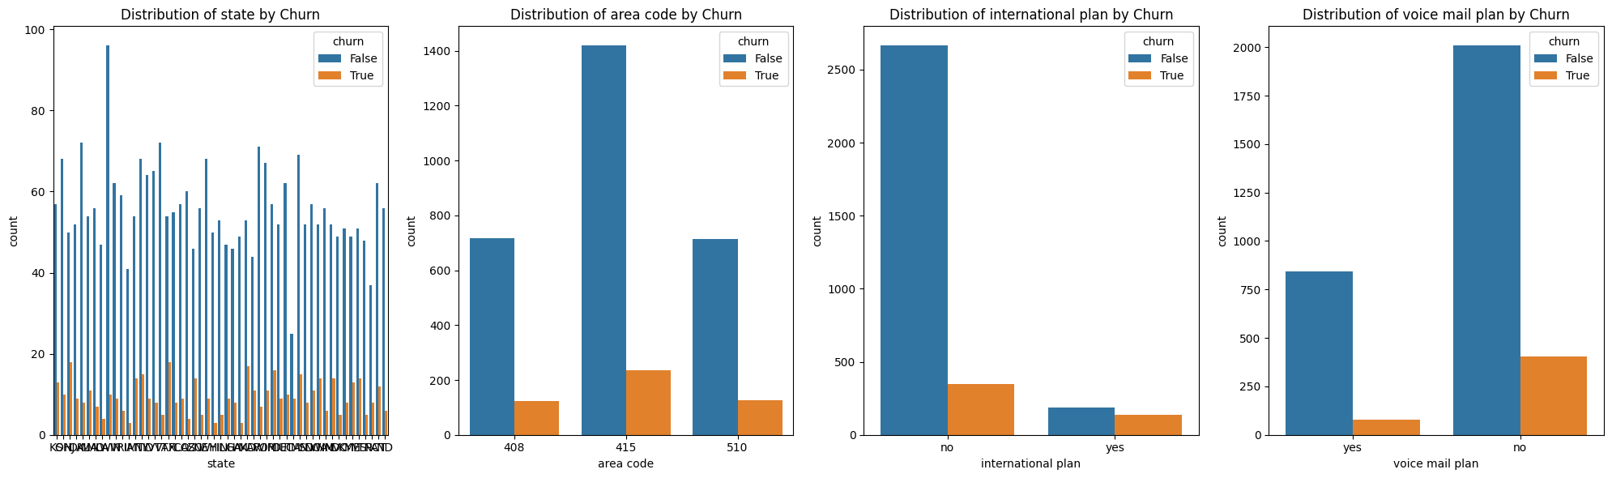
Caterogical feature distributions

Slide 22
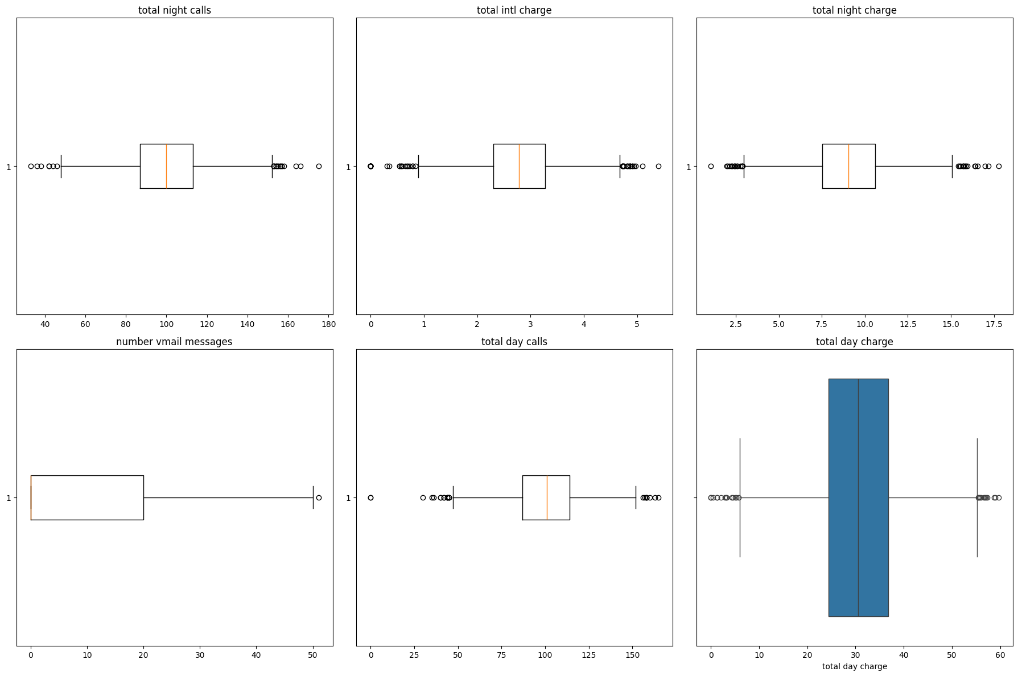
Checking for Outliers

Slide 23
Summary of above visualisations
Outliers: All plots indicate the presence of outliers, especially in number of voicemail messages, total night calls, and total intl charge.
Distribution: Most features are symmetrically distributed around their medians, except for number of voicemail messages, which shows significant skewness.
Considerations: The outliers could impact the model's performance and may need to be addressed depending on their significance to the business problem.

Slide 24
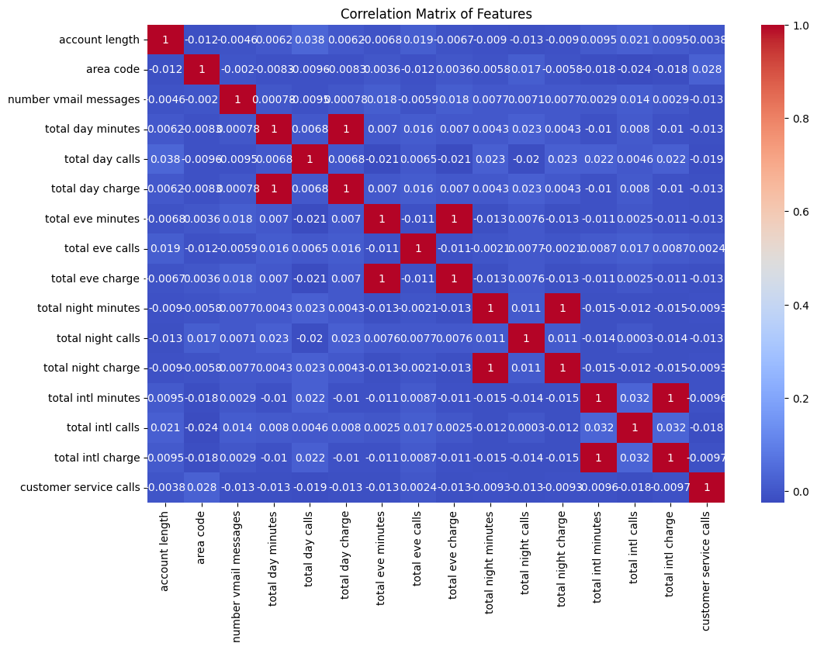
Correlation Analysis

Slide 25
Observations
The correlation matrix visually represents the linear relationships between pairs of features in the dataset. Key observations include:
Perfect Correlations: Features like total day minutes and total day charge, total eve minutes and total eve charge, total night minutes and total night charge, and total intl minutes and total intl charge have perfect correlations (correlation coefficient = 1). This is expected because the charges are directly proportional to the minutes used.
Low Correlation with Target: Features such as customer service calls, account length, and number vmail messages have very low correlation with other features, suggesting they provide unique information.
Potential Redundancy: Features with perfect correlations might be redundant and could be candidates for removal in modeling to reduce multicollinearity.
This matrix is useful for identifying which features are highly correlated and may need to be handled carefully to avoid issues in model training, such as multicollinearity.

Slide 26
Potential Redundancy in Features
In the correlation matrix, the following pairs of features show a perfect correlation (correlation coefficient = 1). These pairs are redundant because one feature in each pair is a linear transformation of the other. When building models, we might consider removing one feature from each pair to reduce multicollinearity:
Total Day Minutes and Total Day Charge:
Both features are perfectly correlated (correlation = 1). Since charges are typically a direct function of minutes used, we could consider removing one of these features.
Total Eve Minutes and Total Eve Charge:
These two features also have a perfect correlation. Removing one of these would reduce redundancy. Total Night Minutes and Total Night Charge:
Like the day and evening features, these are perfectly correlated, and one can be removed.
Total Intl Minutes and Total Intl Charge:
These features are perfectly correlated as well, making one of them redundant.
Suggested Action: we will remove One Feature from Each Pair: For each of the above pairs, consider keeping only one feature (either the minutes or the charge) to simplify the model and avoid multicollinearity issues. Typically, you'd keep the feature that is more directly related to the business problem or has a more straightforward interpretation.

Slide 27
Step 4: Preprocessing
Declare feature vector and target variable
4.1 Train-Test Split
Split the data into training and testing sets before performing any transformations.
4.2 Encoding Categorical Variables
Now that the data is split, we proceed to encode the categorical variables in both the training and test sets.
4.2.1: One-Hot Encode Categorical Variables for Training Set
4.2.2 : One-Hot Encode Categorical Variables for Testing Set

Slide 28
4.2.3 : Align the Test Set with the Training Set Columns
After encoding, it's important to align the test set with the training set to ensure that both datasets have the same features. Any missing columns in the test set will be added and filled with zeros.

Slide 29
Why This Approach is Important
Consistency: Ensures that the training and test sets have the same features, which is crucial for applying machine learning models.
Handling Missing Categories: In some cases, the test set might not have all the categories present in the training set. Aligning ensures that these differences do not cause errors during model training or prediction.

Slide 30
4.3 Feature Scaling
Scale the features in both the training and test sets using the same Scaler to ensure consistency.

Slide 31
4.3.1 Scaling the Training Set
Fit the Scaler: The StandardScaler is first fitted to the X_train_encoded data. This means that the scaler calculates the mean and standard deviation of each feature in the training set.
Transform the Training Data: After fitting, the scaler transforms the training data, standardizing each feature to have a mean of 0 and a standard deviation of 1.
Convert to DataFrame: The transformed data is converted back into a DataFrame for easier inspection and to maintain the column names.

Slide 32
4.3.2 Scaling the Testing Set
Transform the Testing Data: Using the same scaler (which is already fitted to the training data), the test data is transformed. This ensures that the test data is scaled in the same way as the training data.
Convert to DataFrame: Again, the transformed test data is converted into a DataFrame for easier inspection.

Slide 33
Step 5: Removing Redundant Features
5.1 Removing Redundant Features from the Training Set
5.2 Removing Redundant Features from the Testing Set
5.3 Testing for Multicollinearity Using VIF

Slide 34
Key Insights:
No Significant Multicollinearity:
The low VIF values across all features suggest that there is no significant multicollinearity in your dataset. This is a positive result, as it means that your features are not excessively correlated with each other, and the model should not suffer from issues related to multicollinearity, such as inflated standard errors or unstable coefficients.
Model Stability: With VIF values this low, you can expect the model's coefficients to be more stable, leading to more reliable and interpretable results.

Slide 35
Step 6: Handling Class Imbalance
We saw in 3.2 above when visualising distribution of the Target Variable (Churn), there was class imbalance, so we apply SMOTE or another resampling technique only on the training data.

Slide 36
After SMOTE: (4568, 63), (4568,)
We notice that the Original Rows (Before SMOTE) were : 3,333
After SMOTE:
SMOTE added synthetic rows to the minority class to balance the dataset. The resulting dataset now has 4,568 rows.
The total number of rows increased because the minority class was undersampled compared to the majority class, and SMOTE balanced it by generating new, synthetic samples.

Slide 37
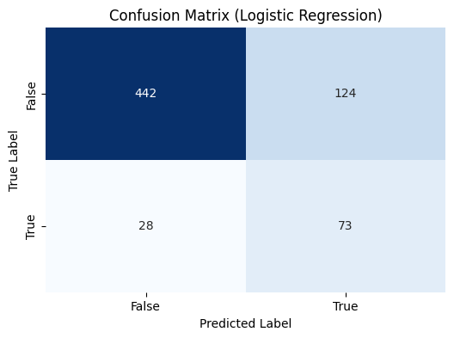
Modeling
Summary Statistics for Logistic Regression:
Model 1( Baseline Model)- Logistic Regression
Summary Statistics for Logistic Regression:
Model | Mean Accuracy | Mean F1-Score | Mean ROC-AUC Score | Mea Precision | Test Accuracy | Test F1-Score | TestOC-AUC Score | Test Precision | Test Recall
Logistic Regression | 0.79 | 0.79 | 0.85 | 0.78 | 0.77 | 0.49 | 0.75 | 0.37 | 0.72
Summary Statistics for Logistic Regression:

Slide 38
Step 7: Modeling
7.1 : Logistic Regression
7.2 : . Random Forest
7.3 : K-Nearest Neighbors (KNN)
7.4 4. Decision Tree

Slide 39
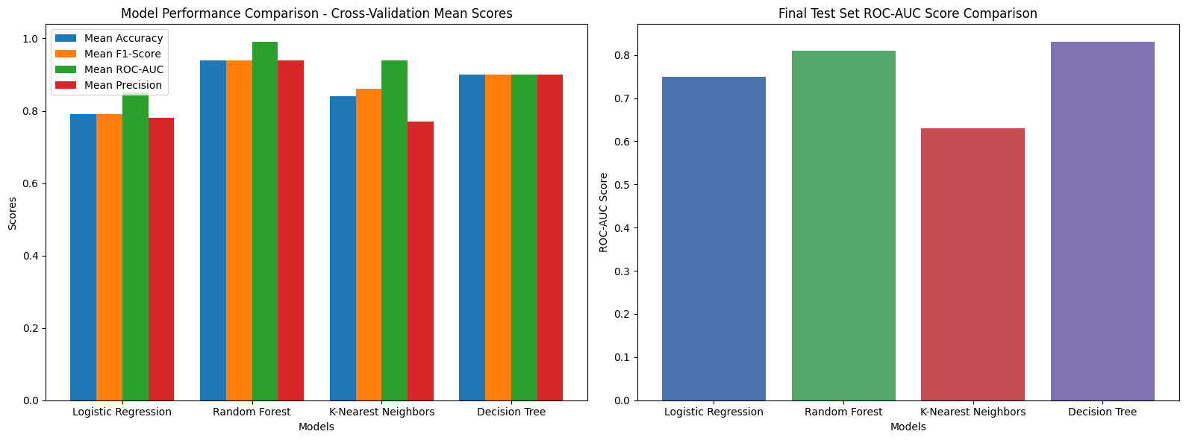
Step 8: Model Evaluation
8.1 Visualizing Model Performance Comparison ( Bar Chart)

Slide 40
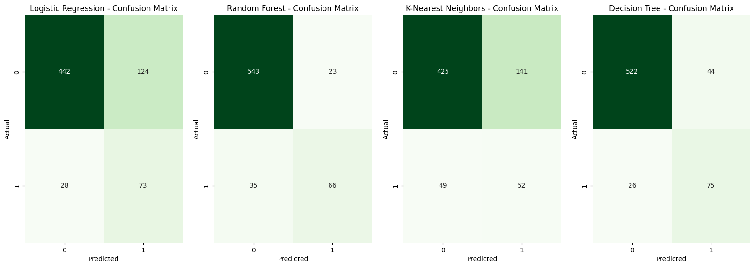
8.2 Combined Visualization of Confusion Matrices and Summary Statistics for Model Evaluation

Slide 41
 | Model | Mean Accuracy | Mean F1-Score | Mean ROC-AUC Score | Mean Precision | Test Accuracy | Test F1-Score | Test ROC-AUC Score | Test Precision | Test Recall
0 | Logistic Regression | 0.79 | 0.79 | 0.85 | 0.78 | 0.77 | 0.49 | 0.75 | 0.37 | 0.72
1 | Random Forest | 0.95 | 0.95 | 0.99 | 0.95 | 0.91 | 0.69 | 0.81 | 0.74 | 0.65
2 | K-Nearest Neighbors | 0.84 | 0.86 | 0.94 | 0.77 | 0.72 | 0.35 | 0.63 | 0.27 | 0.51
3 | Decision Tree | 0.9 | 0.9 | 0.9 | 0.9 | 0.9 | 0.68 | 0.83 | 0.63 | 0.74

Slide 42
Summary Overview for SyriaTel
Objective:
The primary objective of this project is to develop a predictive model that accurately identifies customers likely to churn at SyriaTel. By accurately predicting customer churn, SyriaTel can proactively implement targeted retention strategies, reduce financial losses, and enhance overall customer satisfaction.
Model Evaluation:
We assessed four machine learning models—Logistic Regression, Random Forest, K-Nearest Neighbors (KNN), and Decision Tree—across multiple performance metrics, including Accuracy, F1-Score, ROC-AUC Score, Precision, and Recall. These metrics were evaluated on both cross-validation performance and final test set results to ensure the models' robustness and reliability in identifying customers at risk of churning.
Key Findings:
Logistic Regression: This model demonstrated moderate performance with a Mean Accuracy and F1-Score of 0.79. However, its Test Precision was relatively low at 0.37, which indicates that while it can identify churners well (high recall at 0.72), it often misclassifies non-churners as churners.
Random Forest: The Random Forest model emerged as a strong performer with the highest Mean Accuracy (0.95) and ROC-AUC Score (0.99). It also maintained solid performance on the test set with an Accuracy of 0.91 and an F1-Score of 0.69. This model offers a good balance between precision (0.74) and recall (0.65), making it highly reliable for identifying customers likely to churn.

Slide 43
Step 9: Model Fine-Tuning
9.1 Hyperparameter Selection- Train models with best hyperparameters
9.2 Choose a Hyperparameter Tuning MethodHyperparameter Selection
9.3 Perform Hyperparameter Tuning
9.4 Re-Train the Model with Optimized Hyperparameters
9.5 Evaluate the Optimized Model

Slide 44
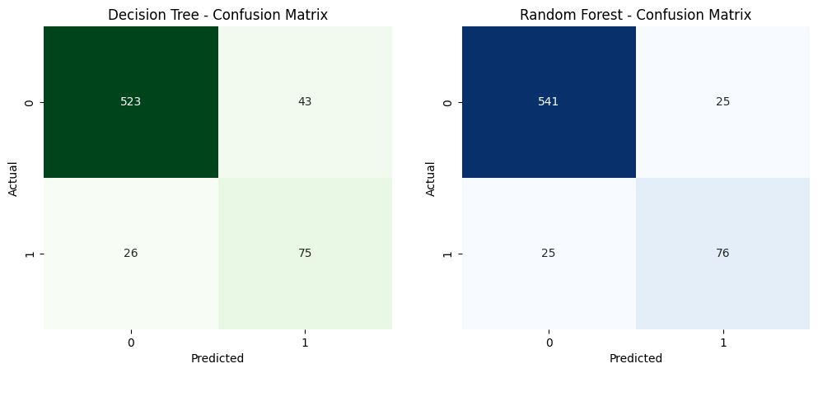
9.6 Visualization of Confusion Matrices and Summary Statistics for Decision Tree and Random Forest Models

Slide 45
Step 10: Summary of Findings Based on the evaluation of the Decision Tree and Random Forest models, after Fine-Tuning
1. Overall Model Performance:
**Random Forest Model outperforms the Decision Tree model across most metrics:**
+ Accuracy: The Random Forest model achieved an accuracy of 0.93, compared to 0.90 for the Decision Tree.
+ F1-Score: The Random Forest model also had a higher F1-Score of 0.75 for the True class, indicating a better balance between precision and recall, compared to the Decision Tree's F1-Score of 0.68.
+ ROC-AUC Score: The Random Forest model achieved a higher ROC-AUC Score of 0.85, indicating a better ability to distinguish between churners and non-churners compared to the Decision Tree's ROC-AUC Score of 0.83.

Slide 46
2. Alignment with Business Objectives:
**Reducing Churn: The primary objective is to accurately identify customers likely to churn so that targeted retention strategies can be implemented. The Random Forest model, with its higher accuracy, F1-Score, and ROC-AUC Score, is better suited to this task. It is more effective in correctly identifying customers who are likely to churn, making it the preferred choice for deployment.**
3. Trade-offs and Considerations:
Precision vs. Recall: While the Random Forest model offers higher overall accuracy and precision, it is essential to consider the balance between precision and recall. The Random Forest model has slightly better precision and recall balance, which is crucial when the cost of false positives and false negatives is significant.
Model Complexity: The Random Forest model is inherently more complex

Slide 47
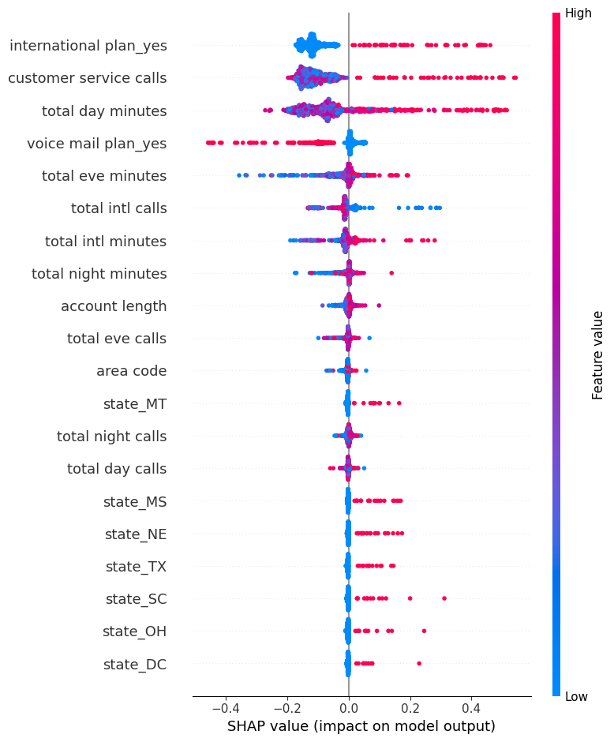

Slide 48
Step 11: SHAP Summary Plot for Random Forest Model: Class 1 (Positive Class) Impact Analysis
This code extracts the SHAP values specifically for class 1 (the positive class) from the SHAP values calculated for the Random Forest model. It then generates a summary plot, which visualizes the impact of each feature on the model's output for predicting the positive class. The summary plot helps in understanding which features are most influential in the model's decision-making process for classifying an instance as belonging to class 1.

Slide 49
Key Insights from the SHAP Summary Plot:
+ International Plan (Yes): This feature has a significant positive impact on the likelihood of churn, as indicated by the positive SHAP values. Customers with an international plan are more likely to churn.
+ Customer Service Calls: The number of customer service calls is another critical feature. Higher values tend to increase the probability of churn, suggesting that customers who frequently contact customer service may be dissatisfied.
+ Total Day Minutes: Customers with high total day minutes also have a higher likelihood of churning, as indicated by the positive SHAP values.
+ Voice Mail Plan (Yes): Interestingly, having a voicemail plan tends to decrease the likelihood of churn, as indicated by negative SHAP values.
+ Total Evening Minutes and Total International Calls: These features also influence churn, though to a lesser extent than the top features.

Slide 50
Model Evaluation and Insights for Predicting Customer Churn at SyriaTel Addressing SyriaTel's Key Questions
1. What is the best model for predicting customer churn?
After thoroughly comparing various models, including Decision Tree, K-Nearest Neighbors (KNN), and Random Forest, **the Random Forest model stands out as the best overall performer**. This model consistently demonstrated superior results across all key metrics:
+ Accuracy: 93%
+ F1-Score: 0.75
+ ROC-AUC Score: 0.85
+ Precision: 0.75
+ Recall: 0.75
Given its robust performance, we recommend deploying the Random Forest model for predicting customer churn. By utilizing this model, SyriaTel will benefit from a highly reliable tool that not only accurately forecasts churn but also provides deep insights into the factors driving it. This will enable the company to implement more effective, targeted retention strategies.

Slide 51
2. How accurately can the model predict customer churn?
The Random Forest model's performance, measured by accuracy, precision, recall, F1-score, and ROC-AUC score, indicates that it can accurately predict customer churn. Specifically:
+ Confusion Matrix: The model correctly identified 541 non-churning customers and 76 churning customers, with minimal false positives and false negatives.
+ Accuracy: The overall accuracy of 93% ensures that SyriaTel can confidently identify at-risk customers, focusing retention efforts where they are most needed.
This high level of accuracy directly supports the effectiveness of SyriaTel's retention strategies by minimizing errors in identifying customers likely

Slide 52
**Recommendations**
1. Deploy the Random Forest Model:
+ Integrate the Random Forest model into SyriaTel's CRM system for real-time churn prediction.
+ Regularly update the model with new data to maintain and improve its predictive accuracy.
2. Enhance Customer Service:
+ Implement proactive support strategies to reduce churn among customers with frequent service interactions.
+ Improve feedback mechanisms to identify and address customer pain points early.
3. Tailor Retention Strategies Based on Feature Importance:
+ Develop and offer specialized plans for high-usage customers to increase loyalty.
+ Implement loyalty programs with incentives for international plan users and other high-risk segments identified by the model.
4. Monitor and Optimize:
+ Continuously monitor the model's predictions and the effectiveness of retention campaigns.
+ Use data-driven insights to refine retention strategies and improve overall customer satisfaction.

Slide 53
**Conclusion**
By addressing these key questions with a data-driven approach and implementing the recommended strategies, SyriaTel will be well-equipped to reduce customer churn. The deployment of the Random Forest model, coupled with targeted retention strategies based on the most influential features, will not only improve customer satisfaction but also enhance the company's financial performance. This proactive shift from understanding to action will enable SyriaTel to maintain a competitive edge in the telecommunications indus

