Slide 1
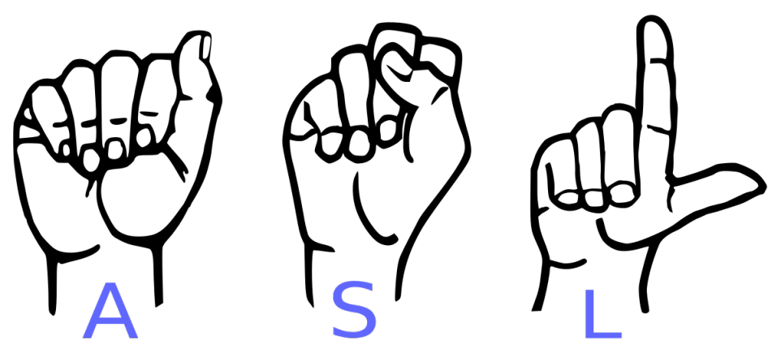
Classification of American Sign-Language using Hidden Markov Models or Convolutional Neural Networks
Source: https://www.microsoft.com/en-us/research/project/ms-asl/
Epp Steffen, Michael Mohr 26.11.2020 | Projekt Neuroinformatik

Slide 2
Method
2 Models:
Hand Segmentation
Hand Pose Estimation
Dataset:
Handseg
ICVL Hand Posture Dataset
Models:
Segnet
Mask R-CNN
possible Extension:
Extended Classification: Hand Movement + Hand Pose Estimation
Problems

Slide 3
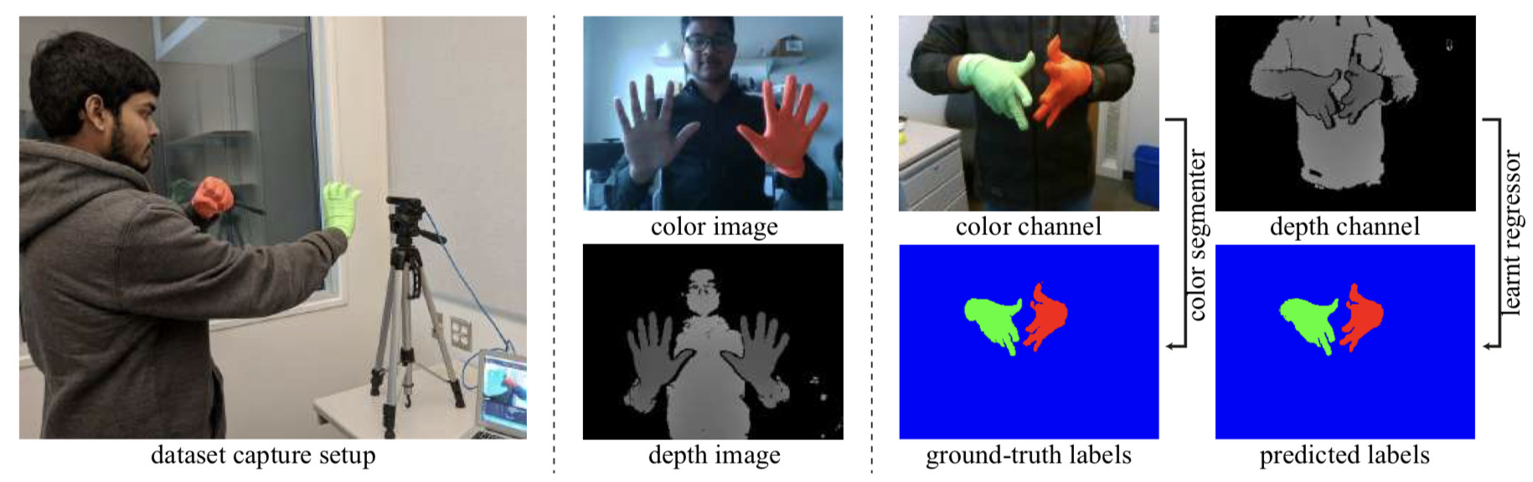
The Handseg Dataset: Hand Segmentation
Bojja et. al, "HandSeg: An Automatically Labeled Dataset for Hand Segmentation from Depth Image", arXiv, 2017

Slide 4
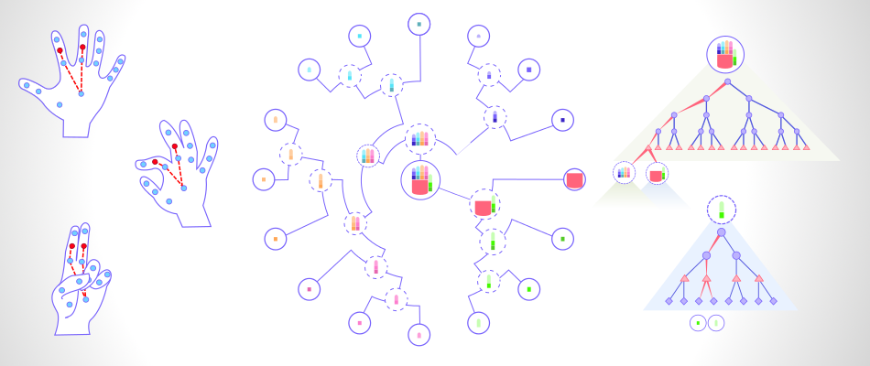
3D Articulated Hand Pose Estimation with Single Depth Images
ICVL: https://labicvl.github.io/hand.html

Slide 5
Problems
Mask R-CNN:
Only works on still images
~ 5 fps performance (according to Facebook Group)
cannot explore temporal information of the object of interest as hand gestures because of blurry images & low framerate
Source: D. Nguyen, T. Le, T. Tran, H. Vu, T. Le and H. Doan, "Hand segmentation under different viewpoints by combination of Mask R-CNN with tracking," 2018 5th Asian Conference on Defense Technology (ACDT), Hanoi, 2018, pp. 14-20, doi: 10.1109/ACDT.2018.8593130.

