Slide 1
Eclipse as an Agent-Based Modeling Platform
Richard Oliver Legendi
rlegendi@aitia.ai
AITIA International, Inc.
Eötvös Loránd University
http://people.inf.elte.hu/legendi/
Eclipse DemoCamps Indigo Budapest - 24 June, 2011

Slide 2
Outline
Agents?
General (and academic) definition
Why care?
Motivation & Examples
How Eclipse is related?
Why the Eclipse Platform?
What tools are available for the modelers?
Who are the modelers?
Conclusion

Slide 3
Agents

Slide 4

Agent?
Replicator (Stargate)
Notes:
Önszerveződő, önreplikáló, formába szerveződő, programozott lények

Slide 5
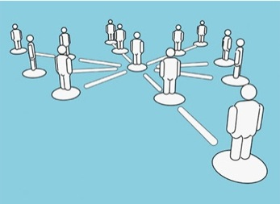
Agent-Based Modeling (ABM)
Agent
Autonomous participators
Complex systems with a set of interacting individuals
Bottom-up computational model:
By specifying low level (micro) rules we search for emergent global (macro) behaviour
Notes:
Valamekkora szabadságfokkal megáldott kis entitánsok
Nincs teljes információ
Praktikusan szoftver komponensek

Slide 6
Agent-Based Modeling (ABM)
Agents are usually:
Autonomous
Make own decisions
Learn, adapt to the changes of the environment
Interact through a specified communication topology (e.g., grid, networks, etc.)
Not for prediction
We search for behavioural patterns,
...and what we can conclude.

Slide 7
Motivation – An Example
„The economy needs agent-based modelling - The leaders of the world are flying the economy by the seat of their pants, say J. Doyne Farmer and Duncan Foley. There is, however, a better way to help guide financial policies.
In today’s high-tech age, one naturally assumes that US President Barack Obama’s economic team and its international counterparts are using sophisticated quantitative computer models to guide us out of the current economic crisis. They are not.”
J. Doyne Farmer and Duncan Foley
The economy needs agent-based modelling
Nature Vol. 460, 6 August, 2009

Slide 8
Economy
The best models, both with their own flaws:
Econometric
Empirical statistical models
Time series analysis: fitted to past data
Perfect to forecast a few quarters ahead
As long as things stay more or less the same
„Dynamic stochastic general equilibrium”
These models assume a perfect world...
... and by their very nature rule out even the definition of crises
Notes:
Remélem nagy hülyeséget nem mondok, ehhez kevésbé értek...
Ha szigorúan vesszük...
Vannak faktorok, amelyekkel egyszerűen nem tudnak mit kezdeni ezek a módszerek
Ez egy példa a sok közül...
...but fail in the face of great change.

Slide 9
Economy
Other aspects:
Heterogeneity?
Individual preferences?
Speculators?
Non rational participators?
And so on...
Using ABM we can shift from these constraints (to other ones, of course)

Slide 10
In General – Why care?
Shift from the representative to heterogeneous actors
In some cases, it could be easier to define a model
Specifying micro instead of macro rules
Using the ABM approach could be more intuitive for specific set of models

Slide 11
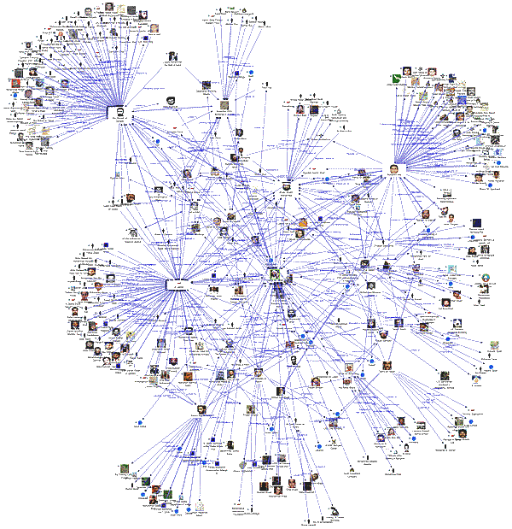
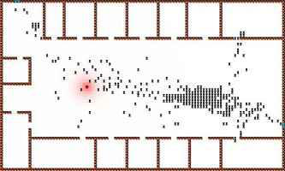

More Examples
Information diffusion
Epistemology
Supporting decision makers
Tax evasion
Notes:
desiging traffic

Slide 12
Eclipse

Slide 13
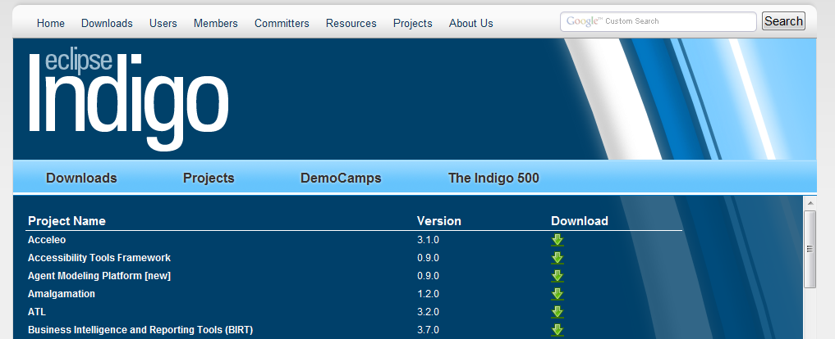
How Eclipse is Related?
Indigo: 62 project teams are part of the release
Including an ABM platform

Slide 14
Modeling with Eclipse?
Eclipse provides many unique features that make it ideal for an ABM platform
JDT/EMF/GMT/DTP/GEF/ZEST/BIRT/...
Several initiations and directions
Agent Modeling Platform
Repast Simphony
Ascape
Fables Modeling Environment

Slide 15
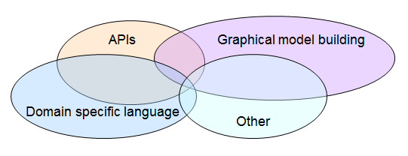
Formalization
Dozens of frameworks exist
Nearly all tool has its own way to define models
Eclipse has a great support for all of them
Notes:
and existed before... Agent UML

Slide 16
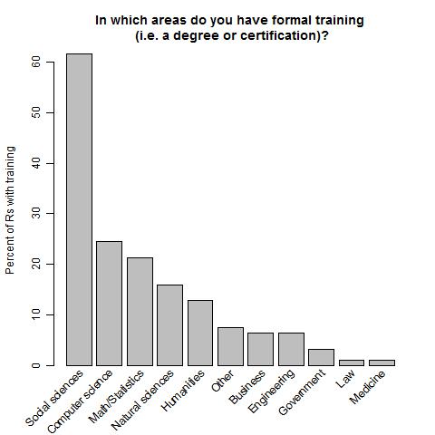
Modelers
Small, but very heterogeneous research area
~15% has formal training in computer science
Source: Computational social scientists: a draft directory and basic survey results http://lowlywonk.blogspot.com/2011/05/computational-social-scientists-draft.html

Slide 17

Agent Modeling Platform
Tools for representing, editing, generating, executing and visualizing agent-based models
Agent Modeling Framework Meta-model representation
Agent Execution Framework UI to observ and manage simulation
Agent Graphics Framework Visualization
http://eclipse.org/amp/

Slide 18
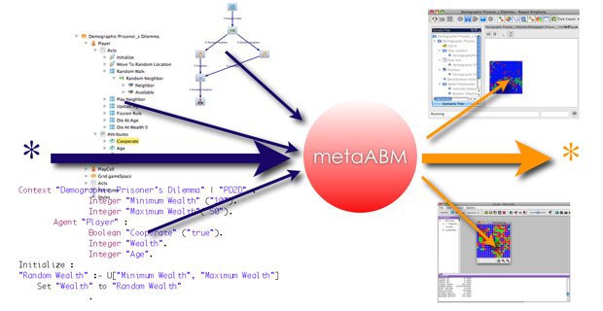
Agent Modeling Platform
Closely related to MetaABM and Ascape
Generates models for different simulation platforms
Validation: Escape, Ascape and Repast Simphony
Similiar to EMF Ecore, but with agents ☺

Slide 19

Repast Simphony
The Repast Suite is one of the most popular platforms
Active user community
Offers several ways to define a model
Java/Groovy API
ReLogo – a Logo-like DSL (cf. NetLogo)
Flowcharts
http://repast.sourceforge.net/

Slide 20

Google Summer of Code – 2011
Repast Simphony was selected for GSoC 2011
University of Michigan Center for the Study of Complex Systems
8 students work under the guidance of 4 mentors
Developing new demo models
Robotics, Swarm intelligence, Virus spreading, Mobile wireless sensor localization, etc.
New features and testing the IDE
http://code.google.com/p/cscs-repast-demos/

Slide 21

Fables
Functional Agent-Based Language for Simulation
Hybrid programming language
Mixing functional, object-oriented and sequential elements
Designed for agent-based simulations
„Support modelers, not the professional programmers”
Save as much on programming as possible
Appropriate language concepts for each part of the model
Syntax is close to formalism used in publications
https://fables.aitia.ai
https://mass.aitia.ai/fables
Notes:
Befejezett dolgozatok, ELTE-hez köthető tanulókkal együtt készített publikációk

Slide 22
Summary

Slide 23
Summary
Eclipse had a considerable influence on ABM tools
Free and open source ABM simulation tools
Built upon the Eclipse Platform
ABMs getting attention
One of the platforms is bundled into Indigo
Tools are collectively under continuous development for several years

Slide 24

Questions

Slide 25
Thank you for your attention!
Richard Oliver Legendi
rlegendi@aitia.ai
AITIA International, Inc.
Eötvös Loránd University
http://people.inf.elte.hu/legendi/
Eclipse DemoCamps Indigo Budapest - 24 June, 2011

Slide 26
