Slide 1
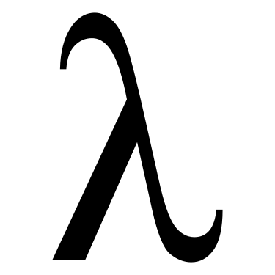
MSFT PL Meetup

Slide 2
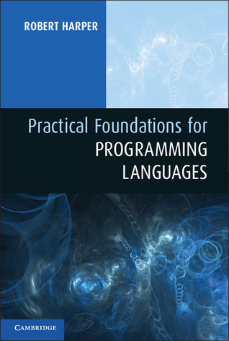
Practical Foundations for Programming Languages
Chapter 1

Slide 3












About Me (周佳孝 Mossaka)
I’m a Software Engineer @
Working on the Azure Machine Learning Python SDK
I graduated from University of California, San Diego with B.S. degrees in Pure Math and Computer Science.
I am familiar with:
I 💛 mathematics, algorithms, logics, and programming languages

Slide 4
Goals of MSFT PL Meetup
一起学习 programming languages 相关的书籍
学习PL principles, design, and implementation
能够读懂PLDI, POPL, ICFP这些conferences的论文
了解PL的历史发展
最终目标是
能够写出更加 readable, clean, expressive code
能够使自己的程序 safer, and scalable
当然还想让自己的代码更加美观

Slide 5
My personal goal
Be an expert (not necessarily obtaining a PhD) in this field
Implement my own programming language that I love to use
Do research in this field
Explore the connection between Math, AI and PL

Slide 6
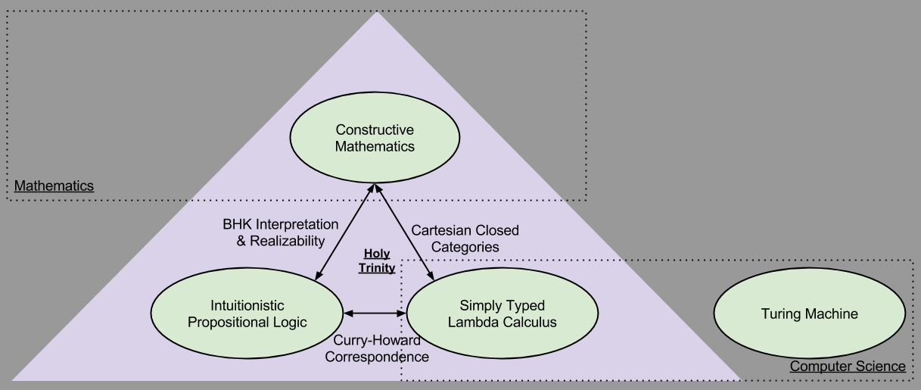

Slide 7
Format of MSPLM
One hour meeting per week
~20 minutes talk at the beginning
~40 minutes discussion afterwards
I will record the meetup for those who cannot attend

Slide 8


If you are interested in working on the exercises, please make a pull request to this GitHub repo’s solutions folder. https://github.com/Mossaka/MSFT_PL_Meetup
Join our discord server: https://discord.gg/uz9YUvV

Slide 9
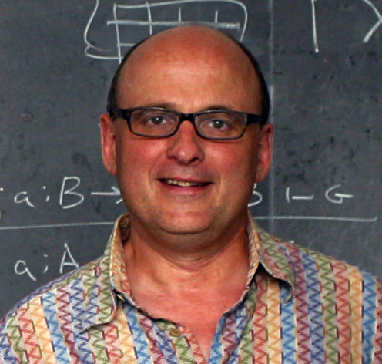

Why PFPL?
PFPL 是我一直想读的一本非常有挑战性的PL书。去年暑假我尝试了一个月，最后放弃了，因为有很多晦涩难懂的概念，一年过后我想和大家一起挑战读懂这本书。
PL 文学里面的著作
Robert Harper 所著

Slide 10
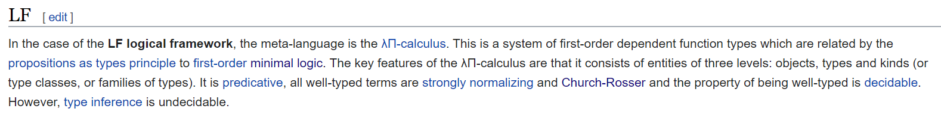
More about Robert Harper
Made major contributions to Standard ML and LF logical framework
ML stands for meta language, designed by Robin Milner
A family of languages originated from ML including
ACM Fellow for his contributions to type systems

Slide 11
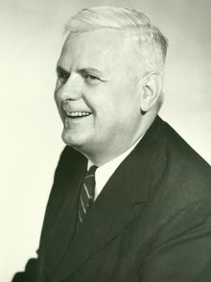
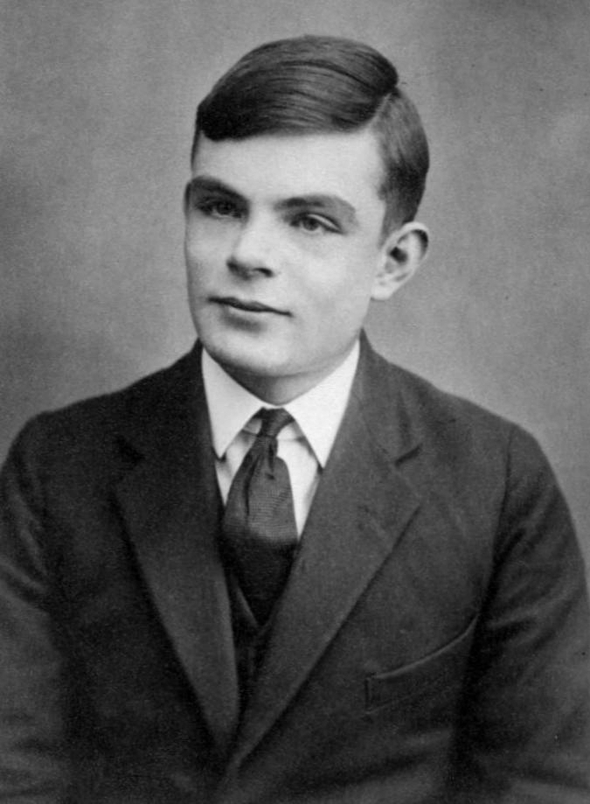
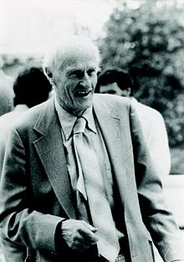
Academic Family Tree
Alonzo Church
| Alan Turing
| Stephen Cole Kleene (Kleene star & RegEx)
| Robert Constable
| Robert Harper
| Edmund Clarke
…

Slide 12
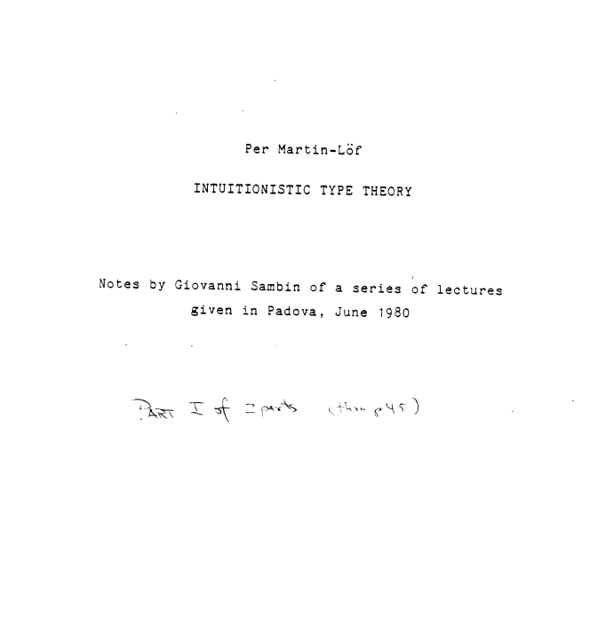
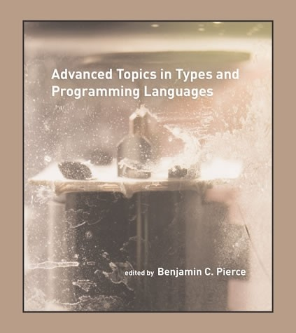
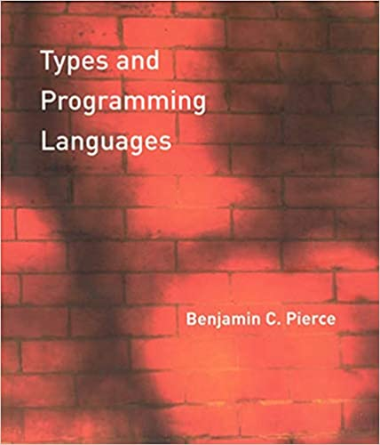
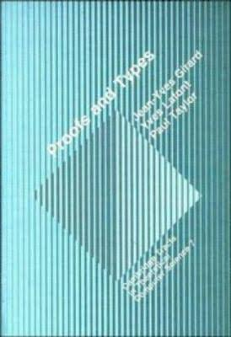
Books to read:

Slide 13


Other potential activities
Weekly paper discussion
Programming contest in many languages
Learn 1 esoteric programming language / month
Brainfuck
APL
https://esolangs.org/wiki/Language_list

Slide 14
Practical Foundations for Programming Languages
Chapter 1

Slide 15
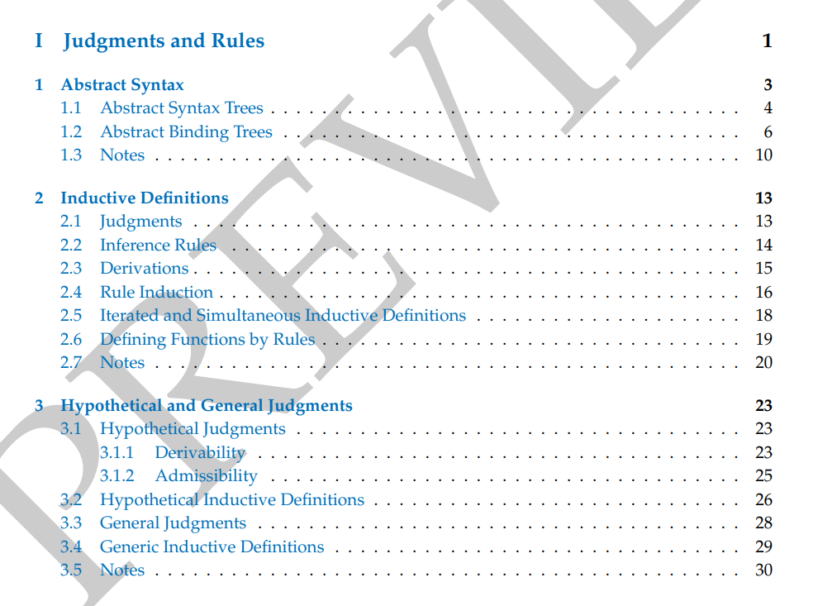

Slide 16
“My purpose in writing this book is to establish a comprehensive framework for formulating and analyzing a broad range of ideas in programming languages.”

Slide 17
Language features are manifestations of type structure.

Slide 18
The syntax of a language is governed by the constructs that define its types, and its semantics is determined by the interactions among those constructs.

Slide 19
Syntax vs Semantics
The syntax of a language specifies how various sorts of phrases (expressions, commands, declarations, and so forth) may be combined to form programs.
The semantics of a language specifies the actions that occur when a program is executed
Operational semantics
Denotational semantics

Slide 20

Language feature = statics + dynamics → safety
Statics: the rules governing the use of the feature in a program
dynamics: the rules defining how programs using this feature are to be executed
Safety: emerges as the coherence of the statics and dynamics

Slide 21
Reading Suggestions
“Part I and Part II provide foundation for the rest of the book. Skim Part I, carefully read Part II and returning back to Part I for clarification of the logical framework.”

Slide 22
Abstract Syntax tree vs Abstract binding tree
“An abstract syntax tree, or ast for short, is an ordered tree whose leaves are variables, and whose interior nodes are operators whose arguments are its children.”
ASTs capture the hierarchical structure of a piece of syntax while avoiding commitment to their concrete representation as a string.
ABTs are an augmentation of ASTs with the means of specifying the binding (declaration) and scope (range of significance) of an identifier.
ABT = AST + Binding + Scope

Slide 23
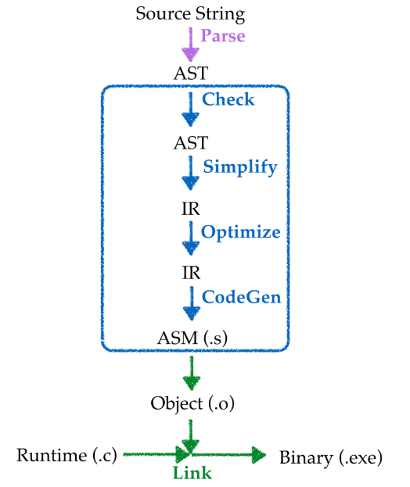
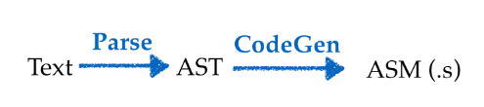
What exactly is AST?
Compiler
compiler :: SourceProgram -> TargetProgram
compiler :: String -> String

Slide 24
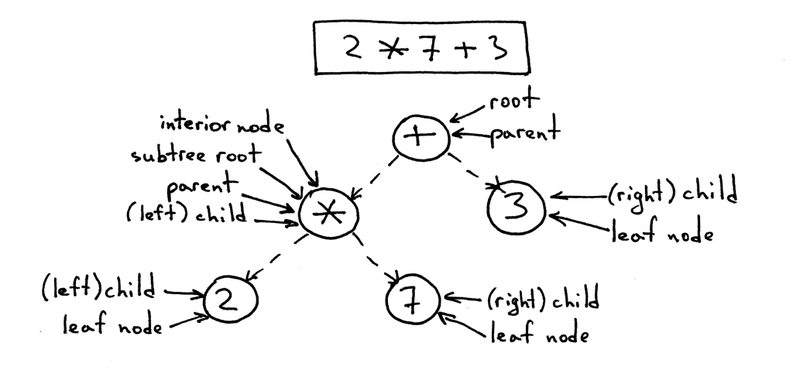

Slide 25
A variable is an unknown, or a place-holder, whose meaning is given by substitution

Slide 26
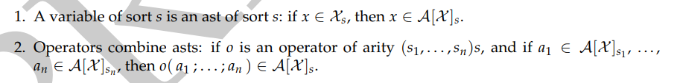
Definitions
S = {…sorts…}
arity has form (s1,…,sn) s, where n >= 0, s, s1, …, sn in S
O arity-indexed operators
X variables x of sort in S
x fresh variable if x not in X
A[X] abstract syntax trees constructing from:

Slide 27
Example
S = {Exp} single element set
O = { num[n] for each n in N} | {plus, times}
X = { … variables … }
A[X] has:
x, num[2], num[5], plus(num[2]; num[5])
plus(num[2]; times(num[3]; x))
plus(times(num[2]; num[7]); num[3])
are all asts in A[X]

Slide 29
Example
arity has form (s1,…,sn) s, where n >= 0, s, s1, …, sn in S
arity of plus is (Exp, Exp)Exp
arity of times is (Exp, Exp)Exp
Hence plus and times are in the same arity-index operator set

Slide 30
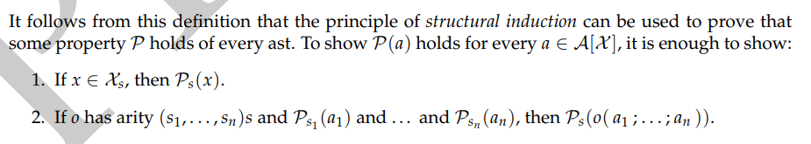
Structural Induction

Slide 31
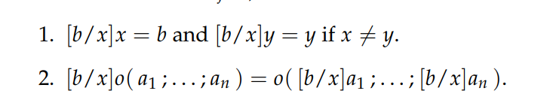
What about Substitution?

Slide 32
Example

Slide 33
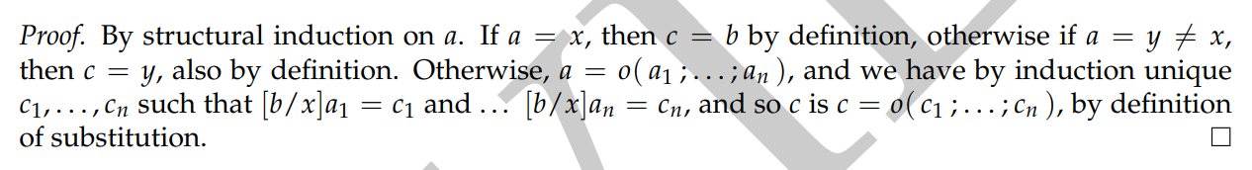
Theorem 1.1 Substitution is well-defined

Slide 34
ABT = AST + binding + scope
Let x be 2 in x + x
Let x be 2 in let y be 3 in x + x
Let y be 2 in let y be 3 in y + y

Slide 35

Definitions
Abstractor has the form x1,…xk . a
X1,….xk are bound within the abt a
Let x be a1 in a2 has the form let(a1; x . a2)
generalized arity (v1,…vn) s
Valence v has the form s1,….sk . S
O set of generalized-arity-indexed operators
B[X] abts

Slide 36
Example
Let x be 2 + 2 in x * x in abt can be written as:
let(plus(num[2];num[2]);x.times(x;x))
Abstractor

Slide 37
Example
generalized arity of times:
(Exp. Exp; Exp. Exp) Exp

Slide 38
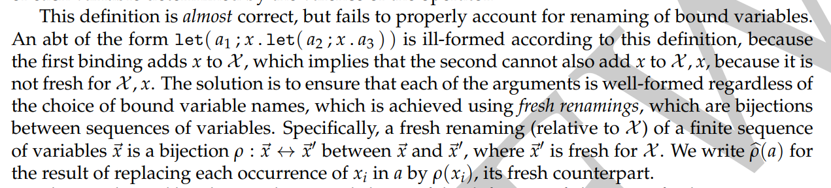
A small problem…

Slide 39
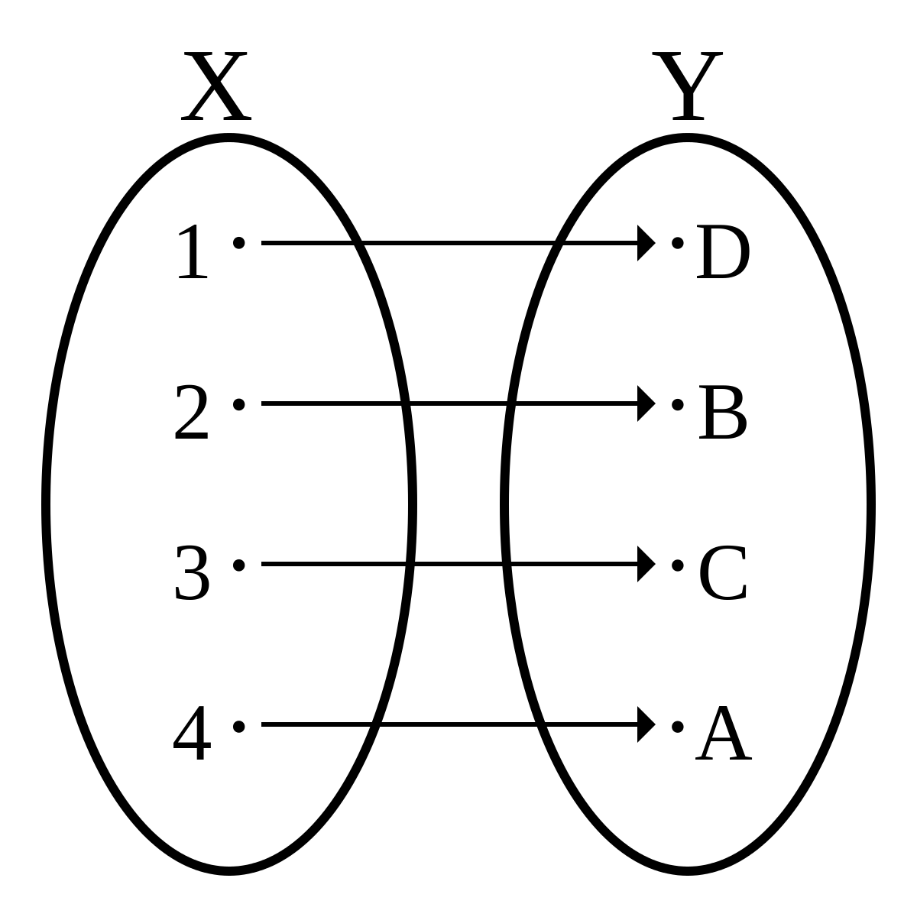
What’s bijection?
Bijection = one-to-one + onto

Slide 41
Alpha-renaming
Renaming bound variables to fresh variables to avoid capture

Slide 42

Now we get our definition correct

Slide 43
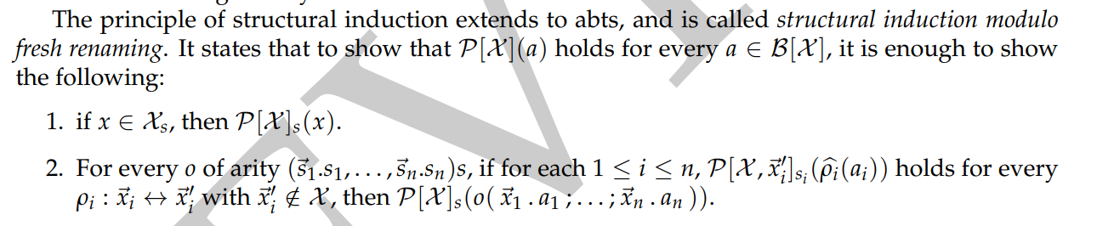
Structural induction modulo fresh renaming

Slide 44
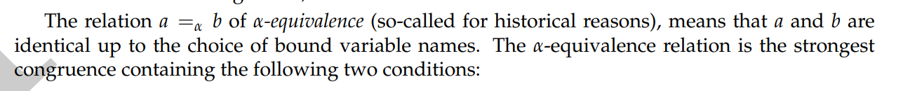
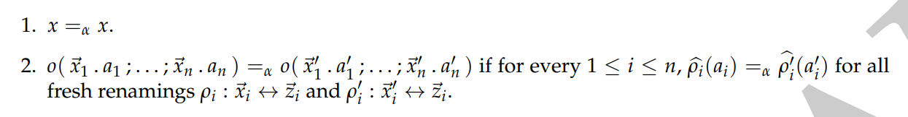
Alpha-equivalence

Slide 45
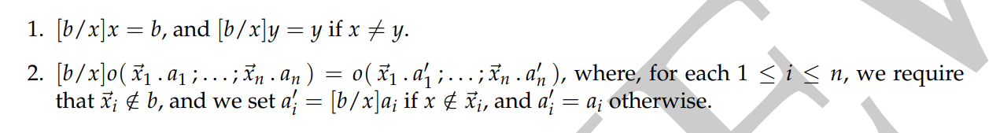
Finally… we can define substitution

Slide 46
Abstract binding trees are always identified up to alpha-equivalence

Slide 47
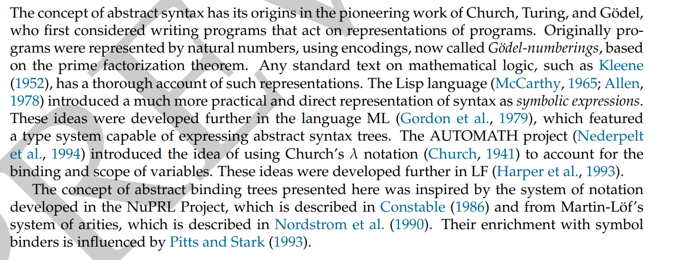
1.3 Notes

Slide 48
References
https://ruslanspivak.com/lsbasi-part7/lsbasi_part7_tree_terminology.png
https://ucsd-progsys.github.io/131-web/lectures.html

