Slide 1
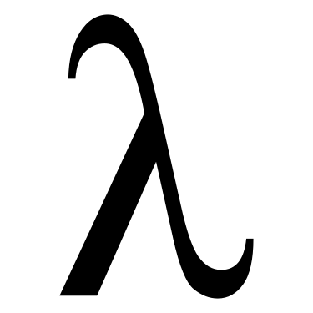
MSFT PL Meetup

Slide 2
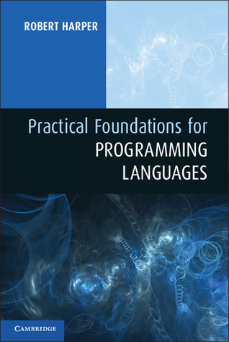
Practical Foundations for Programming Languages
Chapter 2

Slide 3


If you are interested in working on the exercises, please make a pull request to this GitHub repo’s solutions folder. https://github.com/Mossaka/MSFT_PL_Meetup
Join our discord server: https://discord.gg/uz9YUvV

Slide 4
Practical Foundations for Programming Languages
Chapter 2

Slide 5
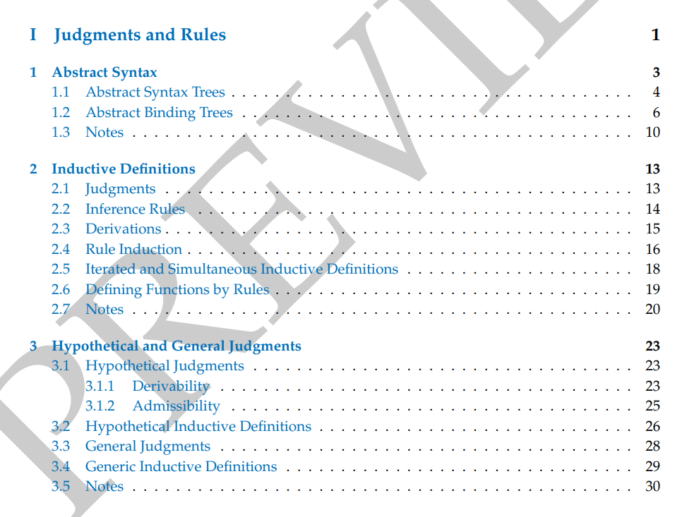

Slide 6
Inductive definitions are an indispensable tool in the study of programming languages.

Slide 7
An inductive definition consists of a set of rules for deriving judgements of a variety of forms.

Slide 8
Judgements are statements about one or more ABTs of some sort.
The rules specify necessary and sufficient conditions for the validity of a judgement, and hence fully determine its meaning.

Slide 9
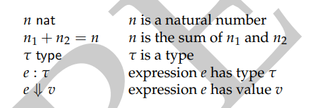
Judgements
Example
A judgement states that one or more ABTs have a property or stand in some relation to one another.

Slide 10
Judgement form is the property of ABTs

Slide 11

Inference Rules
An inductive definition of a judgement form consists of a collection of rules of the form

Slide 12
Premises: above the line
Conclusion: below the line
Axiom: no premises
J_i are all judgements.

Slide 13
Necessity vs Sufficiency
If P, then Q
Q is necessary for P.
P is sufficient for Q.

Slide 14
An inference rule: the premises are sufficient for the conclusion.

Slide 15
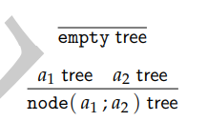
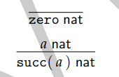
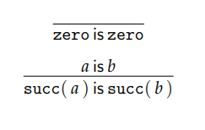
Examples

Slide 16
Derivations
A derivation of a judgement is a finite composition of rules, starting with axioms and ending with that judgements.

Slide 17
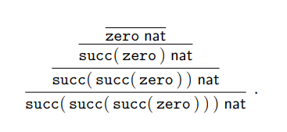
Example

Slide 18
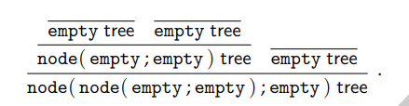
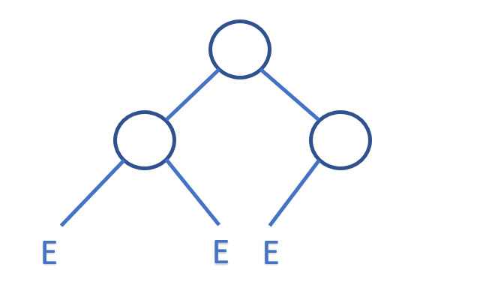
Example

Slide 19
Duality of derivations
forward chaining / bottom-up construction
Starts with the axioms and works forward towards the desired conclusion
backward chaining / top-down construction
Starts with the desired conclusion and works backwards toward the axioms

Slide 20
Rule Induction
The principle of rule induction states that to show that a property P holds whenever judgement form J is derivable, it is enough to show that P is closed under the rules defining the judgement form J.

Slide 21

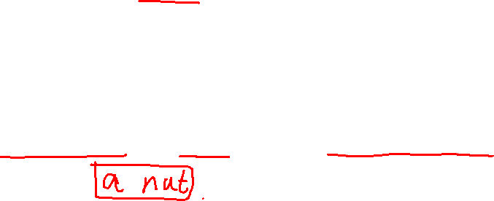
Example
In order to show P where a nat, it is enough to show:

Slide 22

Example
In order to show P where a tree, it is enough to show:

Slide 23
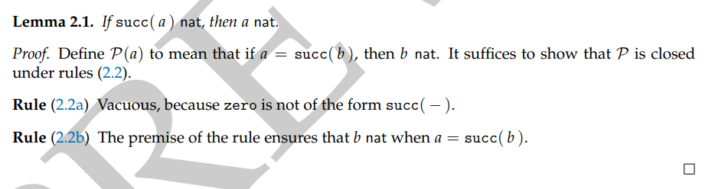
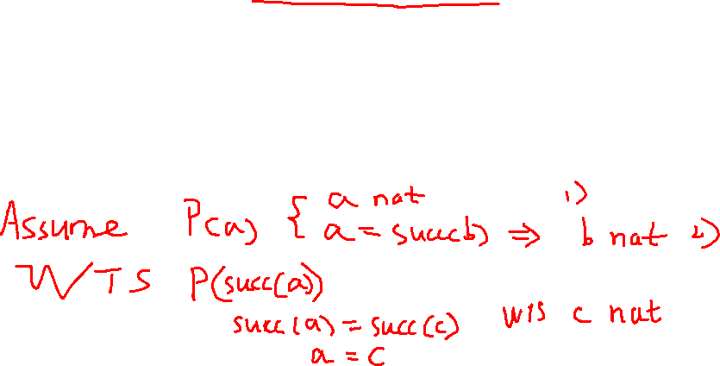
Lemma 2.1

Slide 24
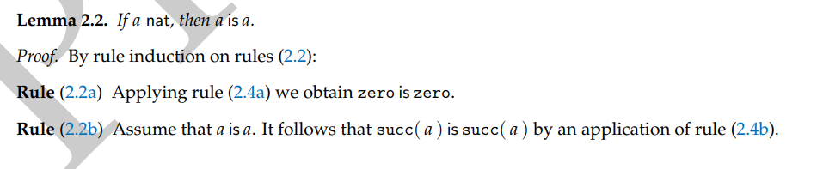
Lemma 2.2

Slide 25
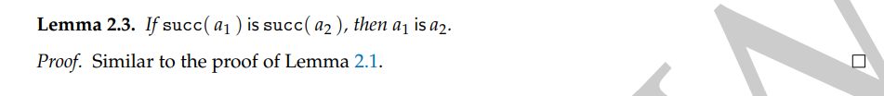
Lemma 2.3

Slide 26
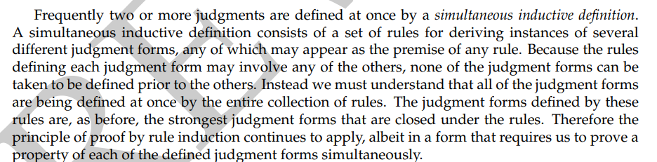
Simultaneous Inductive Definitions

Slide 27
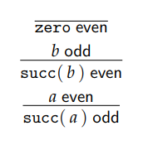
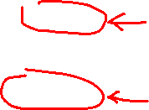
Simultaneous Inductive Definitions

Slide 28
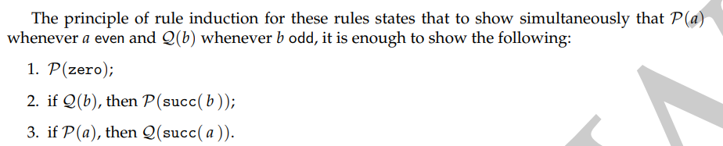

Slide 29
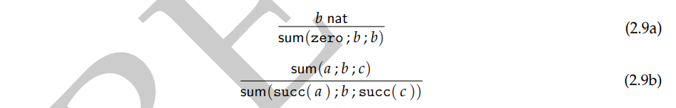
Defining Functions by Rules

Slide 30
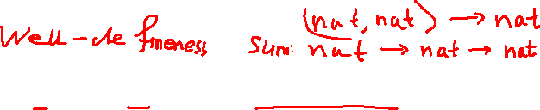
Theorem 2.4

Slide 31
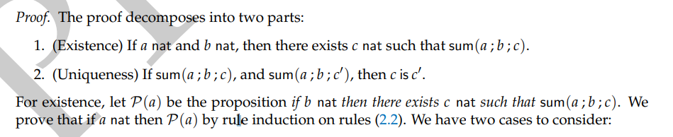

Slide 32
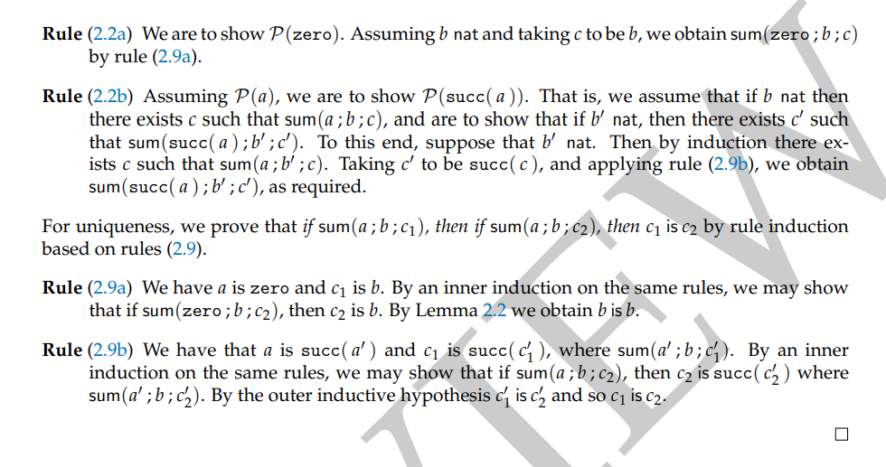
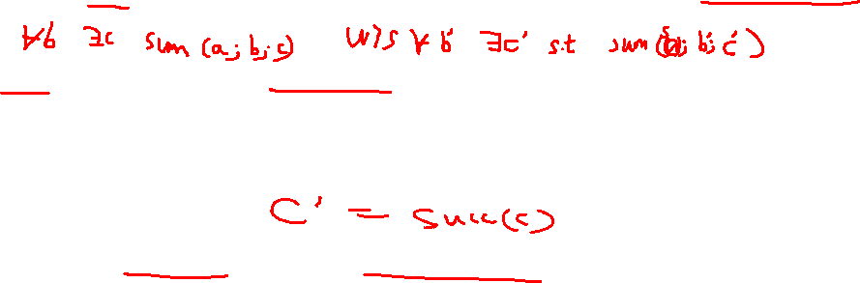

Slide 33
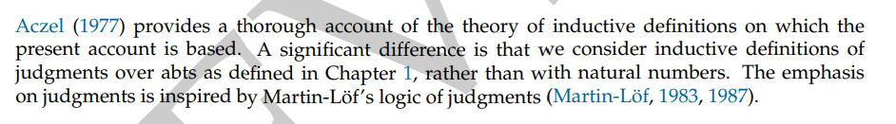
Notes

