Slide 1

Exploration and Recommendations in Amsterdam city
The neighborhood Battle series

Slide 2
Outline
I. Introduction
Problem statement
Targets for bussiness
II. Data collection
III. Results and discussion
IV. Conclusions

Slide 3
I. Introduction
The Amsterdam where I was visiting is one of the most populous cities in the world. Amsterdam is characterized by the large number of canals, museums, culture and arts which form a UNESCO World Heritage Site, then this city is definitely worth to explore and discover.
The targets that exploration website aimed to are tourists, or even people in Netherlands but never go this place in life.
I will present each part of the assignment and address them later. Firstly, I describe the Amsterdam data preparation and then go future steps to start the exploration of boroughs and neighborhoods in Amsterdam.

Slide 4
I.1 Problem definition
The total number of tourists coming to Amsterdam increase steadily every from 2014 to 2020. then the need of clear information and must-go areas or neighborhoods in Amsterdam should be provided in one website for tourist easy to find rather than going to each website and read for each distributed information that taking so much time and boring. Therefore, I assume that create a simple page with enough information about Amsterdams for tourist or people who loves Amsterdams to explore but with time reduction and be able to maximize the knowledge to visit Amsterdam. Furthermore, from this site , we can see that Amsterdams is one of the strong city for its competition in economics, then this place can be good candidate for start-up company want to seek profits. A good example for start-up company is to open a food chain restaurant in neighborhood where lots of people (e.g., with target is office workers, ...) but lack of diverse food.
References:
https://www.statista.com/statistics/658819/inbound-tourism-forecast-in-the-netherlands/
http://mori-m-foundation.or.jp/english/ius2/gpci2/index.shtml

Slide 5
II. Data collection
Based on the previous discussion, there are some factors will effect our decision such as:
Number of venues that we can obtain.
The diverse ecology venues that Amsterdam having.
Number of neighborhoods.
How dense the population is in the desired area.
First, the data will be will be obtained by extracting information about Amsterdam neighborhoods.
Then, using Foursquare API to to obtain the coordination according to each neighborhood. And the data then will be shown in the map to confirm the precise of data collection.

Slide 6
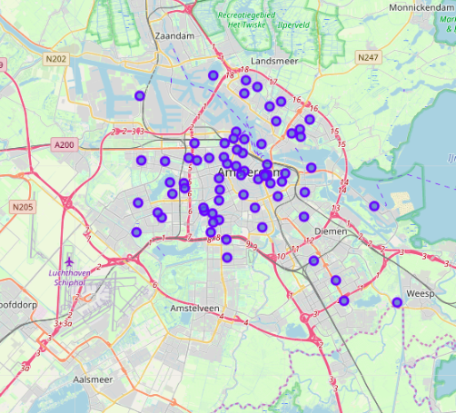
II. Data collection
Here we can see that all the neighborhood concentrating inside the Amsterdam area.
This confirmed that our collection data process is completely on the righ direction.
Next step we will find out more about those clustering.

Slide 7
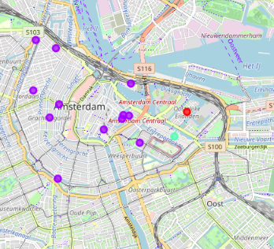
III. Results and discussion
As we can see that most of the area of Amsterdam has the same pattern with violet color, while there are two single neighbor hoods that are a bit different from.
Because the total number of neighborhood are small so we decided to choose the number of clusters are three.
And the results seems to be quite biased.

Slide 8
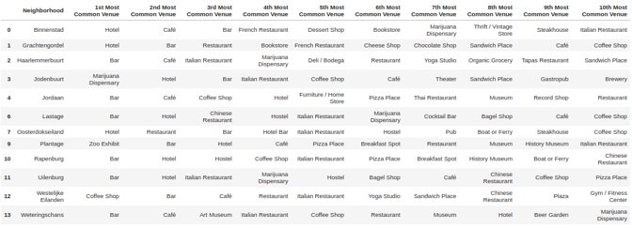
III.1 Results

Slide 9
III.2 Discussion
As we can see from above frames, the group 1, is the neighbor named 'Oostelijke Eilanden' is populated with natural and friedly venues such as gyms, parks and bus stop.
Whereas, in the group 0, they are mostly populated with food and beverage groups with so many bars, cafe, and Hotels.
And in the group 2, we can easy to see that more green area with bus, park and entertainment area.

Slide 10
IV. Conclusions
The goal of this project is to aim to exploration and see the patterns of Amsterdam so that in the final we can have at least some information about the city where someone would like to explore or visit in the future. To fulfill that, we have retrieve data about boroughs of only Amsterdam area where we are interested in, and collect some information such a longitude and latitude which are mandatory because we would like to use Foursquare API to retrive the data about venues around Amsterdam.
In addition, we had explore some common places in all neighborhoods of central area where the population per square kilometer is dense and there are a lot of interesting venue to visit.

