Slide 1
MA3EESHA
Student Housing Marketplace
PRESENTED BY
Mohamed Lasheen
Mostafa Ahmed
Khaled Ahmed
Maher
Amr Tarek Farouk

Slide 2
PART ONE
Technical Overview
How Ma3eesha is built — architecture, modules, and technology.

Slide 3





THE CHALLENGE
The Problem
Finding suitable housing
Students struggle to discover options that fit their needs.
OUR GOAL
Comparing prices
One platform. Total trust.
No easy way to evaluate listings side by side.
Contacting trusted owners
Ma3eesha provides one platform that connects students with trusted property owners in a simple and secure way.
Reaching reliable property owners is difficult.
Verifying credibility
Listings lack a clear trust or verification signal.
Completing the rental process
Search · Compare · Connect · Rent
The end-to-end rental journey is fragmented.
03 / 24

Slide 4



THE SOLUTION
Ma3eesha Connects Three Roles
Students
Property Owners
Admin
MAIN SERVICES
Property Search
Smart Filters
Chat System
Manual Payment
Reviews & Ratings
Dashboards
04 / 24

Slide 5
SYSTEM ARCHITECTURE
System Users & Roles
Admin
Owners
Students
Student
Owner
Admin
Search Properties
Add Units
Manage Users
Rent Units
Manage Listings
Approve Listings
Chat with Owners
Track Performance
Review Payments
Leave Reviews
Receive Payments
Monitor Platform
05 / 24

Slide 6










ARCHITECTURE
Main Modules
The complete architecture of Ma3eesha — eleven integrated modules.
Authentication
Home & Search
Unit Management
Maintenance
User Dashboard
Owner Dashboard
Admin Dashboard
Payment System
Chat System
Notifications
Rating & Reviews
06 / 24

Slide 7





MODULE 01
Authentication Flow
Sign Up
FEATURES
Secure Login
Verification
JWT Authentication
Login
Password Encryption (bcrypt)
JWT Authentication
Email / Phone Verification
Dashboard by Role
Role-Based Access Control (RBAC)
07 / 24

Slide 8






MODULE 02 — CORE
Unit Management
Owner Adds Unit
Payment
Admin Approval
Available
Rent / Sale
History
This is the core module of the entire system.
FEATURES
Add Property
Edit Property
Delete / Deactivate
Manage Status
Property Images
Property Details
08 / 24

Slide 9







MODULE 03 — PROPERTY CARE
Maintenance Requests
Students report issues; owners track and resolve them — all in one thread.
Student
Owner
Submit Maintenance Request
Receive & Review Requests
Attach Photos & Description
Set Priority & Status
Track Request Status
Assign & Resolve
Chat with Owner
Maintenance History Log
09 / 24

Slide 10







MODULE 04
Search System
Search by Location
Search by University
Filter by Price
Filter by Property Type
Sort Results
Availability Filter
Favorite Listings
Premium listings appear at the top of the search results to increase visibility.
10 / 24

Slide 11




MODULE 05
Student Rating System
Students rate their stay after move-out, building a trusted review layer for future renters.
Rate After Move-Out
1–5 Star Rating
Written Review
View Owner Ratings
Verified Renter Reviews
Rating History
Only verified renters can leave a rating, keeping every review trustworthy.
11 / 24

Slide 12
USER EXPERIENCE
Role-Based Dashboards
Each dashboard provides tools tailored to the user’s role.
Student Dashboard
Owner Dashboard
Admin Dashboard
Bookings, Favorites, Chats
Units, Income, Analytics
Users, Payments, Approvals
12 / 24

Slide 13

MODULE 06
Payment Process
Owner Adds Property
Upload Payment Screenshot
Admin Reviews Payment
Approve
Property Published
CURRENT VERSION
FUTURE VERSION
Manual Payment
Paymob Integration
Vodafone Cash
Fawry Integration
InstaPay
13 / 24

Slide 14








TECHNOLOGY STACK
Built With Modern Tools
FRONTEND
BACKEND
DATABASE
AUTH
REAL-TIME
React.js
Node.js
MongoDB
JWT
Socket.io
Vite
Express.js
bcrypt
Tailwind CSS
14 / 24

Slide 15





ROADMAP
Future Work
These features are planned for the next phase of the project.
Online Payment Gateway
AI-Based Recommendations
Mobile Application
Community Module
Push Notifications
Advanced Analytics
15 / 24

Slide 16



WALKTHROUGH
Live Demonstration
1
2
3
4
Login
Home Page
Search & Filter
Owner Dashboard
5
6
7
8
Add Property
Admin Approval
Student Dashboard
Chat System
16 / 24

Slide 17

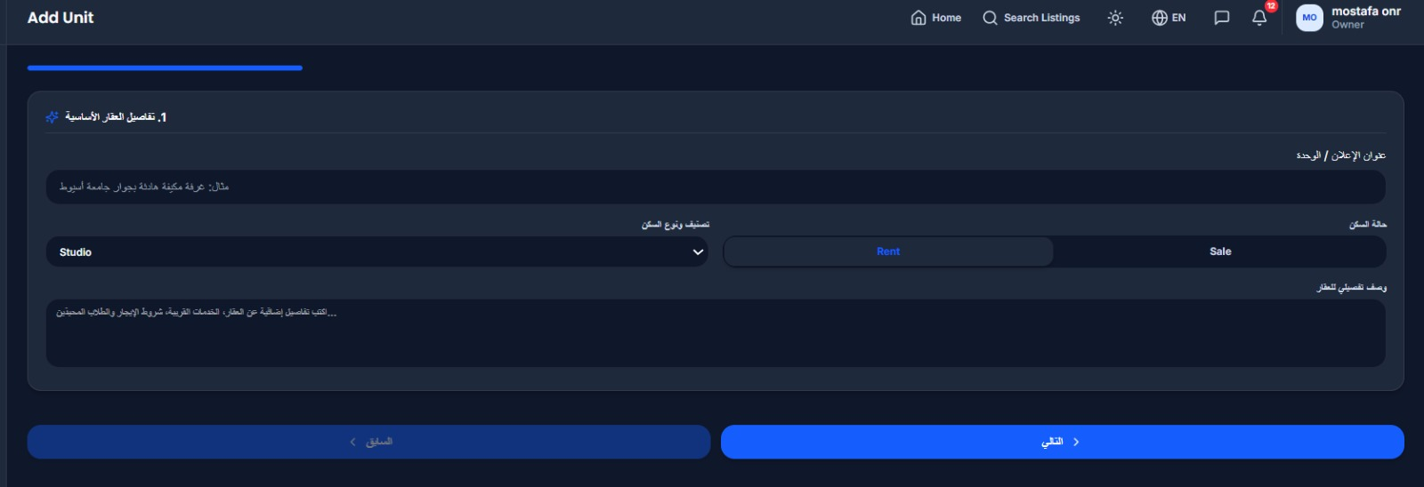
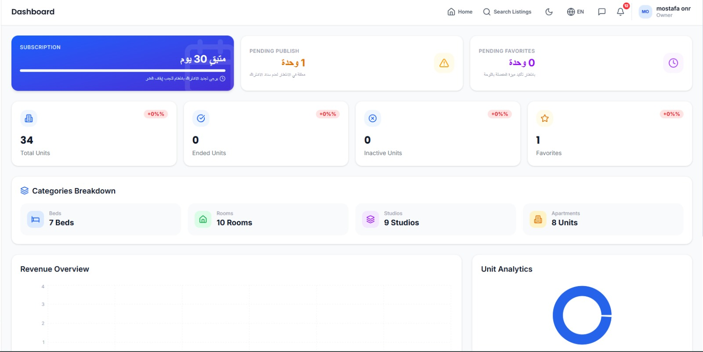
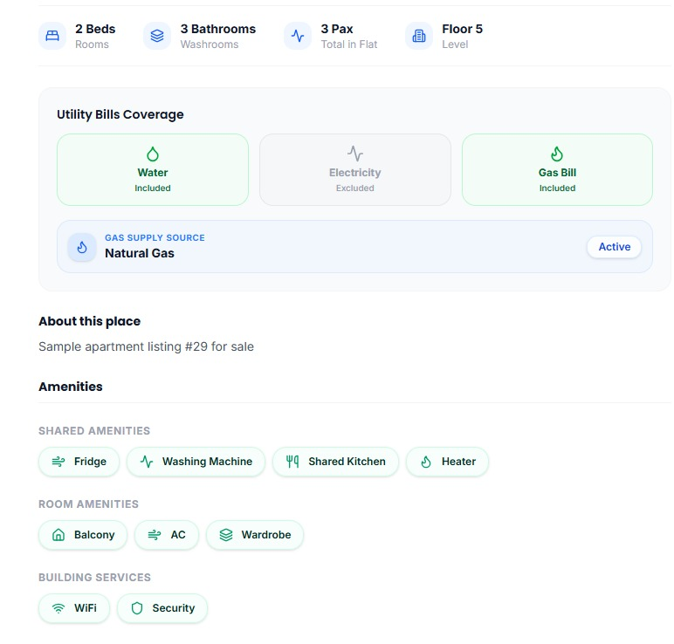
FROM THE PRODUCT
Student & Owner Screens
Real interface captured from the live build.
Home Page — Search Entry Point
Owner — Add Unit Form
Owner Dashboard
Unit Details & Amenities
17 / 24

Slide 18
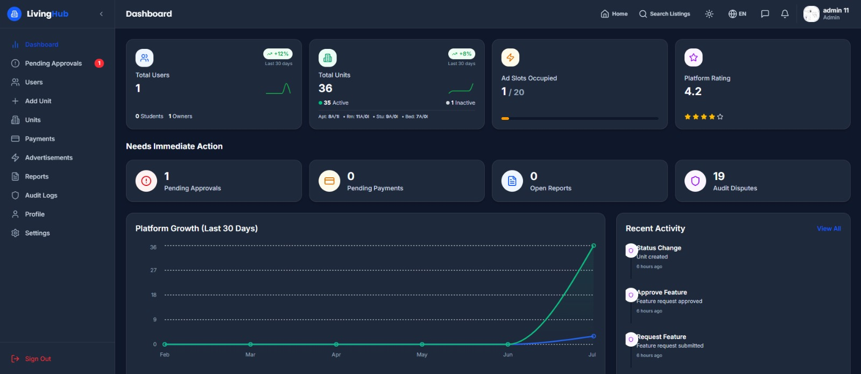
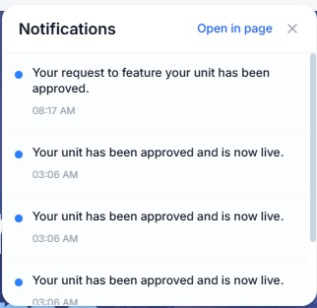
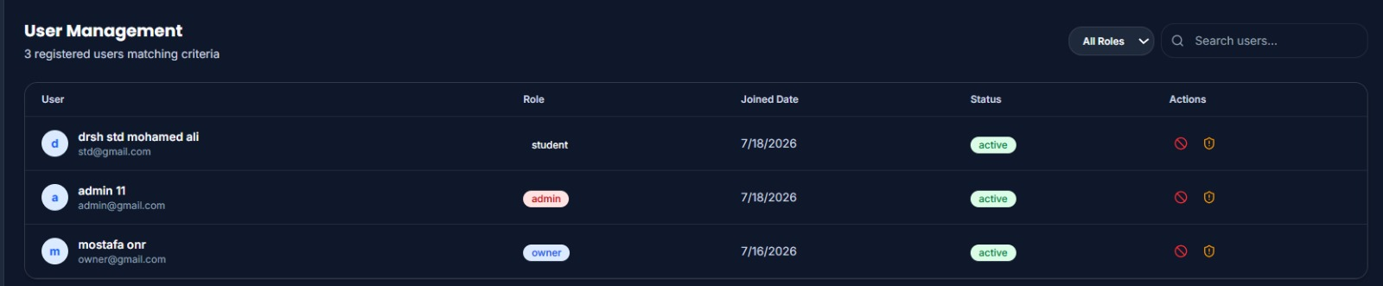
FROM THE PRODUCT
Admin & Platform Screens
The tools admins use to keep Ma3eesha safe, active, and trustworthy.
Live Notifications
Admin Dashboard — Platform Overview
User Management
18 / 24

Slide 19






RETROSPECTIVE
Challenges We Faced
Designing a Role-Based System
Managing Property Lifecycle
Secure Authentication
Payment Verification
Responsive UI Design
Dashboard Development
Database Management
19 / 24

Slide 20
PART TWO
Business Model
How Ma3eesha turns trust into sustainable revenue.

Slide 21




BUSINESS MODEL
Revenue Streams
Four engines power Ma3eesha’s growth — diversified and mutually reinforcing.
Owner Monthly Subscription
Student Connection Fee
A recurring monthly fee from property owners keeps their units listed and visible on the platform.
The first 2 connections are free. After that, students pay a small token fee to connect with an owner.
Transaction Commission
Advertisements
A percentage of every successful deal, with the rate mutually agreed with both the Owner and the Student.
Sponsored banners and promoted listings sold to businesses and owners across key student-facing pages.
21 / 24

Slide 22


BUSINESS MODEL
How Ma3eesha Earns
Every user starts free; revenue kicks in once real value has been delivered.
OWNER — SUBSCRIPTION PATH
Owner Onboards
Lists Units
Monthly Subscription Billed
Continued Listing Access
STUDENT — CONNECTION FEE PATH
Student Signs Up
First 2 Connections Free
3rd Connection Onward
Token Connection Fee Applied
COMMISSION — SUCCESSFUL DEALS
Deal Confirmed
Agreed % Calculated
Split Between Both Sides
Payout Released
Subscriptions, connection fees, and commissions combine into a diversified, predictable revenue engine.
22 / 24

Slide 23
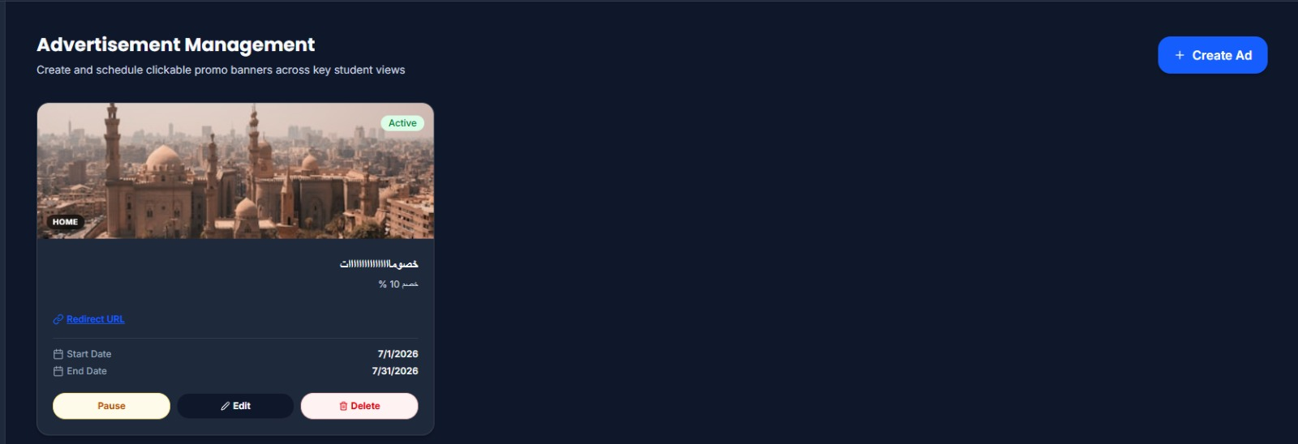
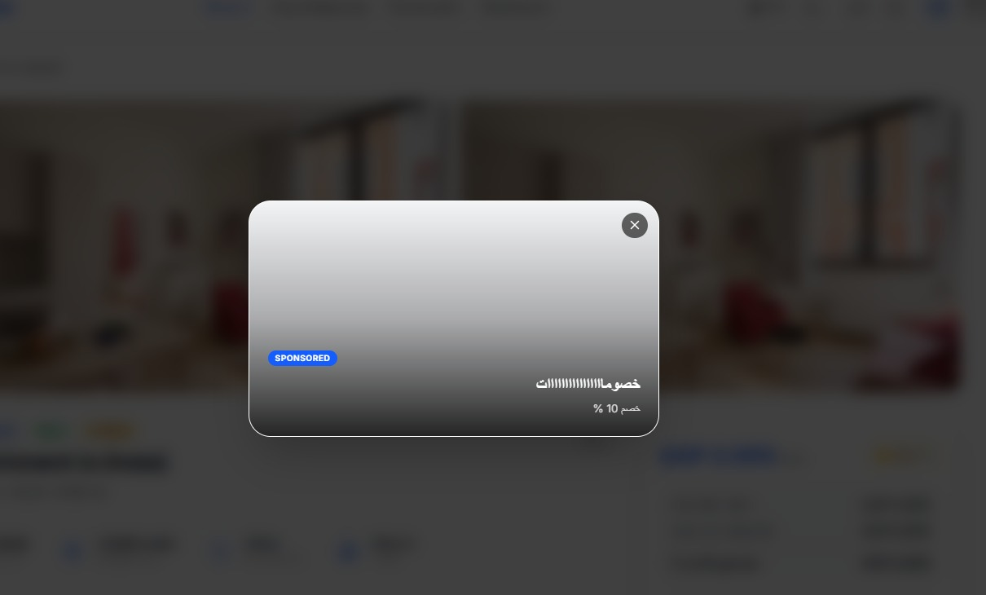
BUSINESS MODEL
Advertisements in Action
Sponsored placements sold directly to local businesses and property owners — live in the product today.
Owner’s Ad Management Panel
Businesses and owners buy sponsored placements directly
Campaigns run on a clear, scheduled start and end date
Full control to pause, edit, or delete a campaign anytime
Sponsored Placement — Student View
23 / 24

Slide 24
MA3EESHA
Thank You
Questions & Discussion

