Slide 1

Business Intelligence Track
Monoufia Branch
Examination System
Oct. 2020-Jan. 2021

Slide 2
Team Members
Habiba Khaled Mostafa Ibrahim
Nouran Sherif
Amira Fayez

Slide 3
Agenda
1-ERD 2-Database Diagram
3-Stored Procedures
4-SSRS Reports
5-Dashboard screenshots
6-Desktop App

Slide 4
1-ERD

Slide 5
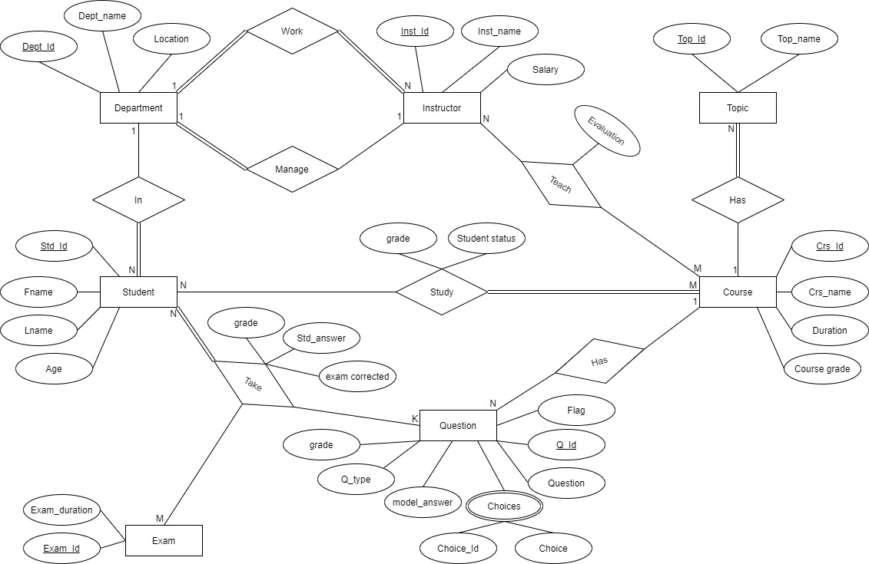
ERD

Slide 6
2-Database Diagram

Slide 7
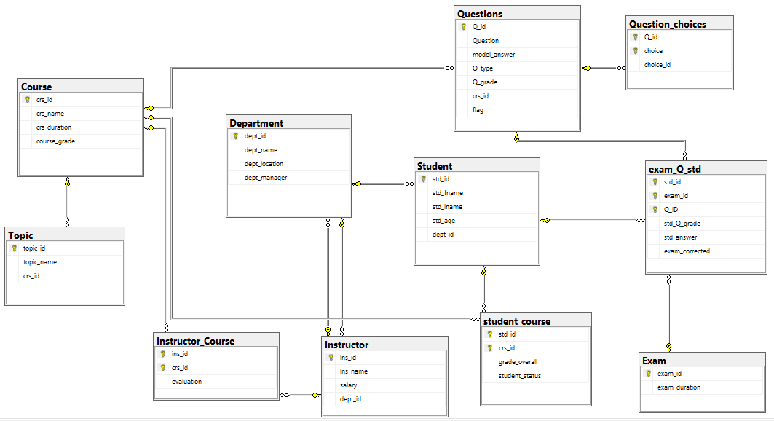
Database Diagram

Slide 8
3-Stored Procedures

Slide 9
Generating Exams
Input : Course Name – No. of MCQ Questions – No. of T/F Questions – Exam Duration
Process : Selects random questions with the input conditions Changes those Question ID’s flags to 1s.
Output : Generates the Exam ID and inserts it with its duration in the Exam table

Slide 10
Answering Exams
Input : Exam ID – Student ID – Answer.
Process : Gets the first Question of the exam, reset its flag to 0 check the Exam ID is correct and is the last created one.
Output : Inserts the student’s answer with the question ID, exam ID and student ID in the exam_Q_std table.

Slide 11
Correcting Exams
Input : Exam ID – Student ID.
Process : Gets each Question ID with its grade, model answer and the student’s answer then compares them.
Output : Inserts the student grade on each answer and mark the exam as corrected.
PS: There is an extra procedure that sums up the student’s grades in the course.

Slide 12
4-SSRS Reports

Slide 13
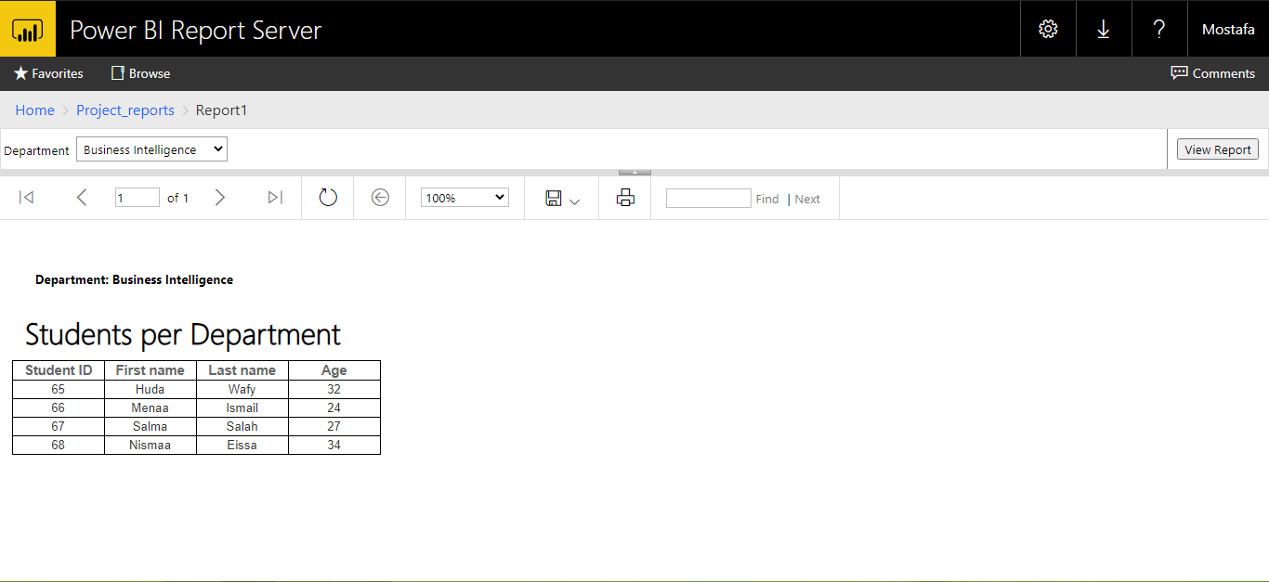
Report 1
Students information according to department name.

Slide 14
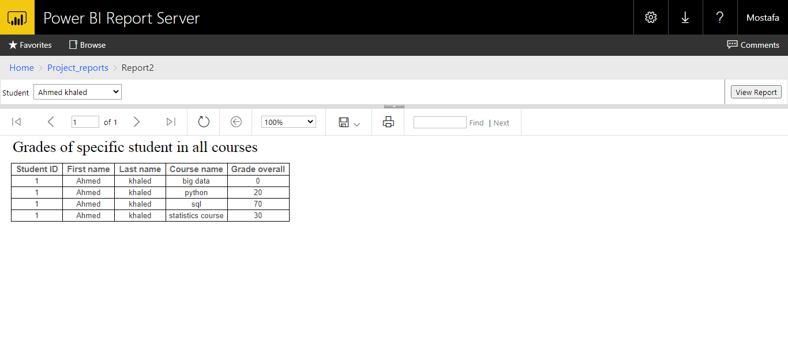
Report 2
Grades of specific student in all courses.

Slide 15
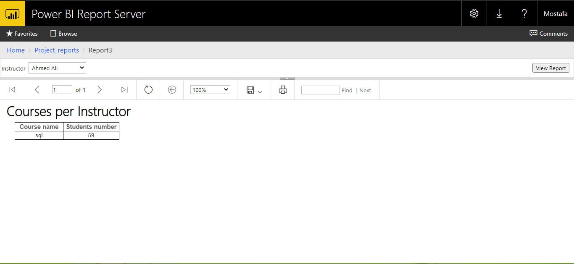
Report 3
Courses that a specific instructor teaches with number of students in it.

Slide 16
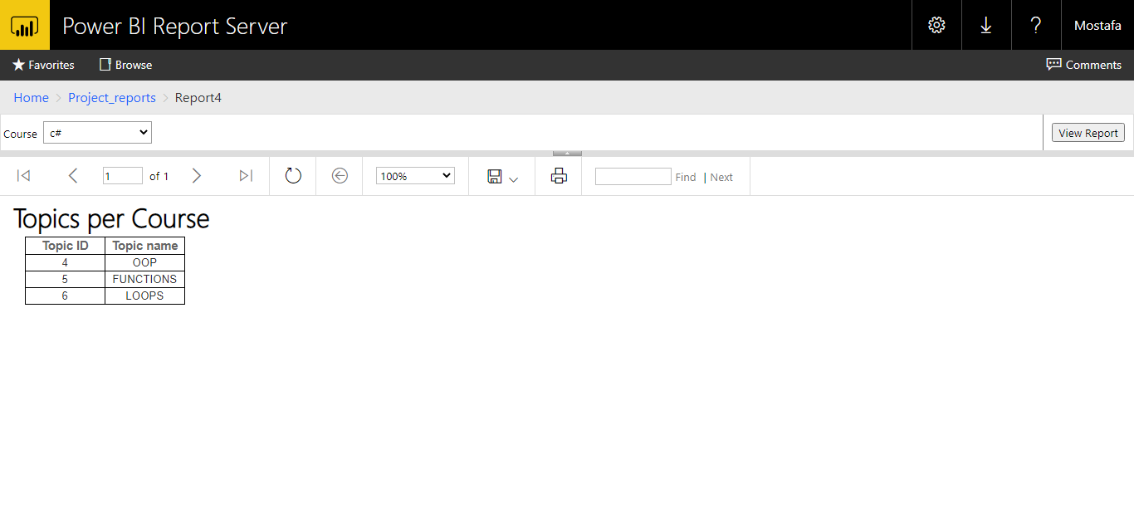
Report 4
Topics of a specific Course.

Slide 17
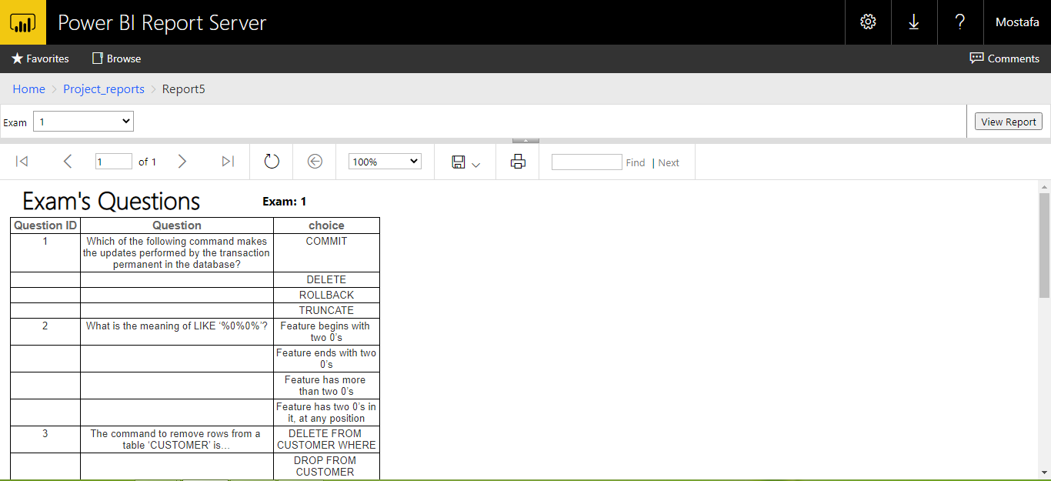
Report 5
Questions of a specific exam.

Slide 18
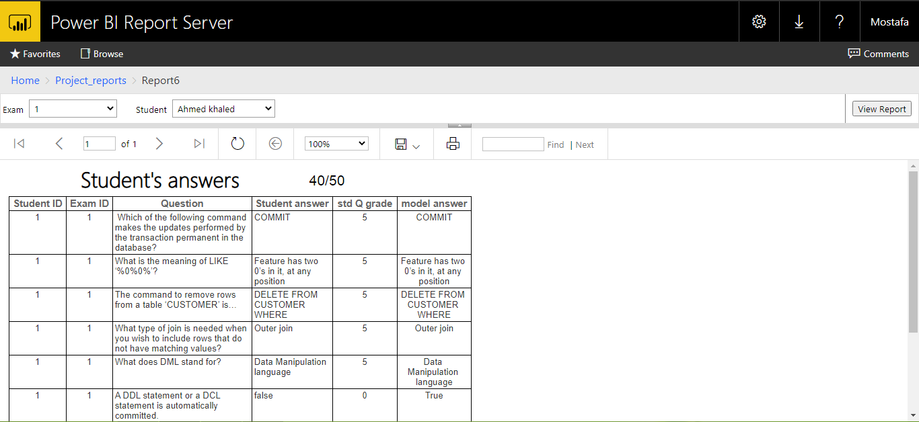
Report 6
Exam question with student answer for specific exam and student

Slide 19
5-Dashboard screenshots

Slide 20
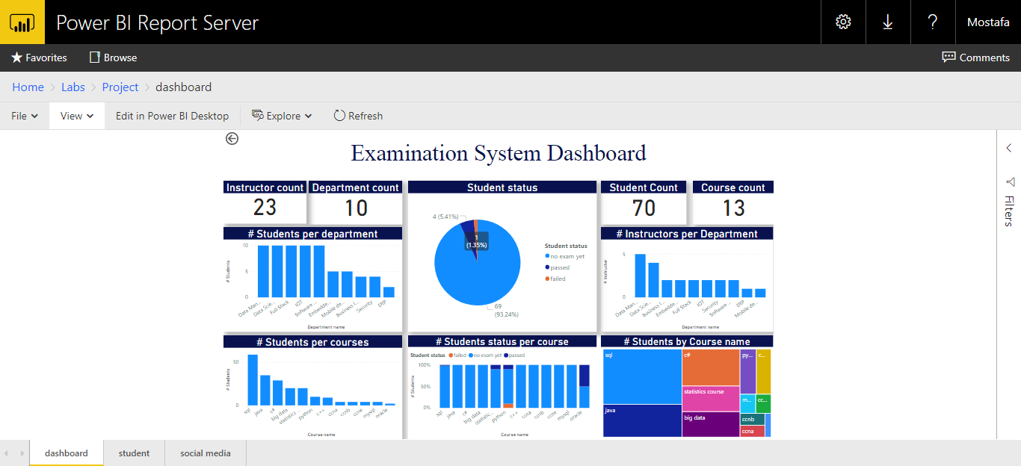
Dashboard

Slide 21
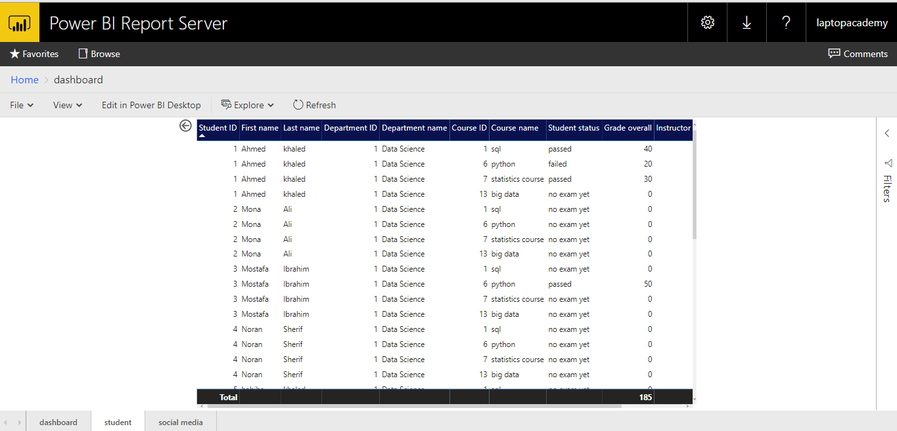
Dashboard Drill-through

Slide 22
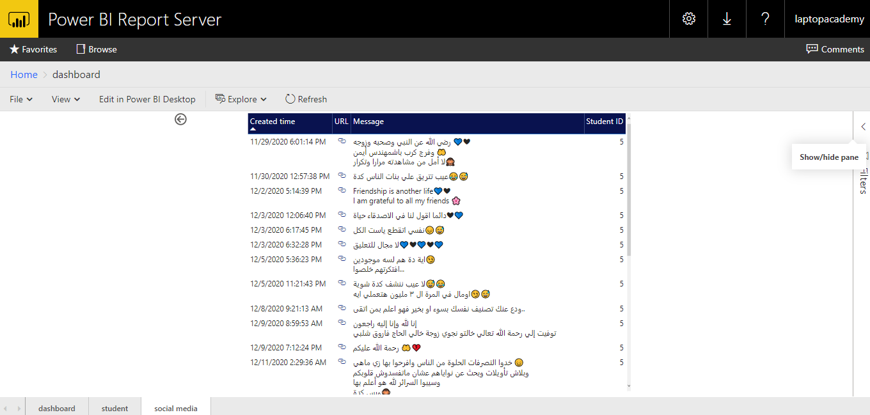
Social Media link

Slide 23
6-Desktop Application

Slide 24
Thank you.

