Slide 1
“Code smell detection using Deep learning”
Name: Mostafa Wagih El Tazy
ID: 142864
Major: Software engineering
Supervisor: Associate Professor. Abeer Hamdy

Slide 2


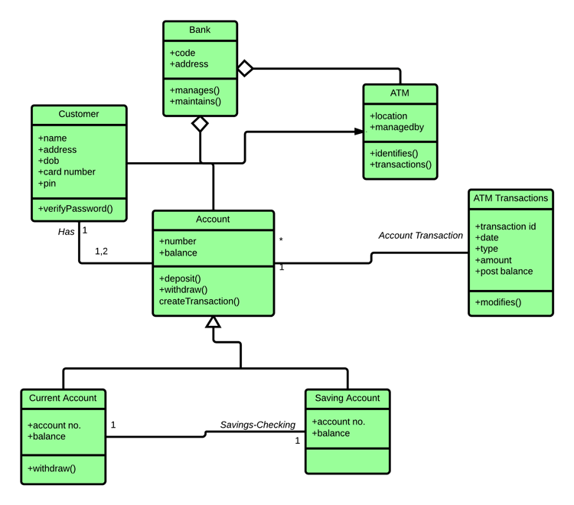
Code smells
Not coding Errors.
Not Software bugs.
They are symptoms of poor design.

Slide 3
Code smells
Code Blocks in the source code of a software that indicates the need for refactoring due to bad design decisions.
Their effect on the software
They do not effect the direct functionality of the code.
They Impact the non-functional quality attributes of the software
By making it :
difficult to comprehend, reform, enhance the source code
Cause bad utilization of resources and large memory consumption
Hence, Increasing the cost and time of refactoring and reworking the software.

Slide 4
Code smells
They are categorized according to the unit of the program they impact being either a class level smell or a method level smell.
Class level
(God Class)
classes that are responsible for the largest amount of the logic in the system.
Characteristics :
It centralizes the intelligence of the system.
god classes usually contain large and complex methods.
Implements several system functionality.
Method Level
(Feature Envy)
are methods that use much more data from other classes than from their own class
Characteristics :
access many foreign attributes from various classes.
access more foreign attributes than local ones.

Slide 5


How TO detect Code Smells
NON Smelly Code
Smelly Code

Slide 6
Object Oriented Metrics
[OOM]
They are quantifiable measures to asses the quality of the software design .
Metrics are a means for :
Attaining more accurate estimations of project Characteristics.
Developing a software system that contains minimal faults.
Examples :
SLOC(OOM): Measures the number of physical Lines of code.
DIT(OOM):Measures the depth of a class in inheritance tree.
NOC(OOM):Measures the Number if children in inheritance tree.
They are used to asses the existence of a certain code smells in the software source code.

Slide 7
Background on code smell detection
Rule Based Approaches
Are rules based on human rules that are invented by engineers and developers that serve as a formally deduced definition that is then used to match a certain type of smell
rule-based approaches maybe considered effective. However, yet may not be very efficient on effort and time management as:
they use more sources of information
requires that the rules are specified in the form of domain-specific language
and this specification process must be undertaken by domain experts, engineers or quality experts.

Slide 8
Background on code smell detection
:Towards a machine learning Approach
Many researchers attempted to use machine learning and data mining techniques on multiple types of code smells.
(Kremier, 2005) Decision Tree Blob and Long Method
(A. Maiga, 2012) Support vector Machine Blob and Spaghetti code.
(Fu, 2015) Evolutionary rules mining Duplicated code and shotgun surgery
Fontana(2016) : A very promising research towards the usage of machine learning
Acquiring the quality corpus dataset for open source software projects
Extracted multiple object oriented matrices from the source code
Used Code smells detection tools and Manual validations to produce a training data set

Slide 9
Background on code smell detection
: Research Benchmark Di Nucci (2018)
Optimized the data set by used in Fontana(2016) by
Feature selection : removed some features (object oriented matrices) that was irrelevant to the definition of the code smells by using gain ratio feature evaluation algorithm and comparing the matrix distribution results using cliff’s delta.
Mixed dataset : in the previous study there were four dataset, one for each code smell with one labor making the classification much simpler for the algorithms, here however they mixed the data of the of two types of the smells of the same type (Class level and Method level).
Technique | Accuracy
Random Forest | 69%
C4.5 | 81%
Naïve Bays | 82%
Note
The adjacent table Contains the results of the machine learning techniques on the GOD CLASS as it’s the scope of our research.

Slide 10
“Code smell detection using Deep learning”
[OOM]

Slide 11
Contribution
Implementing Deep Learning models for detecting “God Class” code smell.
Assess the capacities of the “Textually Extracted Features” in defining the problem
Parametric Study on the Input Parameter to the models being Object Oriented Metrics and Textual Features.
How effective will be the deep learning in the code smell detection if the input features where textually extracted features rather than object-oriented metrics.

Slide 12
How effective will be to use deep learning in the context of code smell detection.
Q1

Slide 13
Q1
How effective will be to use deep learning in the context of code smell detection.
Solution Approach
Acquire “God Class” object oriented metrics.
Develop a Deep convolutional neural network.
Develop a Deep Recurrent neural network.
Metric Features
CNN
Model
RNN
Model

Slide 14
Q1
How effective will be to use deep learning in the context of code smell detection.
Convolutional Network Architecture
Hyper Parameters used:
Epochs=100
Batch size = 20
Optimizer = Adam
Learning rate = {1x10}^(-4)
Loss = Binary Cross entropy
Convolutional Layer
Convolutional Layer
Flatten
Dense(16)
Dropout(0.5)
Dense(1)
Sigmoid
Smelly Code
Non Smelly Code

Slide 15
Q1
How effective will be to use deep learning in the context of code smell detection.
Recurrent Network Architecture
Hyper Parameters used:
Epochs=100
Batch size = 20
Optimizer = Adam
Learning rate = {1x10}^(-4)
Loss = Binary Cross entropy
LSTM
Dropout(0.5)
Dense(16)
Dropout(0.5)
Dense(1)
Sigmoid
Smelly Code
None Smelly Code

Slide 16
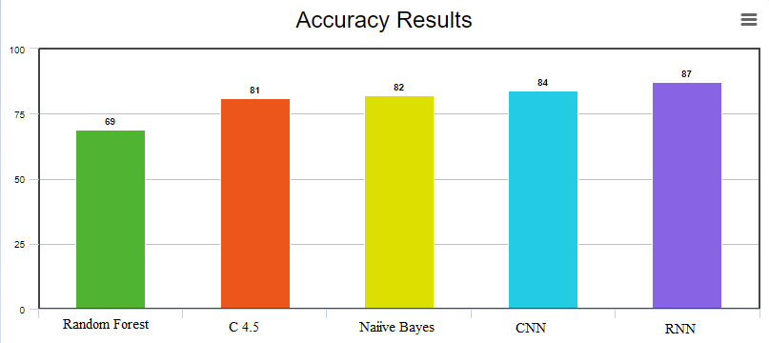
Q1
How effective will be to use deep learning in the context of code smell detection.
Results
The RNN Exceeds all the Models
In Detecting the God Class
Model | Research | Accuracy
Random Forest | (Dario Di Nucci, 2018) | 69%
C 4.5 | (Dario Di Nucci, 2018) | 81%
Naïve Bays | (Dario Di Nucci, 2018) | 82%
CNN | Our Research | 84%
RNN | Our Research | 87%

Slide 17
Is it possible for “Textually extracted features” to Represent the represent the code smell detection problem correctly.
Q2

Slide 18
Q2
Is it possible for “Textually extracted features” to Represent the represent the code smell detection problem correctly.
Solution Approach
We perform a direct comparison between object oriented metrics and textual feature extraction to the same source code.
Download The Qualitas Corpus Distributions.
Rebuild The Data set for the study.
Metric
Features
Qualitas
Corpus
Models
Models
Textual Features

Slide 19
Q2
Is it possible for “Textually extracted features” to Represent the represent the code smell detection problem correctly.
Textual Feature Extraction
Once the source code is acquired it goes through the following process to be ready for modelling
Input
Output
Source code
Tokenization
Parsing
Vectorization
Building
Vocabulary
Sparse Matrix

Slide 20
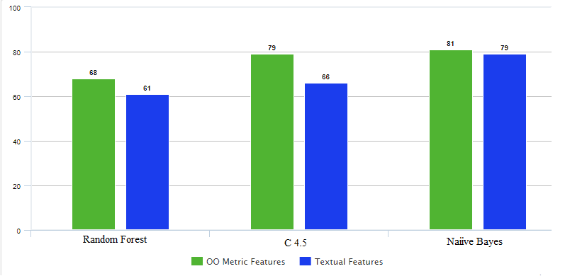
Q2
How effective will be to use deep learning in the context of code smell detection.
Results
The textual Features represent the problem.
The OO-Metrics represent the problem better
than Textual Features in the god class detection.
Model | Object Oriented metrics | Textual Features
Random Forest | 68% | 61%
C 4.5 | 79% | 66%
Naïve Bays | 81% | 79%

Slide 21
How effective will be the deep learning in the code smell detection if the input features where “Textually extracted features”.
Q3

Slide 22
Q3
Is it possible for “Textually extracted features” to Represent the represent the code smell detection problem correctly.
Solution Approach
We Compare between the Metrics and the textual features as input parameter to the models
Metric
Features
Qualitas
Corpus
Models
Models
Textual Features

Slide 23
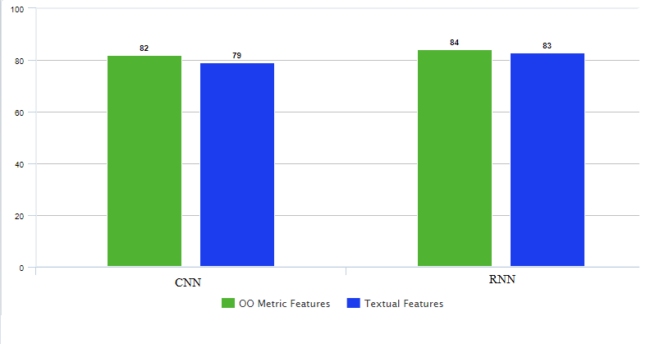
Q3
How effective will be to use deep learning in the context of code smell detection.
Results
The RNN Still Outperforms the CNN.
The OO-Metrics represent the problem better
than Textual Features in the god class detection.
Model | Object Oriented metrics | Textual Features
CNN | 82% | 79%
RNN | 84% | 83%

Slide 24
How could smell detection be leveraged with deep learning using a “Hybrid parameter approach “.
Q4

Slide 25
Q4
Is it possible for “Textually extracted features” to Represent the represent the code smell detection problem correctly.
Solution Approach
We Implement a Hybrid Parameter approach by using both the Metrics and the textual data as input parameter.
We implement the Hybrid approach on the RNN, as it shows the most promise in detecting the God Class
Metric
Features
Hybrid
Features
RNN
Model
Textual Features

Slide 26
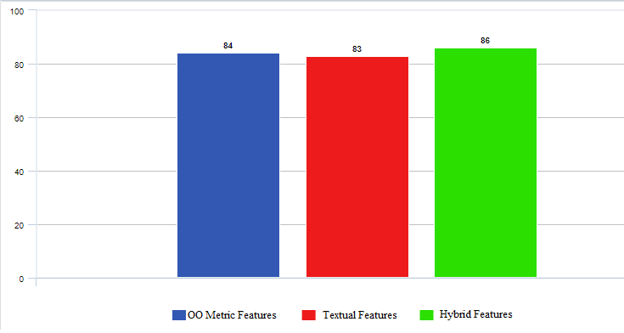
Q4
How effective will be to use deep learning in the context of code smell detection.
Results
The Hybrid approach shows
Improvement Over the other input parameters
Model | Object Oriented metrics | Textual Features | Hybrid Features
RNN | 84% | 83% | 86%

Slide 27
Summary &Conclusion
Compare between deep learning and traditional machine learning, and achieved better results.
Reconstruct a data set of textually extracted features for the study.
Performed a parameter study between the Object oriented metrics and the textually extracted features.
THE BEST model for detecting the god class, is the Recurrent neural network with a hybrid input parameter of both metric and textual features.

Slide 28
Questions !!
Thank you

