Slide 1
When cruise control is activated the vehicle speed is the cruise speed
Automatic acceleration when pre set speed < current speed
Stand by screen
Speed =
SL = stdby
CC= stdby
sL1 : stdby -> sl
sL2 : deac -> sl
Cruise control
deactivate
start
Cruise control button 1st / dec
Vehicle speed > cruise speed
Speed limiter screen
Vehicle speed, limit speed
Options : Speed + / speed –
Speed+ | speed – (stand by )
Main cruise
2ways for cruise control stand by button , brakes
Vehicle speed< cruise speed without brakes
alarm
Vehicle speed > set speed
Cruise control screen
Vehicle speed ,
Options : speed+/ speed-
Speed limiter button 1st time /dec
Speed + (stand by )
Vehicle speed < set speed with brakes
Gas (ALL)
Brakes (ALL)
deactivate
speed limiter
Set Speed+ (C)
Set Speed- (c)
Stand by
Speed limiter (M) ->
Cruise control (M)
System parameters
1-system state (4)
2-speed limiter status(3)
3-cruise control status (3)
4- vehicle speed
Alarm screen
Blink led
Display limit or cruise speed

Slide 2
MCU
io
uart
Display unit
Speed sensor
actuator
uart
io
control switches
uart
io
Switch (gas, brakes,
Alarm unit

Slide 3
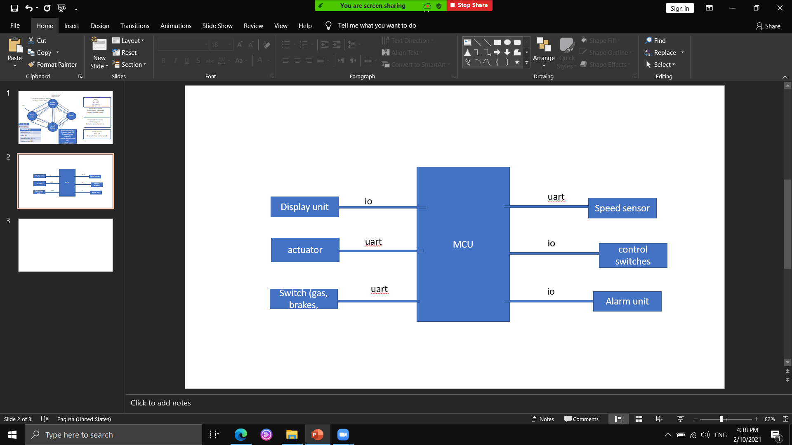
T_alarm
T_display
T_uart
T_speed limit
T_user input
T_Warning
T_cruise control

