Slide 1
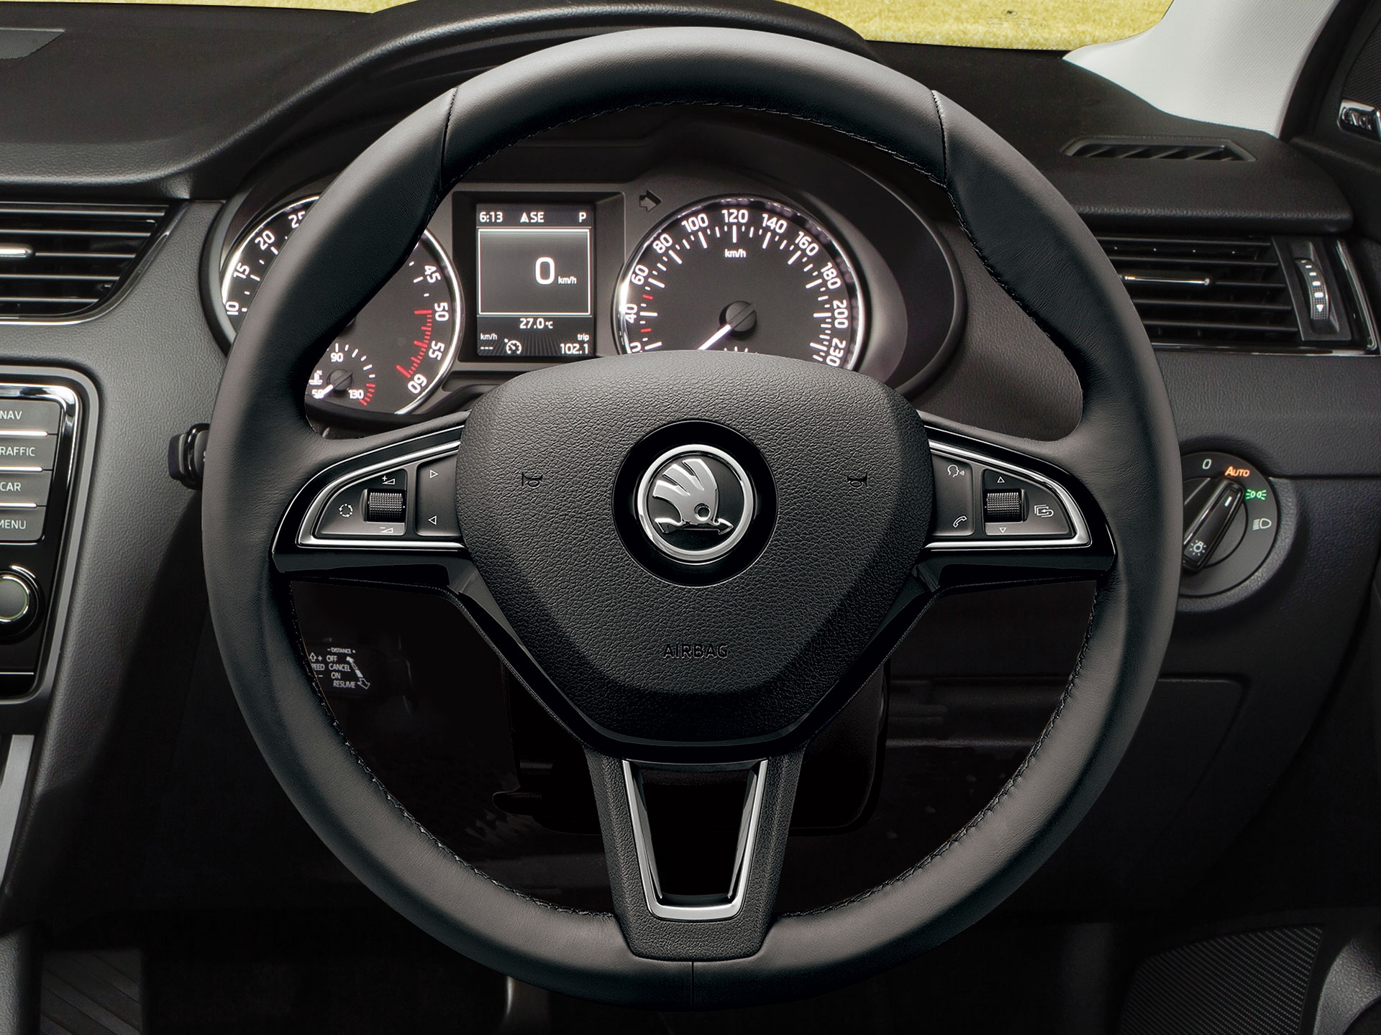
Speed Limit & Cruise Control
RTOS Design
Team Members 1. Mostafa Alaa Abd-Elaal 2. Mostafa Mohamed Abd-Elmegid 3. Ahmed Aly Mohamed

Slide 2
State Design
System parameters
1- System State
2- Speed Limit
3- Cruise Control
4- Speed
5- Limit
6- Gas
7- Break
Cruise control
CC switch(deactivate)
Stand by switch or brakes(CC stand by )
start
Cruise control button 1st / dec
Vehicle speed > cruise speed
Speed+ | speed –
Main cruise
Vehicle speed< cruise speed without brakes
Stand by screen
Speed =
SL = stand BY
CC= Stand By
alarm
Speed limiter button 1st time /deactivate
Vehicle speed > set speed
Speed limiter screen
Vehicle speed, limit speed
Options : Speed + / speed –
Speed + /speed -
deactivate
Vehicle speed < set speed with brakes
speed limiter
Cruise control screen
Vehicle speed ,
Options : speed+/ speed-
Speed Control switches
Stand by button
Set Speed +
Set Speed -
Select Speed limit
Select Cruise control
Normal Driving Switches
brakes
Gas
Alarm screen
Blink led
Display limit or cruise speed

Slide 3
Hardware Design
MCU
io
uart
Display unit
Speed sensor
actuator
uart
io
control switches
uart
io
Switch (gas, brakes,
Alarm unit

Slide 4
Task Design 1
Tasks
5-T_alarm
4-T_speedControl
3-T_userInput
2-T_uart
1-T_display
EG
T_uart
T_display
T_alarm
T_Speed control
BS
T_user input

Slide 5
Task Design 2
Tasks
5-T_alarm
4-T_speedControl
3-T_userInput
2-T_uart
1-T_display
EG
T_Warning
EG: display events
1-E_MainSCR
2-E_SLSCR
3-E_CCSCR
4-E_vehicle speed
5-E-set limit speed
6-E_alarmSCR
EG: Control events
1- E_AlarmON
2- E_Break
3- E_ Gas
T_uart
T_Speed limit
T_display
BS1
T_alarm
BS2
T_user input
T_Cruise control

