Slide 1
Maze Project
Mostafa Hamidifard

Slide 2
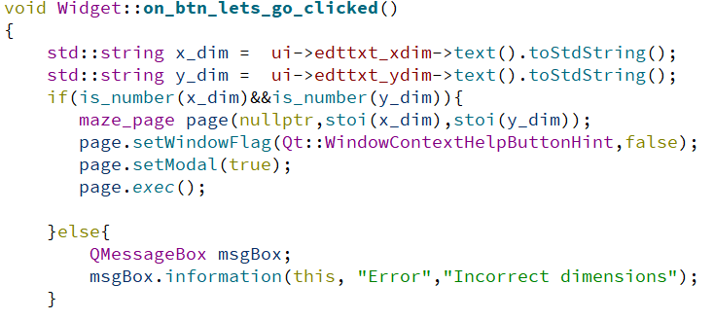
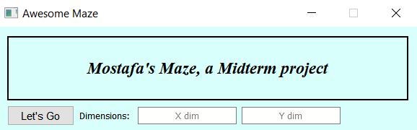
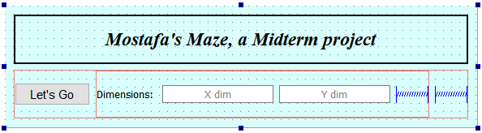
Welcome!

Slide 3
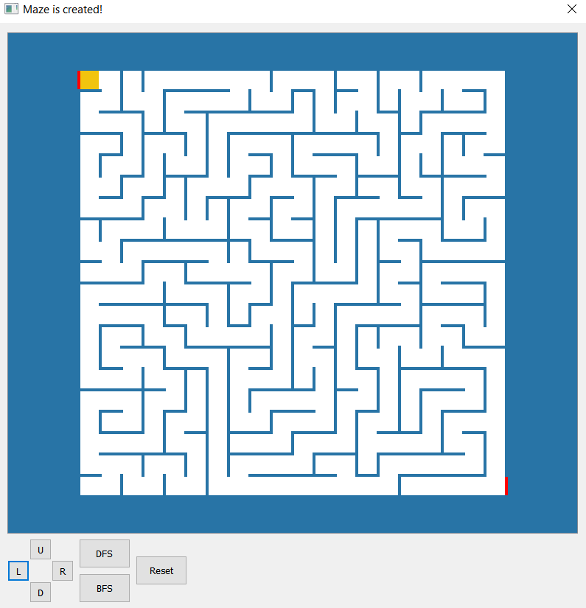
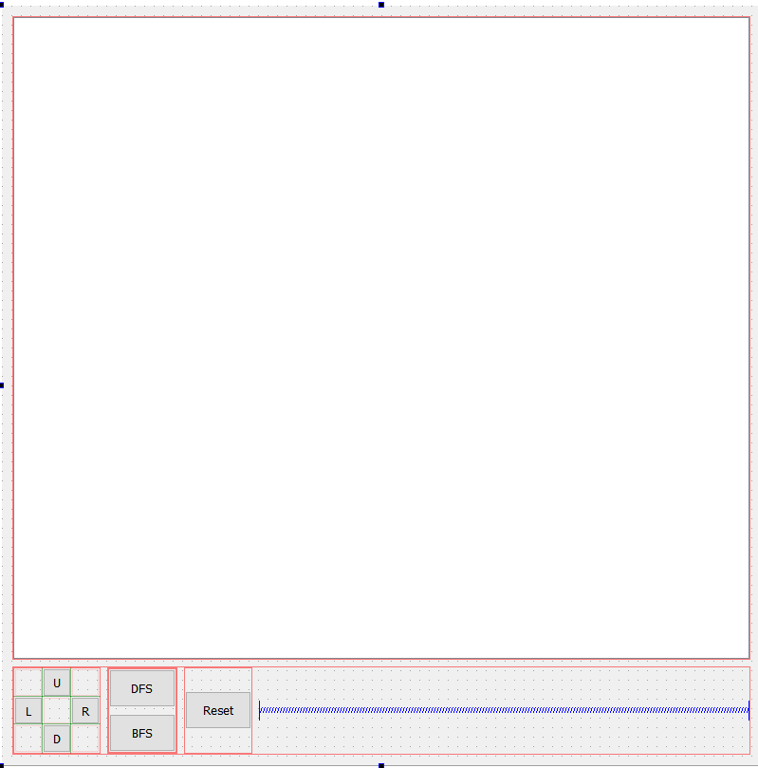
Let’s Create maze page:

Slide 4
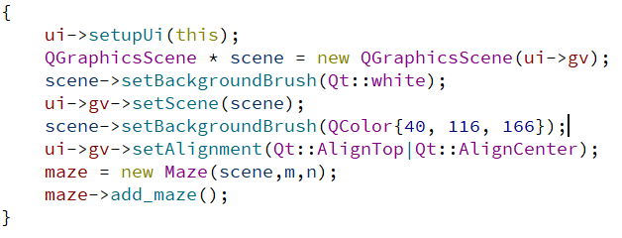
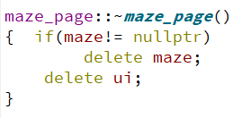
Let’s Create maze page:
Set up the page, Slots and Signals will do the rest
# Why new ?
Don’t forget to delete!

Slide 5
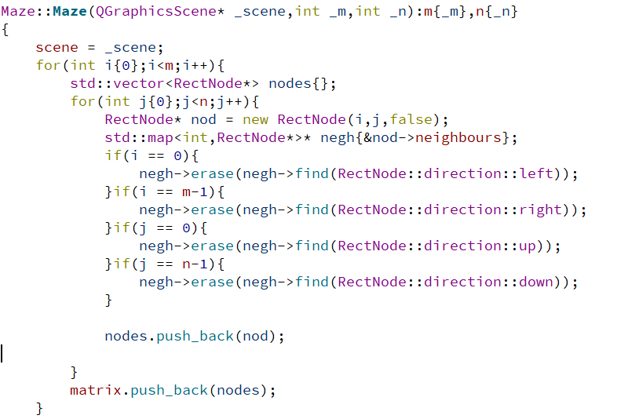
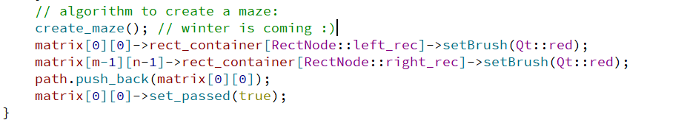
Maze constructor:
Is it the end?
Winter is coming!

Slide 6
Algorithm:
No code showing, just explaining 😎

Slide 7
RectNode class
I know😅
Constructor
Legendary destructor(New issues)
Make_neighbours()
real_neighbour()
Updating Rect colors.
Pass variable

Slide 8
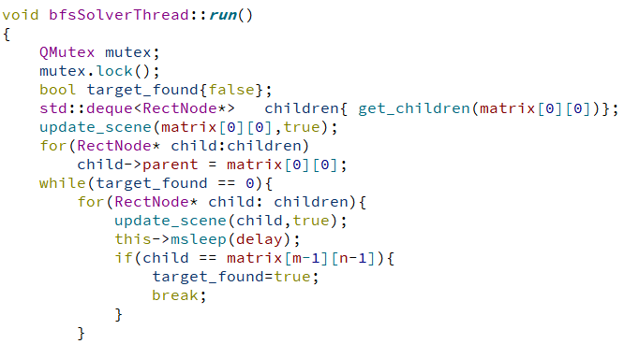
BFS:

Slide 9
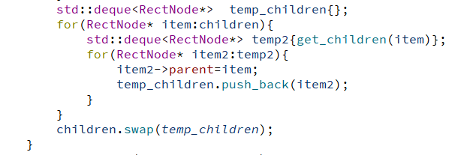
BFS…

Slide 10
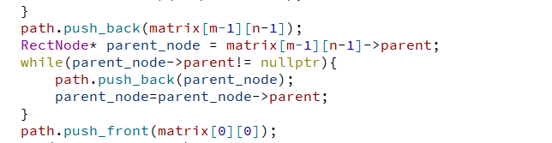
BFS…🥱

Slide 11

DFS:
One Line 😎

Slide 12
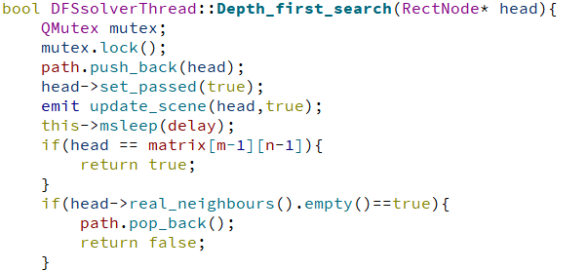
DFS…

Slide 13
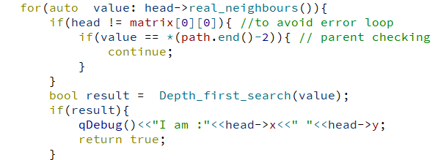
DFS…

Slide 14
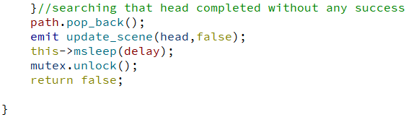
DFS…

Slide 15
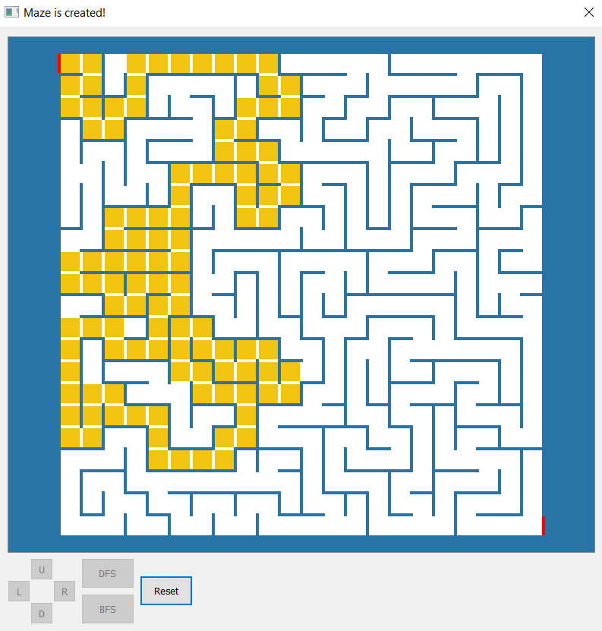
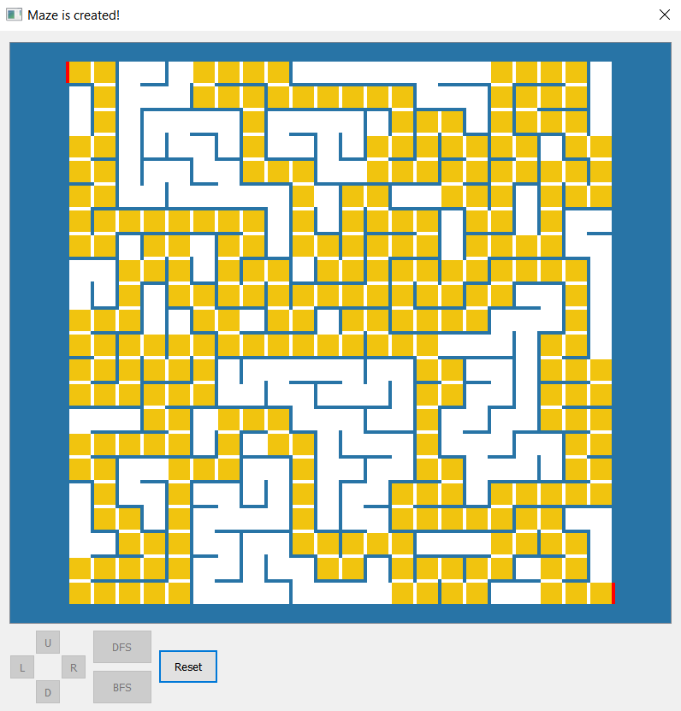
Output

