Slide 1

BGC TRUST UNIVERSITY BANGLADESH
Department of Computer Science and Engineering
Bidirectional Neural Machine Translation Between
Standard Bangla and the Chatgaya Dialect
Using Fine-Tuned mBART-50
Presented by:
Mostafa Al Moin
ID: 220239049
Department of Computer Science and Engineering
Under The Supervision of:
Md. Asaduzzaman
Lecturer
Department of Computer Science and Engineering
Undergraduate Thesis Defense • August 2026

Slide 2









PRESENTATION ROADMAP
Outlines
PHASE 1 — FOUNDATION
01
02
03
Introduction & Background
Problem, Objectives & Research Questions
Research Gap
PHASE 2 — METHODOLOGY
04
05
06
Methodology & Dataset Construction
Data Augmentation & Model Architecture
Experiments, Training & Evaluation
PHASE 3 — OUTCOMES
07
08
09
Results & Human Evaluation
System Deployment & Demo
Contributions, Limitations & Conclusion
Bidirectional NMT: Standard Bangla ↔ Chatgaya
2

Slide 3
01 — SETTING THE STAGE
Introduction
From Rules to Multilingual Transformers
Evolution of Machine Translation
Neural Machine Translation (NMT) has transformed multilingual communication, driven by Transformer architectures and multilingual pre-trained models such as mBART-50.
Yet regional dialects with scarce parallel data — including Bangladesh's Chatgaya (Chittagonian) dialect — remain largely underserved by modern translation systems.
This research fine-tunes mBART-50 to build a bidirectional Standard Bangla ↔ Chatgaya translation system — evaluated with automatic metrics and native-speaker judgment, and deployed as a working mobile prototype.
Rule-Based MT
Statistical MT
Neural MT (Seq2Seq + Attention)
Transformer
Multilingual Models (mBART-50)
Bidirectional NMT: Standard Bangla ↔ Chatgaya
3

Slide 4





01 — CONTEXT
Research Background
Bangla & Its Dialects
Low-Resource Gap
mBART-50 Advantage
Bidirectional Focus
Standard Bangla is spoken worldwide; the Chatgaya (Chittagonian) dialect is one of its most linguistically distinct regional varieties.
Publicly available parallel corpora and translation systems for Standard Bangla–Chatgaya remain extremely limited.
Multilingual pre-training lets mBART-50 reach strong performance with comparatively few parallel sentence pairs.
This study builds independent models for both Bangla→Chatgaya and Chatgaya→Bangla translation directions.
OUR MOTIVATION
Preserve and digitize the Chatgaya dialect while advancing low-resource NMT research for Bangla regional language technologies.
Bidirectional NMT: Standard Bangla ↔ Chatgaya
4

Slide 5
02 — WHY THIS RESEARCH
Problem Statement
The Core Problem
0
Public NMT systems for Bangla–Chatgaya prior to this work
Millions speak the Chatgaya dialect daily, yet no sufficient parallel corpora or NMT systems exist for Standard Bangla ↔ Chatgaya translation.
2,020
Manually curated parallel sentence pairs needed & built
Vocabulary, pronunciation & sentence-structure differences make translation harder than standard language pairs
mBART-50's effectiveness for this pair is unexplored, due to a lack of suitable datasets
Little research compares canonical vs. augmented dataset strategies for dialect translation
2
Translation directions requiring dedicated models
Bidirectional NMT: Standard Bangla ↔ Chatgaya
5

Slide 6





02 — GOALS OF THE STUDY
Research Objectives
01
Construct a manually curated Standard Bangla–Chatgaya parallel corpus
02
Develop separate models for Bangla→Chatgaya and Chatgaya→Bangla translation
03
Investigate canonical vs. augmented datasets for low-resource dialect translation
04
Evaluate translation quality via automatic metrics and human evaluation
05
Build a Flutter + FastAPI prototype for real-time bidirectional translation
Bidirectional NMT: Standard Bangla ↔ Chatgaya
6

Slide 7
02 — WHAT WE SET OUT TO ANSWER
Research Questions
RQ1
How effectively can a bidirectional NMT system be built between Standard Bangla and Chatgaya using mBART-50?
RQ2
How effective is a manually curated parallel corpus for this low-resource dialect scenario?
RQ3
What is the impact of lexicon-based data augmentation on both translation directions?
RQ4
How do standard vs. augmented models compare on BLEU and chrF?
RQ5
What do native Chatgaya speakers perceive about translation quality & naturalness?
RQ6
Can the models be integrated into a practical mobile application?
Bidirectional NMT: Standard Bangla ↔ Chatgaya
7

Slide 8
03 — POSITIONING THIS WORK
Research Gap
Prior work has focused on rule-based conversion, benchmark datasets, or multilingual comparisons — but dedicated bidirectional NMT for Chatgaya using a manually verified corpus remains largely unexplored.
Hossain et al. (2022)
ChatgaiyyaAlap (2025)
Vashantor (2025)
Kothon (2026)
Rule-based bidirectional conversion — limited scalability & generalization
4,012-pair public dataset — social-media sourced, limited diversity
32,500-pair multilingual benchmark across 5 dialects — not Chatgaya-focused NMT
8,000 Chittagonian pairs — dataset-centric, not a fine-tuned bidirectional system
Bidirectional NMT: Standard Bangla ↔ Chatgaya
8

Slide 9
04 — METHODOLOGY AT A GLANCE
Overall Research Workflow
Phase 1
Phase 3
Phase 5
Resource Development
Augmentation
Evaluation
Canonical dataset, lexicon, native-speaker survey
Lexicon-based training-set augmentation
BLEU, chrF, human evaluation
1
2
3
4
5
6
Phase 2
Phase 4
Phase 6
Dataset Preparation
Model Fine-Tuning
Deployment
Bidirectional datasets, 80:10:10 split
4 mBART-50 experiments
FastAPI + Flutter prototype
Result: 2,020-pair canonical corpus → 4 fine-tuned mBART-50 models → deployed translation app
Bidirectional NMT: Standard Bangla ↔ Chatgaya
9

Slide 10
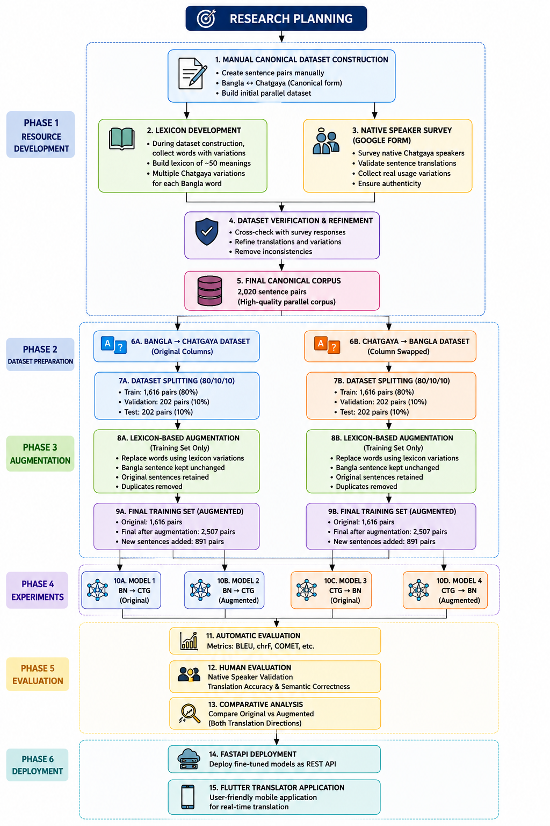
04 — METHODOLOGY AT A GLANCE
Workflow Diagram
Bidirectional NMT: Standard Bangla ↔ Chatgaya
10

Slide 11



04 — BUILDING THE CORPUS
Dataset Construction
Canonical Dataset
Lexicon
2,020 manually created Bangla–Chatgaya sentence pairs across 10 balanced semantic categories (greetings, daily life, family, travel, etc.)
49 semantic entries capturing multiple Chatgaya lexical variants for the same Bangla word, drawn from 5 Chattogram regions
Native Speaker Validation
Dataset Verification
2 domain-specific Google Form surveys (Eating & Food; Work & Shopping) — 44 total responses from native speakers
Manual review + automated cleaning; 20 pairs added to cover under-represented words — corpus grown from 2,000 to 2,020 pairs
Bidirectional NMT: Standard Bangla ↔ Chatgaya
11

Slide 12
05 — EXPANDING TRAINING DIVERSITY
Lexicon-Based Data Augmentation
Original
Training Set
(1,616 pairs)
→
Identify Chatgaya
Words via Lexicon
→
Replace with
Alternative Variants
→
Merge + Remove
Duplicates
→
Augmented
Training Set
(2,507 pairs)
1,616
2,596
89
+891
Original training pairs
Newly generated pairs
Duplicates removed
Net new pairs added
Applied exclusively to the training set — validation & test sets remain untouched to avoid data leakage.
Bidirectional NMT: Standard Bangla ↔ Chatgaya
12

Slide 13






05 — MODEL DESIGN
Fine-Tuned mBART-50 Architecture
Standard Bangla / Chatgaya
Source Sentence
Subword tokenization
mBART-50 Tokenizer
Contextual representations
Fine-Tuning Setup
Pretrained Encoder
Same mBART-50 architecture
Original vs. augmented datasets
BN→CTG and CTG→BN directions
4 independent fine-tuned models
Autoregressive generation
Pretrained Decoder
Chatgaya / Standard Bangla
Generated Translation
Bidirectional NMT: Standard Bangla ↔ Chatgaya
13

Slide 14
06 — FOUR CONTROLLED EXPERIMENTS
Experimental Design
M1
M2
M3
M4
Standard Bangla → Chatgaya
Standard Bangla → Chatgaya
Chatgaya → Standard Bangla
Chatgaya → Standard Bangla
Original Dataset
Augmented Dataset
Original Dataset
Augmented Dataset
Baseline model
Assess augmentation impact
Baseline model
Assess augmentation impact
All models share the same pretrained mBART-50 architecture, tokenizer, and training pipeline — only translation direction and training dataset vary.
Bidirectional NMT: Standard Bangla ↔ Chatgaya
14

Slide 15
06 — FINE-TUNING SETUP
Training Configuration
Pretrained Model
facebook/mbart-large-50
Batch Size (Train / Val)
4 / 4
Framework
Hugging Face Seq2SeqTrainer
Gradient Accumulation
2 steps
Environment
Google Colab
Evaluation Strategy
After every epoch
Epochs
10
Model Selection
Lowest validation loss
Learning Rate
5 × 10⁻⁵
Random Seed
42
Bidirectional NMT: Standard Bangla ↔ Chatgaya
15

Slide 16

06 — MEASURING TRANSLATION QUALITY
Evaluation Metrics
BLEU
chrF
Human Evaluation
N-gram overlap between generated and reference translations — computed via sacreBLEU on the held-out test set.
Character-level F-score, particularly suitable for morphologically rich, low-resource languages like Chatgaya.
4–5 native Chatgaya speakers manually assessed translation accuracy and semantic correctness.
Bidirectional NMT: Standard Bangla ↔ Chatgaya
16

Slide 17
07 — AUTOMATIC EVALUATION
Experimental Results
Standard Bangla → Chatgaya
Chatgaya → Standard Bangla
Augmentation improved both metrics for Bangla→Chatgaya; the reverse direction showed mixed, near-parity results.
Bidirectional NMT: Standard Bangla ↔ Chatgaya
17

Slide 18
07 — BEST-PERFORMING MODEL
Comparative Analysis
Change in Score with Augmentation
BEST MODEL
Direction | Δ BLEU | Δ chrF
Standard Bangla → Chatgaya | +2.67 | +2.60
Chatgaya → Standard Bangla | −0.53 | +0.28
M2 — Standard Bangla → Chatgaya (Augmented)
45.06
72.11
Overall Observation
Lexicon-based augmentation is more beneficial for generating dialectal (Chatgaya) output than for translating dialect into standard language, where performance remained stable regardless of augmentation.
BLEU
chrF
Highest BLEU and chrF improvement of all four experiments — selected for deployment alongside CTG→BN augmented model.
Bidirectional NMT: Standard Bangla ↔ Chatgaya
18

Slide 19


07 — NATIVE SPEAKER JUDGMENT
Human Evaluation Results
Best BN→CTG augmented outputs judged closer to reference translations and more natural dialectal phrasing
Evaluation Setup
Reviewers
4–5 native Chatgaya speakers
Method
Manual comparison vs. reference translations
CTG→BN models (original & augmented) both produced accurate, semantically consistent Standard Bangla
Criteria
Translation accuracy & semantic correctness
Reviewers flagged occasional lexical-choice and sentence-construction issues for further refinement
Purpose
Verify meaning preservation, flag unnatural output
Bidirectional NMT: Standard Bangla ↔ Chatgaya
19

Slide 20
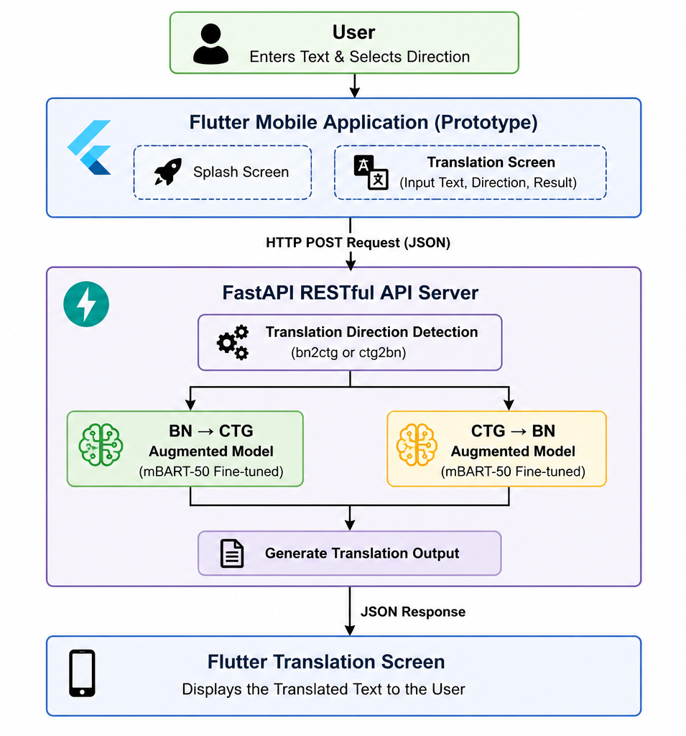
08 — FROM MODEL TO APPLICATION
Overall System Architecture
Bidirectional NMT: Standard Bangla ↔ Chatgaya
20

Slide 21
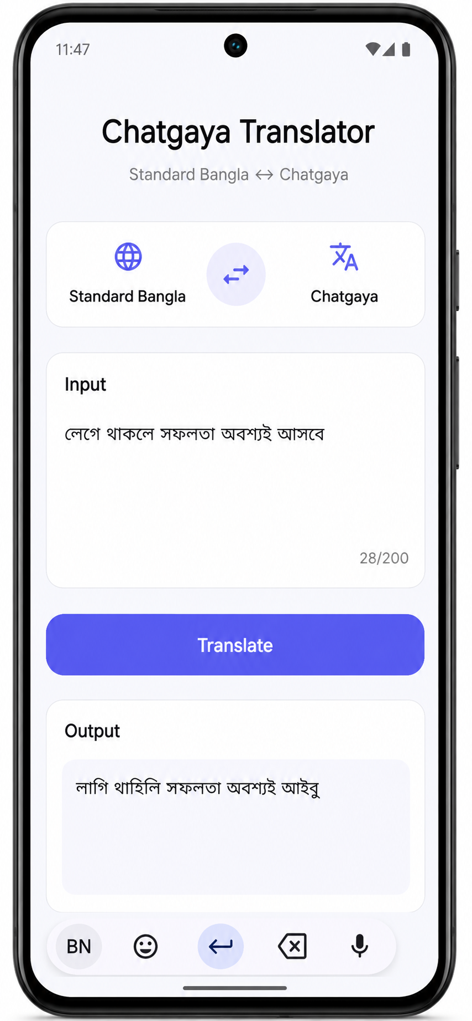



08 — CHATGAYA TRANSLATOR APP
Application Demonstration
Real-Time Inference
FastAPI backend generates translations with live latency reporting for monitoring.
Bidirectional Toggle
Single interface switches between Bangla→Chatgaya and Chatgaya→Bangla instantly.
Cached Model Serving
Previously loaded mBART-50 models are cached in memory to reduce response time.
Bidirectional NMT: Standard Bangla ↔ Chatgaya
21

Slide 22



09 — WHAT THIS WORK DELIVERS
Research Contributions
Curated Parallel Corpus
Augmentation Evaluation
Fine-Tuned Bidirectional Models
Working Prototype
2,020 manually verified Bangla–Chatgaya sentence pairs with a 49-entry lexicon
Empirical analysis of lexicon-based data augmentation for low-resource dialect NMT
Four mBART-50 models spanning both translation directions
FastAPI + Flutter mobile application for real-time translation
Bidirectional NMT: Standard Bangla ↔ Chatgaya
22

Slide 23

09 — HONEST BOUNDARIES
Limitations
Corpus scale is modest compared to large-scale NMT training sets, which may limit generalization
Scope is limited to the Chatgaya dialect only — other Bangla regional dialects were not evaluated
Prototype supports sentence-level text translation only — no speech input, TTS, or offline mode
Bidirectional NMT: Standard Bangla ↔ Chatgaya
23

Slide 24

09 — WHERE THIS CAN GO NEXT
Future Enhancement
Expand the parallel corpus with more diverse, native-speaker-sourced sentence pairs
Explore advanced multilingual models and parameter-efficient fine-tuning techniques
Add speech-to-text input and text-to-speech output for accessibility
Extend the framework to other Bangla regional dialects
Deploy the translation service on a scalable cloud platform
Bidirectional NMT: Standard Bangla ↔ Chatgaya
24

Slide 25
BRINGING IT TOGETHER
Research Summary
Built a manually curated, native-speaker-validated Bangla–Chatgaya parallel corpus (2,020 pairs)
Fine-tuned 4 bidirectional mBART-50 models comparing original vs. augmented training data
Augmentation improved BLEU (+2.67) & chrF (+2.60) for Standard Bangla → Chatgaya translation
Deployed a working FastAPI + Flutter mobile prototype for real-time bidirectional translation
Bidirectional NMT: Standard Bangla ↔ Chatgaya
25

Slide 26
Thank You
Questions?
Mostafa Al Moin
ID: 220239049 • BGC Trust University Bangladesh
Supervised by Md. Asaduzzaman

