Slide 1
JS Unit Testing
Eng / Ryhab Farouq

Slide 2
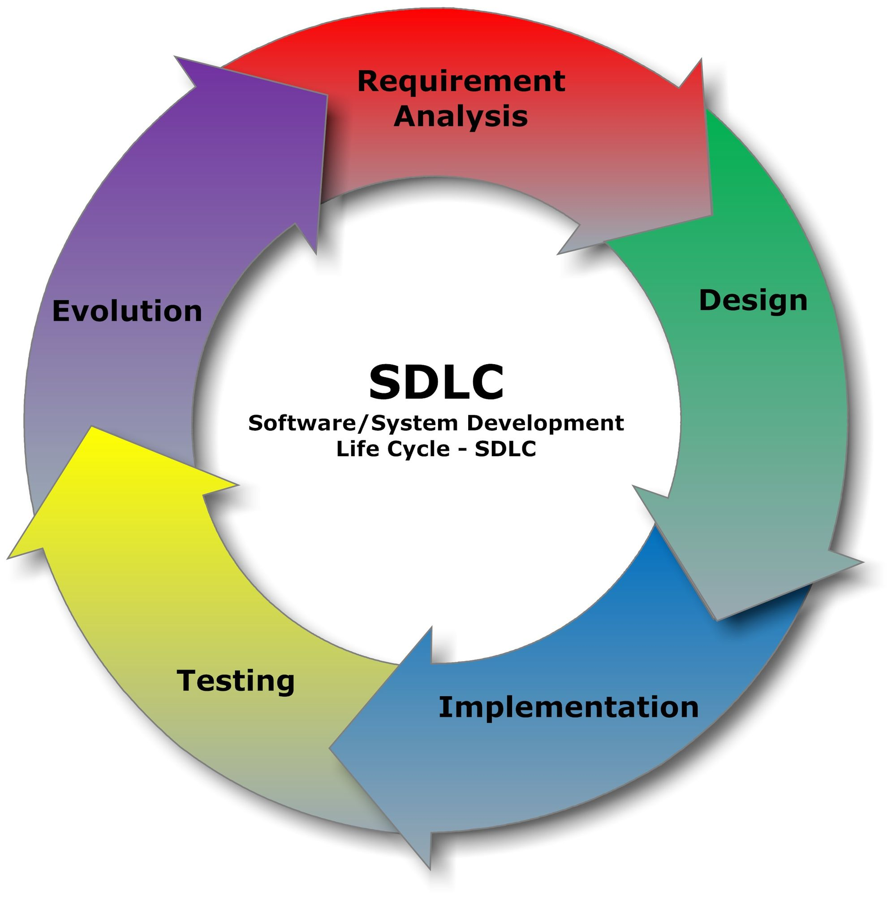

Slide 3
What is Unit-Testing

Slide 4
Why is Software Testing Important?
Testing is important as it uncovers a defect before it is delivered to the customer ensuring the quality of software.
So that the defects or bugs can be identified in the early stages of development; as later the stage in which bug is identified, more is the cost to rectify it.

Slide 5
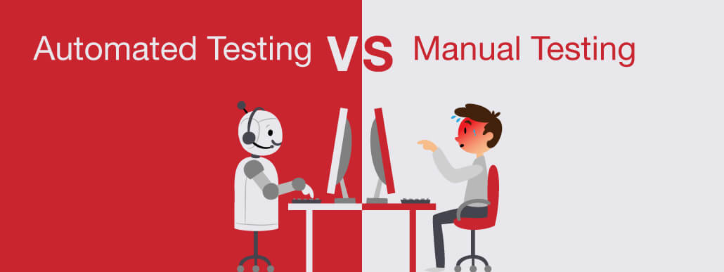

Slide 6
Who does Testing?
In the IT industry, large companies have a team with responsibilities to evaluate the developed software in context of the given requirements
developers also conduct testing which is called Unit Testing.
the following professionals are involved in testing a system within their respective capacities −
Software Tester
Software Developer
Project Lead/Manager
End User

Slide 7
What is Software Testing Life Cycle (STLC)?
SOFTWARE TESTING LIFE CYCLE(STLC) is a sequence of specific activities conducted during the testing process to ensure software quality goals are met
It consists of a series of activities carried out methodologically to help certify your software product

Slide 8
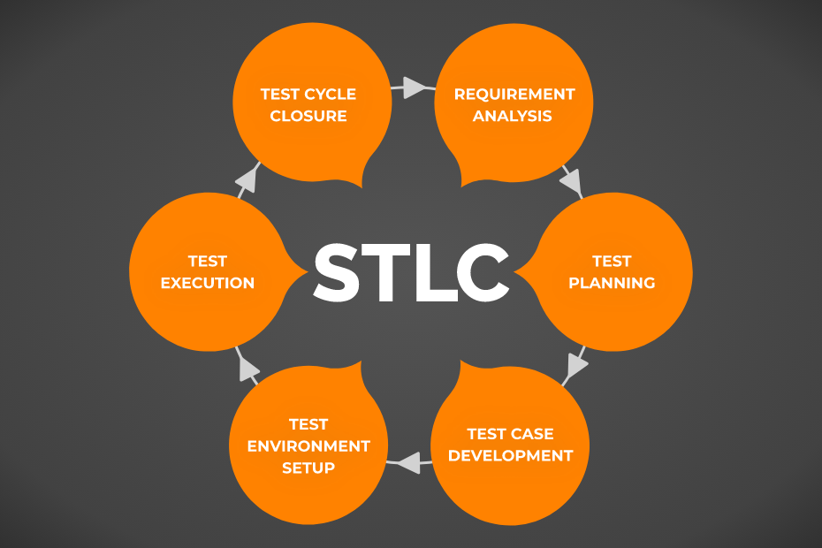

Slide 9
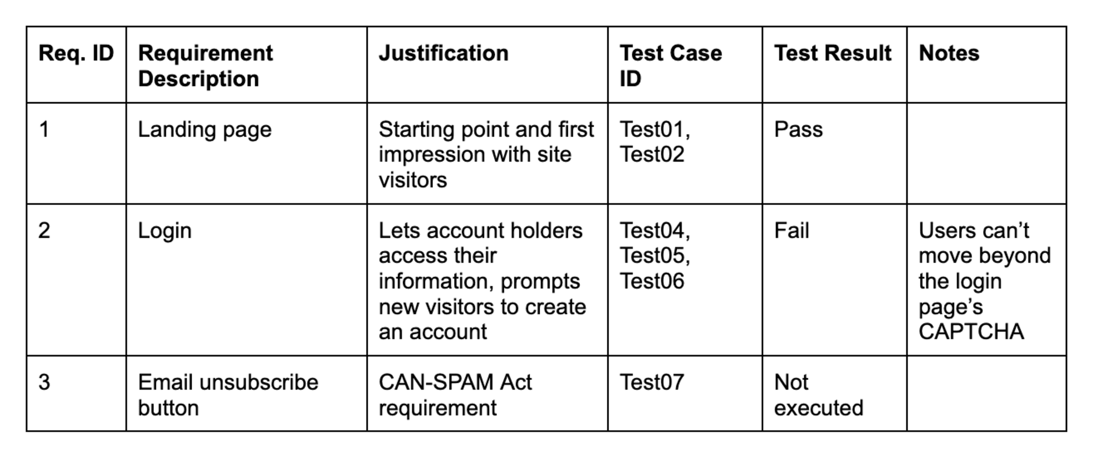

Slide 10
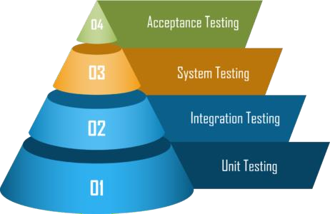
Different Levels of Testing

Slide 11
