Slide 1



VUEJS
Eng / Ryhab Farouq

Slide 2

Directives
Methods
Event Handling
Form Handling
LECTURE ONE
Modifiers
Computed Properties
Watchers
Components

Slide 3

SOME QUICK CONSIDERATIONS BEFORE WE START...
FRONTEND FRAMEWORKS AND LIBRARIES

Slide 4
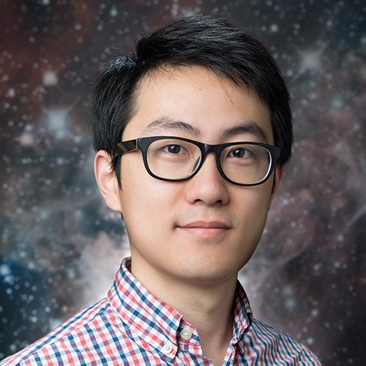
SOME QUICK CONSIDERATIONS BEFORE WE START...
HISTORY OF VUEJS
Vue.Js was created by Evan You. He worked at Google with Angular projects. He extracts the part that we really liked in Angular and builds something really lightweight. The first source code was released in July 2013 and Vue.Js was released in February 2014.

Slide 5

SOME QUICK CONSIDERATIONS BEFORE WE START...
WHY VUEJS ?
Vue is approachable
Vue is versatile
Vue is performance
Familiar with html , css and javascript
Create powerful single page applications
Measures just 20KB minified and gzipped at runtime

Slide 6
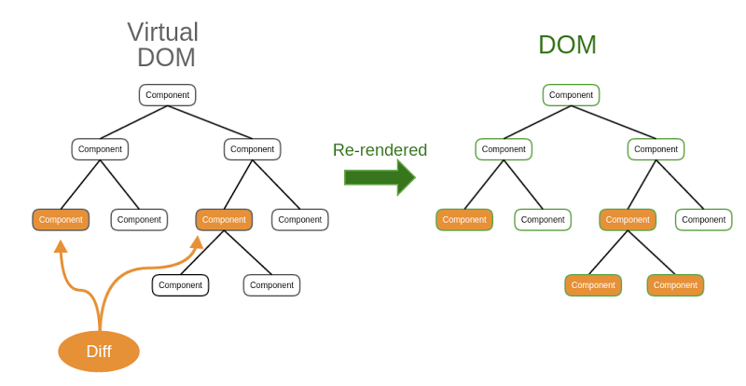
SOME QUICK CONSIDERATIONS BEFORE WE START...
VUEJS AND VIRTUAL DOM

Slide 7
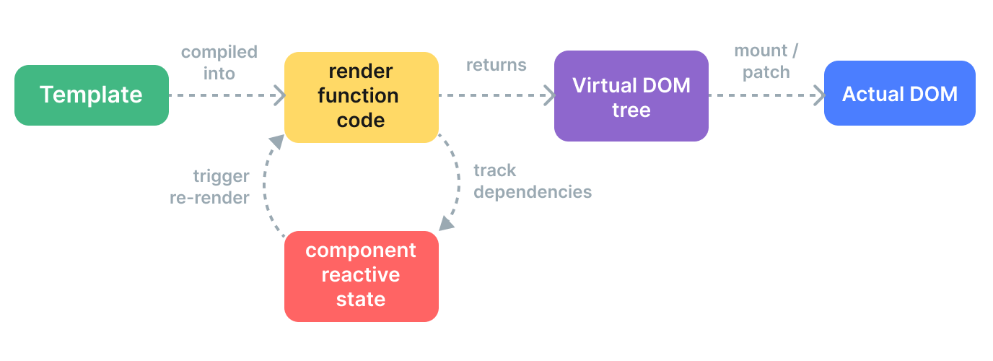
SOME QUICK CONSIDERATIONS BEFORE WE START...
RENDERING MECHANISM

Slide 8

SOME QUICK CONSIDERATIONS BEFORE WE START...
INSTALLATION
CDN
<script src=http://unpkg.com/vue@next></script>
npm install vue@next
NPM
npm install –g @vue/cli
vue create <project-name>
CLI
VITE
npm create vite@latest my-vue-app --template vue

Slide 9
DIFFERENCE BETWEEN PRIMITIVE AND OBJECT DATATYPES
DIRECTIVES IN VUEJS
Special token in the markup that tells the library to do something to a DOM element .
V-text
V-html
V-bind
V-once
V-pre
V-if V-else-if V-else
V-show
V-for
V-model

Slide 10
DIFFERENCE BETWEEN PRIMITIVE AND OBJECT DATATYPES
MODIFIERS IN VUEJS
A suffix you can add to either the v-on directive or the v-model directive to add some functionality inline within the template .
.trim
.number
.lazy
.prevent

Slide 11
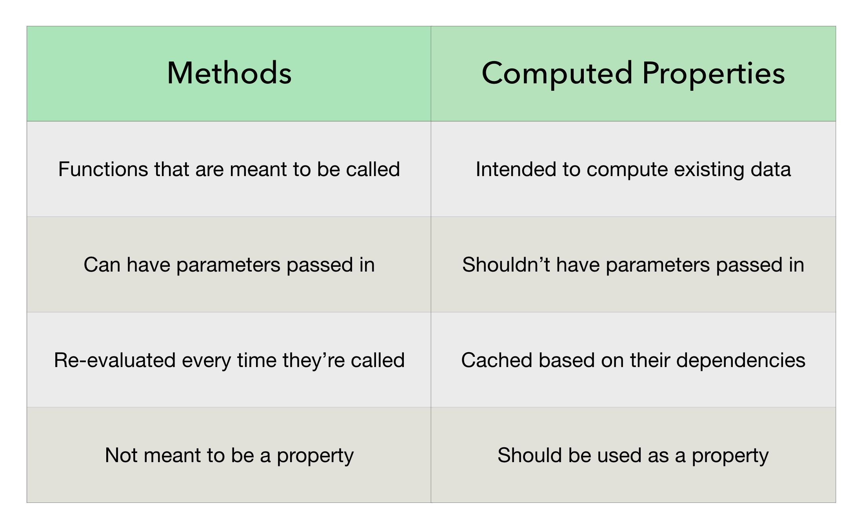
SOME QUICK CONSIDERATIONS BEFORE WE START...
METHODS VS COMPUTED PROPERTIES

Slide 12

SOME QUICK CONSIDERATIONS BEFORE WE START...
COMPUTED PROPERTIES VS WATCHERS
Use Computed Properties
When you need to reduce the length of a variable
Use Watchers
You have to check if a property has changed to a favorable value to know if you’re ready to perform an action

Slide 13
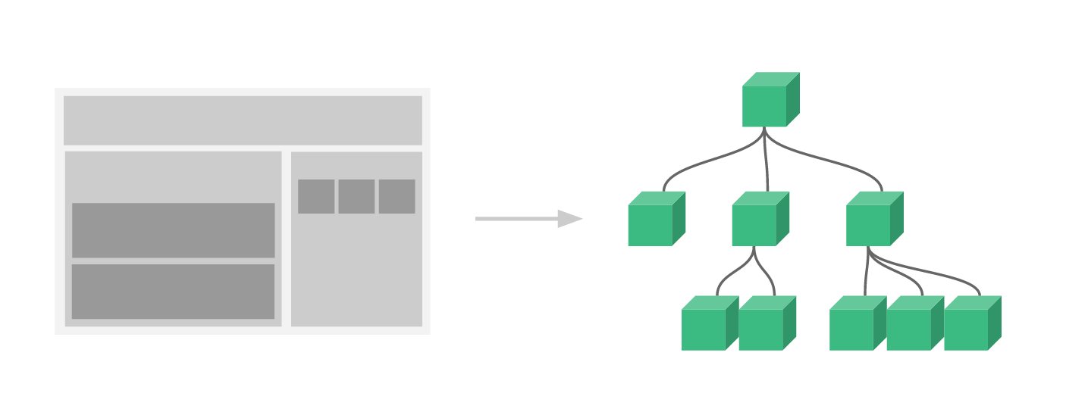
SOME QUICK CONSIDERATIONS BEFORE WE START...
COMPONENTS IN VUEJS

Slide 14
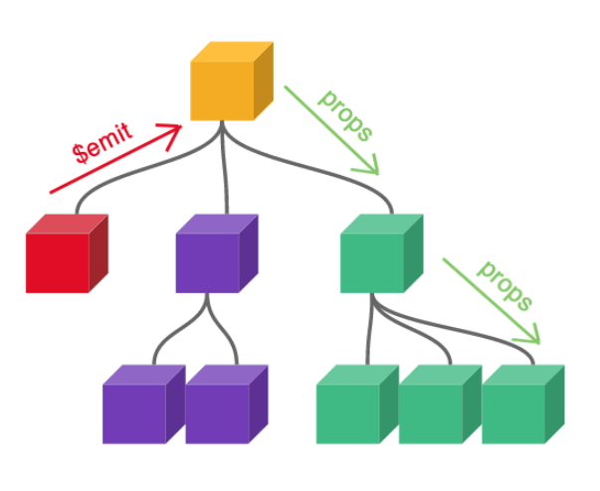
SOME QUICK CONSIDERATIONS BEFORE WE START...
PASSING DATA FROM PARENT TO DIRECT CHILD

Slide 15
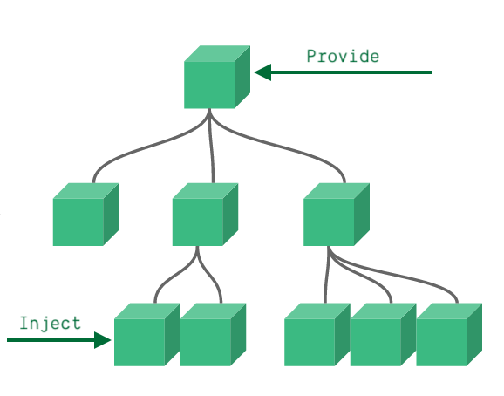
SOME QUICK CONSIDERATIONS BEFORE WE START...
PASSING DATA FROM PARENT TO INDIRECT CHILD

Slide 16
SOME QUICK CONSIDERATIONS BEFORE WE START...
TASK
Create a form to take data of users and admins in parent component
Display the data from child components related to whether the role is user or admin
Emit delete event from child components to parent to delete user or admin
Bonus enable user to change the theme color

Slide 17
SOME QUICK CONSIDERATIONS BEFORE WE START...
REPORT
Immediate and deep in watchers
Component instances in vuejs
Event Modifiers stop , self , capture , passive

Slide 18
SOME QUICK CONSIDERATIONS BEFORE WE START...
EXTENSIONS
Vue VSCode Snippets ‘ sarah.drasner ’
Vetur

