Slide 1
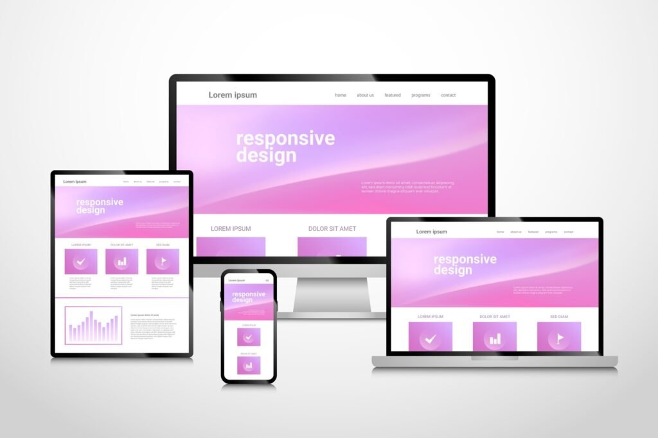
Responsive Web Design
Eng/Ryhab farouq

Slide 2
Grid System

Slide 3
Grid System CSS
Two dimensional layout model .
CSS Grid will allow you to manage layout according to both columns and rows.
Flexbox, by comparison, is really just meant for columns (1-D, if you will). Using CSS Grid, designers will be able to achieve layouts that were downright difficult before. In fact, some of these things were on our wish lists since the days of table-based layouts.

Slide 4
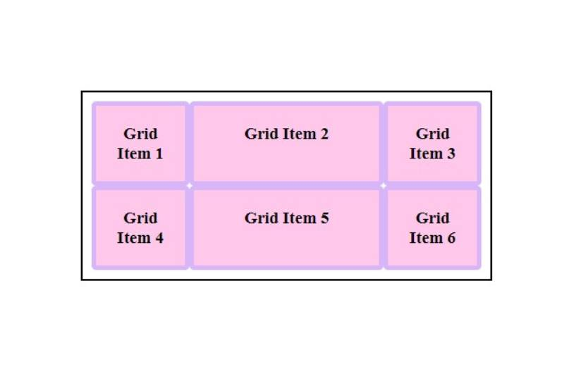
2-D Layout

Slide 5
Terminology
Grid container
Grid items
<div class=‘container’>
<div> item 1 </div>
<div> item 2 </div>
<div> item 3 </div>
</div>

Slide 6
Two Ways to implement Grid in CSS
Way_one
Grid-template-columns
Grid-template-rows
Grid-column : start/end
Grid-row : start/end

Slide 7
Two Ways to implement Grid in CSS
Way_two
Grid-template-areas
Grid-area

Slide 8
Grid Container Properties
Justify-Content
Justify-Items
Align-Content
Align-Items
Place-Content
Place-Items
Gap

Slide 9
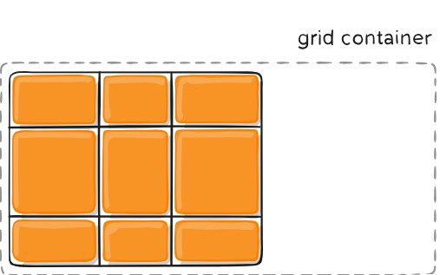
Justify-Content
start | end | center | stretch | space-around | space-between | space-evenly

Slide 10
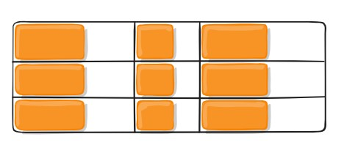
Justify-Items
start | end | center | stretch

Slide 11
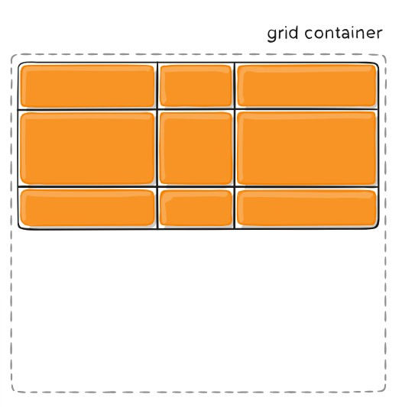
Align-Content
start | end | center | stretch | space-around | space-between | space-evenly

Slide 12
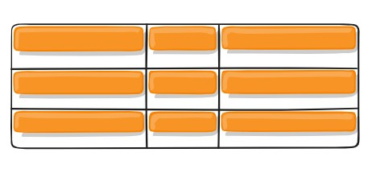
Align-Items
start | end | center | stretch

Slide 13
Grid Items Properties
Justify-Self
Align-Self
Place-Self

Slide 14
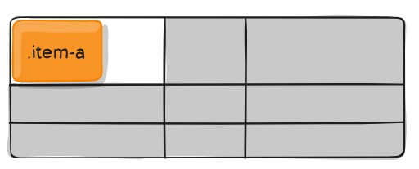
Justify-Self
start | end | center | stretch

Slide 15
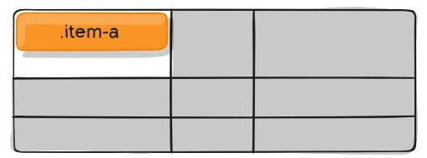
Align-Self
start | end | center | stretch

Slide 16
Media Queries

Slide 17
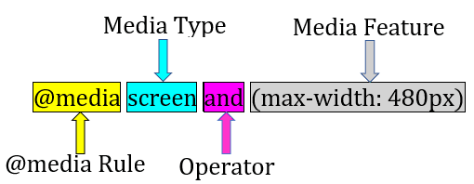
Media Queries
Tell the browser how to style an element at particular viewport dimensions
Types :
all
Screen
Print
Speech

Slide 18
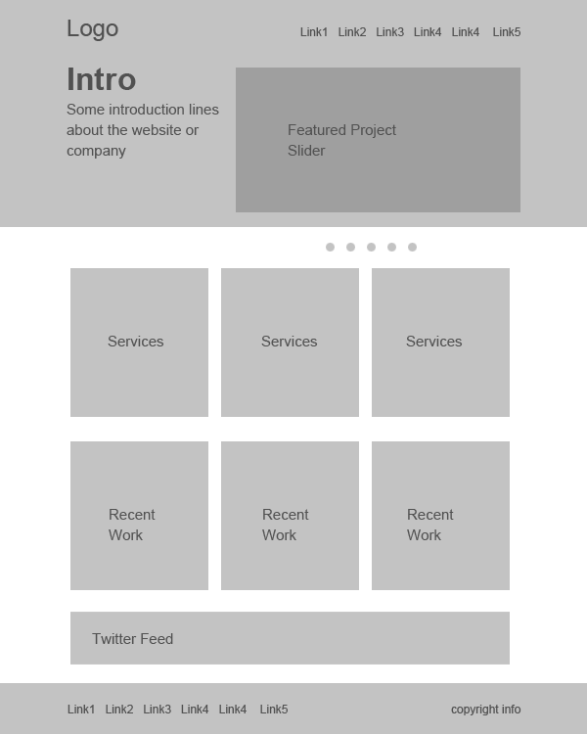
Task_One

Slide 19
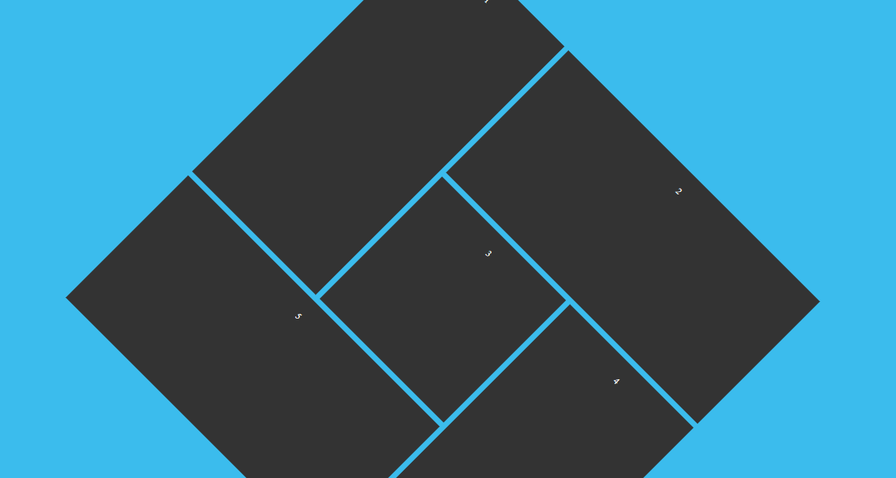
Task_Two

