Slide 1
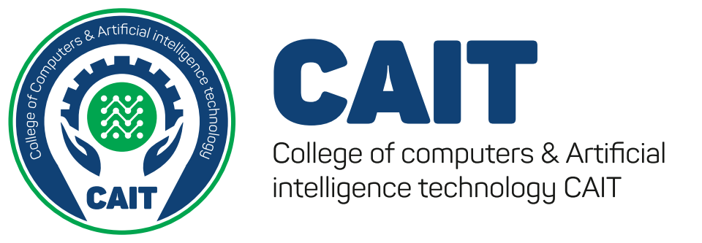

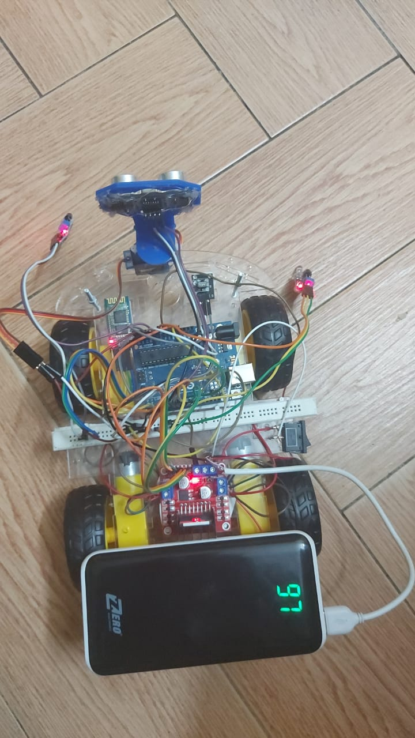
--
Misr University for Science & Technology (MUST)
Academic year
2021-2022
Graduation Project: Intelligent Home Gas System
Mostafa Tarek
94071
Omar Khaled
94105
Basel Ahmed
98052
Roaa Maged
94227
Under supervision of Professor: Mohamed marey
Teaching Assistant / Assistant Lecturer: Ziad Khaled
Technical Assistant
Finding a solution to tasks that are dangerous to humans
Figure 3 shows that the proposed technique
Results / Ouitcome
ABSTRACT
The car can be controlled by remote control, bluetooth and voice commands
It can be used to explore caves, wells, and narrow corridors that humans cannot cross
Finding obstacles and avoiding them
The robot is designed to explore caves and tunnels by remote control and voice commands, and it can move away from obstacles and follow black lines and is controlled by Bluetooth and remote control
Methodology
1 Arduino uno
DC Gear Motor x 4
IR Sensor x 2
L298 Motor Driver
HC-05 Bluetooth Module
IR Receiver Module
MP3 Player IR Remote
sg90 servo motor
Ultrasonic Sensor Holder
Ultrasonic Sensor hc-sr04
4Pcs Smart Robot Car Tyres Wheels
On/Off Switch,18650 Battery Holder – 2 Cell
18650 Battery Cell 3.7V x 2
Background/Introduction
Conclusion/Recommendations
Add here a picture, a diagram, or a screenshot.
Any eye-catching figure to represent your project
It can be used to explore caves, wells, and narrow corridors that humans cannot cross
Control it by any means possible
Problem definition
There are many tunnels and caves that are difficult and dangerous for humans to explore, so humans resorted to searching for ways to use modern technology, including the use of robots.
Future planning
Temperature and humidity gauge to detect temperature
Installing a camera that can shoot in different ways, such as thermal imaging
References
P. Mahajan and A. Sachdeva, “A study of encryption algorithms aes, des and rsa for security,” Global Journal of Computer Science and Technology, 2013.
Boehm B., “A spiral model of software development and enhancement,” IEEE Computers, vol. 21, no. 5, pp. 61-72, 1988.

