Slide 1
Depression Identification
S.A.V.E.R.S Prototype
Names:
Omar Khaled
Mohamed Ezz
Mostafa Tarek
Basel Ahmed
Mohamed Omar
ID’s:
94105
94303
94071
98052
94114

Slide 2
Agenda
01
04
Problem Statement
The Model
02
Related Works
05
Results Demo
03
06
Future Plans
Our Project Initiation

Slide 3
Problem Statement
0
1
0
2
Nowadays, people tend to rely on social media applications to share their emotions and feelings, so, some people share their bad/sad feelings on the social media.
The World Health Organization said that nearly 800,000 people in total commit suicide annually, more than those killed by malaria, breast cancer, wars or homicides.

Slide 4
Related Works
Research
01
Depression Detection on Social Media using Machine Learning Techniques
Research
03
Machine Learning Approach to Detect Depression Using Social Media Posts
Research
04
Sentiment Analysis in Social Media Data for Depression Detection Using Artificial Intelligence: A Review
Research
02
Predicting Depression Through Social Media

Slide 5
S.A.V.E.R.S
Collecting Data
Our Project
01
By Scrapping the Social Media
Analyzation
02
Sentiment Analysis
Detecting Mental Health
03
Performing NLP/ML Models
Actions
04
Depends On the Status of the Mental Health

Slide 6
Machine Learning Infographics
Prediction
LSTM (RNN)
3 Layers
03
Output layer
Sigmoid
Hidden Layer
02
01
Input layer
User Text
Depressed/Not Depressed

Slide 7
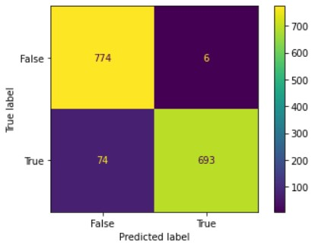
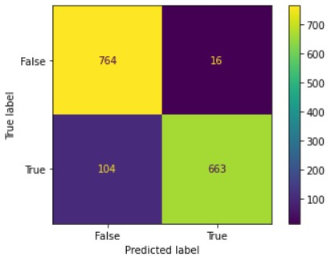
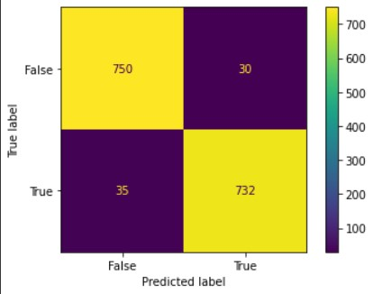
Model Results
LSTM 1
LSTM 2
LSTM 3

Slide 8
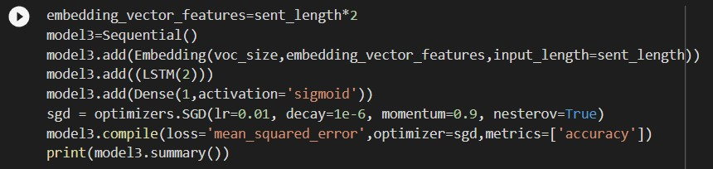
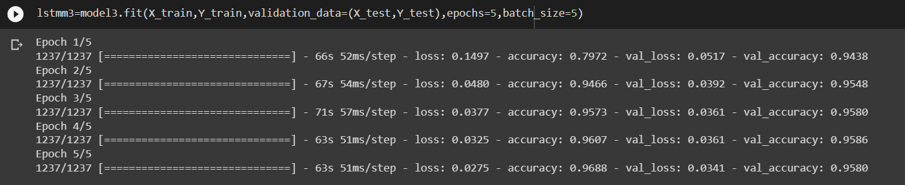
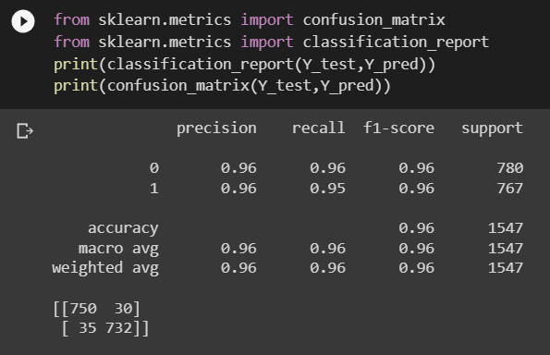
Best Model Sneak peak

Slide 9
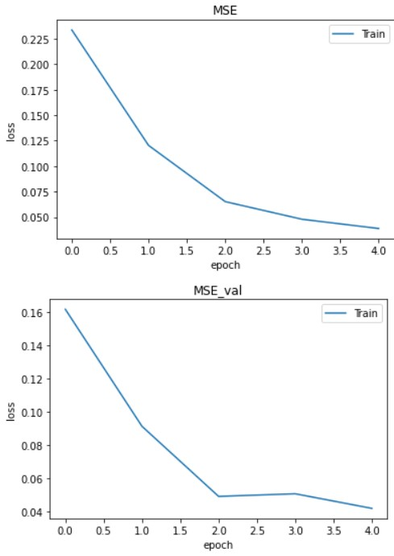
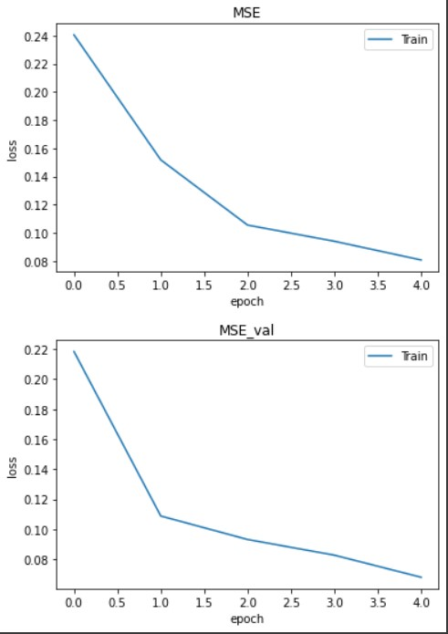
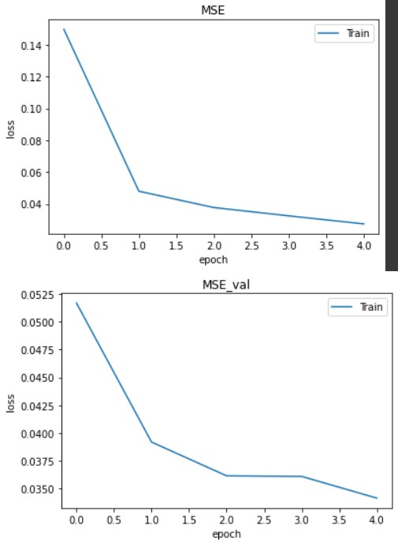
Models MSE Plots
LSTM 1
LSTM 2
LSTM 3

Slide 10
Resources
1- https://www.researchgate.net/publication/349482574_Depression_Detection_on_Social_Media_using_Machine_Learning_Techniques_A_Survey
2- https://link.springer.com/chapter/10.1007/978-981-19-1724-0_6
3- https://link.springer.com/chapter/10.1007/978-981-16-7952-0_27
4- https://link.springer.com/article/10.1007/s42979-021-00958-1
S.A.V.E.R.S

Slide 11
Future Plans
Developing the UI/UX of the Application
Implementing whole system to analyze user Searches/text
Enhancing Notification System
Enhancing User Menta Health by more than way
S.A.V.E.R.S

