Slide 1
ADI/CU GP 2025/2026
Radix-2 FFT Butterfly Hardware Accelerator Integration into PULP
Moustafa Ahmed

Slide 2
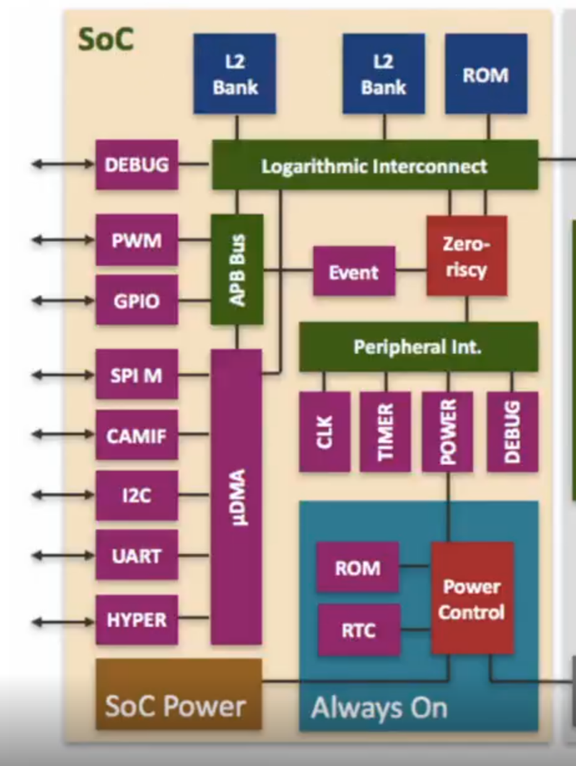
HW/SW Co-design : PULP SoC – Architecture
No Hidden Caches (The TCDM):
Normal processors rely on invisible memory caches, which cause unpredictable delays if data is missing.
PULP replaces caches with a Tightly Coupled Data Memory (TCDM)—a shared, ultra-fast scratchpad where Software must explicitly place data into the TCDM.
The System Actors (The "Factory Floor"):
The Manager (Fabric Controller): The main RISC-V processor that runs our C code and delegates tasks.
The Delivery Service (Micro-DMA): Autonomously moves raw data from the outside world into the TCDM.
The Heavy Machinery (Accelerators): Custom hardware that waits for data and a trigger command to perform massive calculations.

Slide 3
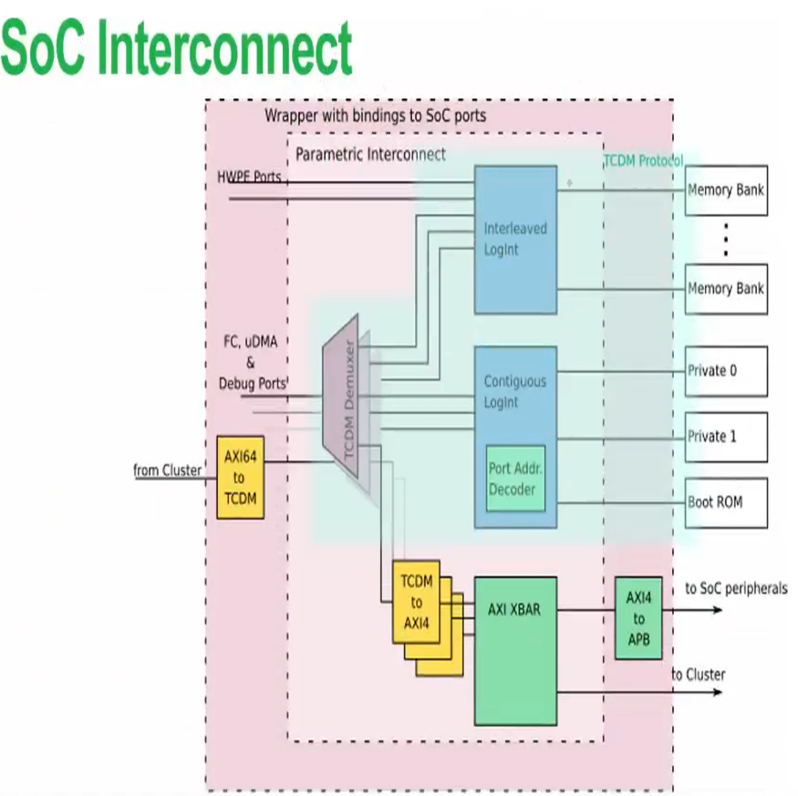
HW/SW Co-design :Highway System – Interconnects and Arbitration
Two Separate Traffic Networks:
The Fast Lane (TCDM Interconnect): Strictly reserved for instant, 1-cycle memory lookups.
The Variable-Delay Highway (AXI Crossbar): Built for complex components. Uses a handshaking protocol to safely pause traffic while our FFT crunches math.
How Software Talks to Hardware:
Address-Based Routing: Hardware doesn't have a name, only a memory address. We mapped our accelerator to.
The Control Path (Memory-Mapped Registers): The RISC-V manager configures the hardware and sends commands by writing configuration values directly to these addresses.
The Data Path: Pushing the actual heavy payloads (our complex operands) to the hardware so it can begin computation.
Acc.

Slide 4
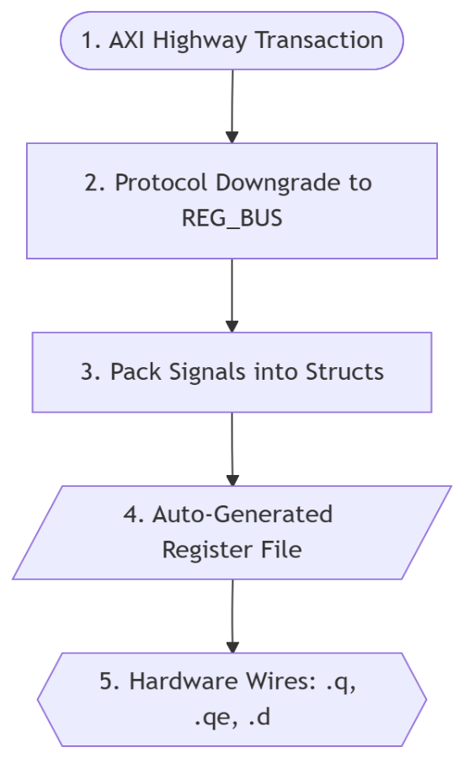
HW/SW Co-design : The Translation Boundary
The Problem: AXI is Too Complex
Our custom FFT hardware is a raw mathematical engine. It doesn't know how to speak the complex AXI handshaking protocol.
The Blueprint (The .hjson file)
We define a "contract" between software and hardware using a simple text file
.hjson, specifying exactly where our operands and triggers live in memory.
The Protocol Downgrade :
AXI → REG_BUS: A converter strips away AXI routing overhead, leaving only a simple interface (Address, Data, and Write-Enable).
REG_BUS → Structs: SystemVerilog interfaces cannot plug into auto-generated registers. The bus signals are packed into strict C-like data Structs
The Hardware Reality (.q , .qe, .d, .de) :
The auto-generated register file unpacks those Structs into raw electrical wires:
.q : Stable Data, .qe: The Spark (1-cycle trigger pulse)
.d : The Results from the hardware. (Data), .de : Data Enable.

Slide 5
Problem Statement
Objective:
Integrate a custom-designed Radix-2 FFT Butterfly hardware accelerator into the PULP platform
Goal:
Validate correct hardware/software interaction via: Custom Radix-2 FFT Implementation
Scope of current work:
Standalone butterfly accelerator integration
Software validation using a simple C test
Current limitation:
Accelerator is not yet invoked by a complete FFT software implementation

Slide 6
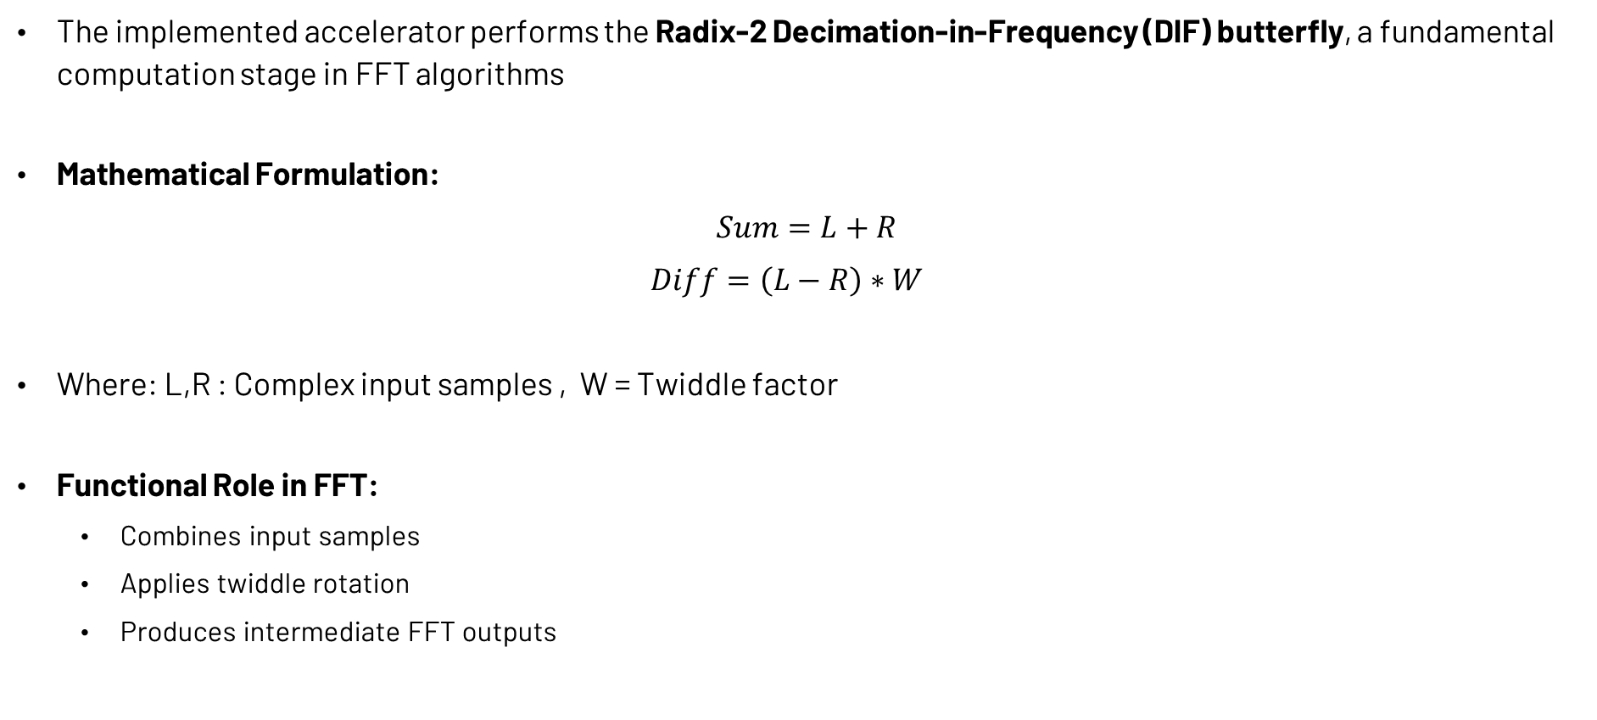
Radix-2 Butterfly Operation
The implemented accelerator performs the Radix-2 Decimation-in-Frequency (DIF) butterfly, a fundamental computation stage in FFT algorithms
Mathematical Formulation:
$$Sum=L+R$$
$$Diff=\left(L−R\right)∗W$$
Where: L,R : Complex input samples , W = Twiddle factor
Functional Role in FFT:
Combines input samples
Applies twiddle rotation
Produces intermediate FFT outputs

Slide 7
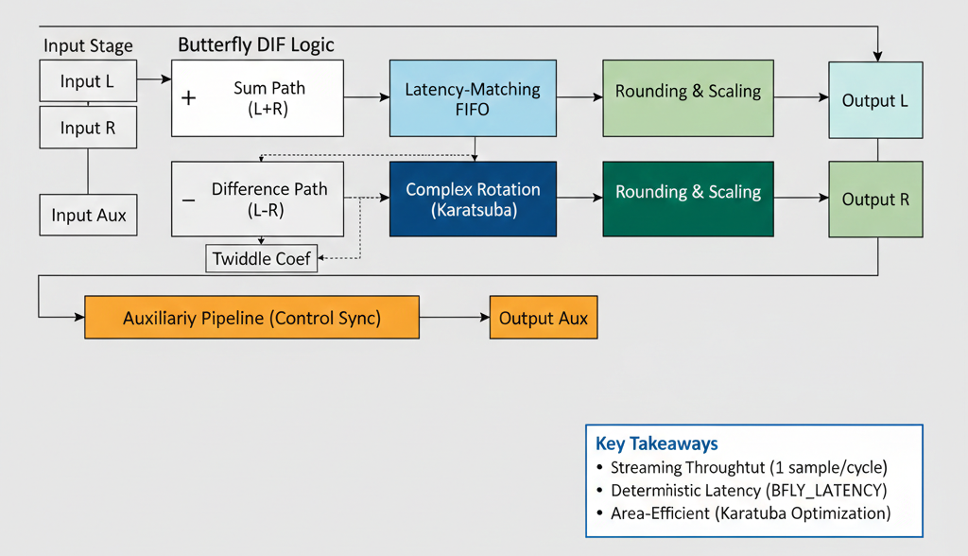
Butterfly RTL Architecture
Core blocks:
Parameterized architecture: IWIDTH, OWIDTH,CWIDTH, SHIFT
Add/Subtract Units
Karatsuba Multiplier
Pipeline / Delay Alignment
Supporting Modules:
bimpy
Base signed multiplier
Longbimpy
Extended precision multiplier
Supports larger operand widths
convround
Convergent rounding

Slide 8
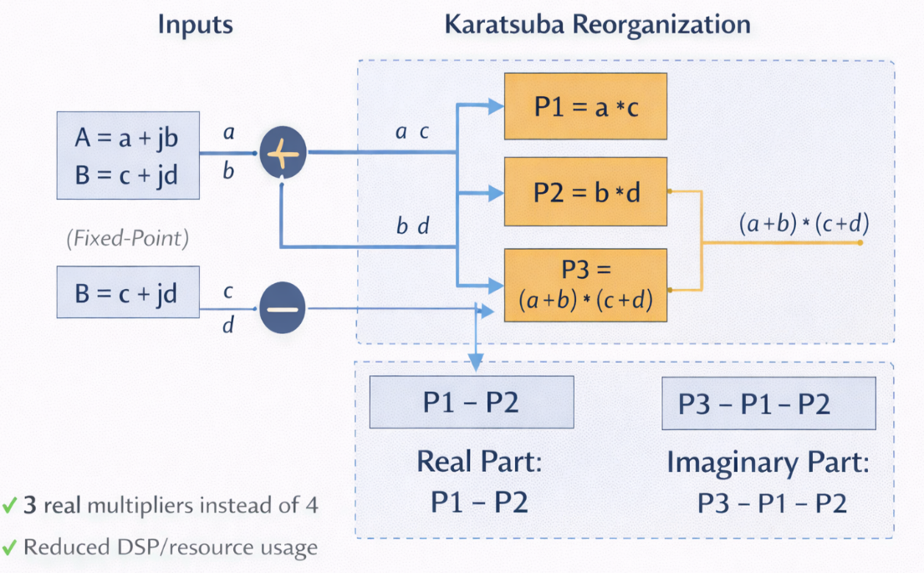
Arithmetic Optimization
Challenge: Complex multiplication is the most expensive operation in the butterfly datapath.
Standard complex multiply requires 4 real multipliers
Optimization Applied: Karatsuba Algorithm
Reformulates multiplication using:
3 real multipliers instead of 4
Benefits:
Reduced multiplier count
Lower hardware area
Reduced DSP/resource usage
Price:
More Adders/Subtractors

Slide 9
Pipeline and Latency Alignment
Motivation:
Multiplier introduces computation latency
Addition/Subtraction paths are faster
Outputs must remain time-aligned
Implemented Solution:
Auxiliary Signal Propagation:
i_aux tracks valid computation
Propagated through auxiliary pipeline
Generates o_aux at completion
Result:
Sum and difference outputs aligned
Pipeline completion correctly indicated

Slide 10
Hardware Integration into PULP
Objective:
Expose the butterfly accelerator as a memory-mapped AXI peripheral within the PULP SoC.
Integration Components:
Register map definition (HJSON)
reggen-generated register file
AXI wrapper
AXI interconnect extension
SoC-Level Modifications:
Wrapper instantiated
AXI slave port added
Address map updated
AXI decoding rule inserted

Slide 11
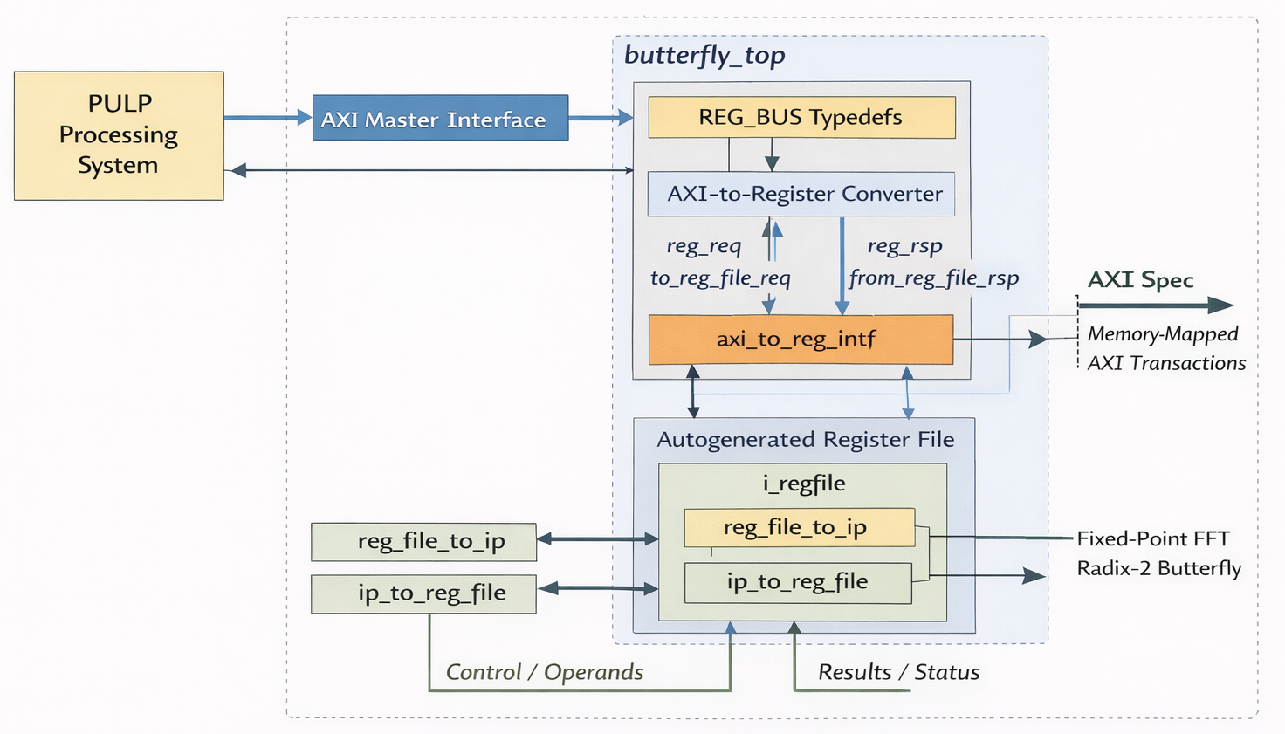
Wrapper Architecture
Purpose:
Integrates the butterfly accelerator into the PULP AXI-based SoC
Translates bus transactions into register-level control
Dataflow Overview:
PULP Processor
AXI Transactions
AXI-to-Register Converter
Register File
Butterfly Accelerator
Autogenerated Register File Stores: Operands, Twiddle Factors, Control signals and Status/Results
AXI-to-Register Converter:
Converts AXI protocol → Generic Register Bus
Enables memory-mapped register access
Register <--> Accelerator Interface
reg_file_to_ip → Configuration & inputs
ip_to_reg_file → Results & status

Slide 12
SoC-Level Integration into PULP
Key Modifications:
Wrapper instantiated in pulp_soc.sv
AXI slave port added
AXI interconnect extended
Address map updated
Address Allocation
Dedicated memory-mapped region assigned
Enables processor access via load/store
Result
Accelerator visible to the system bus
Accessible through AXI transactions

Slide 13
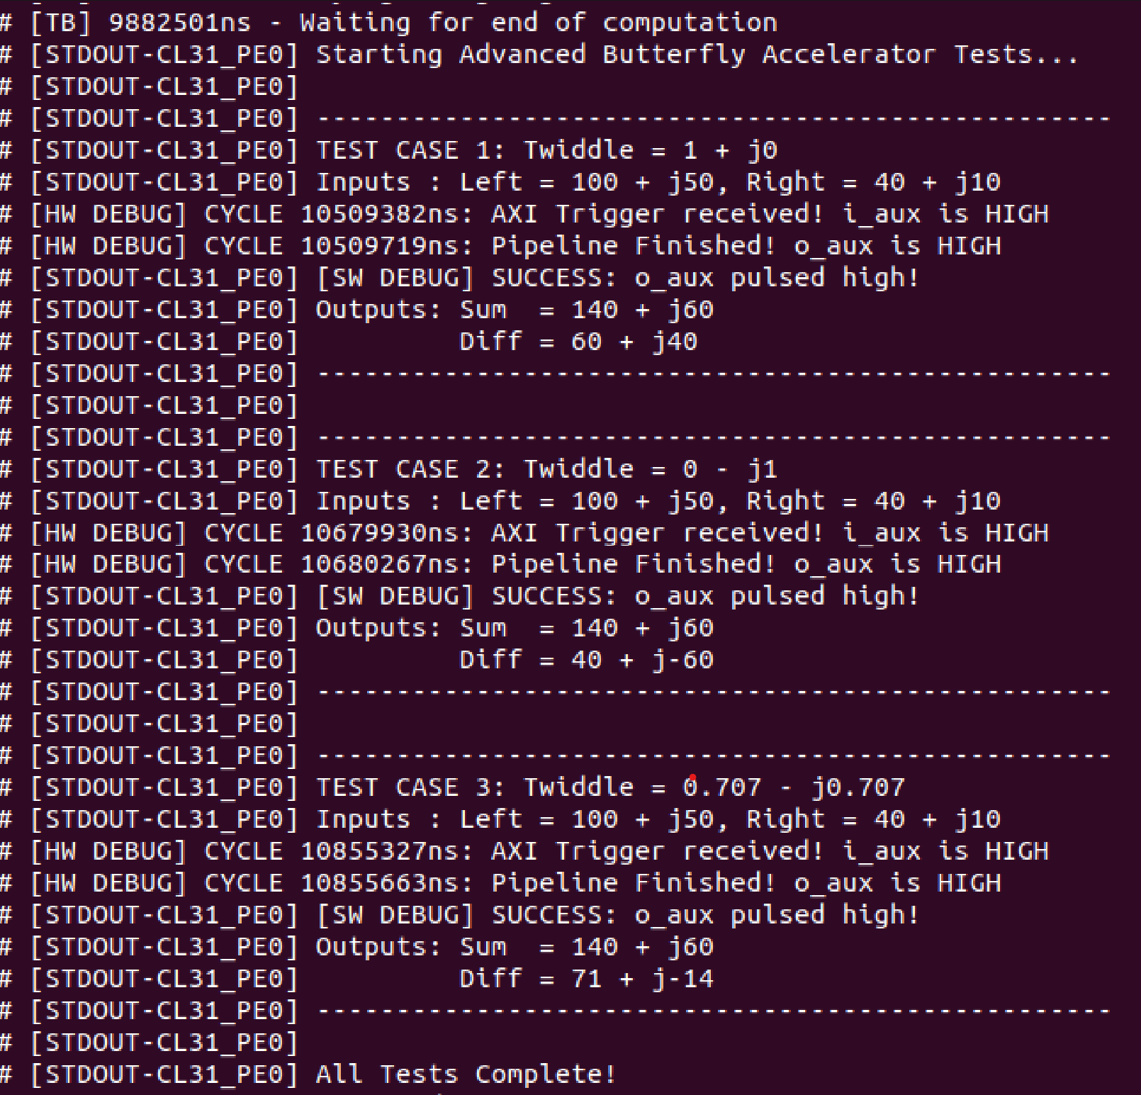
Software Interaction, Result & Verification
Software Control:
Simple Custom C test application developed
Driver functions used for:
Writing operands
Configuring coefficients
Triggering execution
Polling status
Reading results
Execution Flow:
Write inputs to registers
Trigger accelerator
Poll DONE status
Read computed outputs
Observed Results:
Correct butterfly arithmetic
Proper trigger (i_aux) and completion signaling (o_aux)
Successful HW/SW communication

Slide 14
Current Status
Completed:
Radix-2 butterfly RTL implementation
AXI wrapper design
Register interface integration
SoC-level AXI integration into PULP
Validation Achieved:
Correct arithmetic functionality
Successful AXI communication
Proper register-based control

Slide 15
Next Steps
Full FFT Software Integration
Collaborate with Moustafa Youssry to
Integrate the butterfly accelerator into the complete FFT software flow
RTL & Numerical Consistency
Collaborate with Moustafa Fathy and Marwan Khaled to
Synchronize:
Fixed-point analysis
Butterfly arithmetic behavior
FFT RTL implementation

Slide 16
GitHub Repository
RTL implementations and Wrapper codes can be found here:
https://github.com/Mostafa-Yossry/ADI-CU-GP-2025-2026/tree/main/RTL

