Slide 1
ADI/CU GP 2025/2026
Progress Update Meeting (1)
Part (1) : FFT task
Front end team …..

Slide 2
Meeting Timeline
Parallelization Techniques
FFT
HW/SW (Co-Design)
HWPE
Marwan
Mostafa Fathy
Mostafa Ahmed
Mostafa Yousry
Sama
Mohamed Abdel-hay
Sarah
Ali
0
01
02
03
04
Presentation part (1) : FFT task
Presentation part (2) : HWPE
Presentation part (3) : Parallelization Techniques

Slide 3
Agenda
Introduction
Modeling
RTL
HW/SW Co-design (HW Part)
HW/SW Co-design (SW Part)

Slide 4
Introduction

Slide 5
Agenda
Introduction
DFT Definition
DFT calculation methods
FFT
Direct computation vs FFT
Radix-2 vs Radix-4

Slide 6
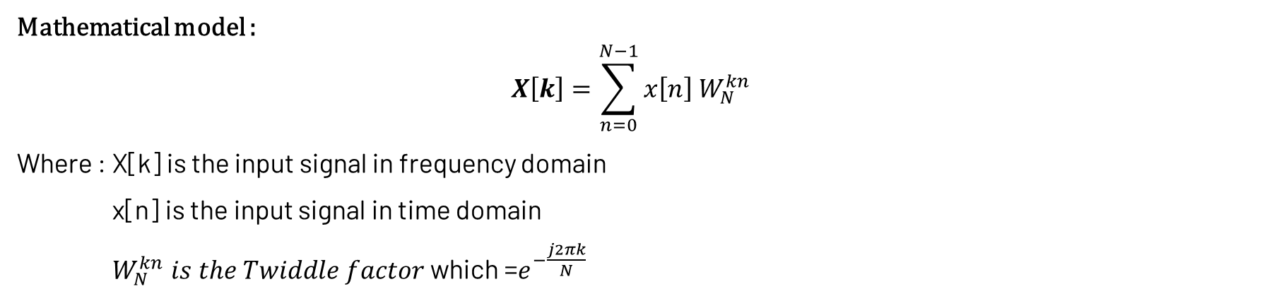
Introduction :DFT Definition
DFT: it stands for Discrete Fourier Transform which is the tool to transform the discrete signal in time domain to discrete in frequency domain
Time domain signal
DFT
Frequency domain signal
Mathematical model :
$$X\left[k\right]=\sum_{n=0}^{N−1}{x\left[n\right] W_{N}^{kn} }$$
Where : X[k] is the input signal in frequency domain
x[n] is the input signal in time domain
$W_{N}^{kn} is the Twiddle factor$which =$e^{−\frac{j2πk}{N}}$
DFT Definition
DFT calculation methods
FFT
Direct computation vs FFT
Radix-2 vs Radix-4

Slide 7
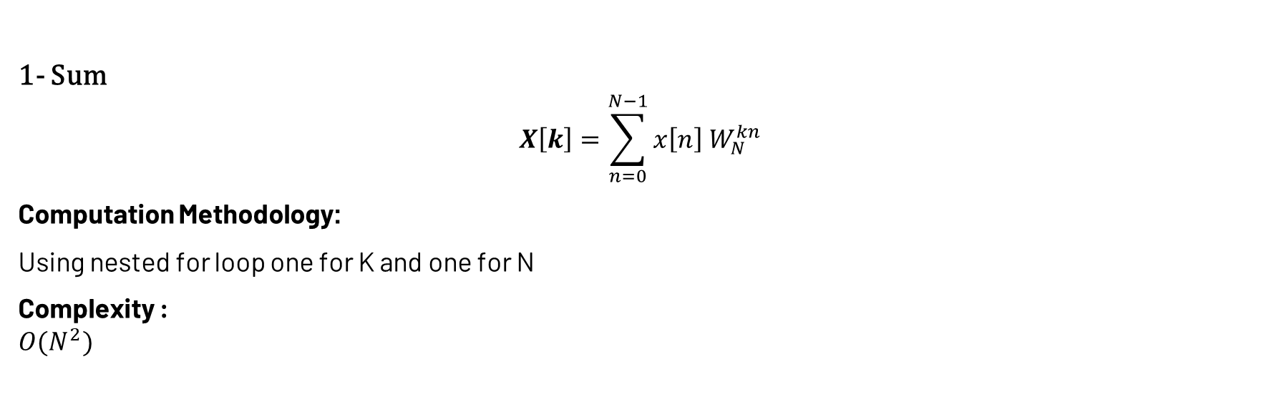
Introduction :DFT calculation methods
DFT
Direct computation
FFT
Sum
Matrix form
1- Sum
$$X\left[k\right]=\sum_{n=0}^{N−1}{x\left[n\right] W_{N}^{kn} }$$
Computation Methodology:
Using nested for loop one for K and one for N
Complexity :
$$O(N^{2})$$
Direct computation:
DFT Definition
DFT calculation methods
FFT
Direct computation vs FFT
Radix-2 vs Radix-4

Slide 8
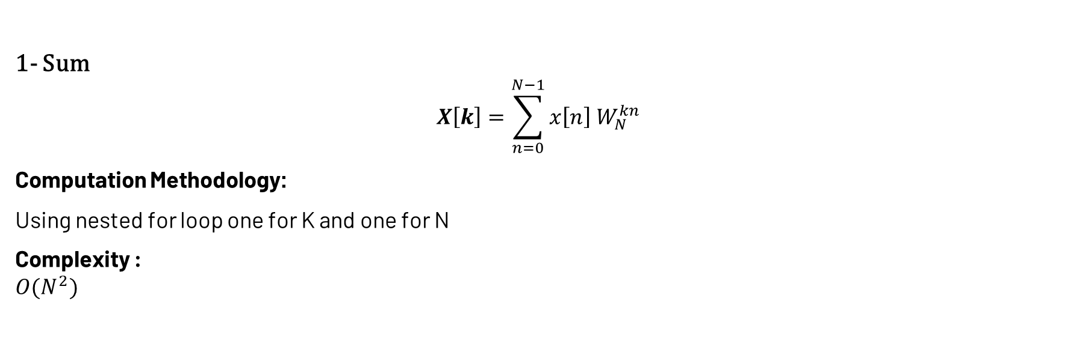

Introduction :DFT calculation methods
DFT
Direct computation
FFT
Sum
Matrix form
2- Matrix form
$${\left[\begin{matrix}X\left[0\right] \\ ⋮ \\ X\left[N−1\right]\end{matrix}\right]}_{N×1}={\left[\begin{matrix}\begin{matrix}W_{N}^{0} \\ ⋮ \\ W_{N}^{0}\end{matrix} & \begin{matrix}… \\ ⋱ \\ …\end{matrix} & \begin{matrix}W_{N}^{0} \\ ⋮ \\ { W}_{N}^{\left(N−1\right)\left(N−1\right)}\end{matrix}\end{matrix}\right]}_{N×N}{\left[\begin{matrix}x\left[0\right] \\ ⋮ \\ x\left[N−1\right]\end{matrix}\right]}_{N×1}$$
Computation Methodology:
Matrix multiplication
Complexity :
$$O(N^{2})$$
1- Sum
$$X\left[k\right]=\sum_{n=0}^{N−1}{x\left[n\right] W_{N}^{kn} }$$
Computation Methodology:
Using nested for loop one for K and one for N
Complexity :
$$O(N^{2})$$
Direct computation:
DFT Definition
DFT calculation methods
FFT
Direct computation vs FFT
Radix-2 vs Radix-4

Slide 9
Introduction :FFT
DFT
Direct computation
FFT
Sum
Matrix form
FFT: The Fast Fourier Transform (FFT) is an algorithm that computes the Discrete Fourier Transform (DFT) of a sequence
Algorithm categories :
Cooley-Tukey algorithm
Radix -2
Radix -4
Decimation in frequency (DIF)
Decimation in time
(DIT)
Radix -2
Radix -4
DFT Definition
DFT calculation methods
FFT
Direct computation vs FFT
Radix-2 vs Radix-4

Slide 10
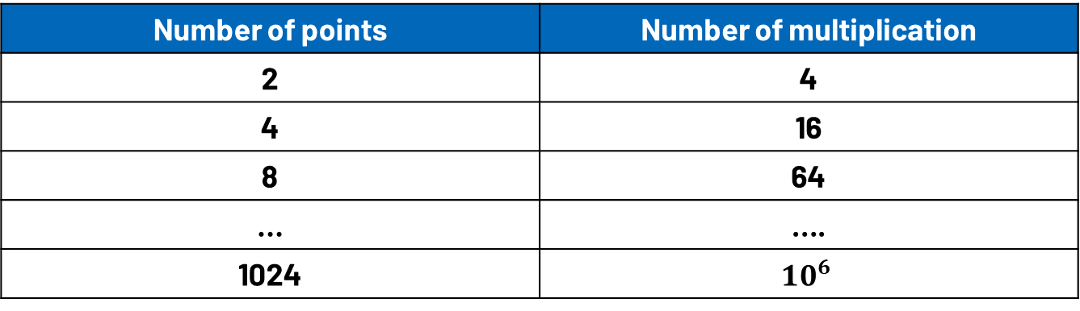
Introduction :FFT
Complexity table of DFT computation :$O\left(N^{2}\right)$
Number of points | Number of multiplication
2 | 4
4 | 16
8 | 64
… | ….
1024 | $${10}^{6}$$
DFT Definition
DFT calculation methods
FFT
Direct computation vs FFT
Radix-2 vs Radix-4

Slide 11
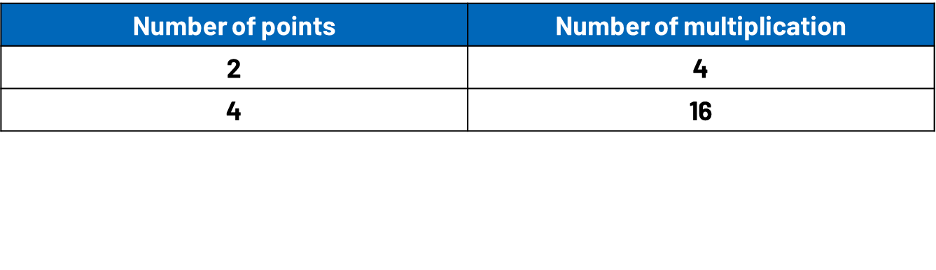




Introduction :FFT
Complexity table of DFT computation :$O\left(N^{2}\right)$
Number of points | Number of multiplication
2 | 4
4 | 16
8 | 64
… | ….
1024 | $${10}^{6}$$
x(0)
X(0)
x(0)
X(0)
2-point DFT
x(1)
X(1)
x(1)
X(1)
4-point DFT
x(2)
X(2)
$X\left[0\right]=x\left[0\right] +$ $x\left[1\right]$
$X\left[1\right]=x\left[0\right] −$ $x\left[1\right]$
$X\left[0\right]=x\left[0\right] W_{2}^{0}+$ $x\left[1\right] W_{2}^{0}$
$X\left[1\right]=x\left[0\right] W_{2}^{0}+$ $x\left[1\right] W_{2}^{1}$
x(3)
X(3)
$X\left[0\right]=x\left[0\right] +$ $x\left[1\right] +x\left[2\right] + x\left[3\right]$
$X\left[1\right]=x\left[0\right]−j$ $x\left[1\right] −x\left[2\right] +j x\left[3\right]$
$X\left[2\right]=x\left[0\right] −$ $x\left[1\right] +x\left[2\right] − x\left[3\right]$
$X\left[3\right]=x\left[0\right] +j$ $x\left[1\right] −x\left[2\right] \text{−}\text{j} x\left[3\right]$
Show Equation
Substitute with W
Show Equation
Substitute with W
$X\left[0\right]=x\left[0\right] W_{4}^{0}+$ $x\left[1\right] W_{4}^{0}+x\left[2\right] W_{4}^{0}+ x\left[3\right] W_{4}^{0}$
$X\left[1\right]=x\left[0\right] W_{4}^{0}+$ $x\left[1\right] W_{4}^{1}+x\left[2\right] W_{4}^{2}+ x\left[3\right] W_{4}^{3}$
$X\left[2\right]=x\left[0\right] W_{4}^{0}+$ $x\left[1\right] W_{4}^{2}+x\left[2\right] W_{4}^{4}+ x\left[3\right] W_{4}^{6}$
$X\left[3\right]=x\left[0\right] W_{4}^{0}+$ $x\left[1\right] W_{4}^{3}+x\left[2\right] W_{4}^{6}+ x\left[3\right] W_{4}^{9}$
DFT Definition
DFT calculation methods
FFT
Direct computation vs FFT
Radix-2 vs Radix-4

Slide 12

Introduction :FFT
x(0)
8-point DFT
X(0)
x(0)
4-point FFT
X(0)
x(1)
X(1)
x(1)
X(1)
x(2)
X(2)
x(2)
X(2)
x(3)
X(3)
$$≡or \text{≢}$$
x(3)
X(3)
x(4)
X(4)
x(4)
4-point FFT
X(4)
x(5)
X(5)
x(5)
X(5)
x(6)
X(6)
x(6)
X(6)
x(7)
X(7)
x(7)
X(7)
64 Multiplication (16 complex)
DFT Definition
DFT calculation methods
FFT
Direct computation vs FFT
Radix-2 vs Radix-4

Slide 13
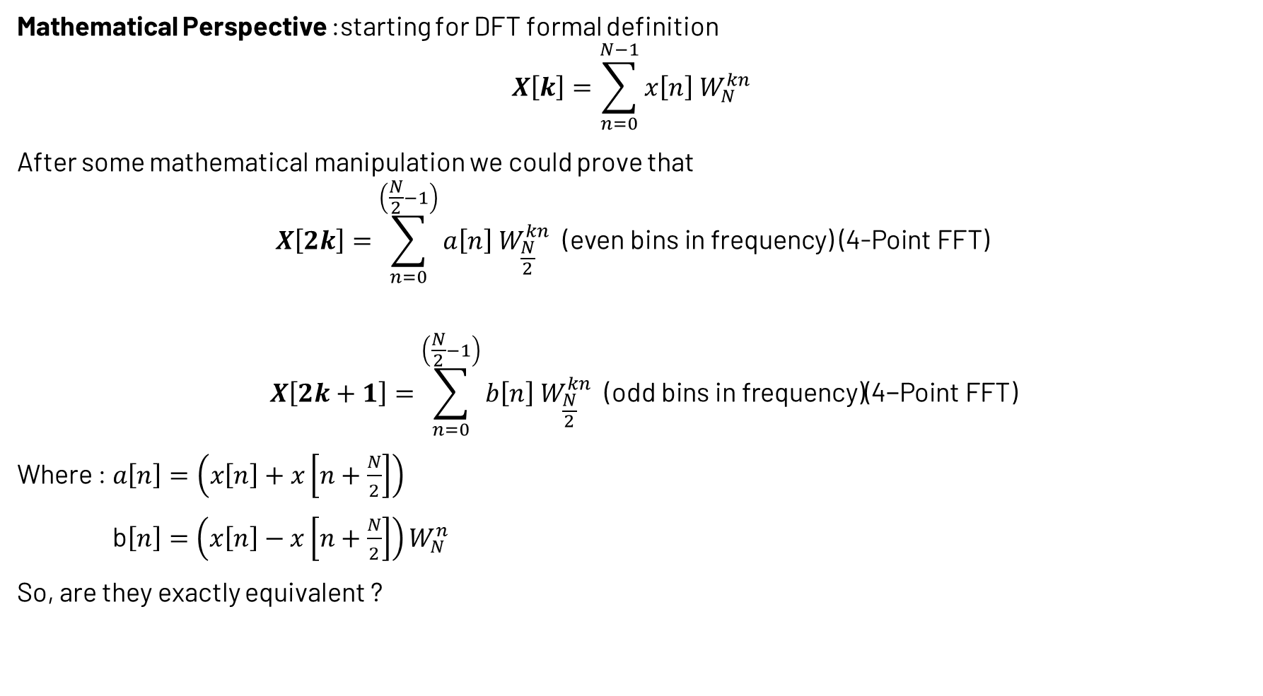
Introduction :FFT
Mathematical Perspective :starting for DFT formal definition
$$X\left[k\right]=\sum_{n=0}^{N−1}{x\left[n\right] W_{N}^{kn} }$$
After some mathematical manipulation we could prove that
$$X\left[2k\right]=\sum_{n=0}^{\left(\frac{N}{2}−1\right)}{a\left[n\right] W_{\frac{N}{2}}^{kn} \text{(}\text{even} \text{bins} \text{in} \text{frequency}\text{) (4−}\text{Point} \text{FFT}\text{) }}$$
$$X\left[2k+1\right]=\sum_{n=0}^{\left(\frac{N}{2}−1\right)}{b\left[n\right] W_{\frac{N}{2}}^{kn} \text{(}\text{odd} \text{bins} \text{in} \text{frequency}\text{)(4−}\text{Point} \text{FFT}\text{)}}$$
Where : $a\left[n\right]=\left(x\left[n\right]+x\left[n+\frac{N}{2}\right]\right)$
b$\left[n\right]=\left(x\left[n\right]−x\left[n+\frac{N}{2}\right]\right)W_{N}^{n}$
So, are they exactly equivalent ?
DFT Definition
DFT calculation methods
FFT
Direct computation vs FFT
Radix-2 vs Radix-4

Slide 14

Introduction :FFT
Splitter
a(0)
x(0)
8-point DFT
X(0)
x(0)
4-point FFT
X(0)
x(1)
X(1)
x(1)
a(1)
X(1)
x(2)
X(2)
x(2)
a(2)
X(2)
x(3)
X(3)
x(3)
a(3)
X(3)
$$≡$$
X(4)
b(4)
X(4)
x(4)
x(4)
4-point FFT
x(5)
X(5)
x(5)
b(5)
X(5)
b(6)
x(6)
X(6)
x(6)
X(6)
x(7)
X(7)
x(7)
b(7)
X(7)
Why do we call it “Splitter” ?
DFT Definition
DFT calculation methods
FFT
Direct computation vs FFT
Radix-2 vs Radix-4

Slide 15
Introduction :FFT
1 Problem
8-point
2 independent Problems
4-point
Splitter
a(0)
x(0)
4-point FFT
X(0)
x(1)
a(1)
X(1)
x(2)
a(2)
X(2)
x(3)
a(3)
X(3)
x(4)
b(4)
X(4)
4-point FFT
x(5)
b(5)
X(5)
b(6)
x(6)
X(6)
x(7)
b(7)
X(7)
DFT Definition
DFT calculation methods
FFT
Direct computation vs FFT
Radix-2 vs Radix-4

Slide 16
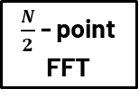


Introduction :FFT
So, we could generalize it to be :
N-point FFT
Splitter
$\frac{N}{2}$ - point FFT
$$≡$$
$$⋮$$
$\frac{N}{2}$ - point FFT
So , when should we stop ?
It depends on the radix . Since we are working with radix-2 , we should stop at 2-point calculation
8 points
4 points
4 points
2 points
2 points
2 points
2 points
DFT Definition
DFT calculation methods
FFT
Direct computation vs FFT
Radix-2 vs Radix-4

Slide 17

Introduction :FFT
8 points
Splitter
4-point
$$⋮$$
4-point
DFT Definition
DFT calculation methods
FFT
Direct computation vs FFT
Radix-2 vs Radix-4

Slide 18
Introduction :FFT
4 points
Splitter
4-point
DFT Definition
DFT calculation methods
FFT
Direct computation vs FFT
Radix-2 vs Radix-4
4-point

Slide 19

Introduction :FFT
4 points
Splitter
Splitter
2 points
2 points
$$⋮$$
DFT Definition
DFT calculation methods
FFT
Direct computation vs FFT
Radix-2 vs Radix-4
4-point

Slide 20
Introduction :FFT
8 points
Splitter
4-point
$$⋮$$
4-point
DFT Definition
DFT calculation methods
FFT
Direct computation vs FFT
Radix-2 vs Radix-4

Slide 21


Introduction :FFT
8 points
4 points
Splitter
Splitter
2 points
2 points
$$⋮$$
$$⋮$$
4 points
Splitter
2 points
2 points
$$⋮$$
DFT Definition
DFT calculation methods
FFT
Direct computation vs FFT
Radix-2 vs Radix-4

Slide 22
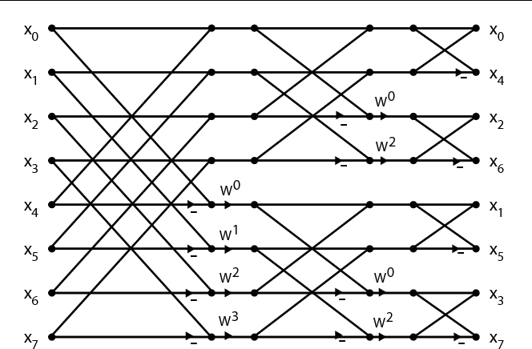
Introduction :FFT
8 points
4 points
Splitter
2 points
2 points
$$⋮$$
$$⋮$$
4 points
Splitter
2 points
2 points
$$⋮$$
DFT Definition
DFT calculation methods
FFT
Direct computation vs FFT
Radix-2 vs Radix-4

Slide 23
Introduction :FFT
8 points
Splitter
Splitter
2 points
2 points
Splitter
2 points
2 points
DFT Definition
DFT calculation methods
FFT
Direct computation vs FFT
Radix-2 vs Radix-4

Slide 24
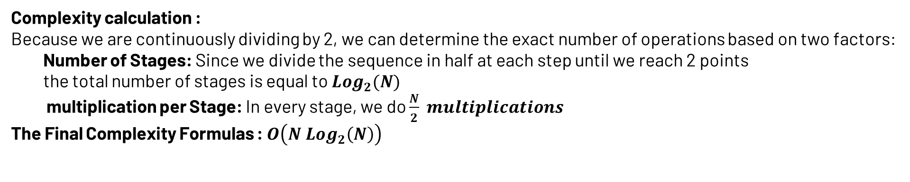
Introduction :FFT
Complexity calculation :
Because we are continuously dividing by 2, we can determine the exact number of operations based on two factors:
Number of Stages: Since we divide the sequence in half at each step until we reach 2 points
the total number of stages is equal to $Log_{2}(N)$
multiplication per Stage: In every stage, we do $\frac{N}{2} multiplications$
The Final Complexity Formulas : $O\left(N Log_{2}\left(N\right)\right)$
DFT Definition
DFT calculation methods
FFT
Direct computation vs FFT
Radix-2 vs Radix-4

Slide 25
Introduction :Direct computation vs FFT
Code Flow
Generate bits
Call FFT
Call DFT
Comparing the performance
DFT Definition
DFT calculation methods
FFT
Direct computation vs FFT
Radix-2 vs Radix-4

Slide 26
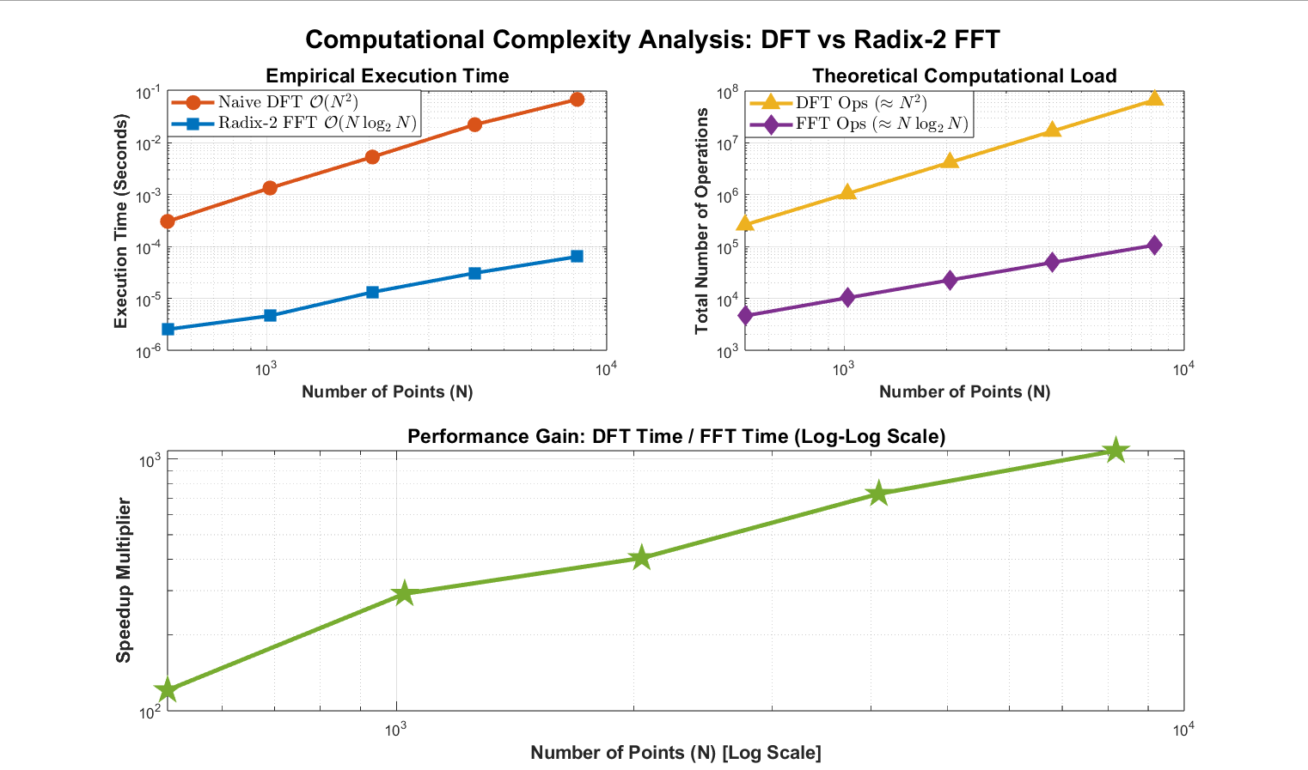
Introduction :Direct computation vs FFT
DFT Definition
DFT calculation methods
FFT
Direct computation vs FFT
Radix-2 vs Radix-4

Slide 27



Introduction :Direct computation vs FFT
Execution Time
4096 point
16384 point
32768 point
DFT Definition
DFT calculation methods
FFT
Direct computation vs FFT
Radix-2 vs Radix-4

Slide 28
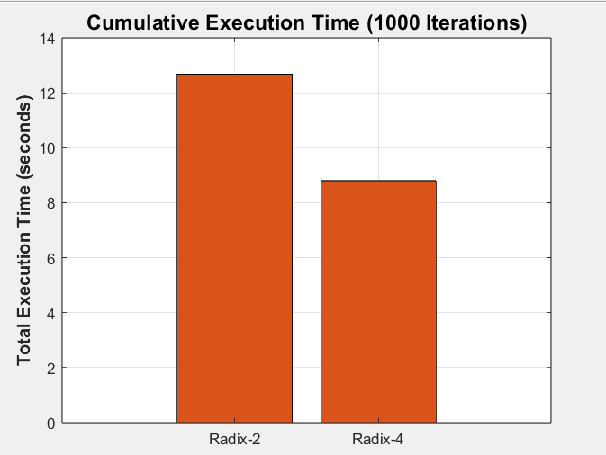
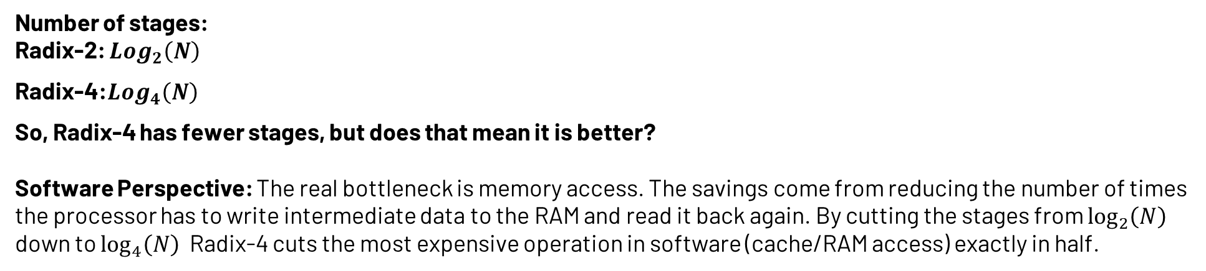
Introduction :Radix-2 vs Radix-4
Number of stages:
Radix-2: $Log_{2}\left(N\right)$
Radix-4:$Log_{4}\left(N\right)$
So, Radix-4 has fewer stages, but does that mean it is better?
Software Perspective: The real bottleneck is memory access. The savings come from reducing the number of times the processor has to write intermediate data to the RAM and read it back again. By cutting the stages from $\log_{2}\left(N\right)$
down to $\log_{4}\left(N\right)$ Radix-4 cuts the most expensive operation in software (cache/RAM access) exactly in half.
DFT Definition
DFT calculation methods
FFT
Direct computation vs FFT
Radix-2 vs Radix-4

Slide 29
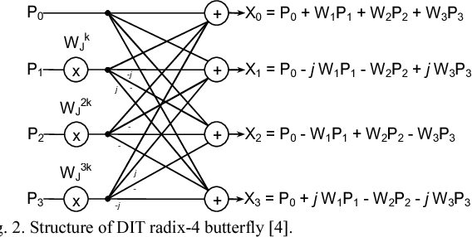
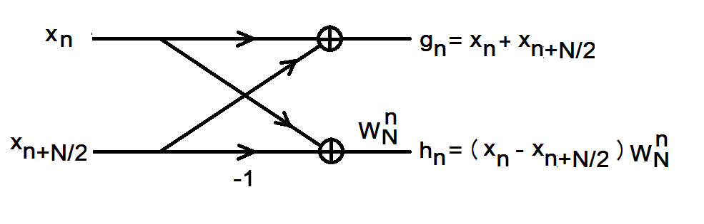
Introduction :Radix-2 vs Radix-4
Hardware perspective :
The real bottleneck is the stage component
In a pipelined FFT architecture, Radix-2 outperforms Radix-4 in maximum frequency because it has a simpler critical path
Radix-2 SDF: Shorter critical path → Higher $F_\max{ }$​ → Higher maximum throughput.
Radix-4 SDF: Longer critical path but ≈50% fewer complex multipliers → Better Area/Power efficiency
DFT Definition
DFT calculation methods
FFT
Direct computation vs FFT
Radix-2 vs Radix-4

Slide 30
Agenda
System definition
Modeling
RTL
HW/SW Co-design (HW Part)
HW/SW Co-design (SW Part)

Slide 31
Modeling

Slide 32
Agenda
Modeling
System Modeling
Algorithm and Architecture
SDF Block diagram
Fixed point analysis
SQNR analysis
Challenges

Slide 33

Modeling :System Modeling
Mapper
N-point IFFT
Adding cyclic extension
Input data
To the channel
Tx (UE)
Multiplexer
Equalizer
De-mapper
N-point FFT
Removing cyclic extension
from the channel
Output data
De-mapper
N-point FFT
Removing cyclic extension
from the channel
Rx (Base Station)
System Modeling
Algorithm and Architecture
SDF Block diagram
Fixed point analysis
SQNR analysis
Challenges
Challenges

Slide 34
Modeling :Algorithm and Architecture
Algorithm: we implemented the Cooley-Tukey algorithm (Radix-2, DIF)
Architecture :we implemented the SDF architecture (Radix-2, DIF)
Why SDF ?
System Modeling
Algorithm and Architecture
SDF Block diagram
Fixed point analysis
SQNR analysis
Challenges

Slide 35
Recall: Rx block diagram
Multiplexer
Equalizer
N-point FFT
Removing cyclic extension
De-mapper
from the channel
De-mapper
N-point FFT
Removing cyclic extension
from the channel
Output data
De-mapper
N-point FFT
Removing cyclic extension
from the channel
System Modeling
Algorithm and Architecture
SDF Block diagram
Fixed point analysis
SQNR analysis
Challenges

Slide 36
FFT Modeling :Algorithm and Architecture
Algorithm: we implemented the Cooley-Tukey algorithm (Radix-2, DIF)
Architecture :we implemented the SDF architecture (Radix-2, DIF)
Why SDF ?
Pros:
Area Efficiency.
Area scaling
Cons:
higher latency (N-1)
low throughput (1 sample/cycle)
High power density
Given the high number of parallel streams in the base station, we prioritized minimizing the area per block over maximizing the single-stream throughput.
But would it really be enough for the required data rate ?
System Modeling
Algorithm and Architecture
SDF Block diagram
Fixed point analysis
SQNR analysis
Challenges

Slide 37
Recall: System Configuration
signal BW, sampling rate
Bandwidth (MHz) | NFFT | NusedFFT (Subcarriers) | NumRBs | Sampling Rate (MHz)
50 | 512 | 384 | 32 | 61.44
100 | 1024 | 792 | 66 | 122.88
400 | 4096 | 3168 | 264 | 491.52
Note: these calculation based on Subcarrier Spacing (SCS): 120 kHz
Would it support 491.52 MHz?
System Modeling
Algorithm and Architecture
SDF Block diagram
Fixed point analysis
SQNR analysis
Challenges

Slide 38


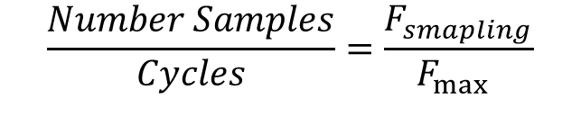
FFT Modeling :Algorithm and Architecture
$$\frac{Number Samples}{Cycles}=\frac{F_{smapling}}{F_{\max{ }}}$$
$$F_{smpling}≈500 MHz$$
$$F_{max}$$
Platform constraints: "Baseline Frequency: 500 MHz (Validated by a silicon-proven 40nm tape-out)." [1]
Critical Path
So , What is the $F_{max}$ for the target technology?
System Modeling
Algorithm and Architecture
SDF Block diagram
Fixed point analysis
SQNR analysis
Challenges

Slide 39
Recall :Adflow Metrics Summary for 3 stages
Metric | Value
Maximum clock frequency | 619.5 MHz
WNS (setup) | 3.386 ns
TNS (setup) | 0
WNS (hold) | 0
TNS (hold) | 0
Post-route utilization | 59.7 %
Technology | GF 22nm
Standard Cell Library | 22nm_gf_fdx_10m
System Modeling
Algorithm and Architecture
SDF Block diagram
Fixed point analysis
SQNR analysis
Challenges

Slide 40
Modeling:SDF Block Diagram
SDF DIF radix-2
12 bits input
S1
S2
S12
12 bits output
2
2
System Modeling
Algorithm and Architecture
SDF Block diagram
Fixed point analysis
SQNR analysis
Challenges

Slide 41
Modeling: Fixed point analysis
Q1.11
Stage1
Q3.9
Stage2
Q4.8
Q4.8
Stage3
Q5.7
Stage4
Q6.6
Q6.6
Stage5
Stage6
Q7.5
Q7.5
Stage7
Stage8
Q8.4
Q8.4
Stage9
Stage10
Q9.3
Q9.3
Stage11
Stage12
System Modeling
Algorithm and Architecture
SDF Block diagram
Fixed point analysis
SQNR analysis
Challenges

Slide 42

Modeling: Fixed point analysis
Q1.11
Stage1
Q3.9
Stage2
Q4.8
Q4.8
Stage3
Q5.7
Stage4
Q6.6
Q6.6
Stage5
Stage6
Q7.5
Q7.5
Stage7
Stage8
Q8.4
Q8.4
Stage9
Stage10
Q9.3
Q9.3
Stage11
Stage12
System Modeling
Algorithm and Architecture
SDF Block diagram
Fixed point analysis
SQNR analysis
Challenges

Slide 43
Modeling : SQNR analysis
Example FFT Output Comparison:
Bin | Reference | Fixed point | Error (Magnitude)
1 | −25.92 −16.64i | −25.75 −16.50i | 0.2202
2 | −42.93 −59.19i | −43.00 −59.25i | 0.0922
3 | 8.23 −31.22i | 8.25 −31.13i | 0.0922
System Modeling
Algorithm and Architecture
SDF Block diagram
Fixed point analysis
SQNR analysis
Challenges

Slide 44
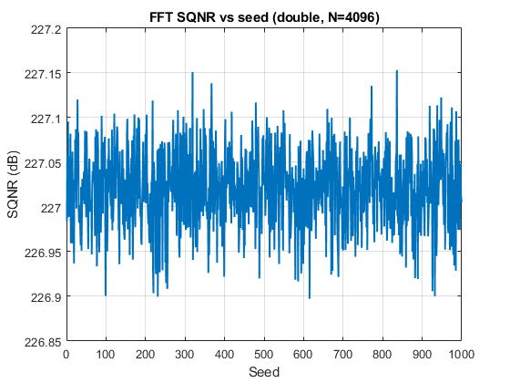
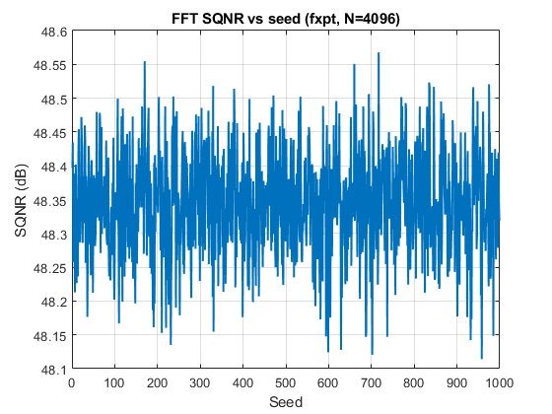
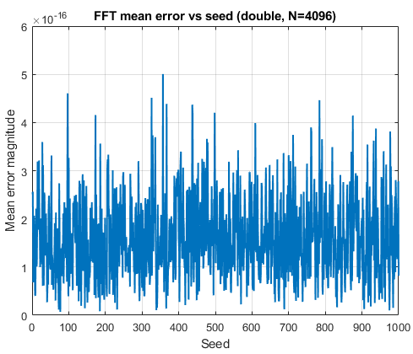
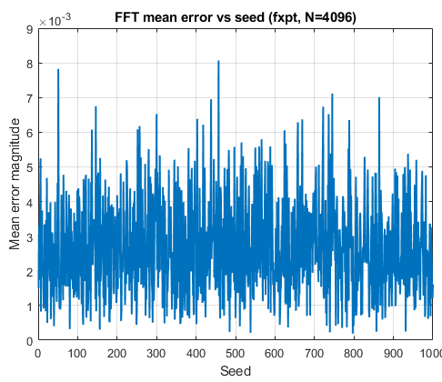


Modeling : SQNR analysis
 | FlPt | FxPt
SQNR
Mean Error
Average SQNR = 227.02 dB
Average SQNR = 48.35 dB
Avg Mean error : 1.59 × ${10}^{−16}$
Avg Mean error: 2.417 × ${10}^{−3}$
System Modeling
Algorithm and Architecture
SDF Block diagram
Fixed point analysis
SQNR analysis
Challenges

Slide 45
Modeling : Challenges
SQNR optimization
Recall : General block diagram
SDF DIF radix-2
12 bits input
S1
S2
S12
12 bits output
2
2
System Modeling
Algorithm and Architecture
SDF Block diagram
Fixed point analysis
SQNR analysis
Challenges

Slide 46


Modeling : Challenges
$$Total Number of Bits=Integer bits+Fractional bits$$
SDF DIF radix-2
12 bits input
S1
S2
S12
12 bits output
2
2
System Modeling
Algorithm and Architecture
SDF Block diagram
Fixed point analysis
SQNR analysis
Challenges

Slide 47
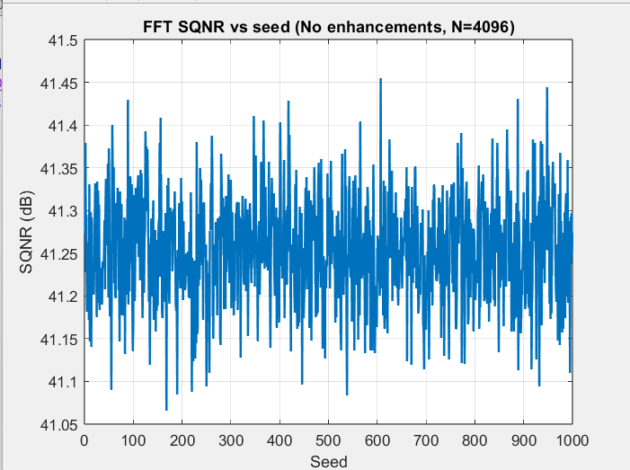
Modeling : Challenges
Level 1 (Floor rounding – No delayed quantization )
Level 1
Floor rounding
No delayed quantization
Bit truncation
41.25 dB
Could we do better ?
System Modeling
Algorithm and Architecture
SDF Block diagram
Fixed point analysis
SQNR analysis
Challenges

Slide 48
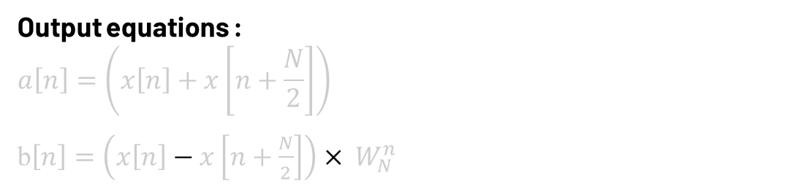
Modeling : Challenges
Level 2 (Floor rounding – No delayed quantization )
Recall :
Output equations :
$$a\left[n\right]=\left(x\left[n\right]+x\left[n+\frac{N}{2}\right]\right)$$
b$\left[n\right]=\left(x\left[n\right]−x\left[n+\frac{N}{2}\right]\right){× W}_{N}^{n}$
Level 1
Floor rounding
No delayed quantization
Bit truncation
Datapath Optimization: Delaying truncation until after the twiddle factor multiplication to improve SQNR
41.25 dB
System Modeling
Algorithm and Architecture
SDF Block diagram
Fixed point analysis
SQNR analysis
Challenges

Slide 49
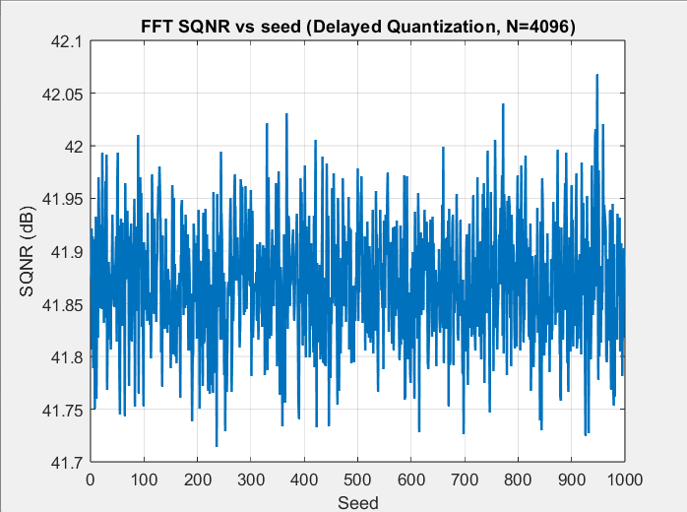
Modeling : Challenges
Level 2 (Floor rounding – delayed quantization )
Level 1
Level 2
Floor rounding
No delayed quantization
Bit truncation
Floor rounding
delayed quantization
Bit truncation
0.75 dB
41.25 dB
41.9 dB
Small change , but can we take the SQNR to the next level ?
System Modeling
Algorithm and Architecture
SDF Block diagram
Fixed point analysis
SQNR analysis
Challenges

Slide 50
Modeling : Challenges
Level 3 (Convergent rounding – delayed quantization )
Fimath (Fixed-point Mathematic object)
RoundingMethod:
1-Floor
2-Celling
3-Zero
4-Nearest
5-Round
6-Convergent
Level 1
Level 2
Floor rounding
No delayed quantization
Bit truncation
Floor rounding
delayed quantization
Bit truncation
0.75 dB
41.25 dB
41.9 dB
OverflowAction:
1-Saturate
2-Wrap
System Modeling
Algorithm and Architecture
SDF Block diagram
Fixed point analysis
SQNR analysis
Challenges

Slide 51
Modeling : Challenges
1-Floor
2-Celling
3-Zero
4-Nearest
5-Round
6-Convergent
Level 3 (Convergent rounding – delayed quantization )
Fimath (Fixed-point Mathematic object)
RoundingMethod:
Advantages:
Eliminates rounding bias
Prevents error accumulation across stages
Improves SQNR performance
Matches RTL hardware implementation
Industry standard in DSP hardware
Level 2
Level 1
Floor rounding
No delayed quantization
Bit truncation
Floor rounding
delayed quantization
Bit truncation
0.75 dB
41.25 dB
41.9 dB
System Modeling
Algorithm and Architecture
SDF Block diagram
Fixed point analysis
SQNR analysis
Challenges

Slide 52
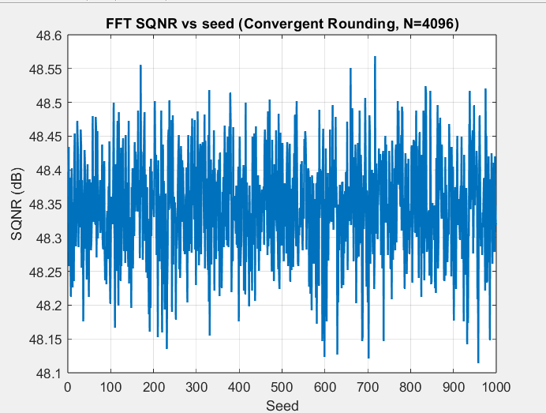
Modeling : Challenges
Level 3 (Convergent rounding – delayed quantization )
Level 3
Convergent rounding
delayed quantization
Bit truncation
6.45 dB
Level 1
Level 2
Floor rounding
No delayed quantization
Bit truncation
Floor rounding
delayed quantization
Bit truncation
0.75 dB
48.35 dB
41.25 dB
41.9 dB
System Modeling
Algorithm and Architecture
SDF Block diagram
Fixed point analysis
SQNR analysis
Challenges

Slide 53
Agenda
System definition
Modeling
RTL
HW/SW Co-design (HW Part)
HW/SW Co-design (SW Part)

Slide 54
RTL

Slide 55
Agenda
RTL
SDF Block diagram
Stage Block diagram
Stage main component
FSM
Simulation results
Challenges
Final Architecture

Slide 56





RTL : stage block diagram
SDF DIF radix-2
$$\frac{N}{2} FIFO$$
$$\frac{N}{4} FIFO$$
$$1$$
12 bits input
R2
R2
R2
12 bits output
2
2
Let's focus on the architecture of a single stage
SDF DIF radix-2
$$\frac{N}{2} FIFO$$
$$\frac{N}{4} FIFO$$
$$1$$
12 bits input
R2
R2
R2
12 bits output
2
2
SDF Block diagram
Stage Block Diagram
Stage Main Component
FSM
Simulation results
Challenges
Final Architecture

Slide 57
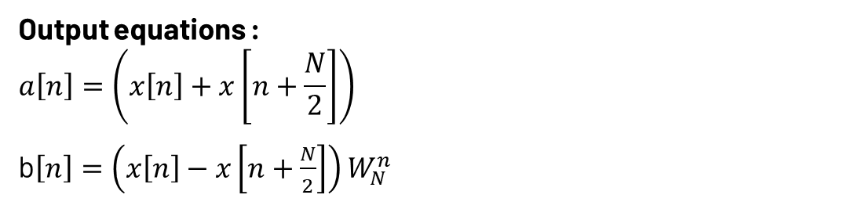
RTL : stage block diagram
FIFO
0
Butterfly
Mux
1
12 bits output
2
12 bits input
0
0
Mux
2
1
Mux
1
Twiddle factor ROM
Output equations :
$$a\left[n\right]=\left(x\left[n\right]+x\left[n+\frac{N}{2}\right]\right)$$
b$\left[n\right]=\left(x\left[n\right]−x\left[n+\frac{N}{2}\right]\right)W_{N}^{n}$
SDF Block diagram
Stage Block Diagram
Stage Main Component
FSM
Simulation results
Challenges
Final Architecture

Slide 58
RTL : stage main component
1- Butterfly Function: the core of the stage it does both addition and subtraction, and, in some implementation, it contains also the multiplier block
2- Multiplier Function: Multiplication the output difference from the Butterfly unit
FIFO
0
Butterfly
Mux
1
12 bits output
2
12 bits input
0
0
Mux
2
1
Mux
1
Twiddle factor ROM
SDF Block diagram
Stage Block Diagram
Stage Main Component
FSM
Simulation results
Challenges
Final Architecture

Slide 59

RTL : stage main component
3- Output multiplexer Function: It is used to route the difference (output of the FIFO) and summation to the output (the next stage)
4- Bypass multiplexer Function: It is used to Bypass the summation without multiplying it by the twiddle factors
5- Twiddle factor ROM Function: It holds the values of twiddle factors
FIFO
0
Butterfly
Mux
1
12 bits output
2
0
12 bits input
0
Mux
0
Mux
2
1
Mux
1
1
Twiddle factor ROM
Twiddle factor ROM
SDF Block diagram
Stage Block Diagram
Stage Main Component
FSM
Simulation results
Challenges
Final Architecture

Slide 60
RTL : stage main component
6- FIFO: Function: It’s used to store the input and the difference from the Butterfly unit
7- FIFO multiplexer Function: It’s used to route the input and the output difference to the FIFO
FIFO
0
Butterfly
Mux
1
12 bits output
2
12 bits input
0
12 bits input
0
Mux
2
0
2
1
Mux
Mux
1
1
Twiddle factor ROM
SDF Block diagram
Stage Block Diagram
Stage Main Component
FSM
Simulation results
Challenges
Final Architecture

Slide 61
RTL: FSM
For demonstration purposes, we will use an 8-point FFT (N=8) , while each stage has its own FSM we will work on stage (1) so the size of FIFO=N/2=4
!valid_in
IDLE_S
count_done && !valid_in
Valid_in
BF_S
!count_done
FILL_S
0
count_done
Butterfly
Mux
!count_done
1
12 bits output
BF_S
2
12 bits input
0
0
Mux
count_done
2
Mux
1
count_done && valid_in
1
Twiddle factor ROM
DRAIN_S
!count_done
SDF Block diagram
Stage Block Diagram
Stage Main Component
FSM
Simulation results
Challenges
Final Architecture

Slide 62
RTL: FSM
The first state is the IDLE state. The system remains inactive until the wake-up signal
(valid_in) is asserted. This signal is generated by external logic
alongside the input data this is for stage (1) but for the other stages it comes
From the (valid_out) of the previous stage
!valid_in
IDLE_S
count_done && !valid_in
Valid_in
BF_S
!count_done
FILL_S
0
count_done
Butterfly
Mux
!count_done
1
12 bits output
BF_S
2
x3
x2
x1
x0
0
0
Mux
count_done
2
Mux
1
count_done && valid_in
1
Twiddle factor ROM
valid_in
DRAIN_S
!count_done
SDF Block diagram
Stage Block Diagram
Stage Main Component
FSM
Simulation results
Challenges
Final Architecture

Slide 63
RTL: FSM
After waking up, the finite state machine (FSM) transitions to the Fill state.
As the name implies, during this state,
the first half of the input samples are loaded into the FIFO.
!valid_in
IDLE_S
count_done && !valid_in
Valid_in
BF_S
!count_done
FILL_S
0
count_done
Butterfly
Mux
!count_done
1
12 bits output
BF_S
x7
x6
x5
x4
2
x3
x2
x1
x0
0
0
Mux
count_done
2
Mux
1
count_done && valid_in
1
Twiddle factor ROM
valid_in
DRAIN_S
!count_done
SDF Block diagram
Stage Block Diagram
Stage Main Component
FSM
Simulation results
Challenges
Final Architecture

Slide 64
RTL: FSM
In the Butterfly state, the second half of the input arrives and bypasses the FIFO. Instead, it is processed directly with the first half that we stored earlier. Regarding the outputs of the Butterfly unit: the sum goes directly to the next stage through the output MUX, while the difference is loaded back into the FIFO for the next cycle It is also important to note that once the first output is available, the valid_out signal is asserted to notify the subsequent stage
!valid_in
IDLE_S
count_done && !valid_in
Valid_in
BF_S
!count_done
FILL_S
x0
x1
x2
x3
0
count_done
Butterfly
Mux
!count_done
1
BF_S
x7
x6
x5
x4
S0
2
0
D0
0
Mux
count_done
2
Mux
1
count_done && valid_in
1
Twiddle factor ROM
valid_out
valid_in
DRAIN_S
!count_done
SDF Block diagram
Stage Block Diagram
Stage Main Component
FSM
Simulation results
Challenges
Final Architecture

Slide 65
RTL: FSM
In the Butterfly state, the second half of the input arrives and bypasses the FIFO. Instead, it is processed directly with the first half that we stored earlier. Regarding the outputs of the Butterfly unit: the sum goes directly to the next stage through the output MUX, while the difference is loaded back into the FIFO for the next cycle It is also important to note that once the first output is available, the valid_out signal is asserted to notify the subsequent stage
!valid_in
IDLE_S
count_done && !valid_in
Valid_in
BF_S
!count_done
FILL_S
D0 D1 D2 D3
S0
S1
S2
S3
0
count_done
Butterfly
Mux
!count_done
x3 x2 x1 x0
1
BF_S
2
x7 x6 x5 x4
0
0
Mux
count_done
2
Mux
1
count_done && valid_in
1
Twiddle factor ROM
valid_out
valid_in
DRAIN_S
!count_done
SDF Block diagram
Stage Block Diagram
Stage Main Component
FSM
Simulation results
Challenges
Final Architecture

Slide 66
RTL: FSM
Finally, we reach the Drain state. Here, we perform two operations concurrently. The stored difference data is multiplied by the appropriate twiddle factor and then routed to the next stage. Simultaneously, we load the incoming data for the next frame directly into the FIFO to keep the pipeline completely full.
!valid_in
IDLE_S
count_done && !valid_in
Valid_in
BF_S
!count_done
FILL_S
D0
D1
D2
D3
0
count_done
Butterfly
Mux
!count_done
1
BF_S
2
x3
x2
x1
x0
0
0
Mux
count_done
2
Mux
1
count_done && valid_in
1
Twiddle factor ROM
valid_out
valid_in
DRAIN_S
!count_done
SDF Block diagram
Stage Block Diagram
Stage Main Component
FSM
Simulation results
Challenges
Final Architecture

Slide 67
RTL: FSM
Finally, we reach the Drain state. Here, we perform two operations concurrently. The stored difference data is multiplied by the appropriate twiddle factor and then routed to the next stage. Simultaneously, we load the incoming data for the next frame directly into the FIFO to keep the pipeline completely full.
!valid_in
IDLE_S
count_done && !valid_in
Valid_in
BF_S
!count_done
FILL_S
x0 x1 x2 x3
D0
D1
D2
D3
0
count_done
Butterfly
Mux
!count_done
1
BF_S
D0 D1 D2 D3
2
x7
x6
x5
x4
0
0
Mux
count_done
2
Mux
1
count_done && valid_in
1
Twiddle factor ROM
valid_out
valid_in
DRAIN_S
!count_done
SDF Block diagram
Stage Block Diagram
Stage Main Component
FSM
Simulation results
Challenges
Final Architecture

Slide 68
RTL: FSM
From this point, the FSM simply alternates between the Butterfly and Drain states to continuously process the incoming data. This loop continues as long as data is flowing. Once the valid_in signal is De-asserted , meaning we have reached the end of the packet , the FSM transitions back to the IDLE state, ready for the next frame.
!valid_in
IDLE_S
count_done && !valid_in
Valid_in
BF_S
!count_done
FILL_S
count_done
!count_done
BF_S
count_done
count_done && valid_in
DRAIN_S
!count_done
SDF Block diagram
Stage Block Diagram
Stage Main Component
FSM
Simulation results
Challenges
Final Architecture

Slide 69

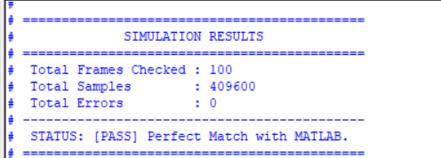
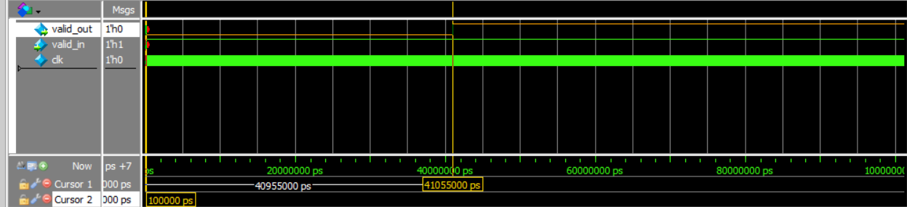

RTL: Simulation results and latency calculation
Verification Results for 100 Frames
Latency calculation check == (N-1 )
Latency= $\frac{40955000}{10000}=4095.5 cycles$
SDF Block diagram
Stage Block Diagram
Stage Main Component
FSM
Simulation results
Challenges
Final Architecture

Slide 70
RTL: Challenges
Rounding vs truncation (flooring )
FIFO
0
Butterfly
Mux
1
12 bits output
2
Convergent Rounding
12 bits input
0
0
Mux
2
1
Mux
1
Twiddle factor ROM
SDF Block diagram
Stage Block Diagram
Stage Main Component
FSM
Simulation results
Challenges
Final Architecture

Slide 71
RTL: Challenges
Convergent Rounding
Convergent Rounding
13-bit input
12-bit output
(rounding to the nearest even number)
Ex:
13-bit input
0 | 0 | 0 | 0 | 0 | 0 | 0 | 0 | 1 | 1 | 0 | 0 | 1
12-bit output
0 | 0 | 0 | 0 | 0 | 0 | 0 | 0 | 1 | 1 | 0 | 0
As we can see we didn’t round the LSB (0) as it’s even but what if the LSB was 1 ? Let’s see
SDF Block diagram
Stage Block Diagram
Stage Main Component
FSM
Simulation results
Challenges
Final Architecture

Slide 72
RTL: Challenges
Convergent Rounding
Ex:
13-bit input
0 | 0 | 0 | 0 | 0 | 0 | 0 | 0 | 1 | 1 | 0 | 1 | 1
12-bit output
0 | 0 | 0 | 0 | 0 | 0 | 0 | 0 | 1 | 1 | 1 | 0
We rounded it up, so it became even and to understand the logic let’s call the bit (1) in the input L and the bit (0) S then we have rounded bit Which= L & S and then we take this rounded bit and add it to the input [12:1]
let’s revisit the last example again
L
S
13-bit input
0 | 0 | 0 | 0 | 0 | 0 | 0 | 0 | 1 | 1 | 0 | 1 | 1
L=1 , S=1 -> rounded bit =1 , output= input [12:1] + rounded bit = [000000001101]+[1’b1] =[000000001110]
SDF Block diagram
Stage Block Diagram
Stage Main Component
FSM
Simulation results
Challenges
Final Architecture

Slide 73
RTL: Challenges
Convergent Rounding
Let’s compare Convergent Rounding to other two rounding methods (Round-floor )
Recall :
Rounding Methods :
1-Floor
2-Celling
3-Zero
4-Nearest
5-Round
6-Convergent
SDF Block diagram
Stage Block Diagram
Stage Main Component
FSM
Simulation results
Challenges
Final Architecture

Slide 74
RTL: Challenges
Convergent Rounding
Why does the convergent rounding enhance the SQNR by 6 dB compared to floor rounding ?
This is because Floor rounding consistently rounds down, introducing a DC offset that degrades the SQNR
 | Floor | Convergent rounding
SQNR
Average SQNR = 41.9 dB
Average SQNR = 48.35 dB
SDF Block diagram
Stage Block Diagram
Stage Main Component
FSM
Simulation results
Challenges
Final Architecture

Slide 75
RTL: Challenges
Convergent Rounding
Why does Convergent Rounding enhance the SQNR by ~2 dB compared to Standard Rounding (Round) ?
Standard Rounding Issue: It rounds up for positive signals and down for negative signals. While this doesn't introduce a DC offset, it makes the quantization error dependent on the signal itself. This correlation creates unwanted harmonics.
The Convergent Advantage: It breaks ties based on the Least Significant Bit (LSB). Since the LSB acts as a random variable, it decorrelates the error from the signal, turning the error into evenly distributed "white noise."
Proof in Frequency Domain: Let’s look at the next demo lab result. We input a single-tone signal and monitored the error spectrum for both methods to see this difference clearly
SDF Block diagram
Stage Block Diagram
Stage Main Component
FSM
Simulation results
Challenges
Final Architecture

Slide 76
RTL: Challenges
Convergent Rounding
 | Time domain | Frequency domain
Round
Convergent Rounding
SDF Block diagram
Stage Block Diagram
Stage Main Component
FSM
Simulation results
Challenges
Final Architecture

Slide 77
RTL: Challenges
Convergent Rounding
As seen in the previous figure, when the error is dependent on the signal, it introduces severe distortion in the frequency domain. In contrast, with Convergent Rounding, the error becomes like noise spread evenly across all frequencies
Note: Rounding and Convergent Rounding behave identically for any value not exactly at 0.5 (e.g., both round 3.4 to 3, and 3.6 to 4). Their behavior only diverges at exact half-way points (e.g., 3.5) due to their different tie-breaking rules
Example: Q11.1 to Q12.0 Conversion Let's assume the input value is 2.5. We need to remove the 1 fractional bit to get an integer output (Q12.0).
Convergent Rounding: Rounds to the nearest even number → 2
Standard Round: Rounds up (away from zero) → 3
Floor (Truncation): Rounds down → 2
Final Note: Round and Convergent Rounding outperform Floor not only by preventing severe DC offset, but also by minimizing the maximum quantization error. They introduce a worst-case error of 0.5 LSB, whereas Floor introduces an error approaching 1 LSB
SDF Block diagram
Stage Block Diagram
Stage Main Component
FSM
Simulation results
Challenges
Final Architecture

Slide 78
RTL: Challenges
Convergent Rounding
 | Convergent Rounding | Floor | Round
DC offset | No | Yes | No
Maximum Quantization error | 0.5 bit | 1 bit | 0.5 bit
SQNR values | 48.35 dB | 41.9 dB | 46.4dB
SDF Block diagram
Stage Block Diagram
Stage Main Component
FSM
Simulation results
Challenges
Final Architecture

Slide 79
RTL: Challenges
Different Q notation form sum and multiplier
FIFO
0
Butterfly
Mux
Q3.9
1
Q2.10
2
0
0
Q2.10
Mux
2
Mux
Q3.9
1
1
Twiddle factor ROM
SDF Block diagram
Stage Block Diagram
Stage Main Component
FSM
Simulation results
Challenges
Final Architecture

Slide 80
RTL: Challenges
Bit reversal :
Recall :
x(0)
8-point FFT
X(0)
x(0)
8-point FFT
X(0)
x(1)
X(4)
x(1)
X(1)
x(2)
X(2)
x(2)
X(2)
x(3)
X(6)
x(3)
X(3)
x(4)
X(1)
x(4)
X(4)
x(5)
X(5)
x(5)
X(5)
x(6)
X(3)
x(6)
X(6)
x(7)
X(7)
x(7)
X(7)
Scrambled Output
Ordered Output
SDF Block diagram
Stage Block Diagram
Stage Main Component
FSM
Simulation results
Challenges
Final Architecture

Slide 81
RTL: Challenges
Ping-Pong memory architecture
1-Write in Memory A (7 Clock cycles) Latency
8-point FFT
SDF - DIF
X(0)
X(4)
x(n)
Scrambled Output
Memory (A)
SDF Block diagram
Stage Block Diagram
Stage Main Component
FSM
Simulation results
Challenges
Final Architecture

Slide 82
RTL: Challenges
Ping-Pong memory architecture
1-Write in Memory A (7 Clock cycles) Latency
2-Fill in Memory after (15 Clock cycles) Latency
8-point FFT
SDF - DIF
X(0)
X(1)
X(2)
X^(0)
X^(4)
X(3)
x(n)
Scrambled Output
X(4)
Ordered Output
X(5)
X(6)
X(7)
Memory (A)
SDF Block diagram
Stage Block Diagram
Stage Main Component
FSM
Simulation results
Challenges
Final Architecture

Slide 83
RTL: Challenges
Ping-Pong memory architecture
1-Write in Memory A (7 Clock cycles) Latency
2-Fill in Memory after (15 Clock cycles) Latency
3-Add another Memory (B) to receive the second frame
8-point FFT
SDF - DIF
X(0)
X(1)
X(2)
X^(0)
X^(4)
X(3)
x(n)
Scrambled Output
X(4)
Ordered Output
X(5)
X(6)
X(7)
Memory (B)
Memory (A)
SDF Block diagram
Stage Block Diagram
Stage Main Component
FSM
Simulation results
Challenges
Final Architecture

Slide 84
RTL: Challenges
Ping-Pong memory architecture
1-Write in Memory A (7 Clock cycles) Latency
2-Fill in Memory after (15 Clock cycles) Latency
3-Add another Memory (B) to receive the second frame
4-Switch the roles: Now Memory A receives the data while Memory B outputs it
8-point FFT
SDF - DIF
X^(0)
X^(1)
X^(2)
X^(3)
x(n)
Scrambled Output
X^(4)
Ordered Output
X^(5)
X^(6)
X^(6)
Memory (B)
Memory (A)
SDF Block diagram
Stage Block Diagram
Stage Main Component
FSM
Simulation results
Challenges
Final Architecture

Slide 85
RTL: Challenges
Ping-Pong memory architecture
1-Write in Memory A (7 Clock cycles) Latency
2-Fill in Memory after (15 Clock cycles) Latency
3-Add another Memory (B) to receive the second frame
4-Switch the roles: Now Memory A receives the data while Memory B outputs it
8-point FFT
SDF - DIF
z
X^(0)
X^(1)
X^(2)
X^(3)
x(n)
Scrambled Output
X^(4)
Ordered Output
X^(5)
X^(6)
X^(6)
Memory (A)
Memory (B)
SDF Block diagram
Stage Block Diagram
Stage Main Component
FSM
Simulation results
Challenges
Final Architecture

Slide 86
RTL: Challenges
Bit reversal :
Problems :
Increasing the area (12.5 KB RAM )
Reducing the max frequency and increasing the power consumption
Increasing the latency form (N-1 ) to (2N-1)
Could we optimize the DIF scrambled output on the system level ?
Multiplexer
Equalizer
De-mapper
N-point FFT
Removing cyclic extension
from the channel
Output data
De-mapper
N-point FFT
Removing cyclic extension
from the channel
Rx (Base Station)
SDF Block diagram
Stage Block Diagram
Stage Main Component
FSM
Simulation results
Challenges
Final Architecture

Slide 87
RTL: Final Architecture
in_r
fft4096_dif
out_r
in_i
out_i
valid_in
valid_out
rst_n
Frame_done
clk
out_index
Singal Name | Function
in_r (input ) , in_r (input) | Input real and input imaginary
valid_in | Asserted when there is a valid input and Enable the FFT block
valid_out | Asserted when there is a valid output
out_r , out_i | output real and output imaginary
Frame done | Asserted when a frame ends ( for one pulse only )
out_index | The index of the current output
parameter (DATA_WIDTH) | The width of data input and output ports
parameter (ORDERED_OUTPUT) | (1) Ordered output , (0) Scrambled output
SDF Block diagram
Stage Block Diagram
Stage Main Component
FSM
Simulation results
Challenges
Final Architecture

Slide 88


RTL: Final Architecture
Ping-Pong
memory architecture
fft4096_dif
Scrambled Output
Ordered Output
(0) Scrambled output
ORDERED_OUTPUT
(1) Ordered output
SDF Block diagram
Stage Block Diagram
Stage Main Component
FSM
Simulation results
Challenges
Final Architecture

Slide 89
Agenda
System definition
Modeling
RTL
HW/SW Co-design (HW Part)
HW/SW Co-design (SW Part)

Slide 90
HW/SW Co-design (HW Part)

Slide 91
Agenda
HW/SW Co-design
Problem Statement
Butterfly Operation
RTL Design
Arithmetic Optimization
Pipeline Alignment
PULP Integration
Wrapper Architecture
SoC Modifications
Software & Verification (1)
Optimizations
Software & Verification (2)

Slide 92
HW/SW Co-design : Problem Statement
Objective:
Integrate a custom-designed Radix-2 FFT Butterfly hardware accelerator into the PULP platform as an AXI peripheral and drive it with a complete software FFT implementation.
Goal:
Validate correct hardware/software interaction.
Scope of current work:
Hardware Scope:
RTL of radix-2 Butterfly, Map the standalone butterfly accelerator to the AXI bus, design the protocol translation wrapper, and a simple Software validation using a simple C test.
Problem Statement
Arithmetic Optimization
Butterfly Operation
RTL Design
Pipeline Alignment
PULP integration
Wrapper Architecture
SoC Modifications
Software & Verification

Slide 93
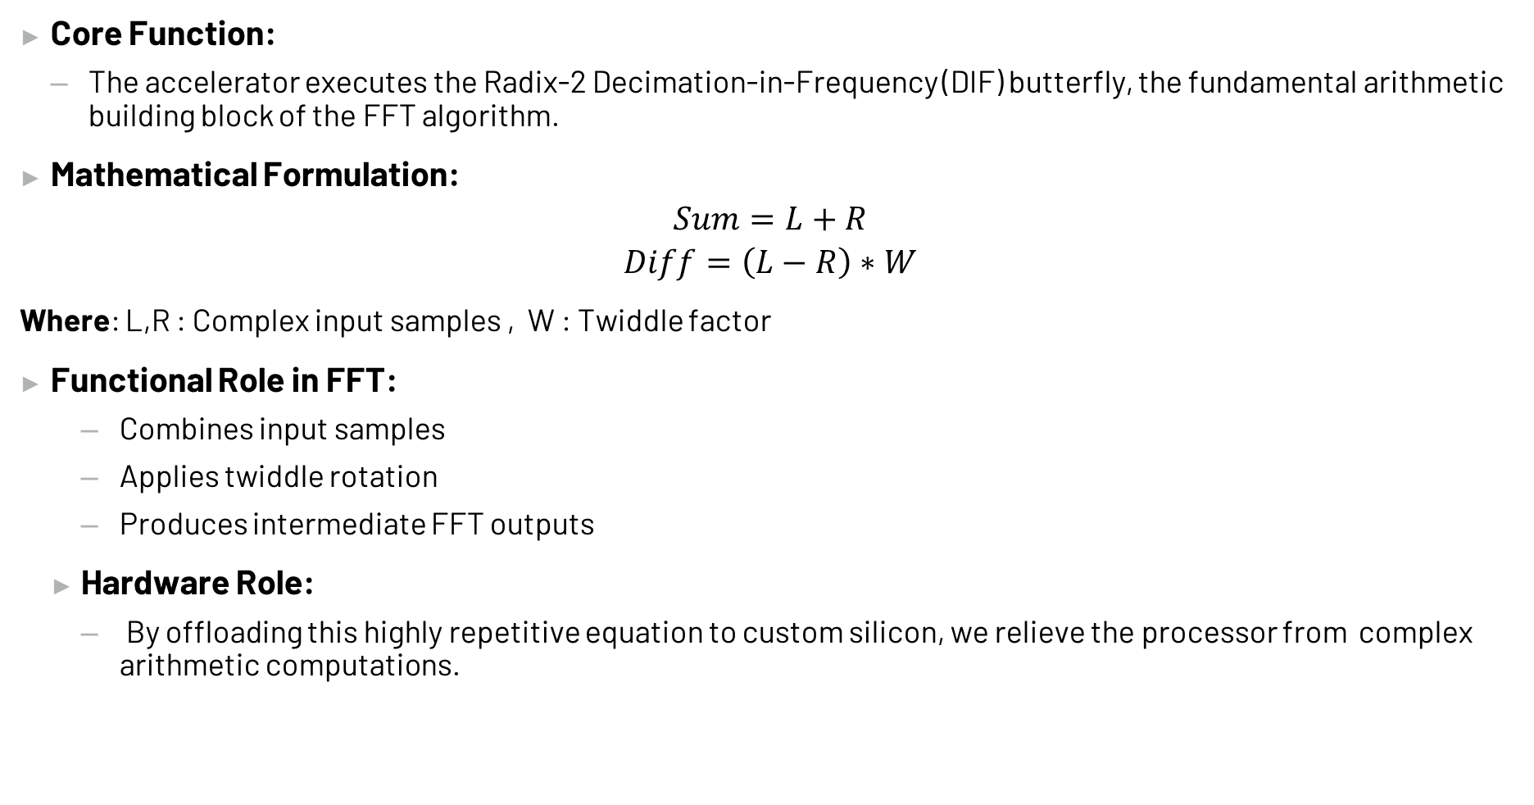
HW/SW Co-design : Butterfly Operation
Core Function:
The accelerator executes the Radix-2 Decimation-in-Frequency (DIF) butterfly, the fundamental arithmetic building block of the FFT algorithm.
Mathematical Formulation:
$$Sum=L+R$$
$$Diff=\left(L−R\right)∗W$$
Where: L,R : Complex input samples , W : Twiddle factor
Functional Role in FFT:
Combines input samples
Applies twiddle rotation
Produces intermediate FFT outputs
Hardware Role:
By offloading this highly repetitive equation to custom silicon, we relieve the processor from complex arithmetic computations.
Problem Statement
Arithmetic Optimization
Butterfly Operation
RTL Design
Pipeline Alignment
PULP integration
Wrapper Architecture
SoC Modifications
Software & Verification

Slide 94
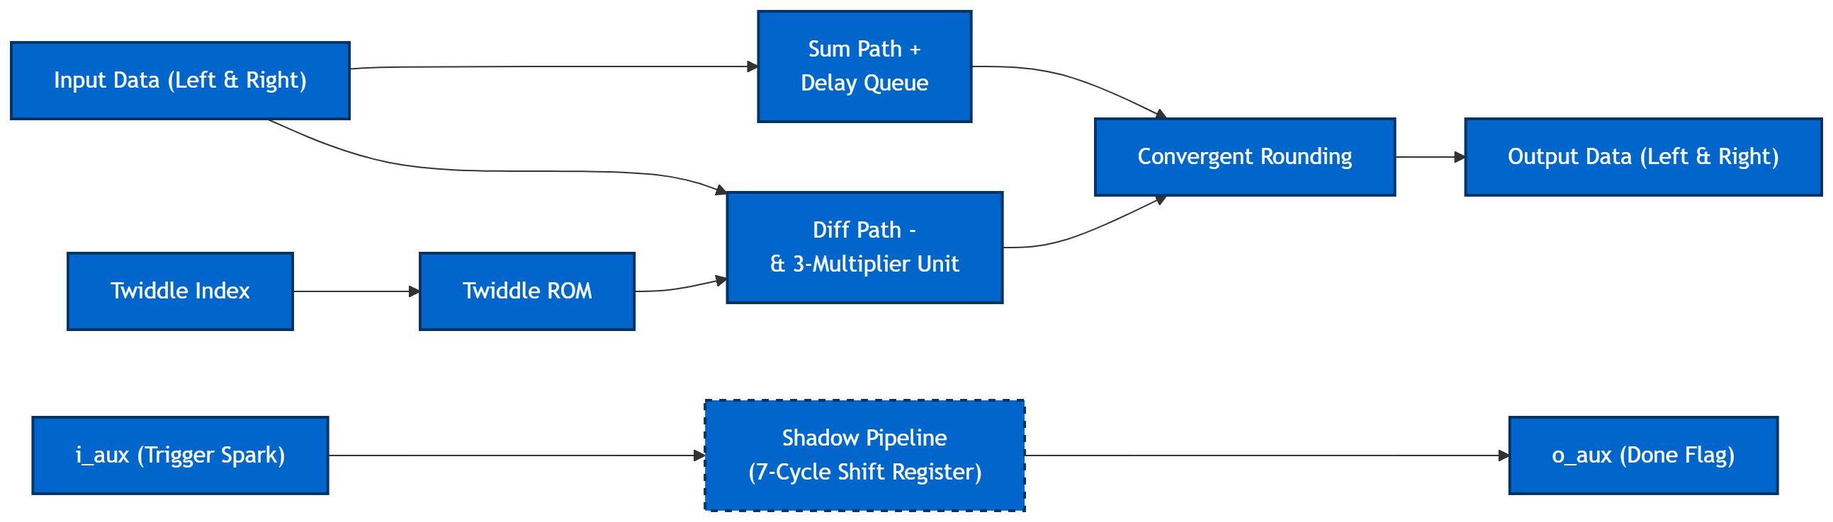
HW/SW Co-design : RTL Design
Core blocks:
Add/Subtract Units
Karatsuba Multiplier
Pipeline / Delay Alignment
Supporting Modules Originally:
bimpy
Base signed multiplier
Longbimpy
Extended precision multiplier
Supports larger operand widths
convround
Convergent rounding
Currently Used
standard multiplication logic
Problem Statement
Arithmetic Optimization
Butterfly Operation
RTL Design
Pipeline Alignment
PULP integration
Wrapper Architecture
SoC Modifications
Software & Verification

Slide 95
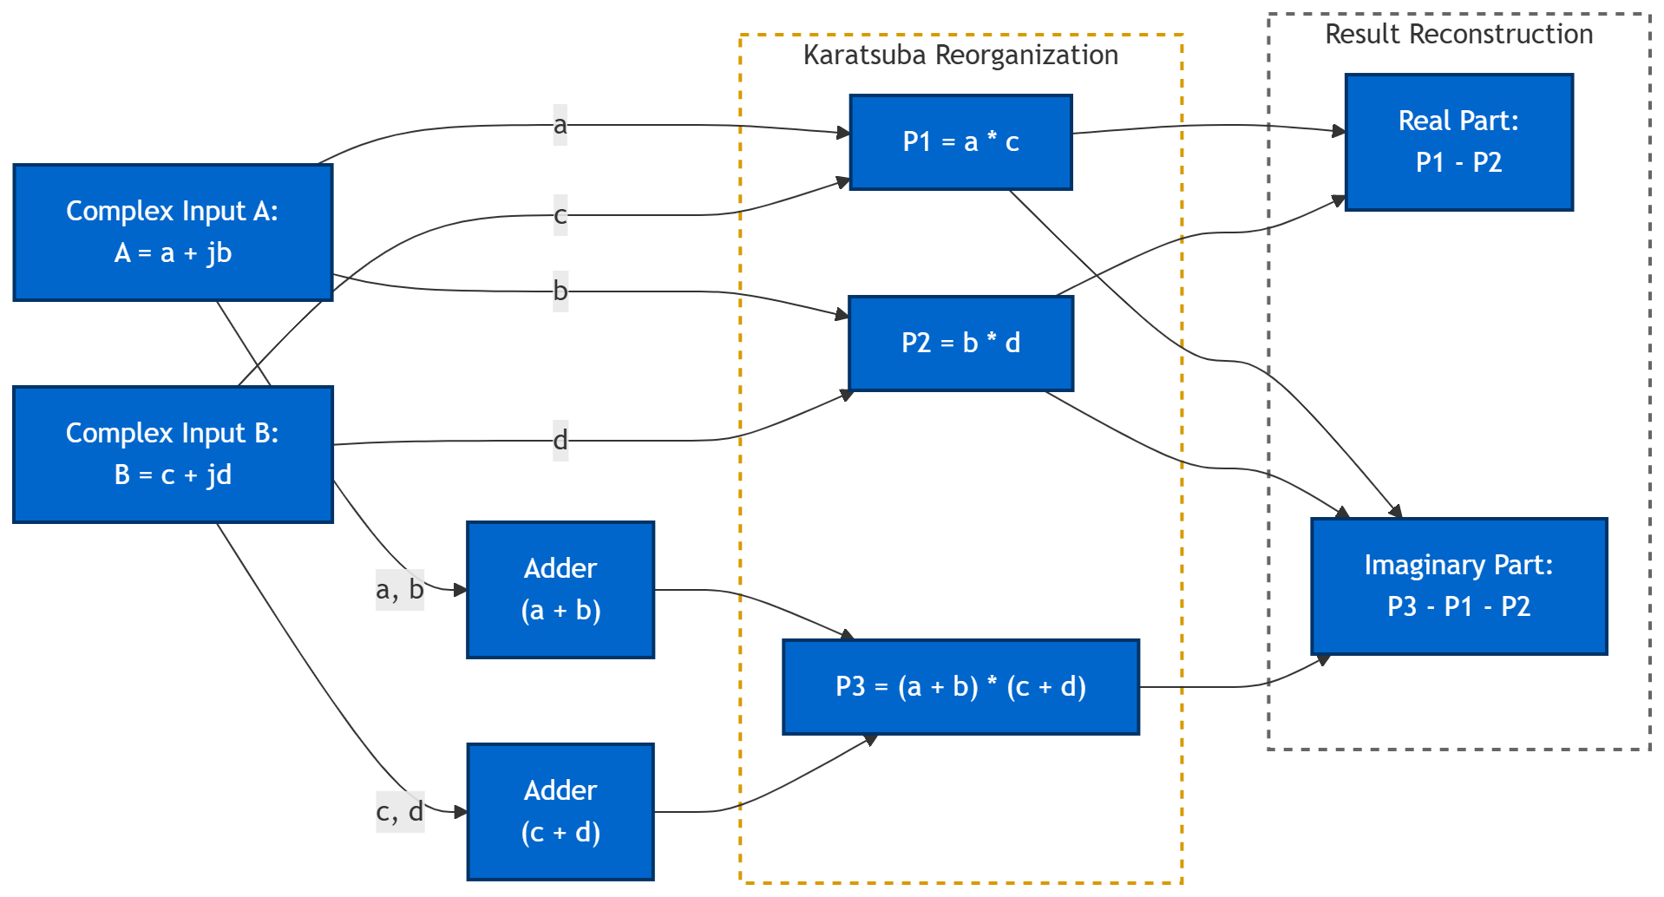
HW/SW Co-design : Arithmetic Optimization
The Hardware Challenge:
Complex multiplication is the most expensive operation in our entire Datapath.
A standard complex multiply requires 4 real multipliers.
The Optimization : Karatsuba Algorithm
Reformulated the multiplication logic. we complete the math using only 3 real multipliers.
Benefits:
Reduced multiplier count
Lower hardware area and power
The Price:
This approach requires adding extra Adders.
Problem Statement
Arithmetic Optimization
Butterfly Operation
RTL Design
Pipeline Alignment
PULP integration
Wrapper Architecture
SoC Modifications
Software & Verification

Slide 96
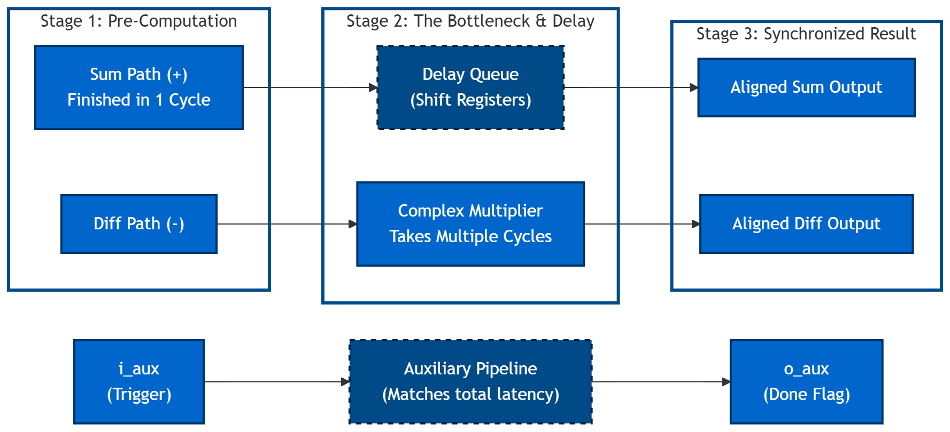
HW/SW Co-design : Pipeline Alignment
Motivation:
Multiplier introduces computation latency
Addition path is faster
Outputs must remain time-aligned
Implemented Solution:
Auxiliary Signal Propagation
Result:
The faster mathematical path is delayed to match the slower paths, ensuring the Sum and Difference outputs are aligned.
Problem Statement
Arithmetic Optimization
Butterfly Operation
RTL Design
Pipeline Alignment
PULP integration
Wrapper Architecture
SoC Modifications
Software & Verification

Slide 97
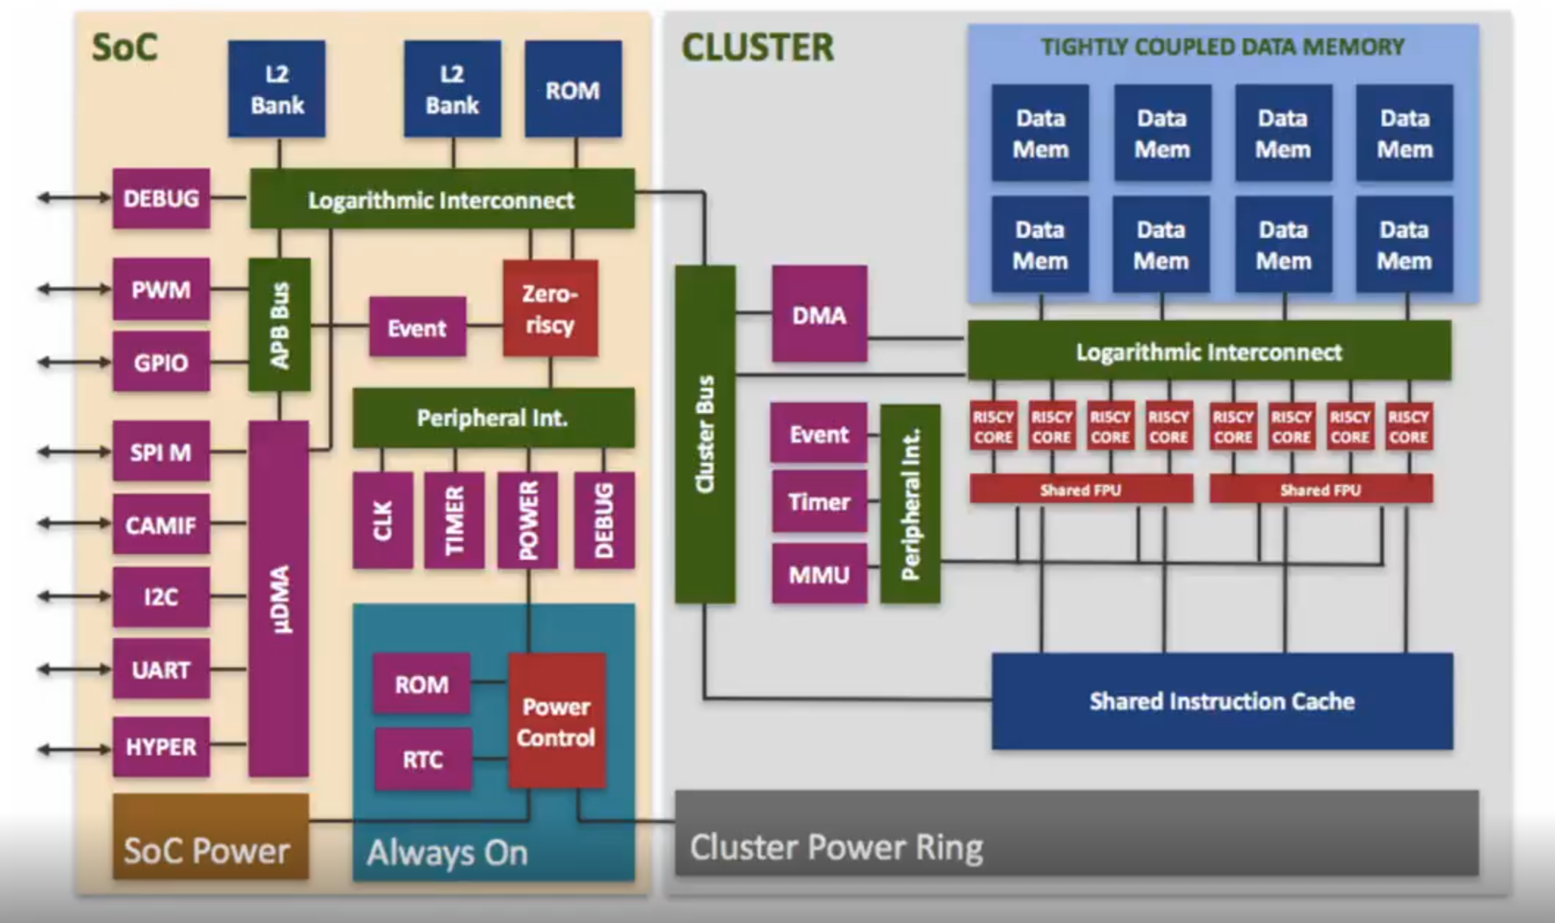
HW/SW Co-design : PULP Intergation
Objective:
Expose the butterfly accelerator as a memory-mapped AXI peripheral within the PULP SoC.
Pulp Architecture Overview
The TCDM:
Normal processors rely on invisible memory caches, which cause unpredictable delays.
PULP replaces caches with a Tightly Coupled Data Memory (TCDM)—a shared, ultra-fast scratchpad where Software must explicitly place data into the TCDM.
The System Actors:
Fabric Controller
Micro-DMA
Accelerators
Problem Statement
Arithmetic Optimization
Butterfly Operation
RTL Design
Pipeline Alignment
PULP integration
Wrapper Architecture
SoC Modifications
Software & Verification

Slide 98
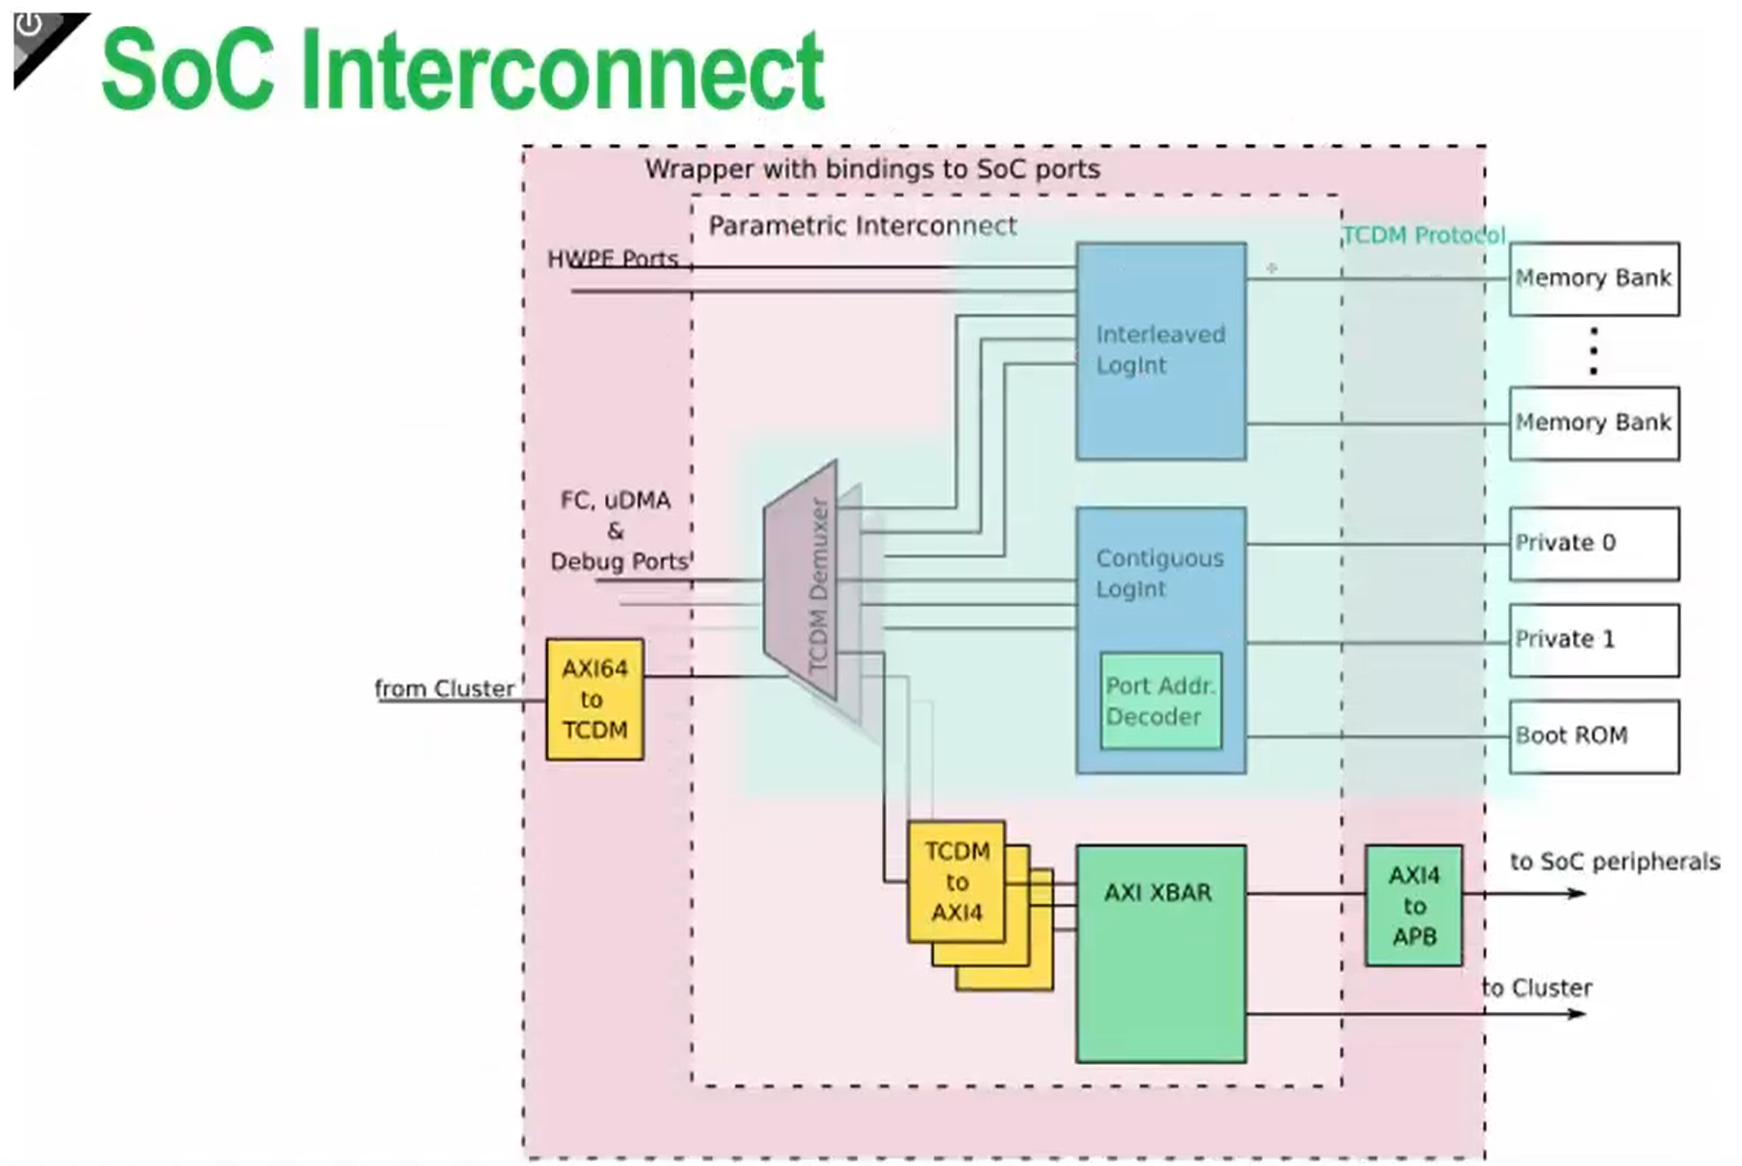
HW/SW Co-design :Highway System – Interconnects and Arbitration
Two Separate Traffic Networks:
TCDM Interconnect: reserved for fast operations, 1-cycle memory lookups.
AXI Crossbar: Built for complex components that needs multiple cycles.
How Software Talks to Hardware:
Address-Based Routing: Hardware doesn't have a name, only a memory address.
Two Paths of Communication:
The Control Path :The FC configures the hardware by writing values to these addresses.
The Data Path: Pushing the heavy payloads to the hardware so it can begin computation.
Wrapper
Accelerator
Problem Statement
Arithmetic Optimization
Pipeline Alignment
Butterfly Operation
RTL Design
PULP integration
SOC-Interconnect
Wrapper Architecture
Software & Verification

Slide 99
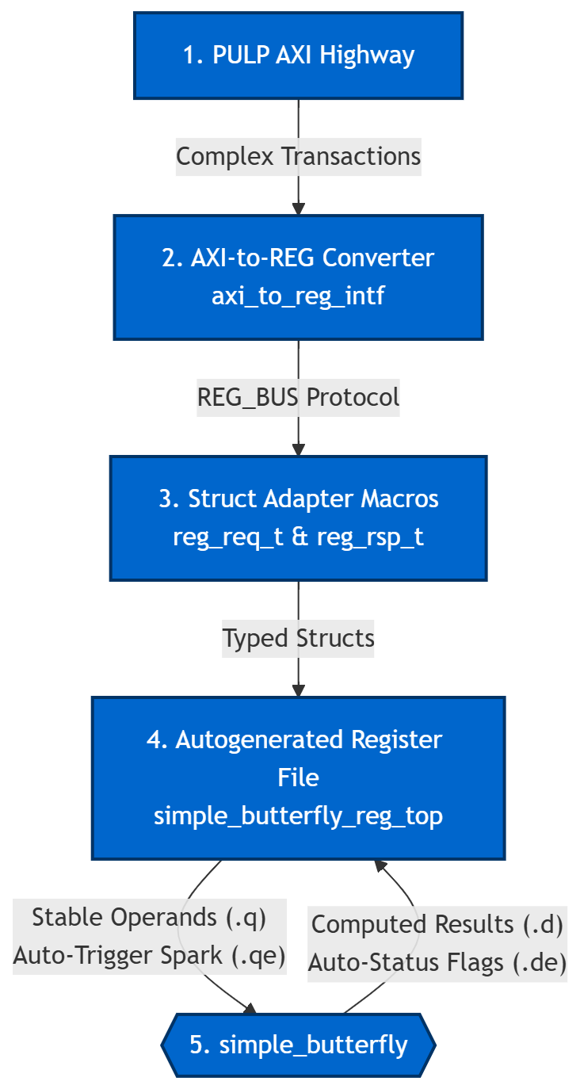
HW/SW Co-design : The Translation Wrapper
The Problem: AXI is Too Complex
Our custom accelerator doesn't know how to speak the complex AXI handshaking protocol.
Solution
Translate bus transactions into register-level control via wrapper
The Blueprint (The .hjson file)
A "contract" between software and hardware.
The Protocol Downgrade :
AXI → Protocol Converter → REG_BUS
REG_BUS → Macros → Structs
The Hardware Reality (.q , .qe, .d, .de) :
The auto-generated register file unpacks those Structs into raw electrical wires:
.q : Stable Data, .qe: The Spark (1-cycle trigger pulse)
.d : The Results from the hardware , .de : Data Enable.
Problem Statement
Arithmetic Optimization
Butterfly Operation
RTL Design
Pipeline Alignment
PULP integration
Wrapper Architecture
SoC Modifications
Software & Verification

Slide 100
HW/SW Co-design : Soc Modifications
Key Modifications:
Instantiated the top-level wrapper inside the pulp_soc.sv.
Added a dedicated AXI slave port to the system crossbar.
Extended the AXI interconnect routing logic to accommodate the new peripheral.
Updated the global SoC address map to recognize the accelerator.
Address Allocation:
Assigned a dedicated memory-mapped region for the Butterfly IP.
Result:
The custom accelerator is now a fully visible, permanently integrated node on the system bus. It is accessible through standard AXI memory transactions.
Problem Statement
Arithmetic Optimization
Butterfly Operation
RTL Design
Pipeline Alignment
PULP integration
Wrapper Architecture
SoC Modifications
Software & Verification

Slide 101
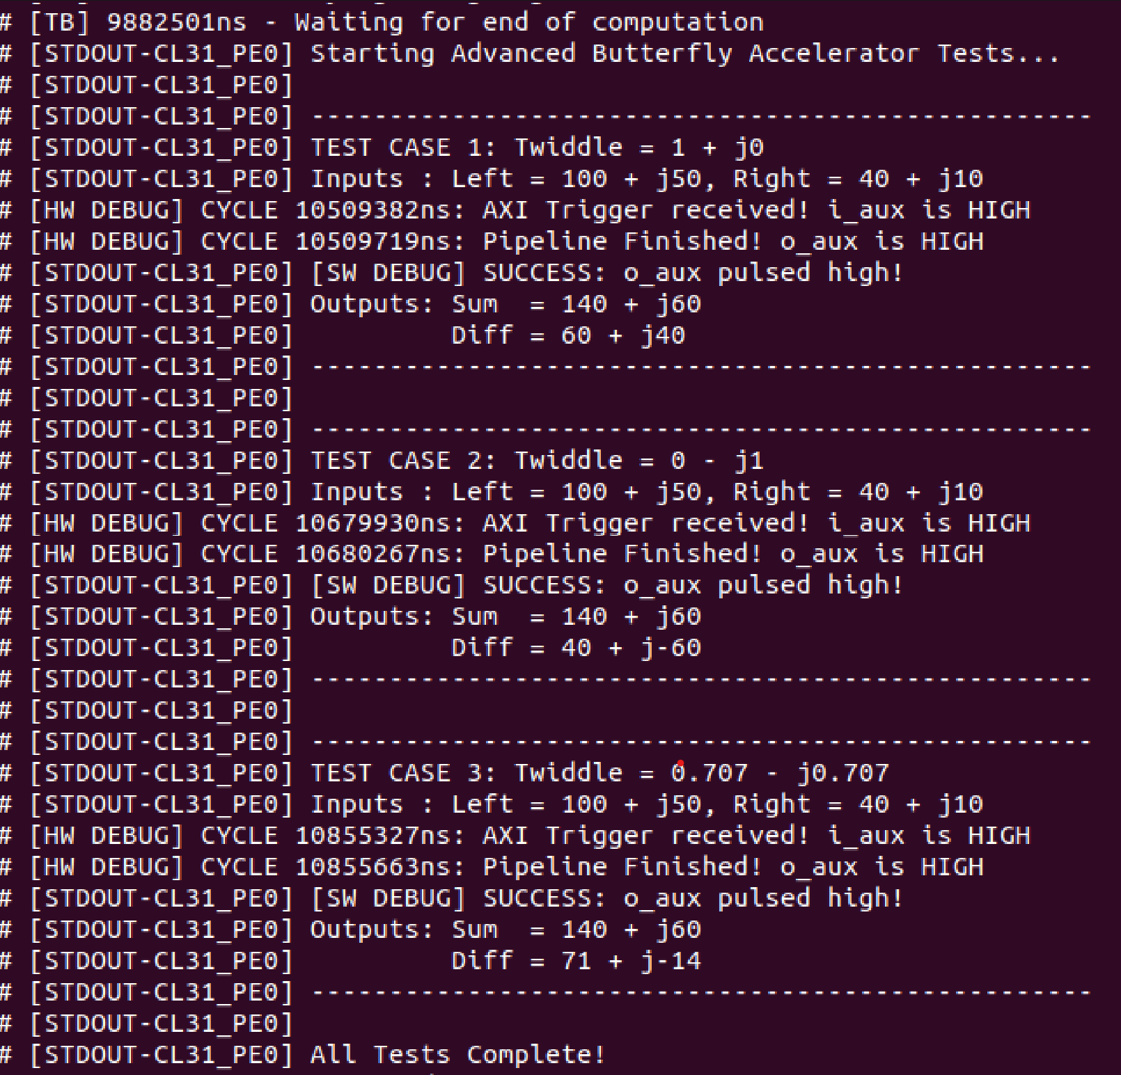
HW/SW Co-design : Software & Verification (1)
Step 1: Verify Integration &Mathematical Correctness
Results Match the results from the Written Testbench
Software Control:
Simple Custom C test application developed
Execution Flow:
Write inputs to registers
Trigger accelerator
Poll DONE status
Read computed outputs
Observed Results:
Correct butterfly arithmetic
Successful HW/SW communication
Measured Latency For Original butterfly was 442 cycle!!
Problem Statement
Arithmetic Optimization
Butterfly Operation
RTL Design
Pipeline Alignment
PULP integration
Wrapper Architecture
SoC Modifications
Software & Verification

Slide 102
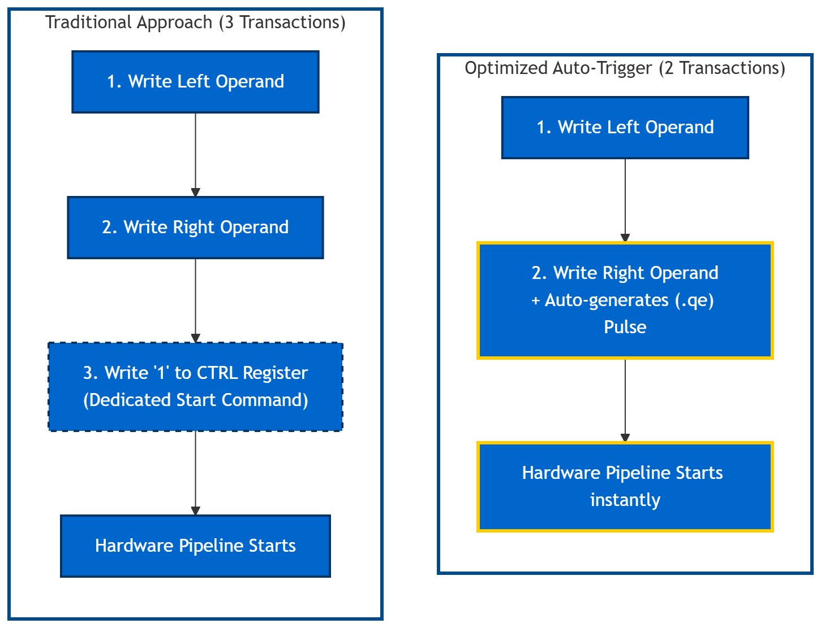
HW/SW Co-design : Optimization 1 – The Auto-Trigger
The Traditional Approach (3 Bus Transactions):
Software writes the Left Operand.
Software writes the Right Operand.
Software writes a '1' to a CTRL register to wake up the hardware.
Optimized Solution (2 Bus Transactions):
Eliminated the dedicated "Start" register.
Flagged the Right Operand register to generate a Write-Enable pulse.
The Benefit:
The hardware instantly fires up instantly.
Saves AXI transaction on every single butterfly
Result:
Number of Cycles taken for the End-to-end Butterfly execution decreased.

Slide 103
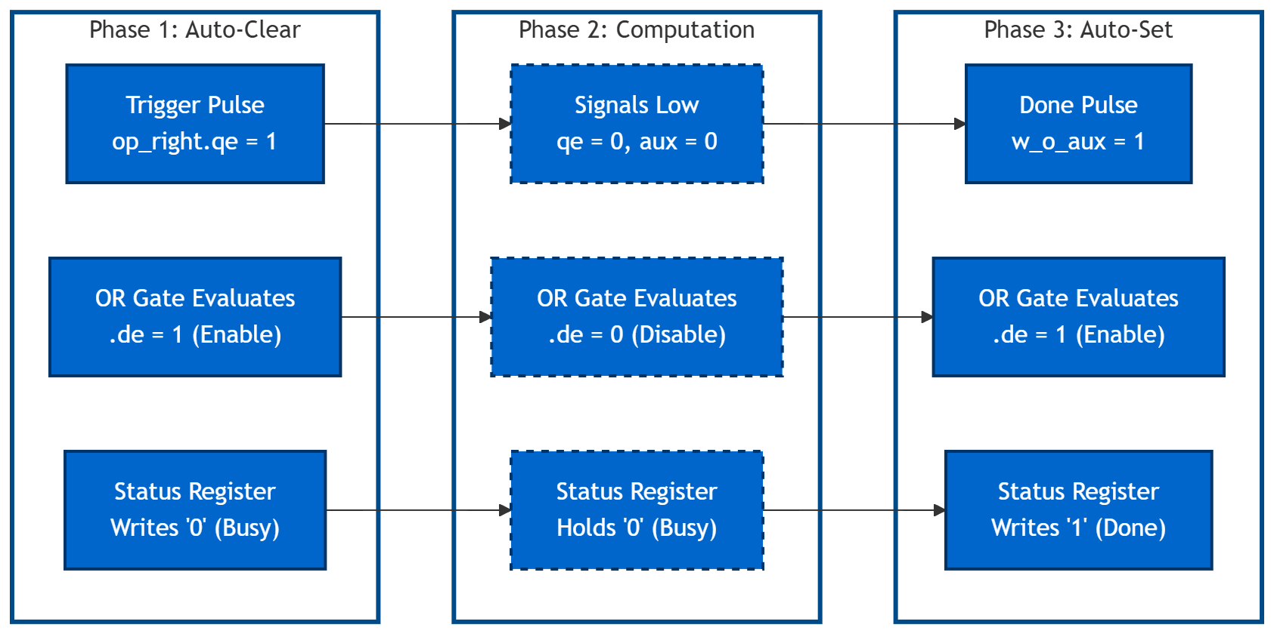
HW/SW Co-design : Optimization 2 – Auto-Status
The Polling Problem:
Software must manually clear this STATUS flag before new calculation, wasting an AXI transaction.
Solution (The .de Wire):
status.d = w_o_aux ? 1'b1 : 1’b0, status.de = w_o_aux | op_right.qe
Result:
Saved another AXI transaction. So,Number of Cycles taken for the End-to-end Butterfly execution decreased.

Slide 104
HW/SW Co-design : Software & Verification (2)
Step 2:Latency Profiling
Design Feature | Phase 1 (Pipelined) | Phase 2 (Pipelined) | Phase 3 (Pipelined) | Phase 4 (Flattened)
Operand Widths | Oversized: 34b In, 38b Out, 42b Twiddle | Corrected: 24b In, 24b Out, 32b Twiddle | Corrected: 24b In, 24b Out, 32b Twiddle | Corrected: 24b In, 24b Out, 32b Twiddle
Twiddle Delivery | Full payload passed over AXI | Full payload passed over AXI | Twiddle Index passed over AXI | Twiddle Index passed over AXI
Wrapper | No optimizations | No optimizations | optimized | optimized
Multiplier Type | Pipelined | Pipelined | Standard | Standard
Software Driver | High Overhead | Optimized | Optimized | Optimized
Latency | 442 cycles | 59 cycles | 24 cycles | 24 cycles

Slide 105
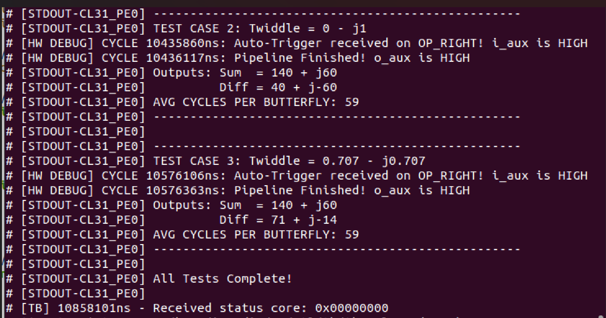
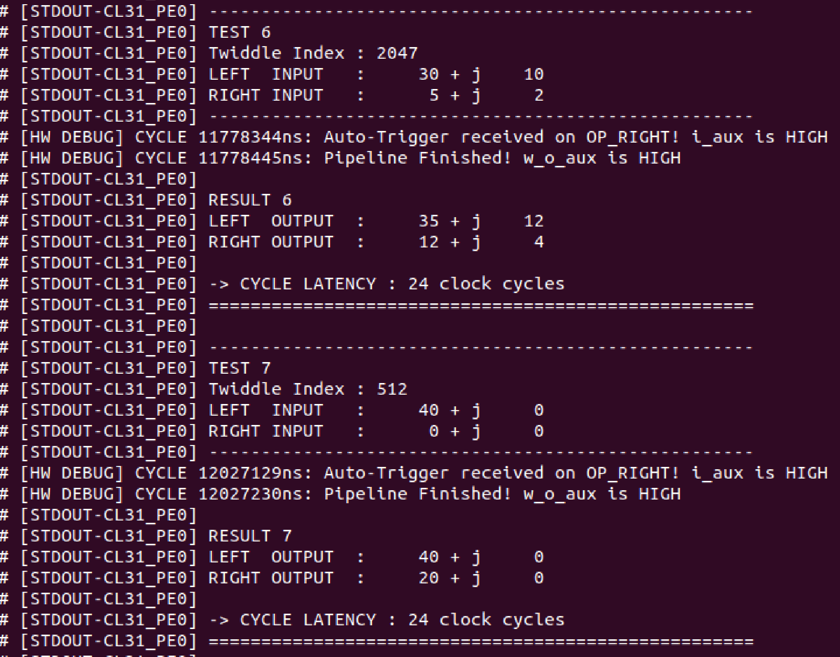
HW/SW Co-design : Software & Verification (2)
Step 2:Latency Profiling
Phase 2: Result
Phase 3: Result

Slide 106
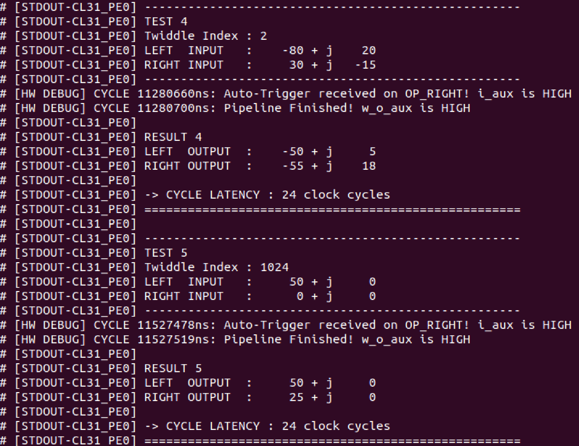
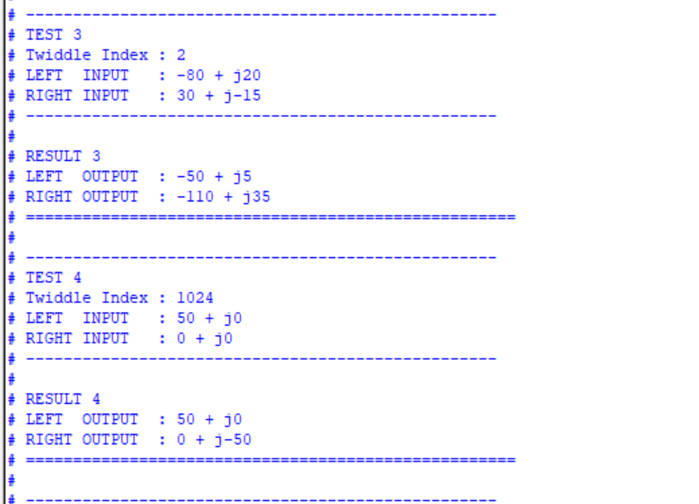
HW/SW Co-design : Software & Verification (2)
Step 2:Latency Profiling
Phase 4: Result
Testbench result

Slide 107
HW/SW Co-design :Questions
Overhead Sources ?
Pulp-runtime vs SDK, Is there a difference for SW latency and total overhead ?
Are the Results Valid and Logical ?

Slide 108
Agenda
System definition
Modeling
RTL
HW/SW Co-design (HW Part)
HW/SW Co-design (SW Part)

Slide 109
HW/SW Co-design (SW Part)

Slide 110
Agenda
HW/SW Co-design (SW Part)
Problem Statement
Architecture Challenges
SW vs. HW Data Flow
Benchmarking Results
Moving to High-Radix

Slide 111
Problem Statement
Objective:
Integrate a custom-designed Radix-2 FFT Butterfly hardware accelerator into the PULP platform.
Minimize processing latency
Goal:
Identify and mitigate architectural bottlenecks to surpass the performance of optimized CPU SIMD.
Current limitation:
Communication overhead (AXI bus latency) currently outweighs the speedup gained from hardware arithmetic.

Slide 112
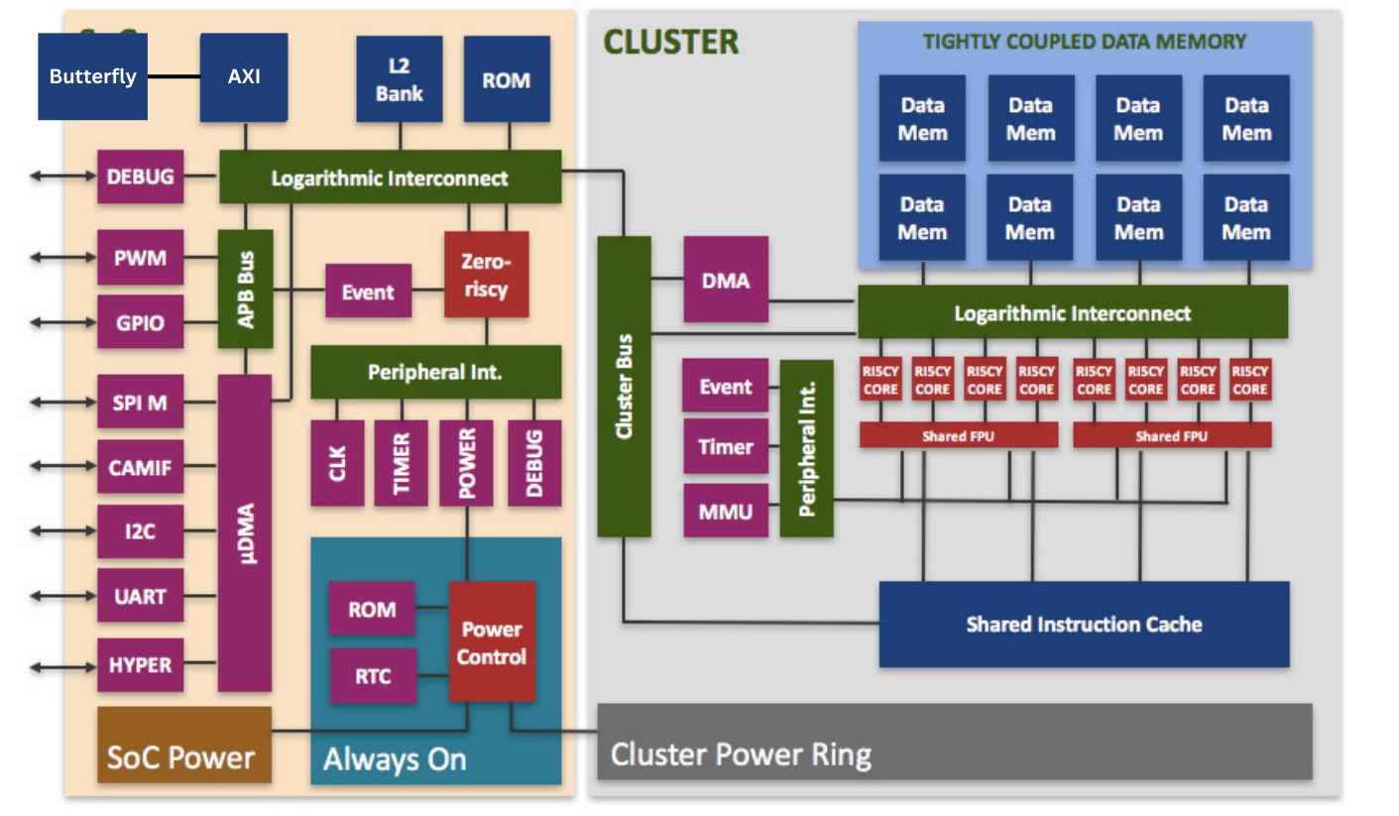
Architecture Challenges
Time saved by high-speed hardware arithmetic is currently outweighed by the latency of moving operands and results across the AXI.
Cores residing in the Cluster must transition through the Cluster Bus and across the SoC’s Logarithmic Interconnect to reach the AXI bridge.
While the cluster provides eight parallel cores, the SoC AXI bridge acts as a bottleneck, allowing only one transaction to the accelerator at a time

Slide 113
SW vs. HW Data Flow
Pure Software:
HW/SW:
Load data
Vector
Operations
Write data
Load data
Write data
Load data
pack 1st op
pack 2nd op
Calc. Tw. IDX
Push 1st op to AXI
Push 2nd op to AXI
Store data
Pull 2nd
result
Pull 1st result
HW Operations

Slide 114
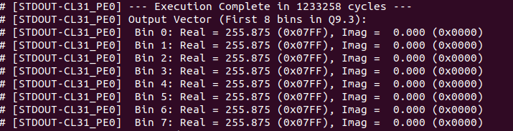
Benchmarking Results
HW/SW:
Pure SW (Single core):
Pure SW (Multiple core):
Butterfly SW:

Slide 115
Benchmarking Results
Vector Extensions: The software implementation is not standard C code; it heavily utilizes OpenPULP's vector instructions.
AXI and Bit manipulation Overhead: While the hardware executes the actual butterfly arithmetic in a few clock cycles, the CPU spend roughly 50 cycles per butterfly executing bit-shifting operations and waiting for AXI bus.

Slide 116

Moving to High-Radix
Number of butterfly operations:
$$B\left(R\right)=\frac{N}{R}{\log{ }}_{R}N$$
$B\left(2\right)=\frac{N}{2}{\log{ }}_{2}N , B\left(8\right)=\frac{N}{8}{\log{ }}_{8}N=$ $\frac{N}{24}{\log{ }}_{2}N$
Overhead increases linearly:
$$T_{1}=h⋅B\left(R_{1}\right), T_{2}=3h⋅B\left(R_{2}\right)$$
Speed-up:
$$S=\frac{T_{2}}{T_{8}}=\frac{h⋅\frac{N}{2}{\log{ }}_{2}N}{h⋅\frac{N}{8}{\log{ }}_{2}N}=4$$

Slide 117
GitHub Repositories
1- MATLAB modeling code for SDF DIF : (Modeling part by Mostafa Fathy)
https://github.com/Mostafa-Yossry/ADI-CU-GP-2025-2026/tree/main/System-Modelling/SDF-Radix2-FFT
2- SDF 4092-point code : (RTL part by Marwan Khaled and Mostafa Fathy)
https://github.com/Mostafa-Yossry/ADI-CU-GP-2025-2026/tree/main/RTL/FFT_SDF
3- Source code can be found here: (Firmware part by Mostafa Yossry) https://github.com/Mostafa-Yossry/ADI-CU-GP-2025-2026/tree/main/Firmware/Radix2-FFT 4- RTL implementations and Wrapper codes can be found here: (AXI integration part by Mostafa Ahmed)
https://github.com/Mostafa-Yossry/ADI-CU-GP-2025-2026/tree/main/RTL/simple_butterfly/simple_butterfly

Slide 118
References
Mr.Wolf: An Energy-Precision Scalable Parallel Ultra Low Power SoC for IoT Edge Processing:
https://pulp-platform.org/docs/publications/08715500.pdf [1]
Fast Fourier Transform :Algorithms And Applications)
https://danylastchild07.wordpress.com/wp-content/uploads/2016/05/fft_algorithms-and-applications.pdf
VLSI Digital Signal Processing Systems: Design and Implementation
https://d1.amobbs.com/bbs_upload782111/files_18/ourdev_480582.pdf
PULP platform
https://pulp-platform.org/index.html

Slide 119
Thank You!

