Slide 1
ADI/CU GP 2025/2026
Progress Update Meeting (2)
Part (1) : Accelerated FFT task
Front end team …..

Slide 2
Agenda
HW/SW Co-design (HW Part)
HW/SW Co-design (SW Part)

Slide 3
HW/SW Co-design (HW Part)

Slide 4
Agenda
HW/SW Co-design
Where we were?
AXI butterfly Latency analysis
Moving to TCDM
PULP Integration
Wrapper Architecture
SoC Modifications
Software & Verification (1)
Optimizations
Software & Verification (2)

Slide 5
HW/SW Co-design : Where were we?
Latency Profiling
Design Feature | Phase 1 (Pipelined) | Phase 2 (Pipelined) | Phase 3 (Pipelined)
Operand Widths | Oversized: 34b In, 38b Out, 42b Twiddle | Corrected: 24b In, 24b Out, 32b Twiddle | Corrected: 24b In, 24b Out, 32b Twiddle
Twiddle Delivery | Full payload passed over AXI | Full payload passed over AXI | Twiddle Index passed over AXI
Wrapper | No optimizations | No optimizations | optimized
Multiplier Type | Pipelined | Pipelined | Standard
Software Driver | High Overhead | Optimized | Optimized
Latency | 442 cycles | 59 cycles | 24 cycles
Phase 4 (Flattened)
Corrected: 24b In, 24b Out, 32b Twiddle
Twiddle Index passed over AXI
optimized
Standard
Optimized
18 cycles

Slide 6
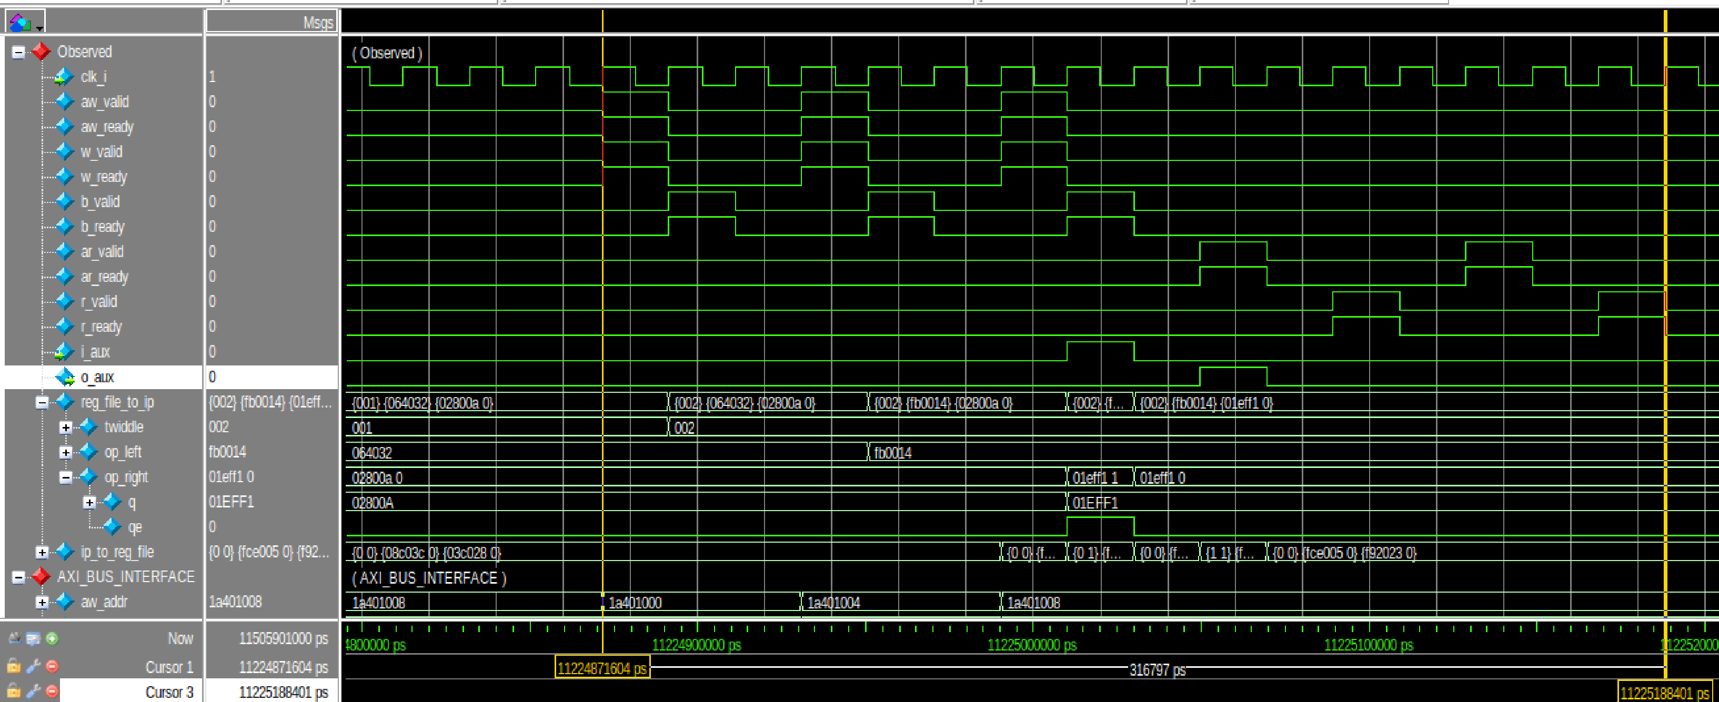
HW/SW Co-design : Flattened AXI Integrated Butterfly
Latency Profiling : Latency = 7 Write + 2 butterfly + 7 Read = 16 cycles

Slide 7
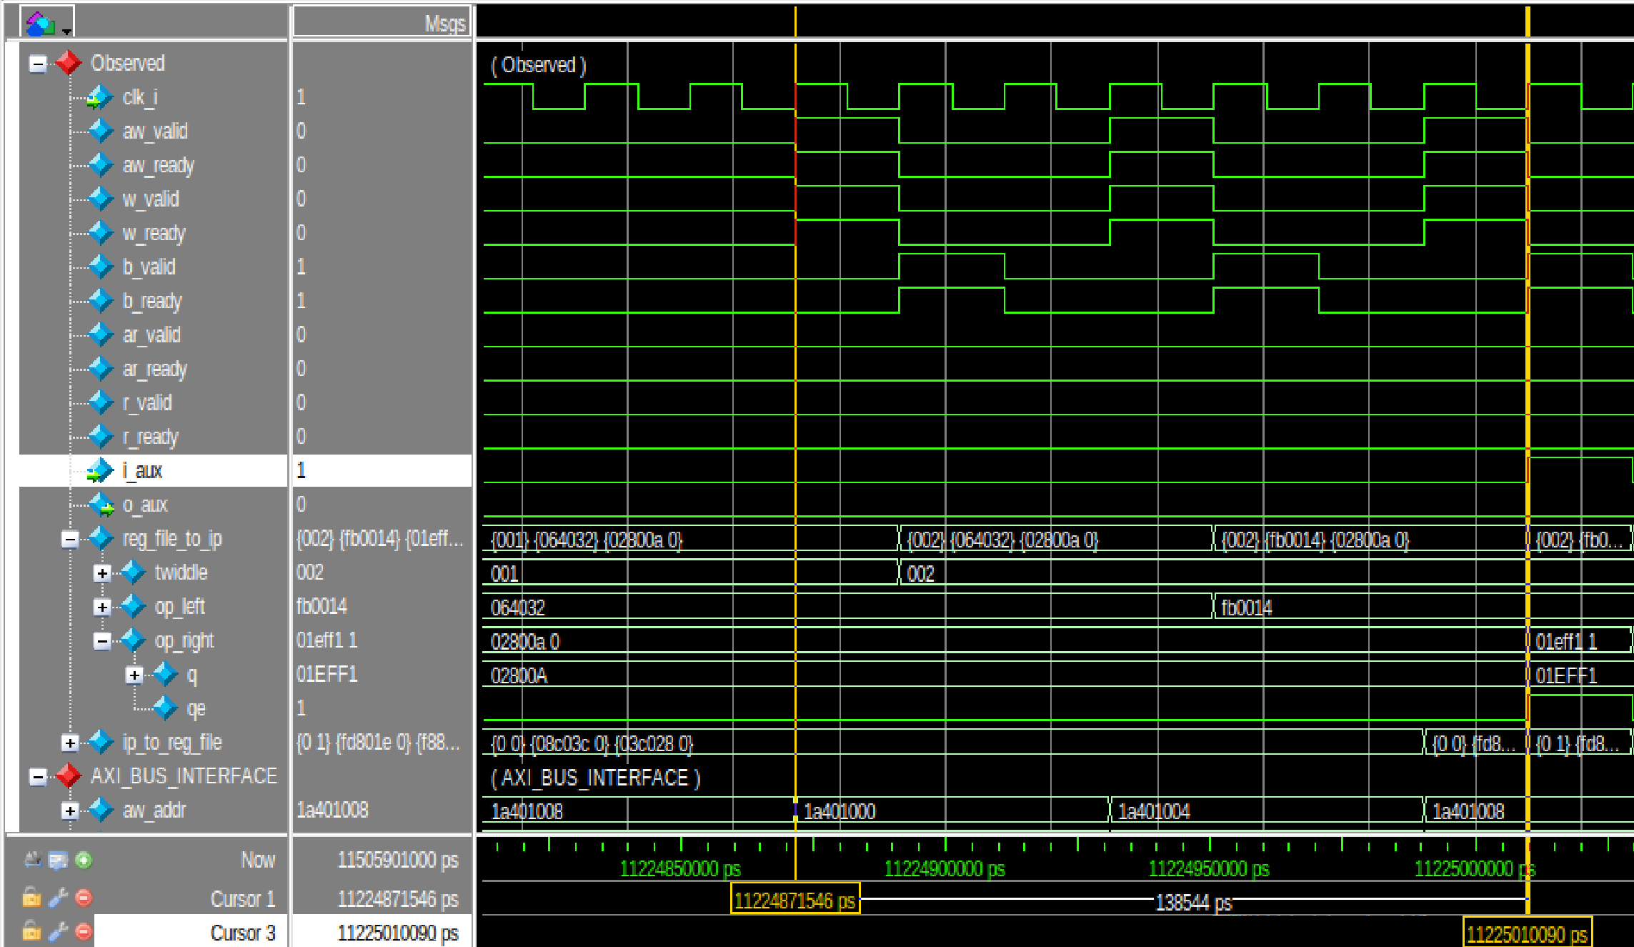
HW/SW Co-design : Flattened AXI Integrated Butterfly
Latency Profiling : Write Phase : 7 cycles = 1 twiddle index + 3 left operand + 3 right operand

Slide 8
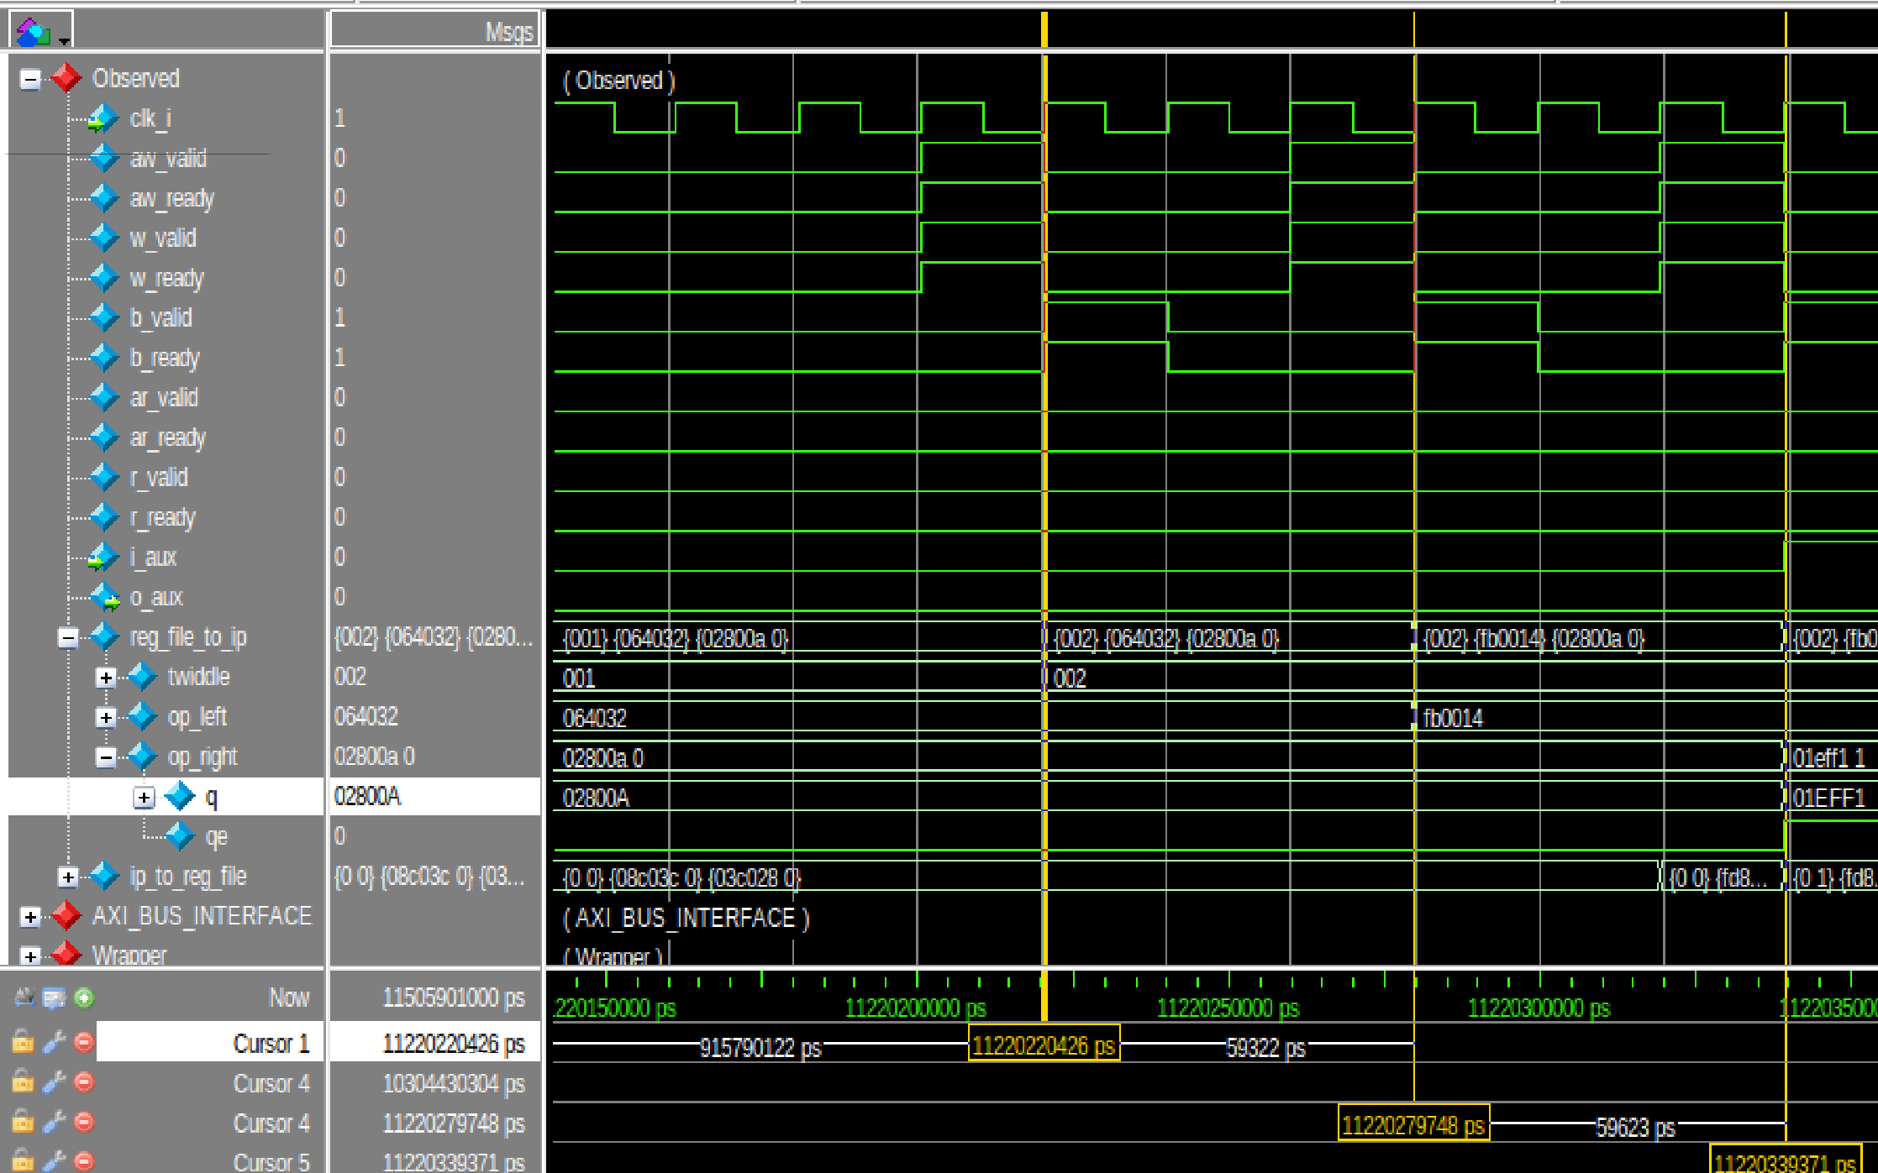
HW/SW Co-design : Flattened AXI Integrated Butterfly
Latency Profiling : 3 cycles between writes on bus
Cycle 1: Capture
aw_valid, w_valid, aw_ready, and w_ready The hardware captures both the destination address and the operand data.
Cycle 2: The Confirmation Response
The Wrapper asserts b_valid and the CPU asserts b_ready to acknowledge that the data was safely written.
Cycle 3: The State Machine Reset
The b_valid signal drops. The AXI slave requires a clock cycle to reset its internal state machine before it can accept new data.

Slide 9
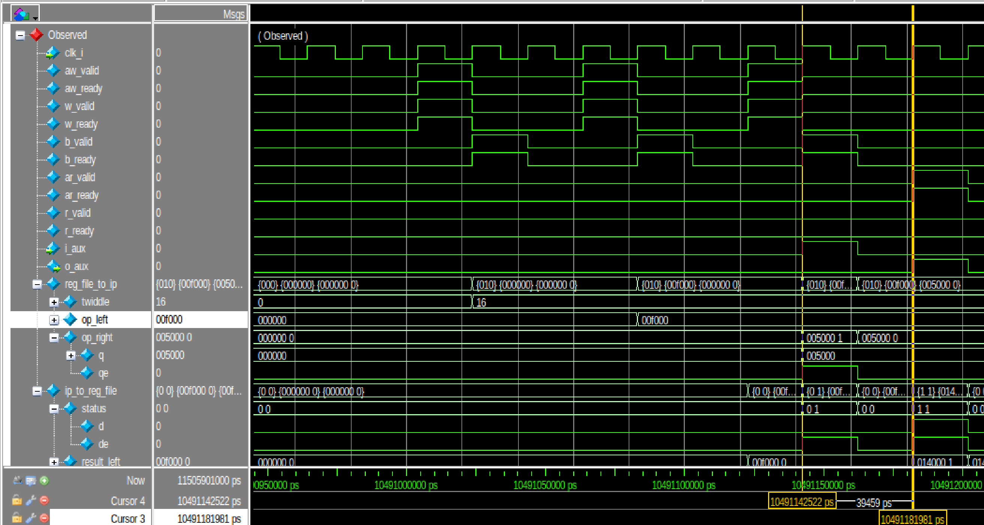
HW/SW Co-design : Flattened AXI Integrated Butterfly
Latency Profiling : 2 cycles for butterfly operation = 1 intermediate values + 1 final results

Slide 10
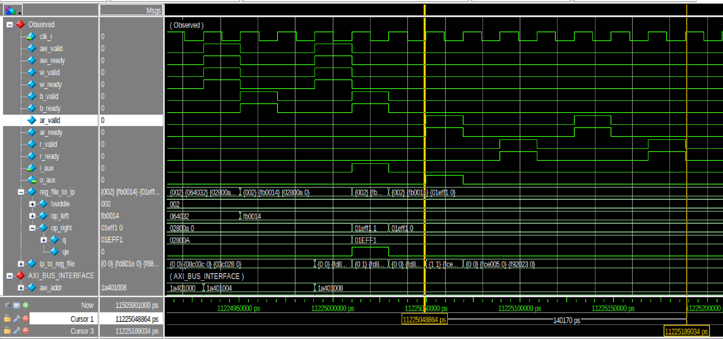
HW/SW Co-design : Flattened AXI Integrated Butterfly
Latency Profiling : Read Phase : 7 cycles = 3 left result + 3 right result + 1 cycle gap

Slide 11
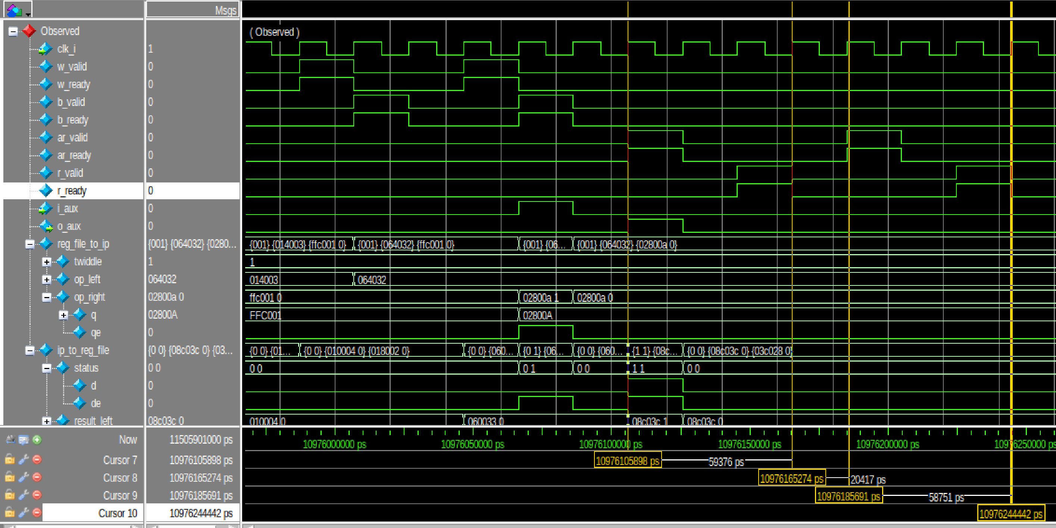
HW/SW Co-design : Flattened AXI Integrated Butterfly
Latency Profiling :read takes 3 cycles
Cycle 1: The Address Handshake
The CPU asserts ar_valid to request a specific memory address.
The Wrapper asserts ar_ready to accept the request.
Cycle 2: Preparing Data
HW fetches the requested result
Cycle 3: The Data Handshake
The Wrapper asserts r_valid and pushes the computed math onto the bus.
The CPU asserts r_ready to capture the returned data.
Gap cycle (The storage Cycle)
The CPU de-asserts ar_valid and the bus goes completely silent. In order for the CPU to store result in one of its internal registers

Slide 12
HW/SW Co-design : Flattened AXI Integrated Butterfly
Latency Profiling : Latency = 7 Write + 2 butterfly + 7 Read = 16 cycles

Slide 13
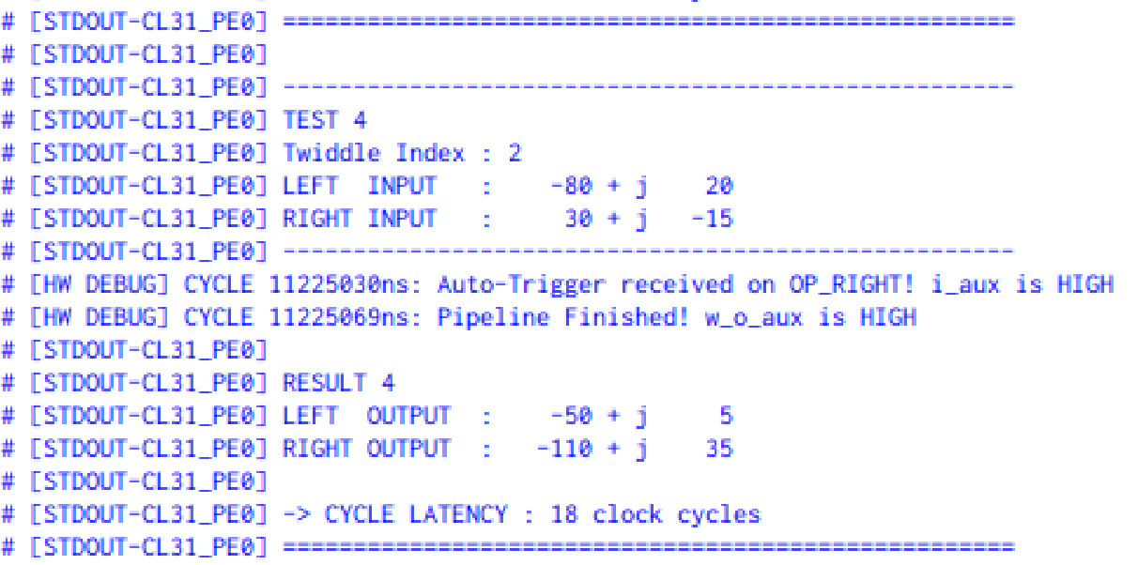
HW/SW Co-design : Flattened AXI Integrated Butterfly
Latency Profiling : Latency = 7 Write + 2 butterfly + 7 Read = 16 cycles
APIs used to calculate latency perf_start and perf_stop, each takes a cycle
Therefore 16 cycles + 2 cycles = 18 cycles

Slide 14
HW/SW Co-design : Moving to TCDM
Objective:
Re-integrate the custom-designed Radix-2 FFT Butterfly hardware accelerator directly into the PULP platform's TCDM (Tightly Coupled Data Memory) interconnect to eliminate AXI bus overhead.
Goal:
Achieve physical-limit execution latency
Scope of current work:
Hardware Scope:
Map the butterfly accelerator to the TCDM busand design a low-latency protocol translation wrapper
Problem Statement
Arithmetic Optimization
Butterfly Operation
RTL Design
Pipeline Alignment
PULP integration
Wrapper Architecture
SoC Modifications
Software & Verification

Slide 15
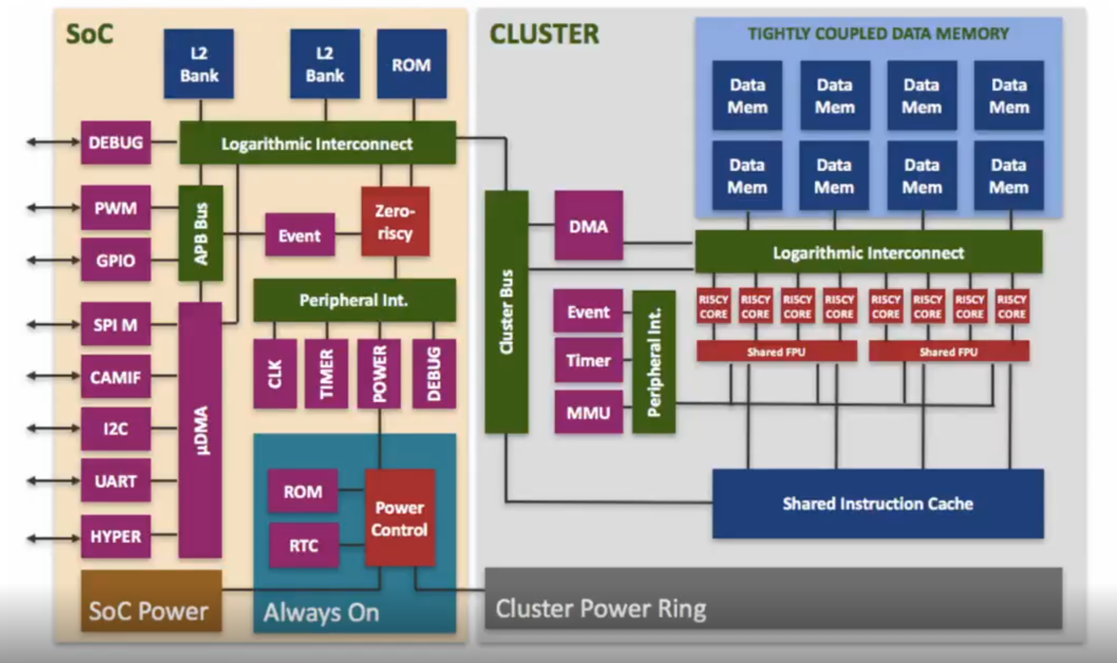
HW/SW Co-design : PULP Intergation
Objective:
Expose the butterfly accelerator as a memory-mapped AXI peripheral within the PULP SoC.
Pulp Architecture Overview
The TCDM:
Normal processors rely on invisible memory caches, which cause unpredictable delays.
PULP replaces caches with a Tightly Coupled Data Memory (TCDM)—a shared, ultra-fast scratchpad where Software must explicitly place data into the TCDM.
The System Actors:
Fabric Controller
Micro-DMA
Accelerators
Problem Statement
Arithmetic Optimization
Butterfly Operation
RTL Design
Pipeline Alignment
PULP integration
Wrapper Architecture
SoC Modifications
Software & Verification

Slide 16
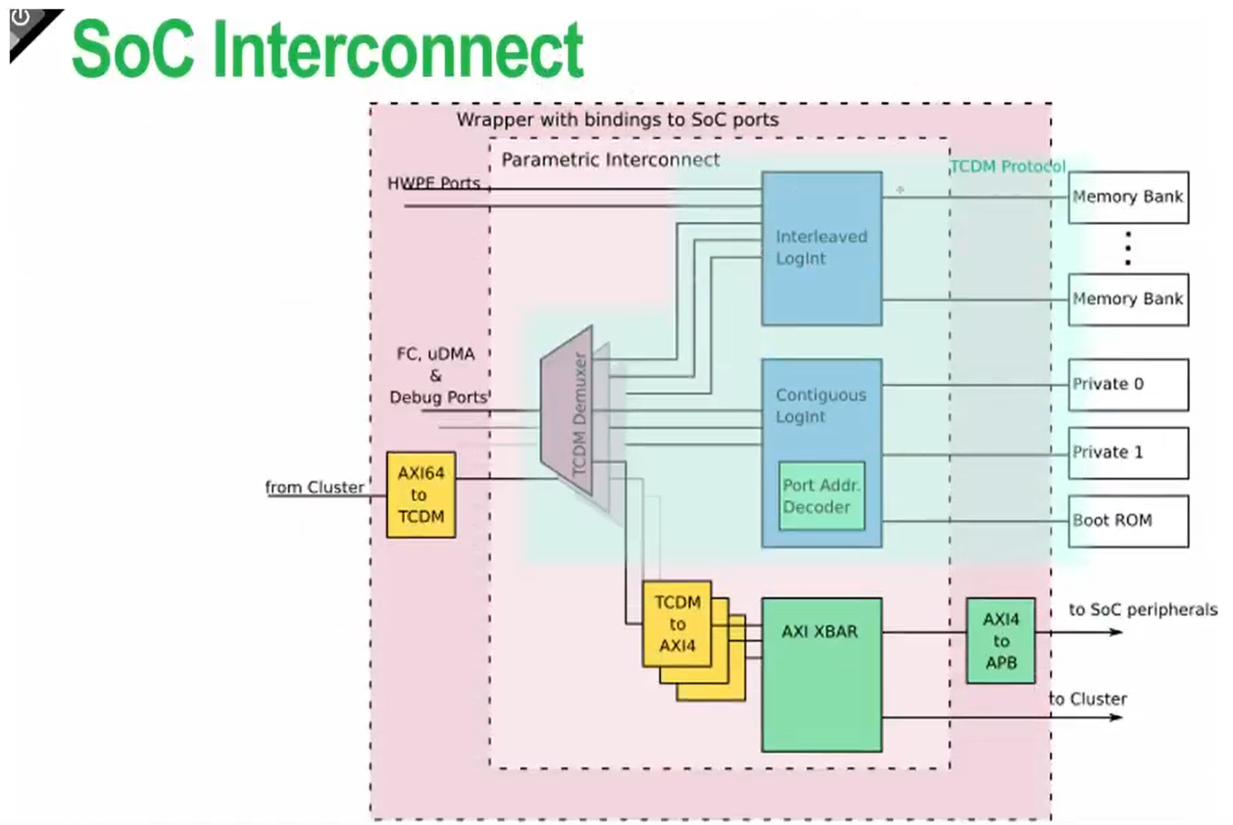
HW/SW Co-design :Highway System – Interconnects and Arbitration
Two Separate Traffic Networks:
TCDM Interconnect: reserved for fast operations, 1-cycle memory lookups.
AXI Crossbar: Built for complex components that needs multiple cycles.
How Software Talks to Hardware:
Address-Based Routing: Hardware doesn't have a name, only a memory address.
Two Paths of Communication:
The Control Path :The FC configures the hardware by writing values to these addresses.
The Data Path: Pushing the heavy payloads to the hardware so it can begin computation.
Wrapper
Accelerator
Problem Statement
Arithmetic Optimization
Pipeline Alignment
Butterfly Operation
RTL Design
PULP integration
SOC-Interconnect
Wrapper Architecture
Software & Verification

Slide 17
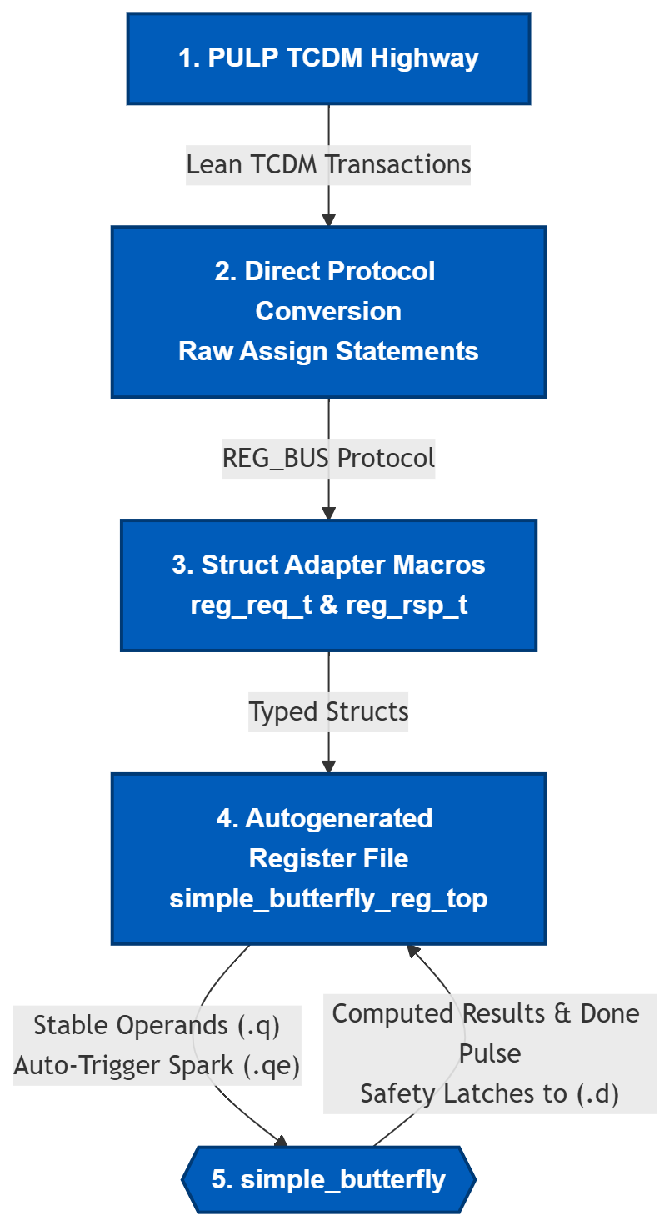
HW/SW Co-design : The Translation Wrapper
The Problem: AXI Overhead
The multi-channel AXI handshake crippled our math core, turning a 2-cycle computation into a 18-cycle bottleneck.
Solution: TCDM Integration
The Blueprint (The .hjson file)
A "contract" between software and hardware.
The Protocol Downgrade :
TCDM → Direct Protocol Converter → REG_BUS
REG_BUS → Macros → Structs
The Hardware Reality (.q , .qe, .d, .de) :
.q & .qe: Stable inputs and the 1-cycle Auto-Trigger spark.
Safety Latches to .d: TCDM has one cycle delay to read so we latch results steady for an extra cycle
Problem Statement
Arithmetic Optimization
Butterfly Operation
RTL Design
Pipeline Alignment
PULP integration
Wrapper Architecture
SoC Modifications
Software & Verification

Slide 18
HW/SW Co-design : Soc Modifications (TCDM )
Key Modifications:
Instantiated the top-level TCDM wrapper inside the pulp_soc.sv top module.
Declared a dedicated XBAR_TCDM_BUS interface to physically wire the accelerator into the system.
Updated L2 Demux Routing: Expanded NR_RULES_L2_DEMUX and added an addressing rule to funnel the Butterfly's memory space from the main cluster into the Contiguous Crossbar.
Updated Crossbar Routing: Expanded NR_RULES_CONTIG_CROSSBAR and mapped the incoming traffic directly to the newly instantiated TCDM slave port.
Address Allocation:
Assigned a dedicated memory-mapped region (0x1C01_0000 to 0x1C09_0000) inside soc_mem_map.svh.
Result:
The custom accelerator is now a fully visible, permanently integrated node directly on the Tightly Coupled Data Memory (TCDM) highway. It is accessible through ultra-fast, 1-cycle memory transactions, completely bypassing the AXI crossbar.
Problem Statement
Arithmetic Optimization
Butterfly Operation
RTL Design
Pipeline Alignment
PULP integration
Wrapper Architecture
SoC Modifications
Software & Verification

Slide 19
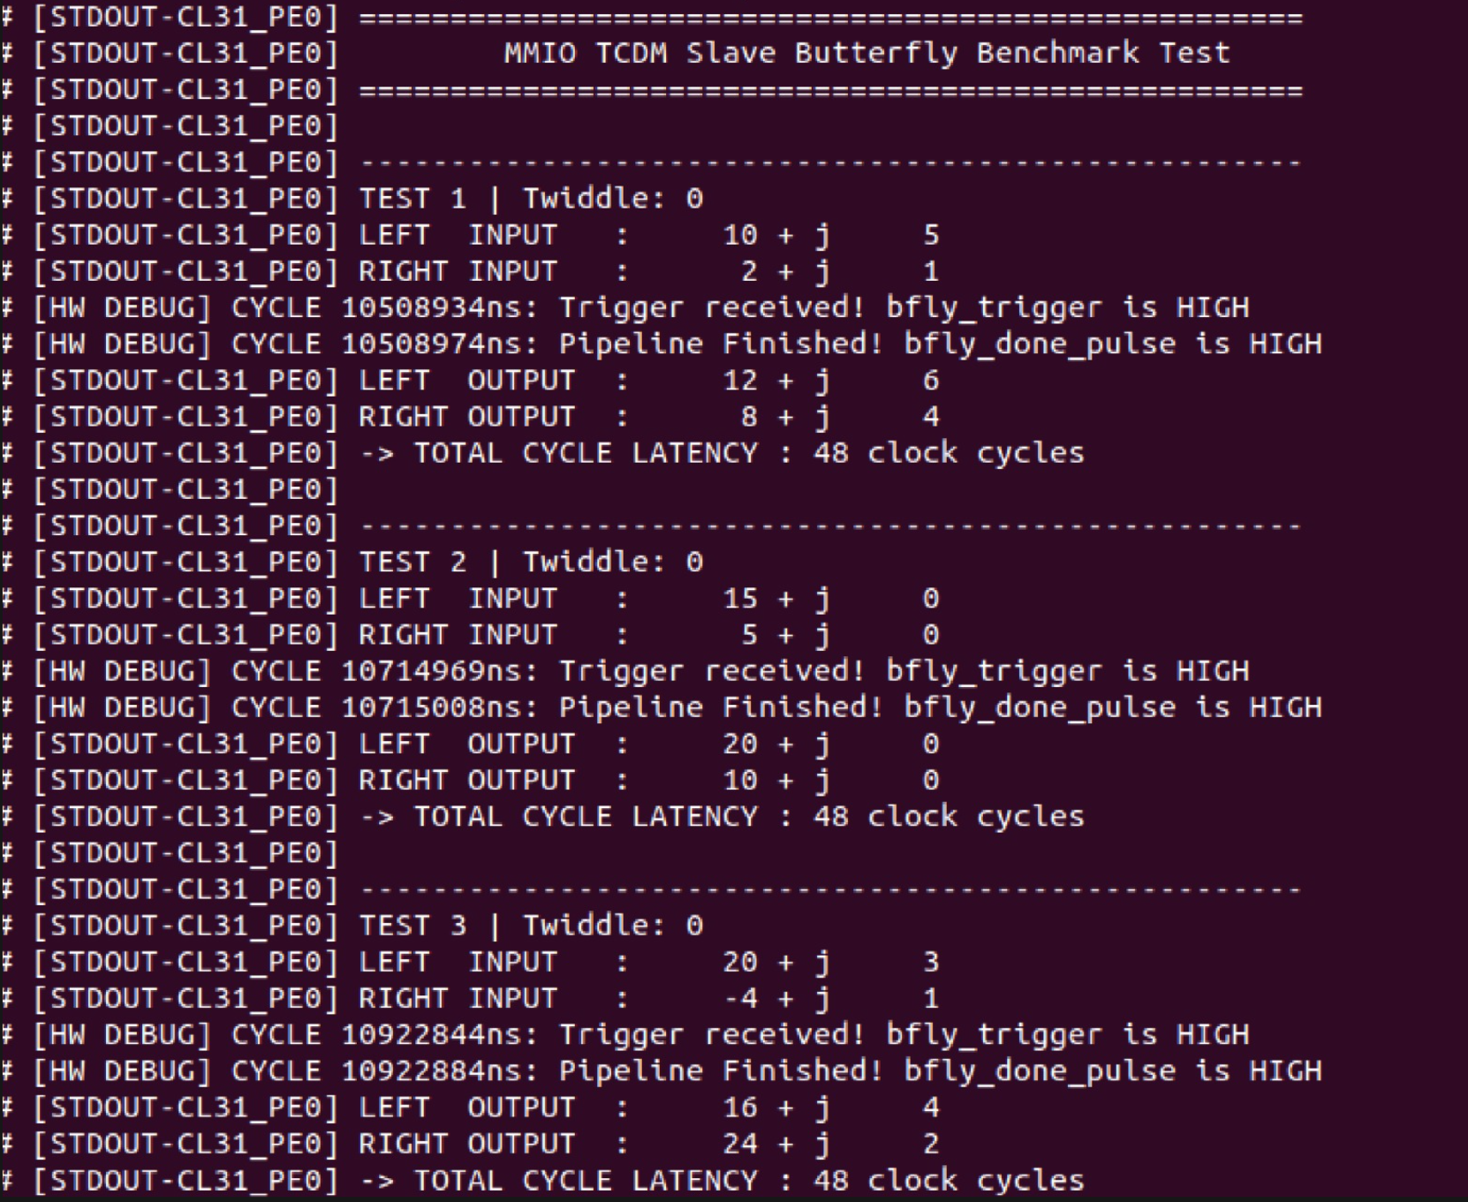
HW/SW Co-design : Software & Verification (1)
Step 1: Verify Integration &Mathematical Correctness
Results Match the results from the Written Testbench
Software Control:
Simple Custom C test application developed
Execution Flow:
Write inputs to registers
Trigger accelerator
Poll DONE status
Read computed outputs
Observed Results:
Correct butterfly arithmetic
Successful HW/SW communication
Measured Latency At first was 48 cycles, But we reached 18 cycles with AXI
Problem Statement
Arithmetic Optimization
Butterfly Operation
RTL Design
Pipeline Alignment
PULP integration
Wrapper Architecture
SoC Modifications
Software & Verification

Slide 20
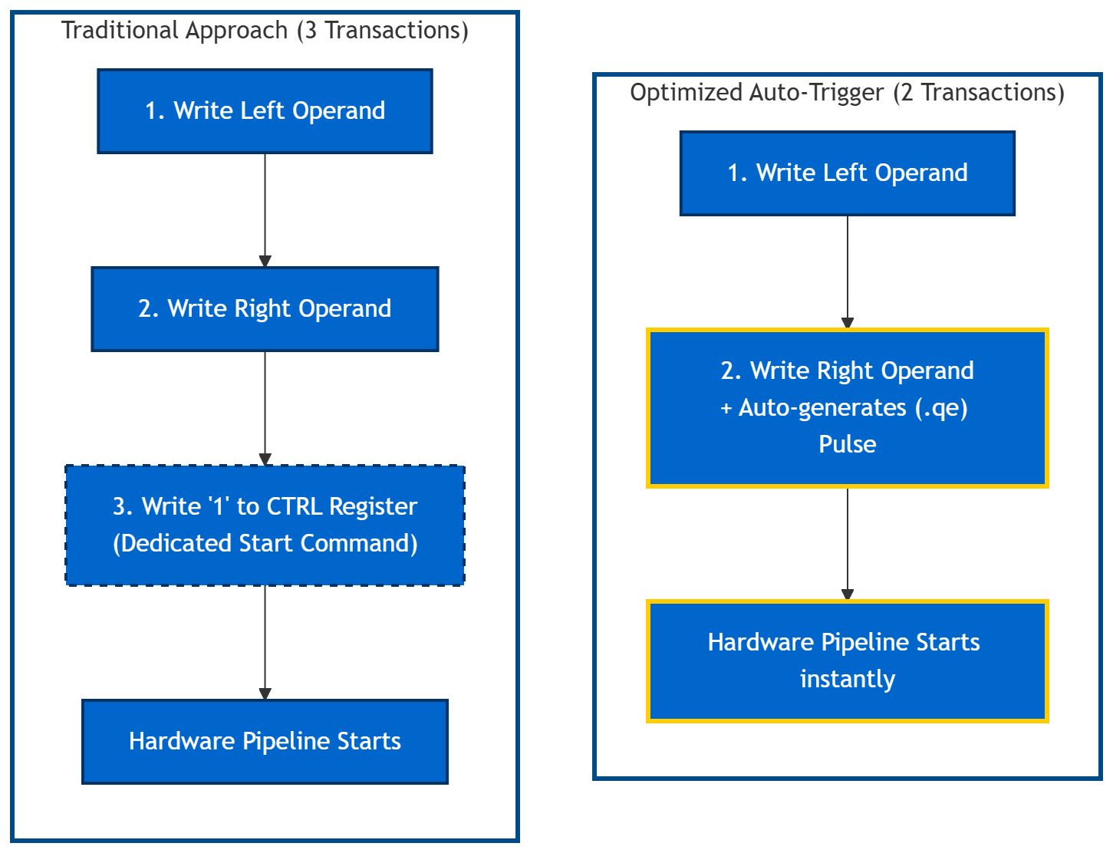
HW/SW Co-design : Optimization 1 – The Auto-Trigger
The Traditional Approach (3 Bus Transactions):
Software writes the Left Operand.
Software writes the Right Operand.
Software writes a '1' to a CTRL register to wake up the hardware.
Optimized Solution (2 Bus Transactions):
Eliminated the dedicated "Start" register.
Flagged the Right Operand register to generate a Write-Enable pulse.
The Benefit:
The hardware instantly fires up instantly.
Saves a transaction on every single butterfly
Result:
Number of Cycles taken for the End-to-end Butterfly execution decreased.

Slide 21
HW/SW Co-design : Where we were?
Latency Profiling
Design Feature | Phase 1 (AXI Pipelined) | Phase 2 (AXI Pipelined) | Phase 3 (AXI Pipelined) | Phase 4 (AXI Flattened)
Operand Widths | Oversized: 34b In, 38b Out, 42b Twiddle | Corrected: 24b In, 24b Out, 32b Twiddle | Corrected: 24b In, 24b Out, 32b Twiddle | Corrected: 24b In, 24b Out, 32b Twiddle
Twiddle Delivery | Full payload passed over AXI | Full payload passed over AXI | Twiddle Index passed over AXI | Twiddle Index passed over AXI
Wrapper | No optimizations | No optimizations | optimized | optimized
Multiplier Type | Pipelined | Pipelined | Standard | Standard
Software Driver | High Overhead | Optimized | First Optimized | Fully Optimized
Latency | 442 cycles | 59 cycles | 24 cycles | 18 cycles
Phase 5 (TCDM Flattened)
Corrected: 24b In, 24b Out, 32b Twiddle
Twiddle Index passed
No optimizations
Standard
High Overhead
48 cycles
Phase 6 (TCDM Flattened)
Corrected: 24b In, 24b Out, 32b Twiddle
Twiddle Index passed
optimized
Standard
Optimized
11 cycles

Slide 22
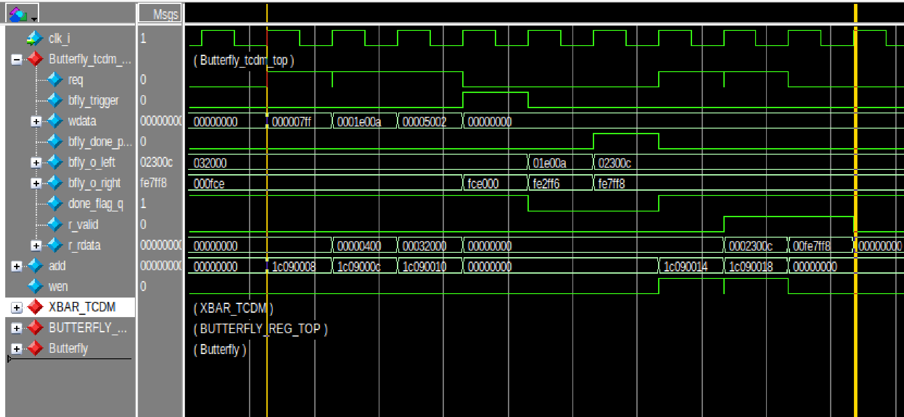
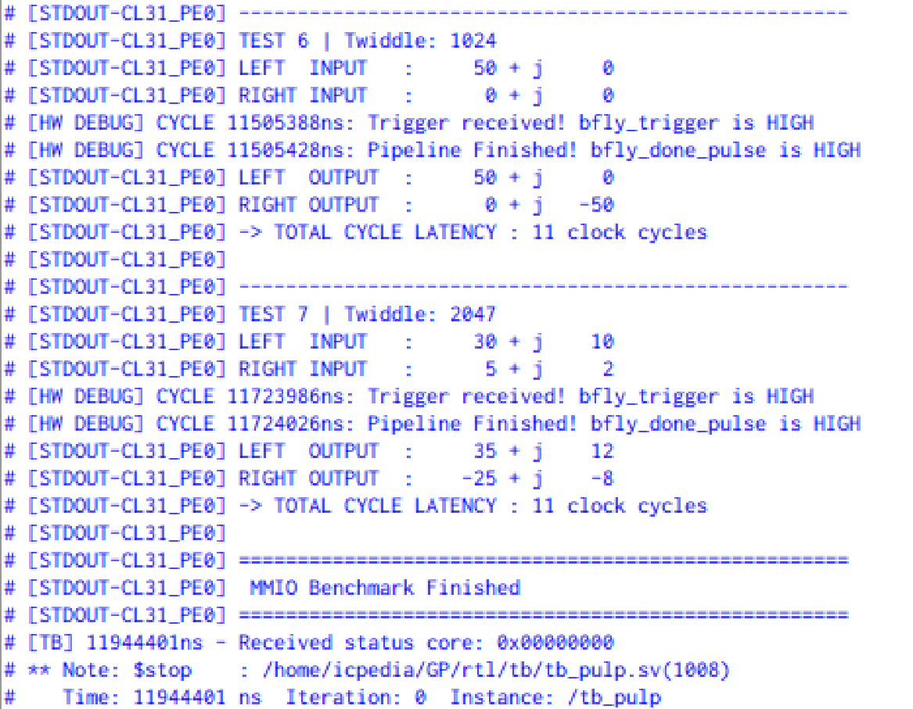
HW/SW Co-design : Software & Verification (2)
Step 2:Latency Profiling : 9 cycles + 2 APIs = 11 cycles

Slide 23
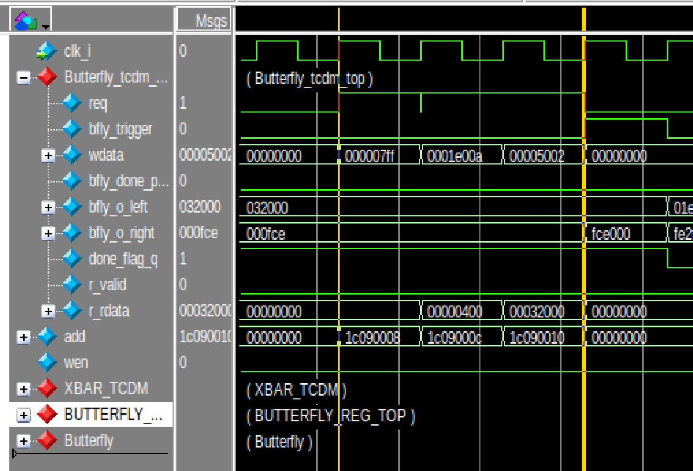
HW/SW Co-design : Software & Verification (2)
Step 2:Latency Profiling : Writing 3 times takes 3 cycles

Slide 24
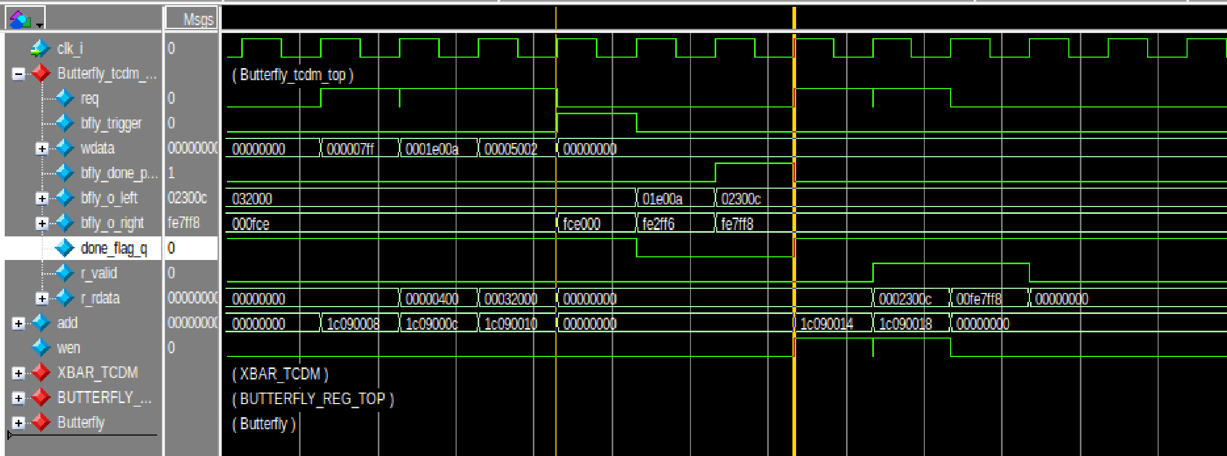
HW/SW Co-design : Software & Verification (2)
Step 2:Latency Profiling : 2 cycles butterfly + 1 delay to match TCDM → Question

Slide 25
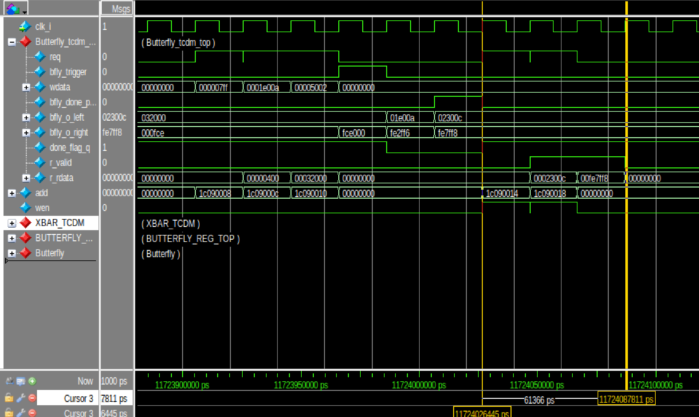
HW/SW Co-design : Software & Verification (2)
Step 2:Latency Profiling : 3 cycles read results and addresses

Slide 26
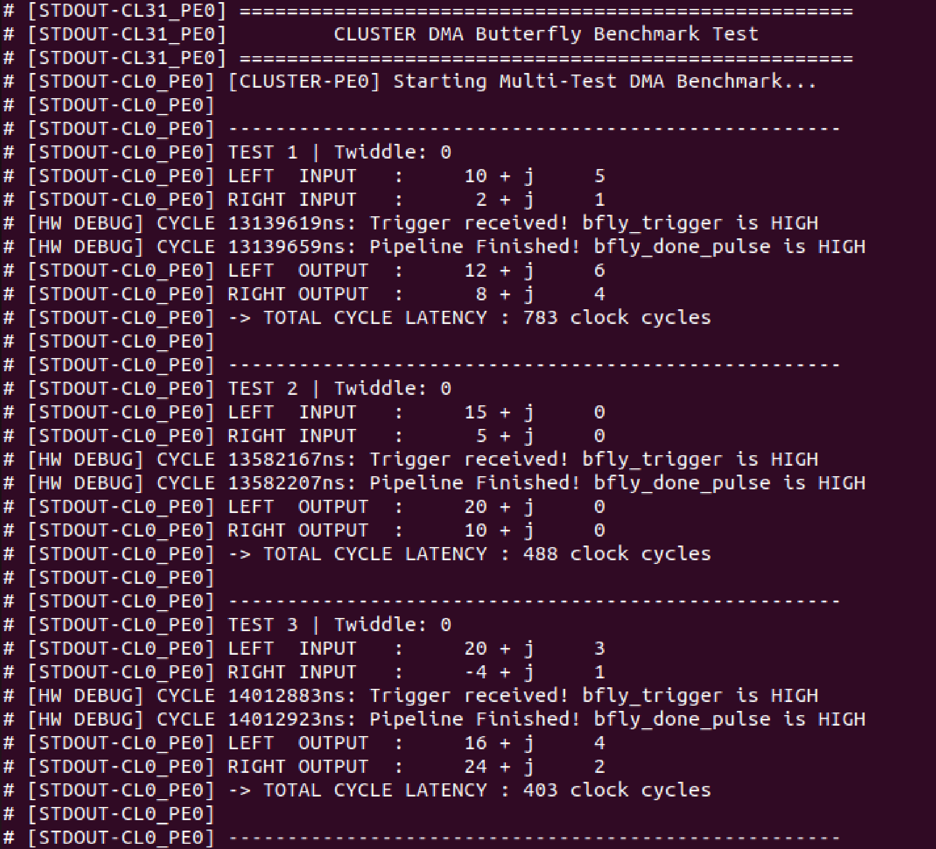
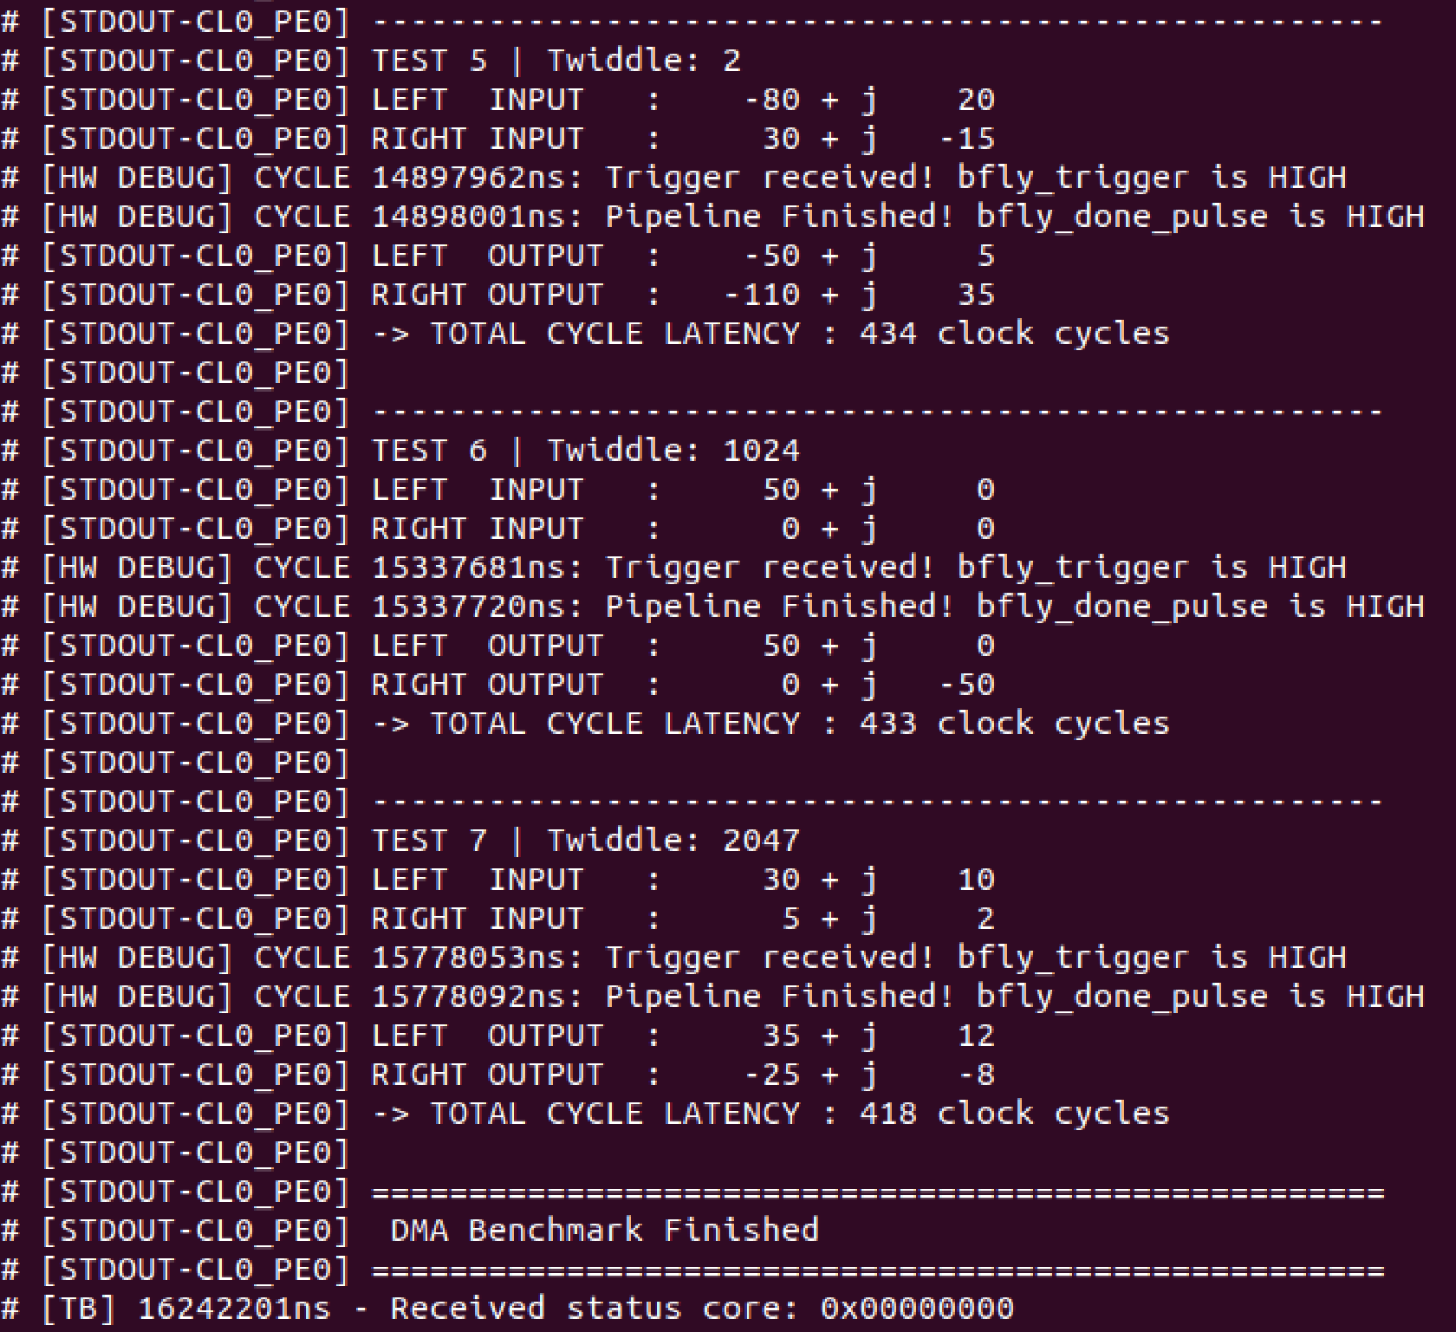
HW/SW Co-design : Next steps
Higher Radix Butterfly
I started with DMA for data delivery instead of Memory mapped

Slide 27
GitHub Repositories
RTL implementations and Wrapper codes can be found here: (AXI integration part by Mostafa Ahmed)
https://github.com/Mostafa-Yossry/ADI-CU-GP-2025-2026/tree/main/RTL/

Slide 28
References
PULP platform
https://pulp-platform.org/index.html

Slide 29
Thank You!

