Slide 1
ADI/CU GP 2025/2026
Progress Update Meeting (2)
Front end team …..

Slide 2
Agenda
HW/SW Co-design (HW Part)
HW/SW Co-design (SW Part)
Multi clusters
HWPE

Slide 3
HW/SW Co-design (HW Part)

Slide 4
Agenda
HW/SW Co-design
Where we were?
AXI butterfly Latency analysis
Moving to TCDM
PULP Integration
Wrapper Architecture
SoC Modifications
Software & Verification (1)
Optimizations
Software & Verification (2)

Slide 5
HW/SW Co-design : Where were we?
Latency Profiling
Design Feature | Phase 1 (Pipelined) | Phase 2 (Pipelined) | Phase 3 (Pipelined)
Operand Widths | Oversized: 34b In, 38b Out, 42b Twiddle | Corrected: 24b In, 24b Out, 32b Twiddle | Corrected: 24b In, 24b Out, 32b Twiddle
Twiddle Delivery | Full payload passed over AXI | Full payload passed over AXI | Twiddle Index passed over AXI
Wrapper | No optimizations | No optimizations | optimized
Multiplier Type | Pipelined | Pipelined | Standard
Software Driver | High Overhead | Optimized | Optimized
Latency | 442 cycles | 59 cycles | 24 cycles
Phase 4 (Flattened)
Corrected: 24b In, 24b Out, 32b Twiddle
Twiddle Index passed over AXI
optimized
Standard
Optimized
18 cycles

Slide 6
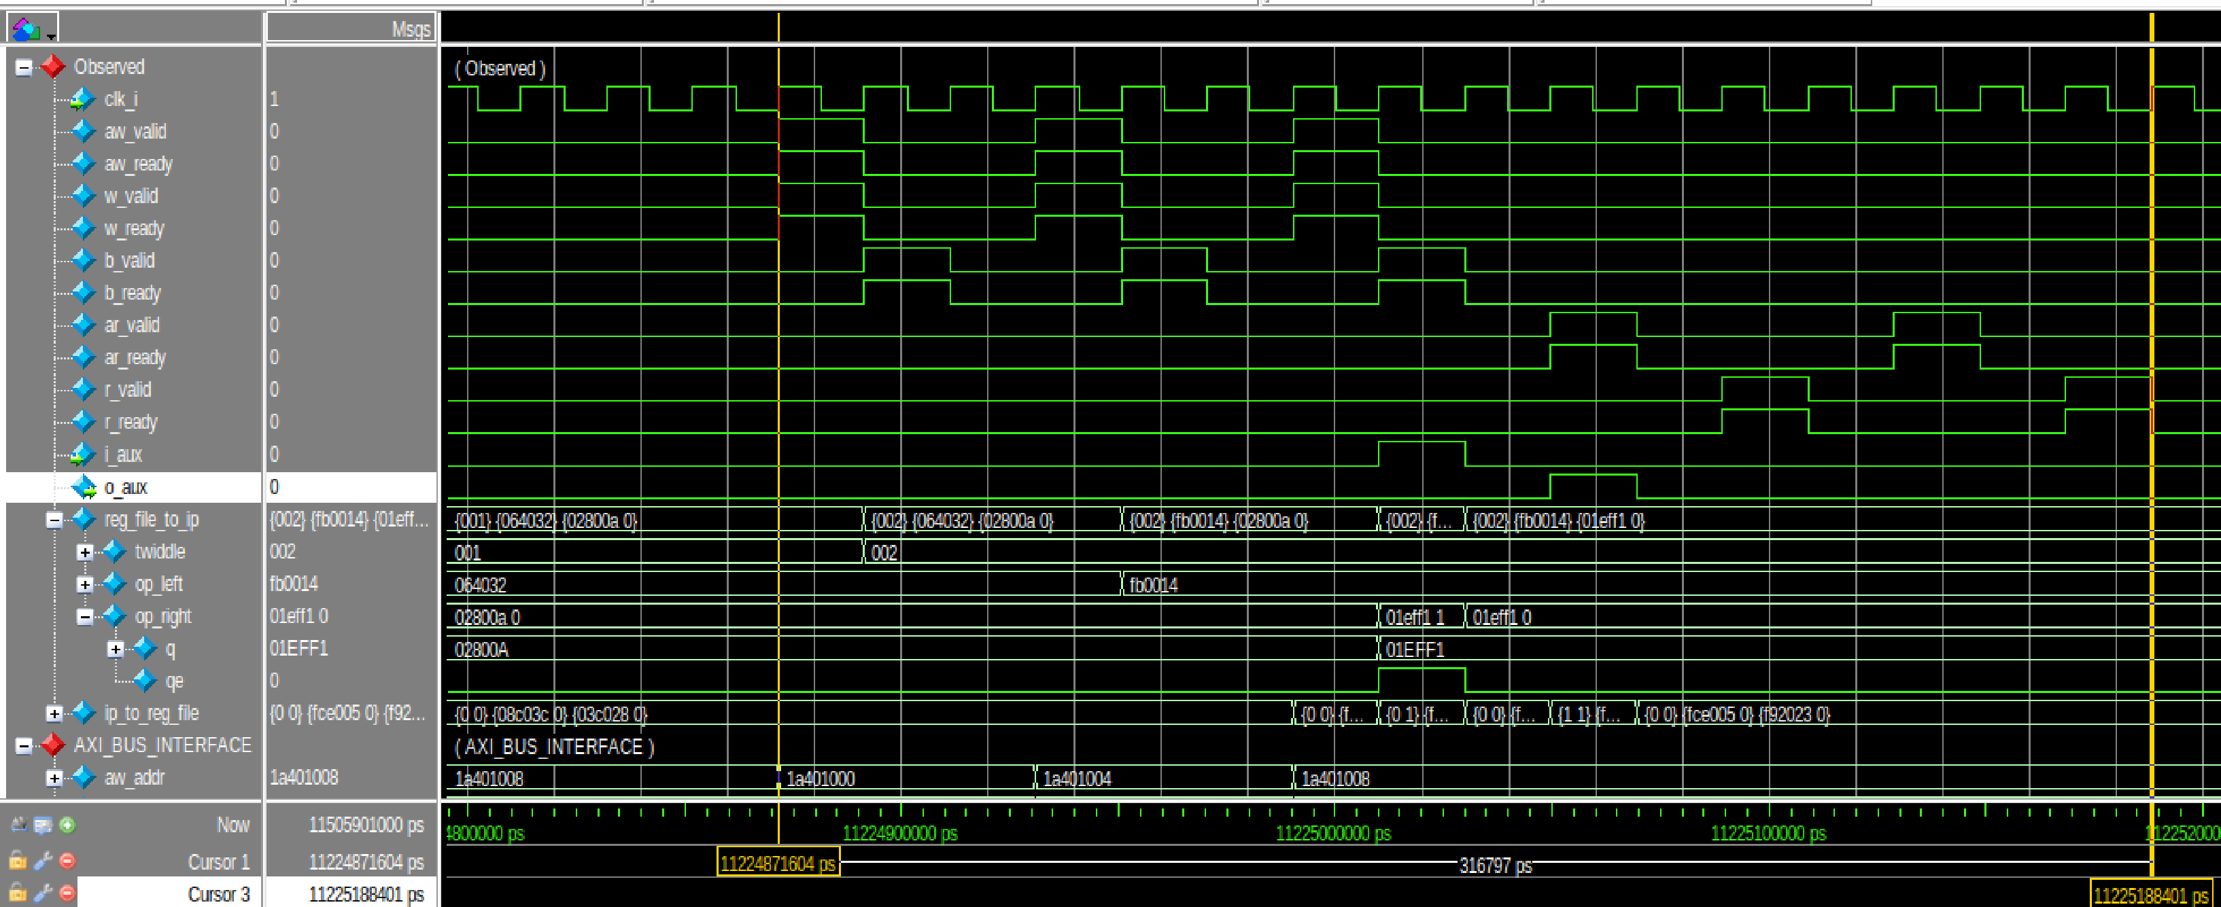
HW/SW Co-design : Flattened AXI Integrated Butterfly
Latency Profiling : Latency = 7 Write + 2 butterfly + 7 Read = 16 cycles

Slide 7
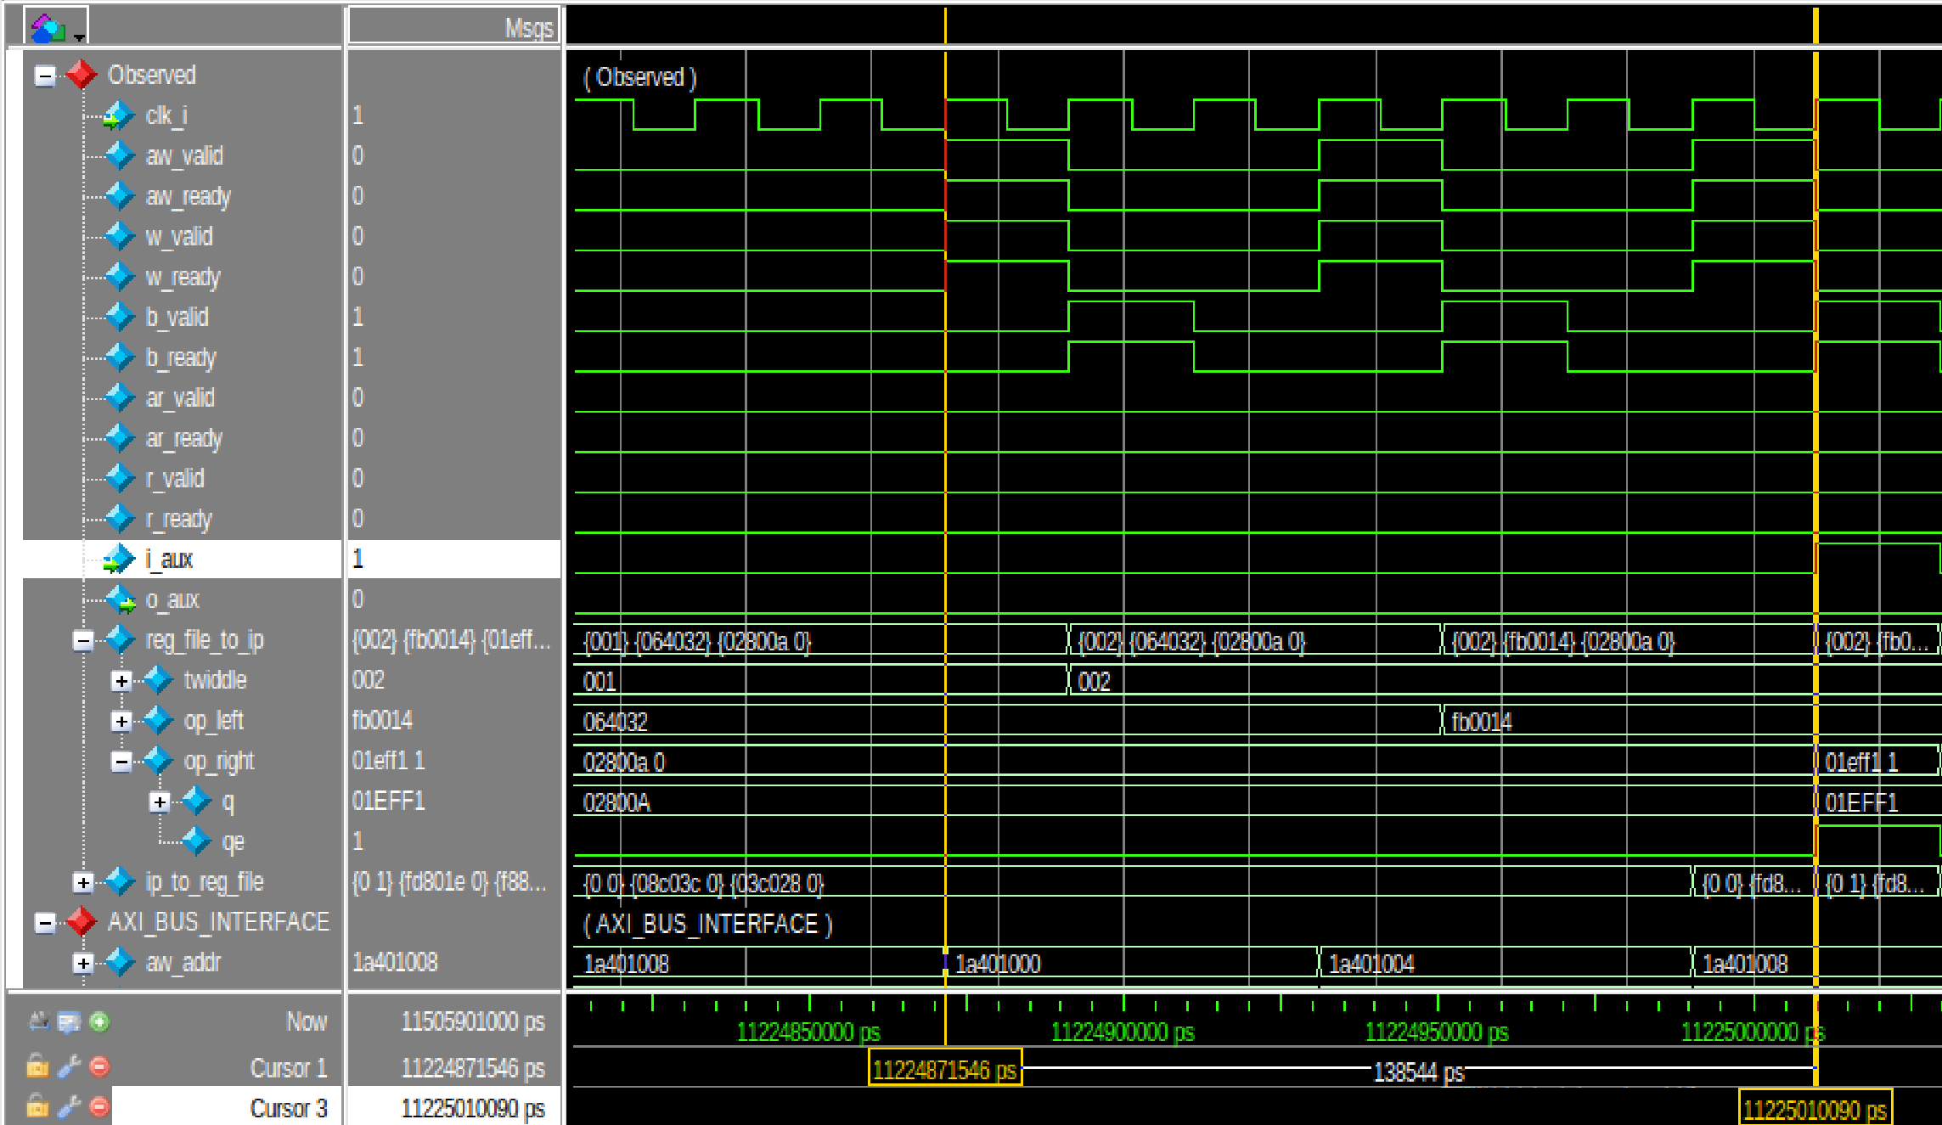
HW/SW Co-design : Flattened AXI Integrated Butterfly
Latency Profiling : Write Phase : 7 cycles = 1 twiddle index + 3 left operand + 3 right operand

Slide 8
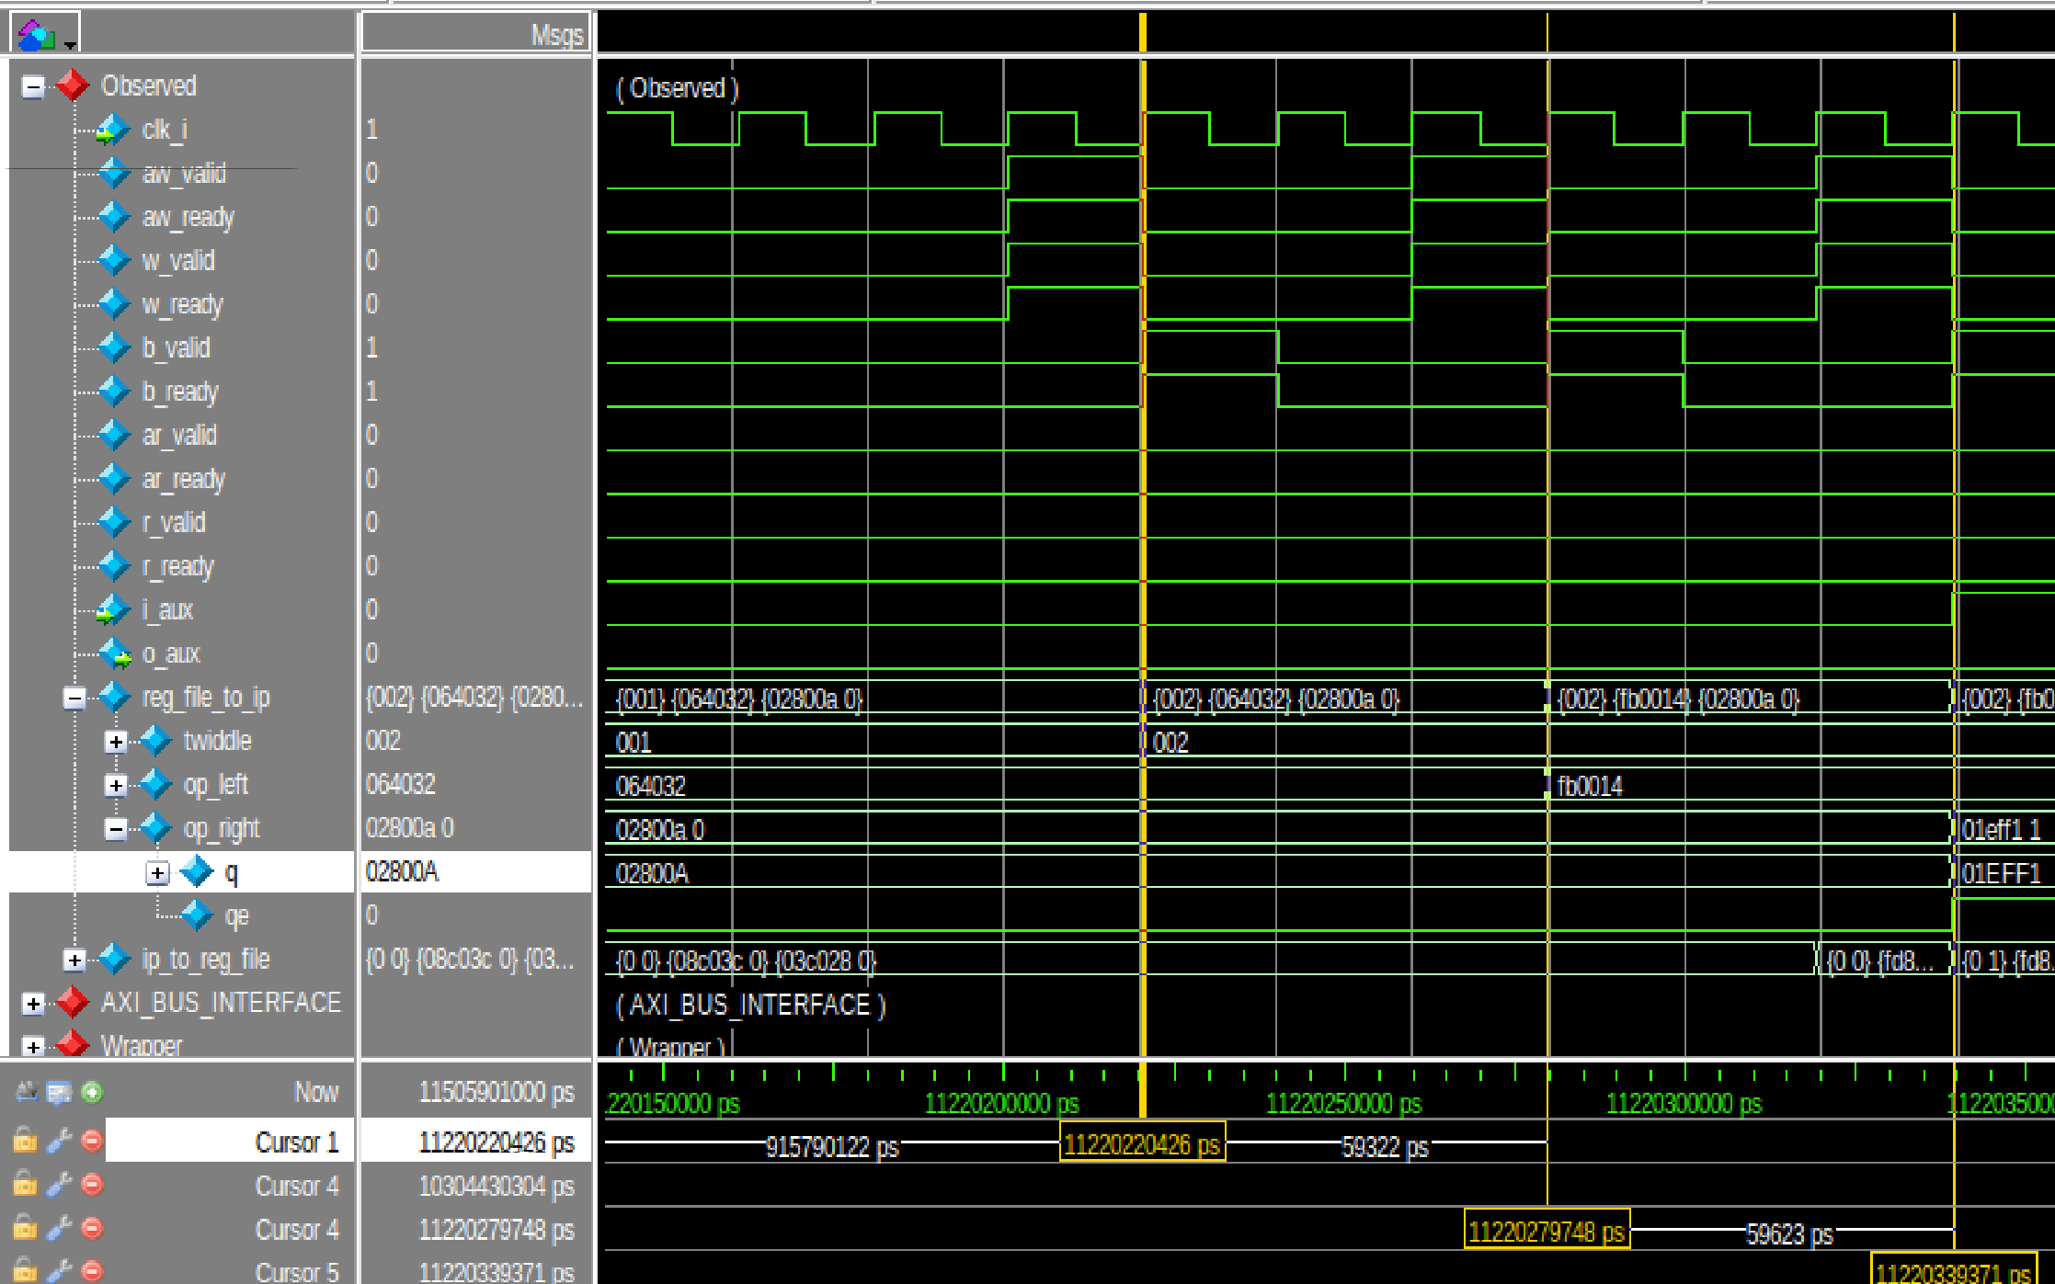
HW/SW Co-design : Flattened AXI Integrated Butterfly
Latency Profiling : 3 cycles between writes on bus
Cycle 1: Capture
aw_valid, w_valid, aw_ready, and w_ready The hardware captures both the destination address and the operand data.
Cycle 2: The Confirmation Response
The Wrapper asserts b_valid and the CPU asserts b_ready to acknowledge that the data was safely written.
Cycle 3: The State Machine Reset
The b_valid signal drops. The AXI slave requires a clock cycle to reset its internal state machine before it can accept new data.

Slide 9
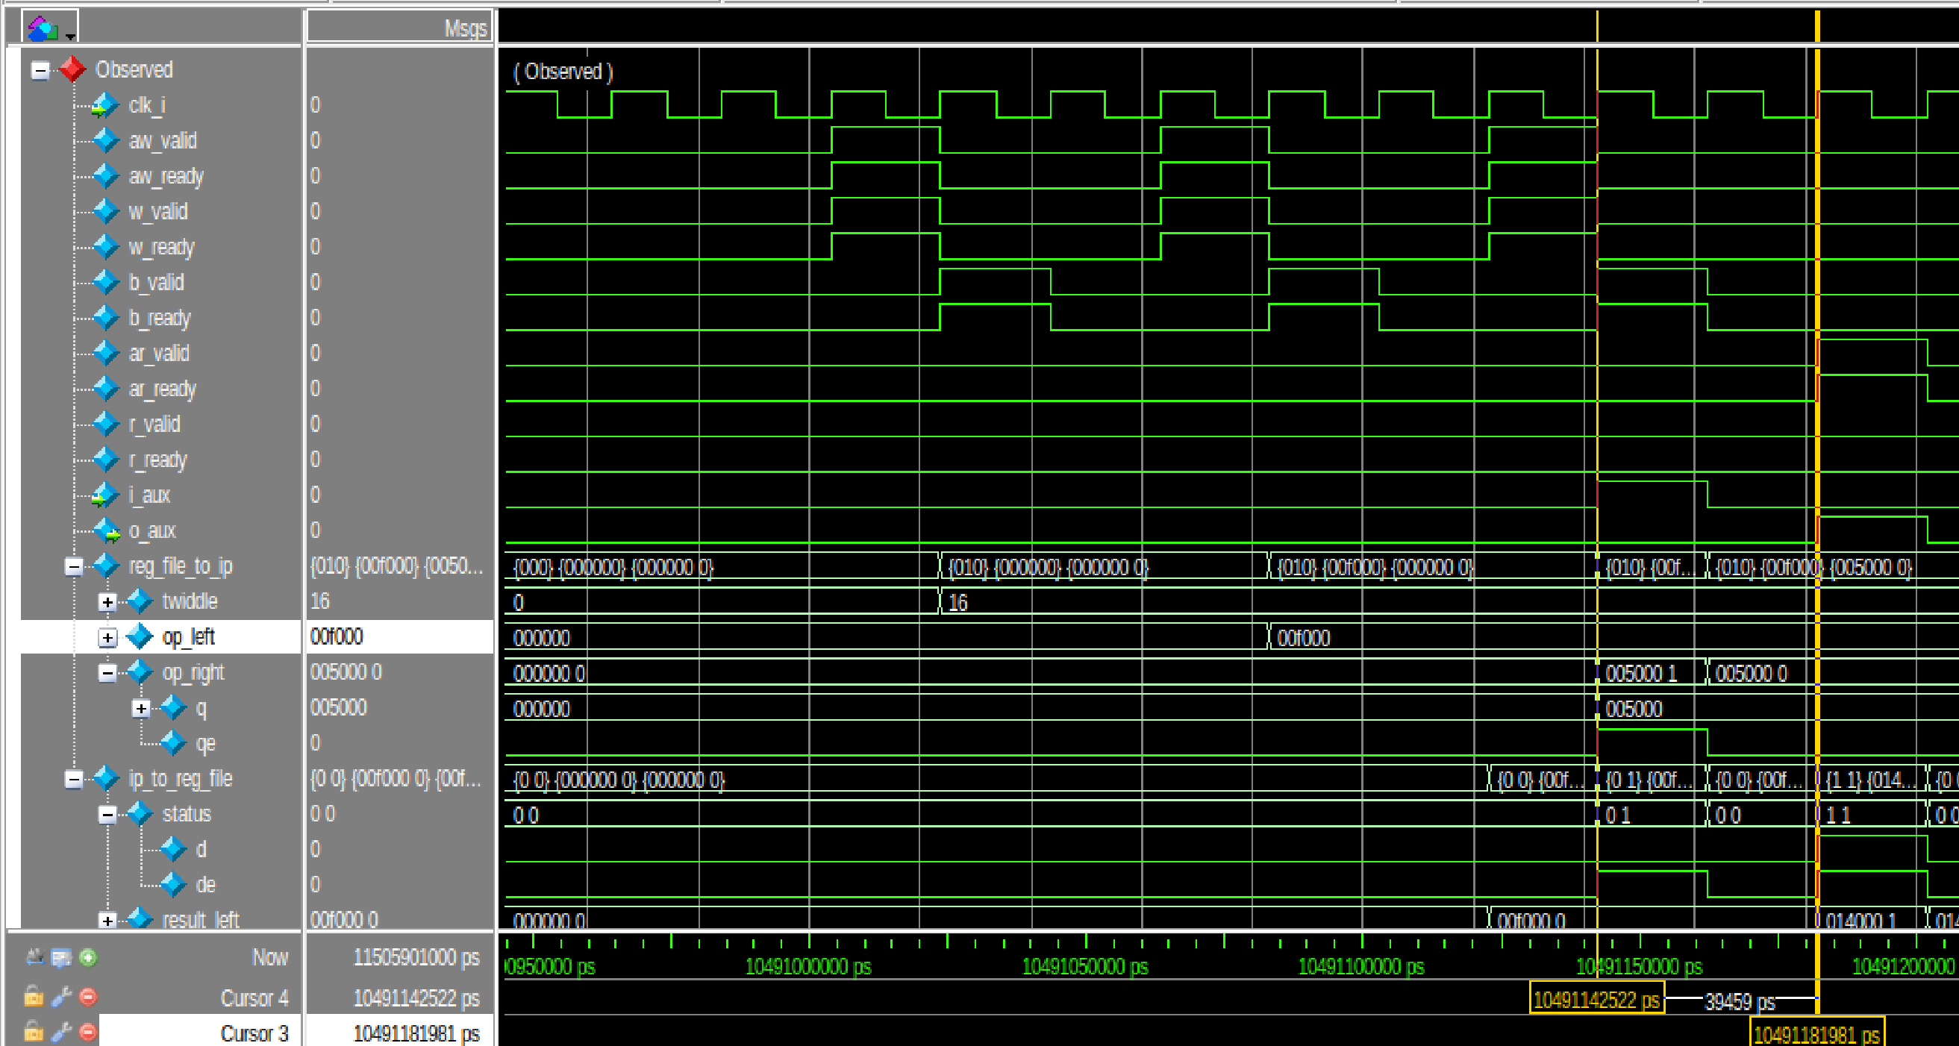
HW/SW Co-design : Flattened AXI Integrated Butterfly
Latency Profiling : 2 cycles for butterfly operation = 1 intermediate values + 1 final results

Slide 10
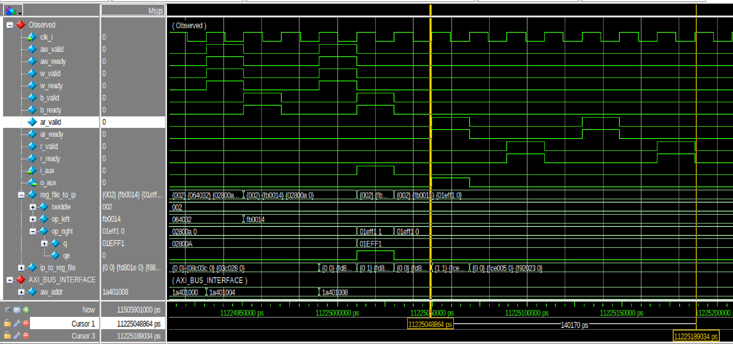
HW/SW Co-design : Flattened AXI Integrated Butterfly
Latency Profiling : Read Phase : 7 cycles = 3 left result + 3 right result + 1 cycle gap

Slide 11
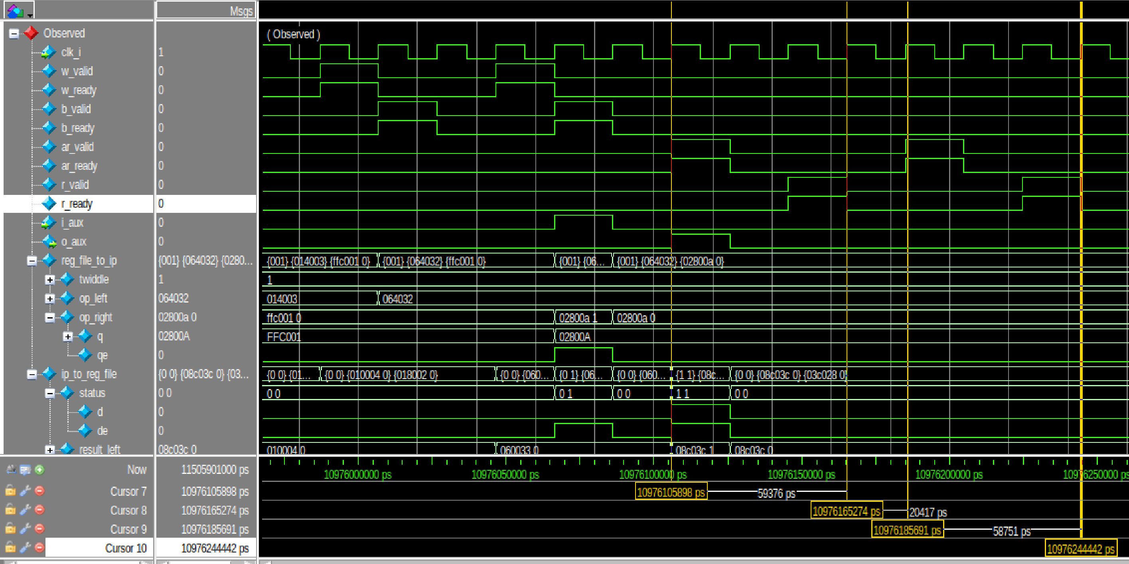
HW/SW Co-design : Flattened AXI Integrated Butterfly
Latency Profiling :read takes 3 cycles
Cycle 1: The Address Handshake
The CPU asserts ar_valid to request a specific memory address.
The Wrapper asserts ar_ready to accept the request.
Cycle 2: Preparing Data
HW fetches the requested result
Cycle 3: The Data Handshake
The Wrapper asserts r_valid and pushes the computed math onto the bus.
The CPU asserts r_ready to capture the returned data.
Gap cycle (The storage Cycle)
The CPU de-asserts ar_valid and the bus goes completely silent. In order for the CPU to store result in one of its internal registers

Slide 12
HW/SW Co-design : Flattened AXI Integrated Butterfly
Latency Profiling : Latency = 7 Write + 2 butterfly + 7 Read = 16 cycles

Slide 13
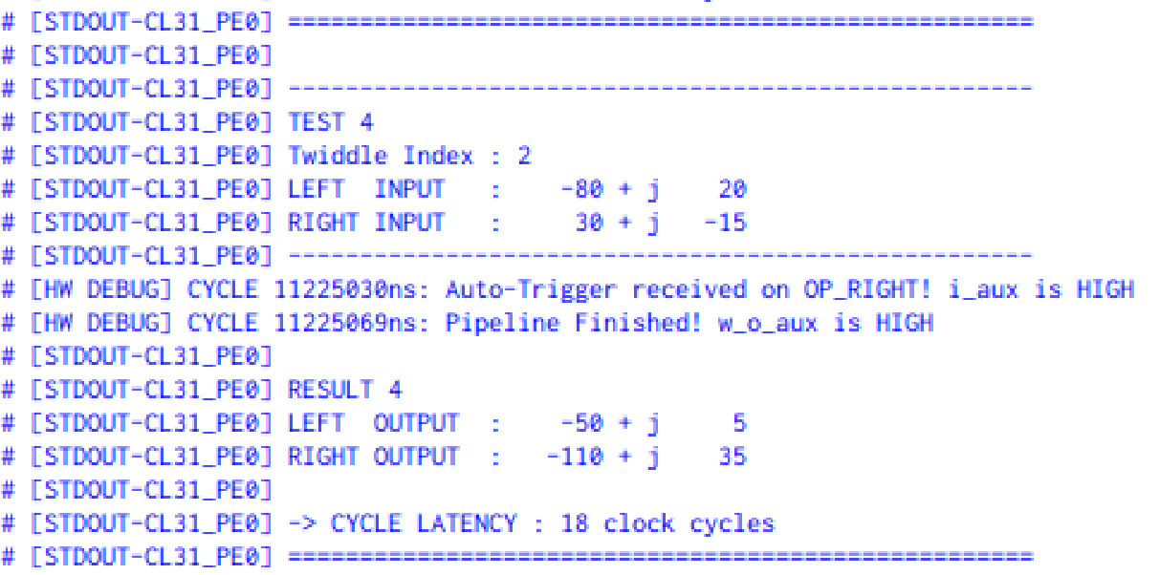
HW/SW Co-design : Flattened AXI Integrated Butterfly
Latency Profiling : Latency = 7 Write + 2 butterfly + 7 Read = 16 cycles
APIs used to calculate latency perf_start and perf_stop, each takes a cycle
Therefore 16 cycles + 2 cycles = 18 cycles

Slide 14
HW/SW Co-design : Moving to TCDM
Objective:
Re-integrate the custom-designed Radix-2 FFT Butterfly hardware accelerator directly into the PULP platform's TCDM (Tightly Coupled Data Memory) interconnect to eliminate AXI bus overhead.
Goal:
Achieve physical-limit execution latency
Scope of current work:
Hardware Scope:
Map the butterfly accelerator to the TCDM busand design a low-latency protocol translation wrapper

Slide 15
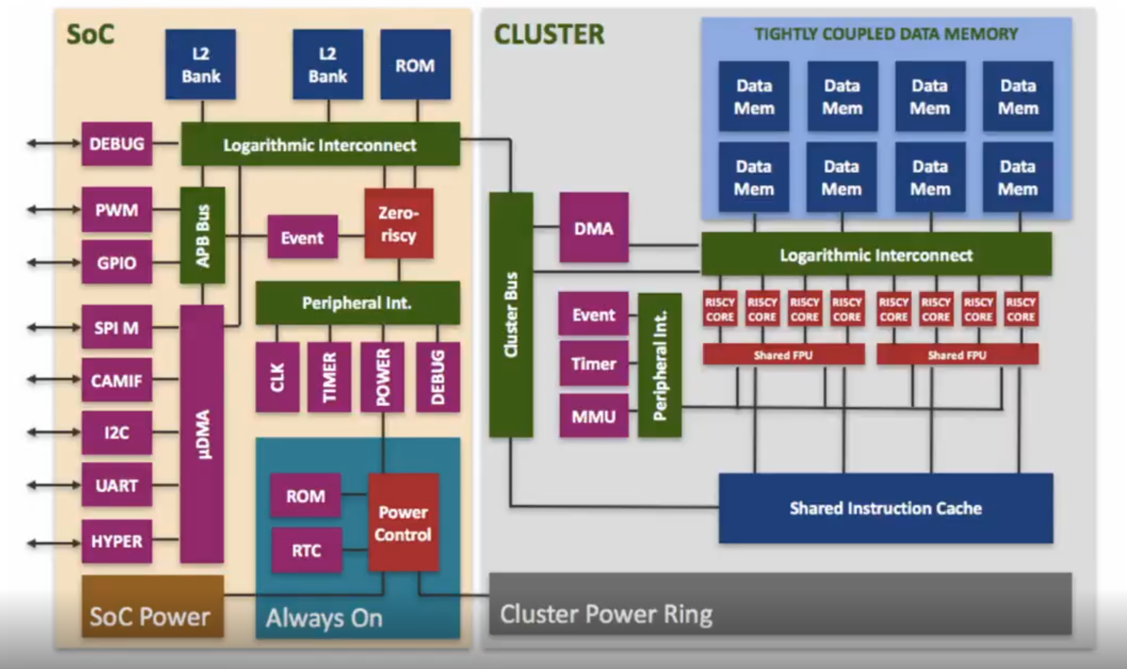
HW/SW Co-design : PULP Intergation
Objective:
Expose the butterfly accelerator as a memory-mapped AXI peripheral within the PULP SoC.
Pulp Architecture Overview
The TCDM:
Normal processors rely on invisible memory caches, which cause unpredictable delays.
PULP replaces caches with a Tightly Coupled Data Memory (TCDM)—a shared, ultra-fast scratchpad where Software must explicitly place data into the TCDM.
The System Actors:
Fabric Controller
Micro-DMA
Accelerators

Slide 16
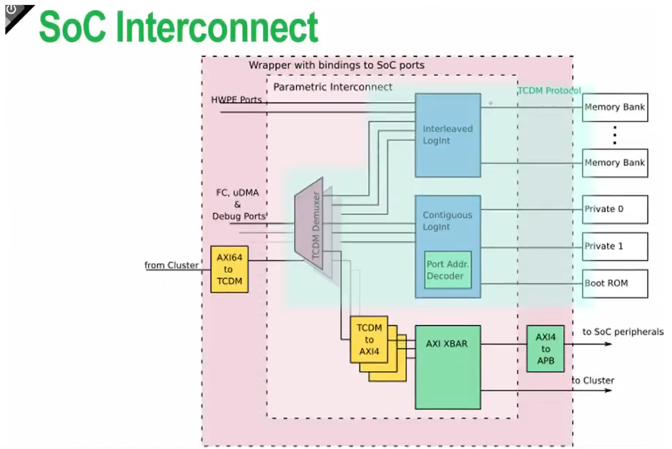
HW/SW Co-design :Highway System – Interconnects and Arbitration
Two Separate Traffic Networks:
TCDM Interconnect: reserved for fast operations, 1-cycle memory lookups.
AXI Crossbar: Built for complex components that needs multiple cycles.
How Software Talks to Hardware:
Address-Based Routing: Hardware doesn't have a name, only a memory address.
Two Paths of Communication:
The Control Path :The FC configures the hardware by writing values to these addresses.
The Data Path: Pushing the heavy payloads to the hardware so it can begin computation.
Wrapper
Accelerator

Slide 17
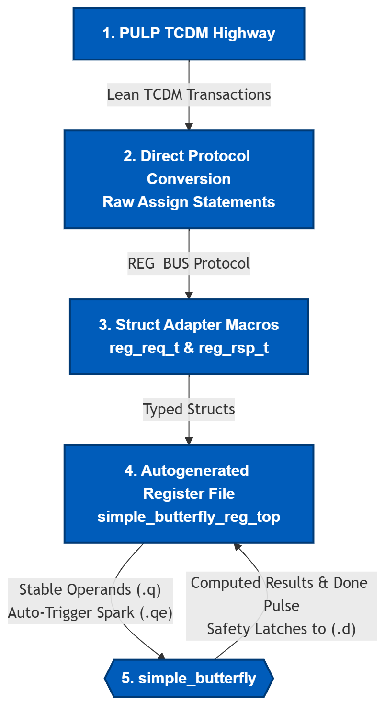
HW/SW Co-design : The Translation Wrapper
The Problem: AXI Overhead
The multi-channel AXI handshake crippled our math core, turning a 2-cycle computation into a 18-cycle bottleneck.
Solution: TCDM Integration
The Blueprint (The .hjson file)
A "contract" between software and hardware.
The Protocol Downgrade :
TCDM → Direct Protocol Converter → REG_BUS
REG_BUS → Macros → Structs
The Hardware Reality (.q , .qe, .d, .de) :
.q & .qe: Stable inputs and the 1-cycle Auto-Trigger spark.
Safety Latches to .d: TCDM has one cycle delay to read so we latch results steady for an extra cycle

Slide 18
HW/SW Co-design : Soc Modifications (TCDM )
Key Modifications:
Instantiated the top-level TCDM wrapper inside the pulp_soc.sv top module.
Declared a dedicated XBAR_TCDM_BUS interface to physically wire the accelerator into the system.
Updated L2 Demux Routing: Expanded NR_RULES_L2_DEMUX and added an addressing rule to funnel the Butterfly's memory space from the main cluster into the Contiguous Crossbar.
Updated Crossbar Routing: Expanded NR_RULES_CONTIG_CROSSBAR and mapped the incoming traffic directly to the newly instantiated TCDM slave port.
Address Allocation:
Assigned a dedicated memory-mapped region (0x1C01_0000 to 0x1C09_0000) inside soc_mem_map.svh.
Result:
The custom accelerator is now a fully visible, permanently integrated node directly on the Tightly Coupled Data Memory (TCDM) highway. It is accessible through ultra-fast, 1-cycle memory transactions, completely bypassing the AXI crossbar.

Slide 19
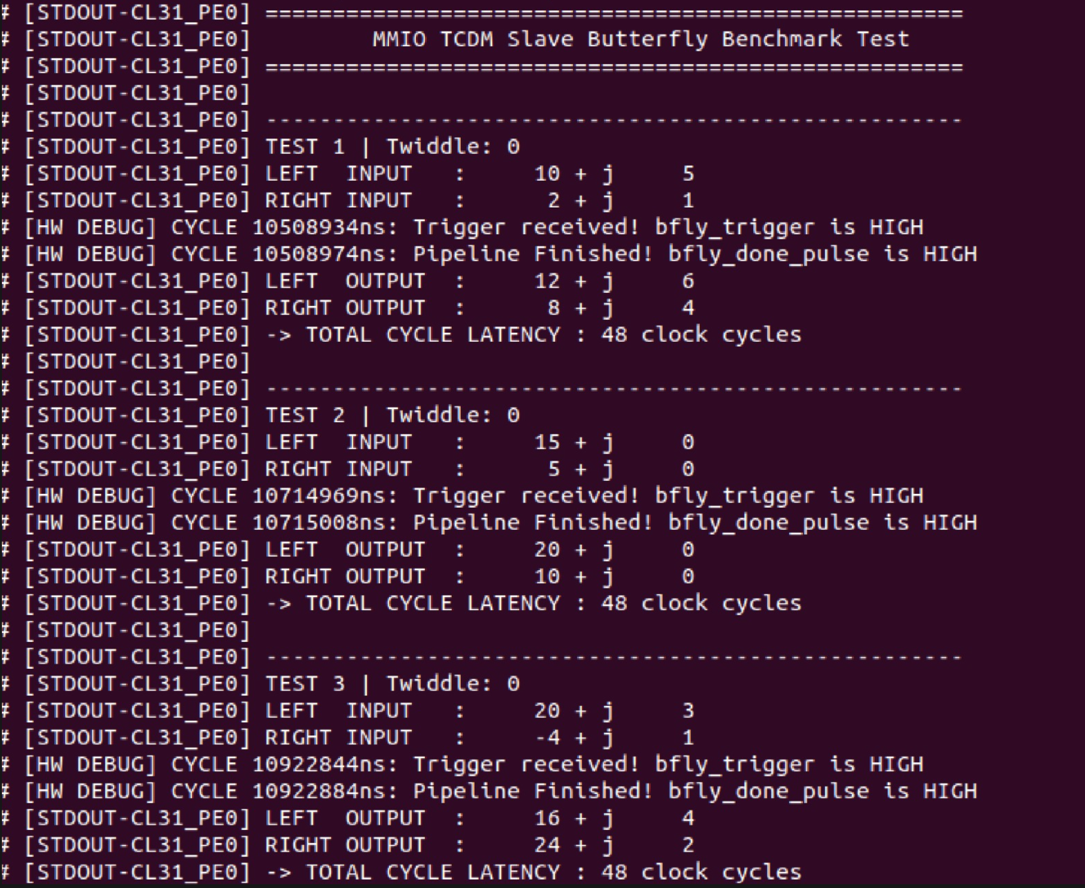
HW/SW Co-design : Software & Verification (1)
Step 1: Verify Integration &Mathematical Correctness
Results Match the results from the Written Testbench
Software Control:
Simple Custom C test application developed
Execution Flow:
Write inputs to registers
Trigger accelerator
Poll DONE status
Read computed outputs
Observed Results:
Correct butterfly arithmetic
Successful HW/SW communication
Measured Latency At first was 48 cycles, But we reached 18 cycles with AXI

Slide 20
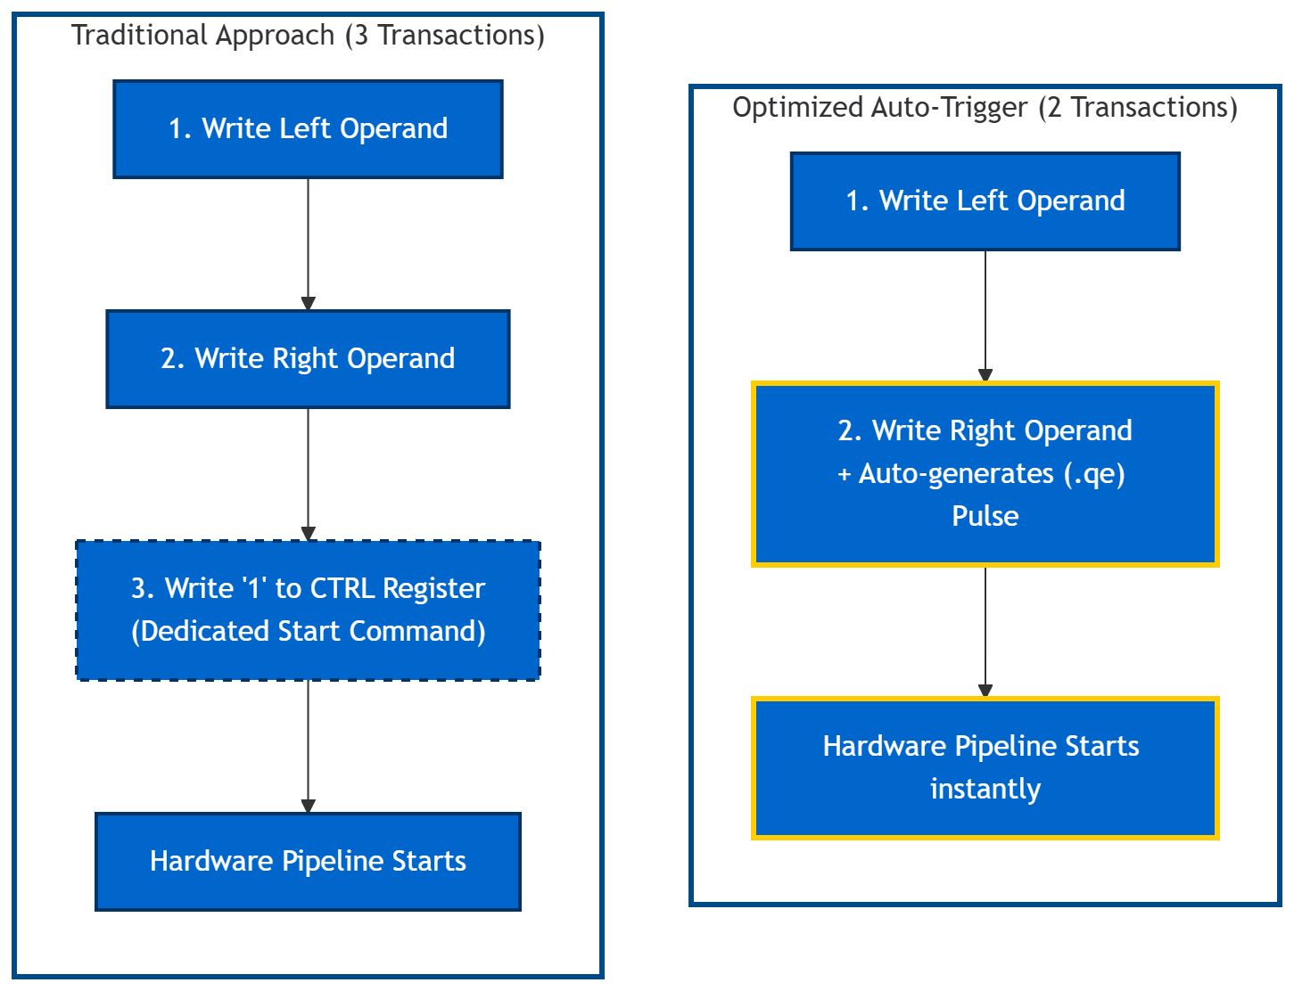
HW/SW Co-design : Optimization 1 – The Auto-Trigger
The Traditional Approach (3 Bus Transactions):
Software writes the Left Operand.
Software writes the Right Operand.
Software writes a '1' to a CTRL register to wake up the hardware.
Optimized Solution (2 Bus Transactions):
Eliminated the dedicated "Start" register.
Flagged the Right Operand register to generate a Write-Enable pulse.
The Benefit:
The hardware instantly fires up instantly.
Saves a transaction on every single butterfly
Result:
Number of Cycles taken for the End-to-end Butterfly execution decreased.

Slide 21
HW/SW Co-design : Where we were?
Latency Profiling
Design Feature | Phase 1 (AXI Pipelined) | Phase 2 (AXI Pipelined) | Phase 3 (AXI Pipelined) | Phase 4 (AXI Flattened)
Operand Widths | Oversized: 34b In, 38b Out, 42b Twiddle | Corrected: 24b In, 24b Out, 32b Twiddle | Corrected: 24b In, 24b Out, 32b Twiddle | Corrected: 24b In, 24b Out, 32b Twiddle
Twiddle Delivery | Full payload passed over AXI | Full payload passed over AXI | Twiddle Index passed over AXI | Twiddle Index passed over AXI
Wrapper | No optimizations | No optimizations | optimized | optimized
Multiplier Type | Pipelined | Pipelined | Standard | Standard
Software Driver | High Overhead | Optimized | First Optimized | Fully Optimized
Latency | 442 cycles | 59 cycles | 24 cycles | 18 cycles
Phase 5 (TCDM Flattened)
Corrected: 24b In, 24b Out, 32b Twiddle
Twiddle Index passed
No optimizations
Standard
High Overhead
48 cycles
Phase 6 (TCDM Flattened)
Corrected: 24b In, 24b Out, 32b Twiddle
Twiddle Index passed
optimized
Standard
Optimized
11 cycles

Slide 22
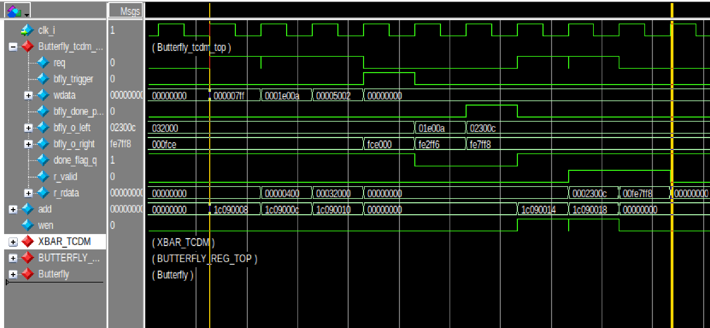
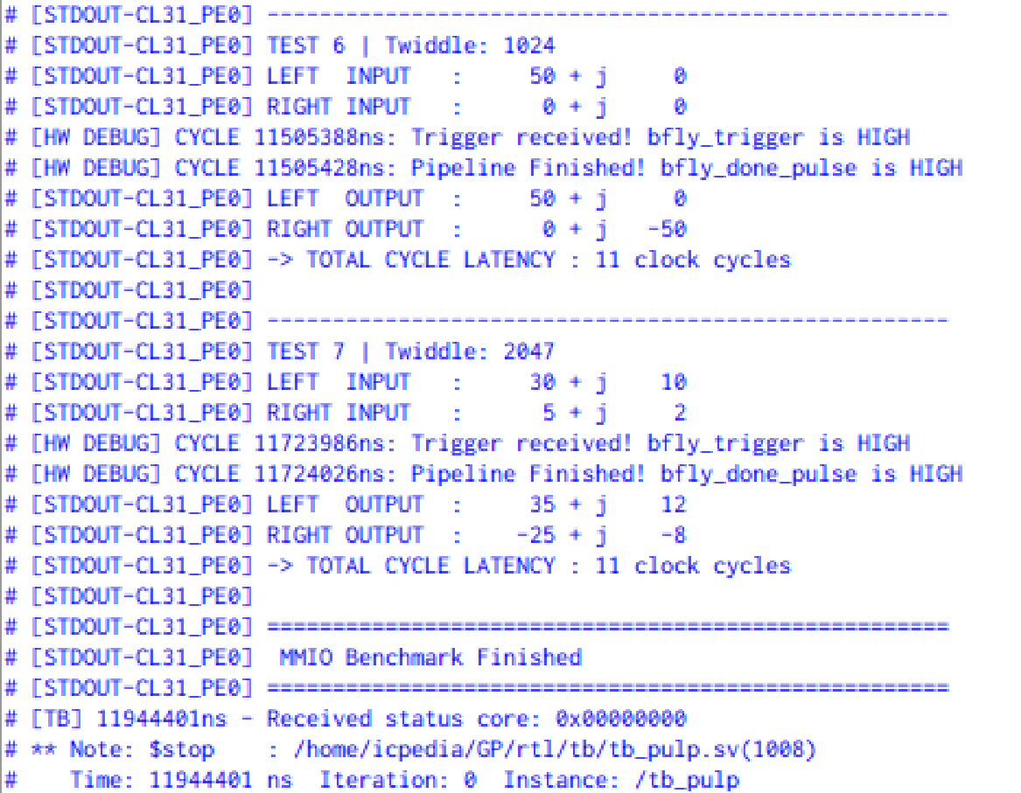
HW/SW Co-design : Software & Verification (2)
Step 2:Latency Profiling : 9 cycles + 2 APIs = 11 cycles

Slide 23
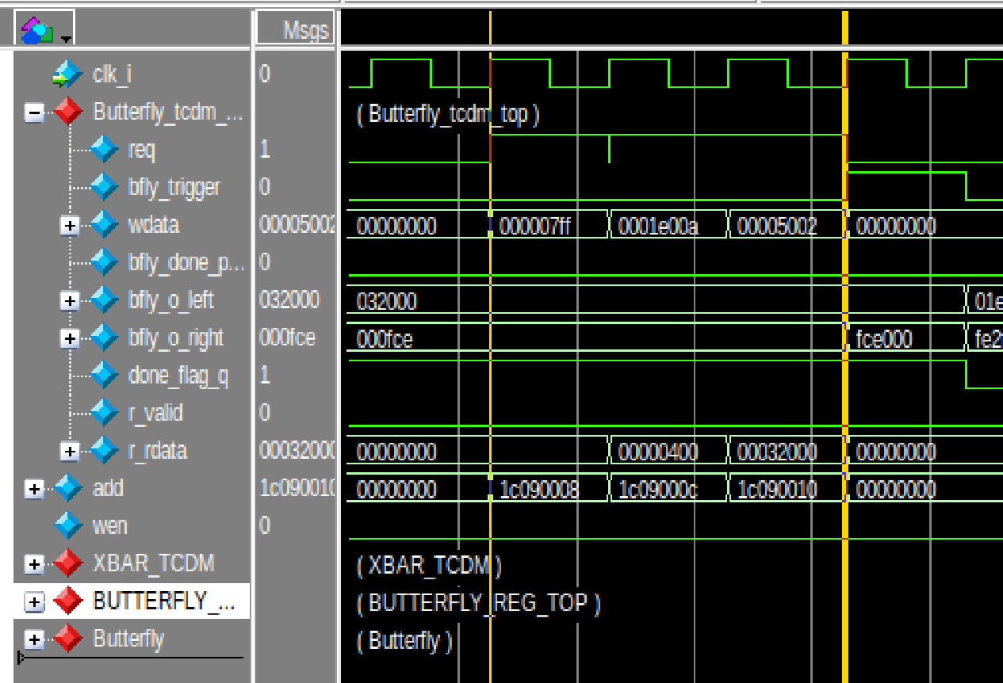
HW/SW Co-design : Software & Verification (2)
Step 2:Latency Profiling : Writing 3 times takes 3 cycles

Slide 24
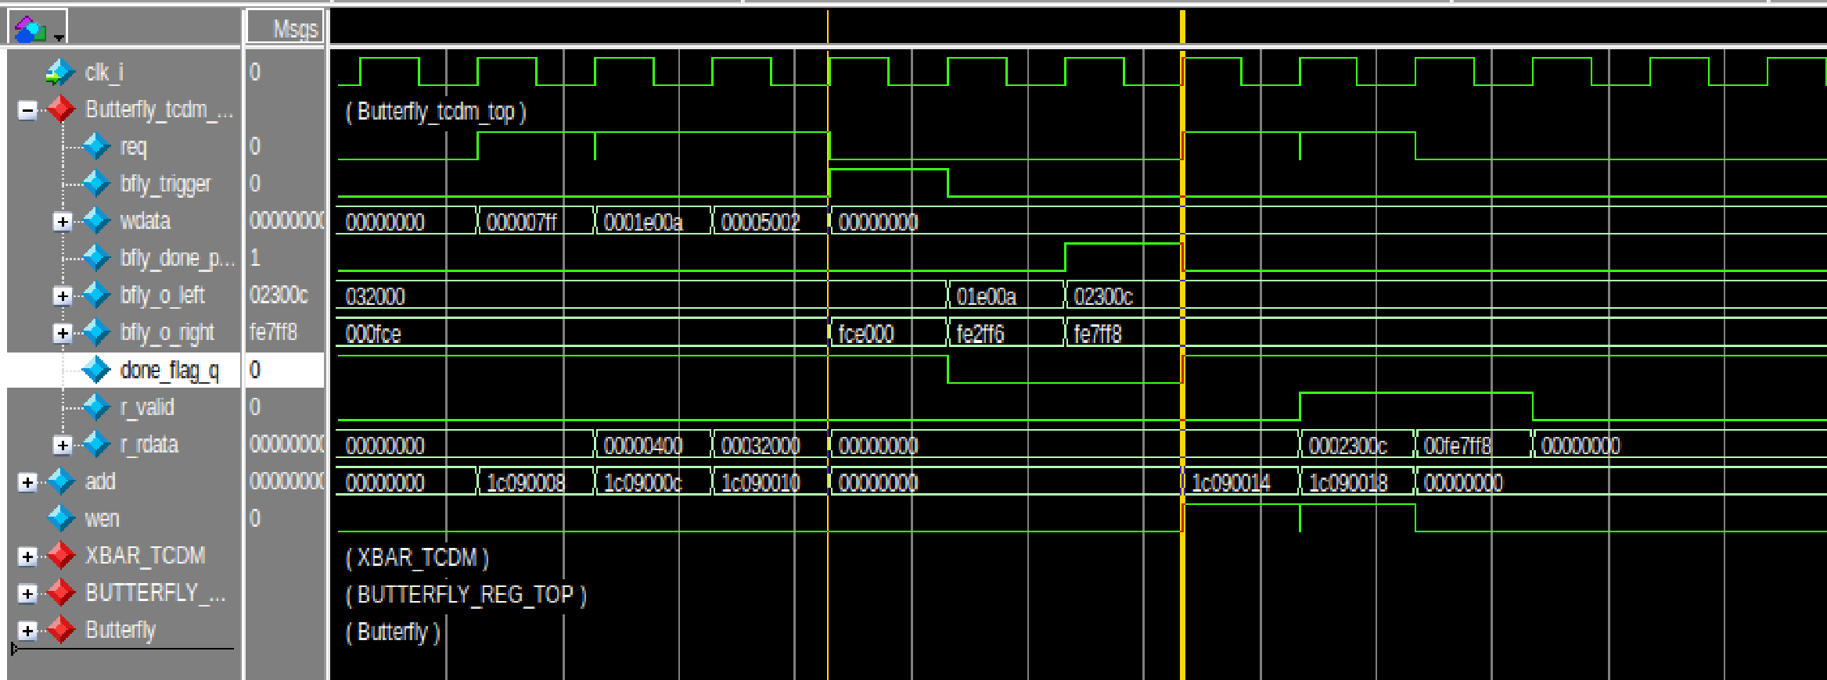
HW/SW Co-design : Software & Verification (2)
Step 2:Latency Profiling : 2 cycles butterfly + 1 delay to match TCDM → Question

Slide 25
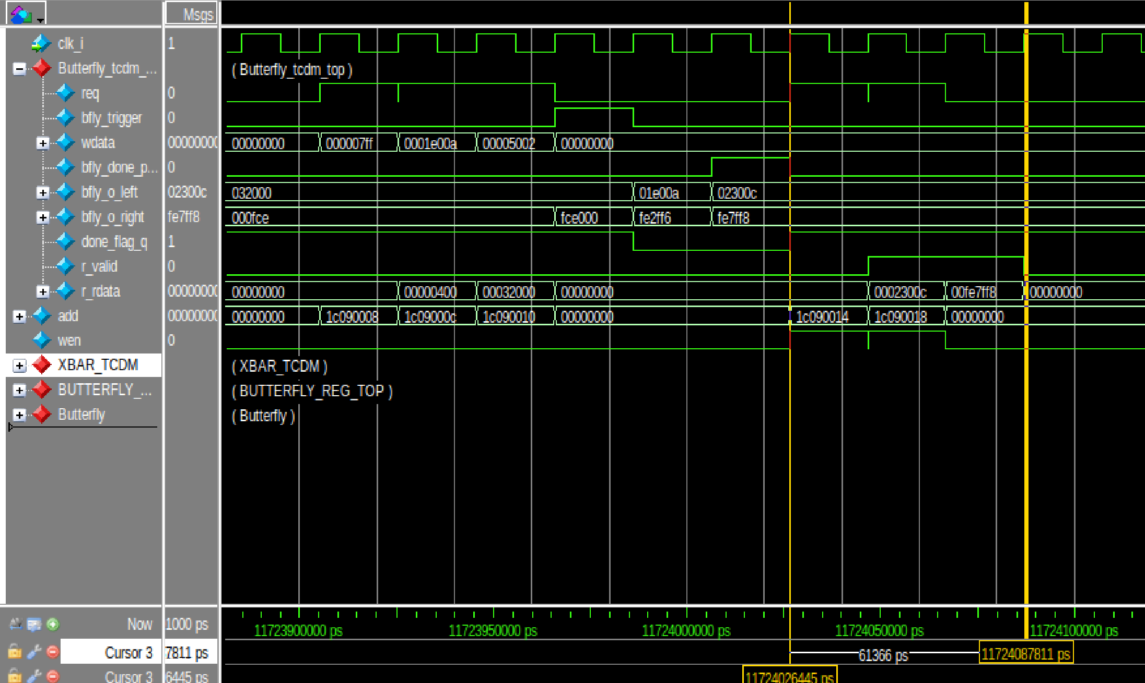
HW/SW Co-design : Software & Verification (2)
Step 2:Latency Profiling : 3 cycles read results and addresses

Slide 26
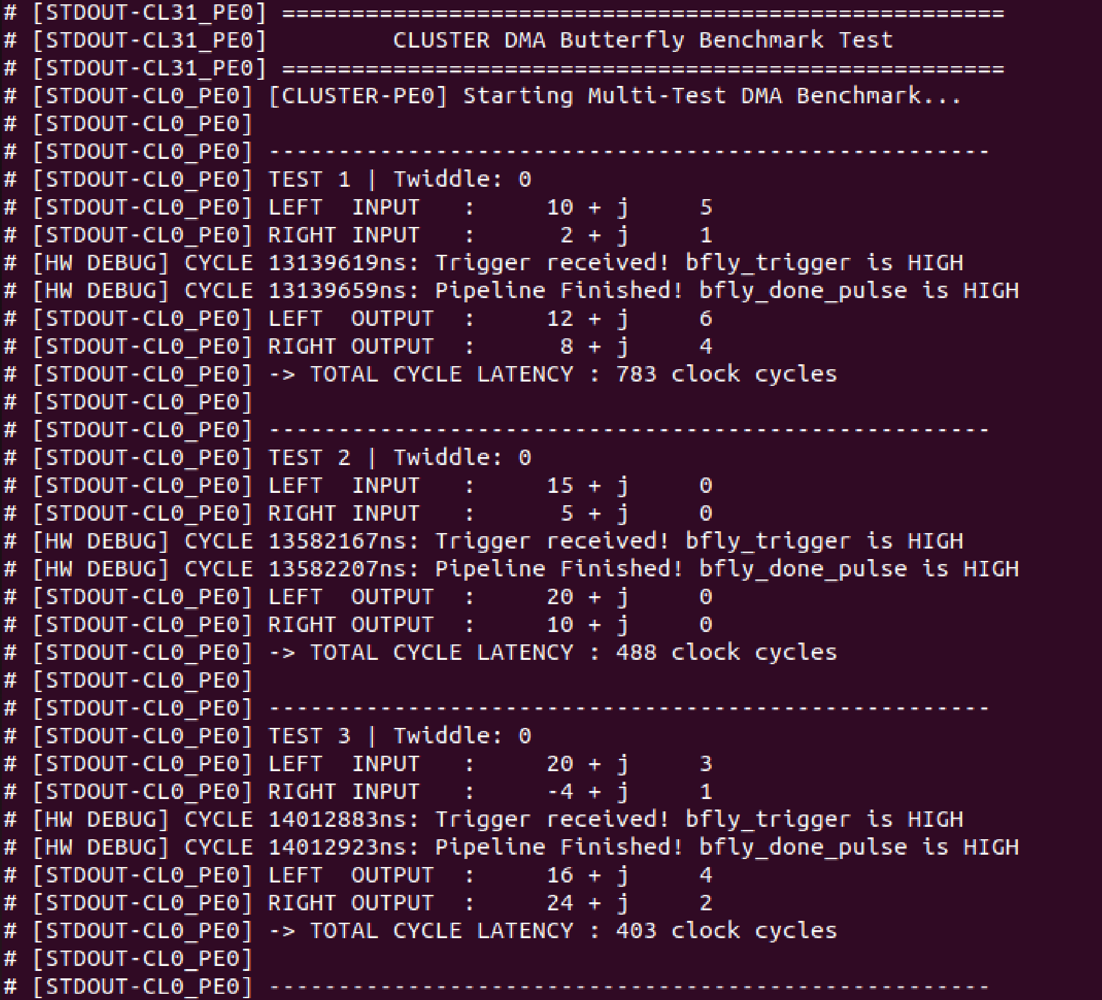
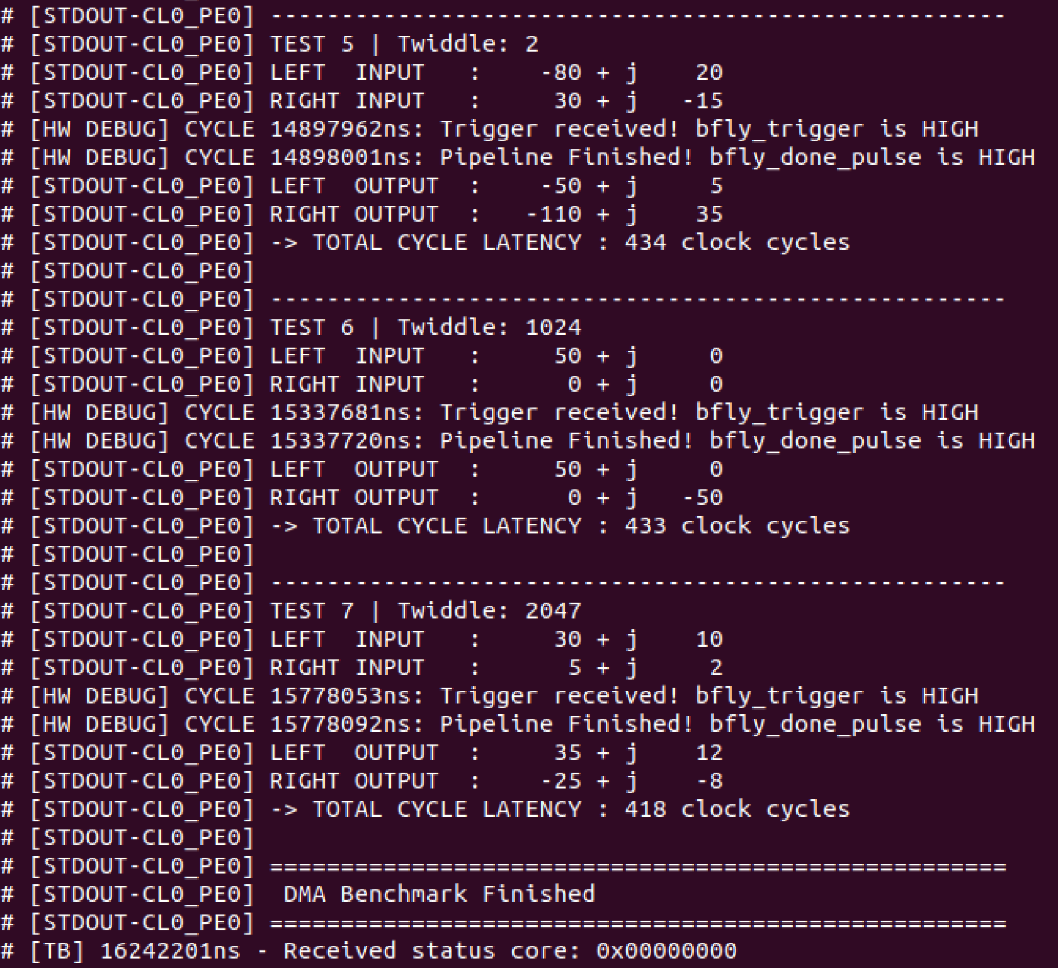
HW/SW Co-design : Next steps
Higher Radix Butterfly
I started with DMA for data delivery instead of Memory mapped

Slide 27
HW/SW Co-design (SW Part)

Slide 28
SW Trace Log Results
Cycles 0-1 (Loads): lw x14, lw x11
Cycles 2-3 (Shifts): pv.sra.sci.h
Cycle 4 (Subtract): pv.sub.h
Cycles 5-6 (Dot Products): pv.dotsp.h
Cycles 7-8 (Arithmetic Shifts): srai
Cycle 9 (Add): pv.add.h
Cycle 10 (Pack): pv.pack.h
2 Cycles (For loop)

Slide 29
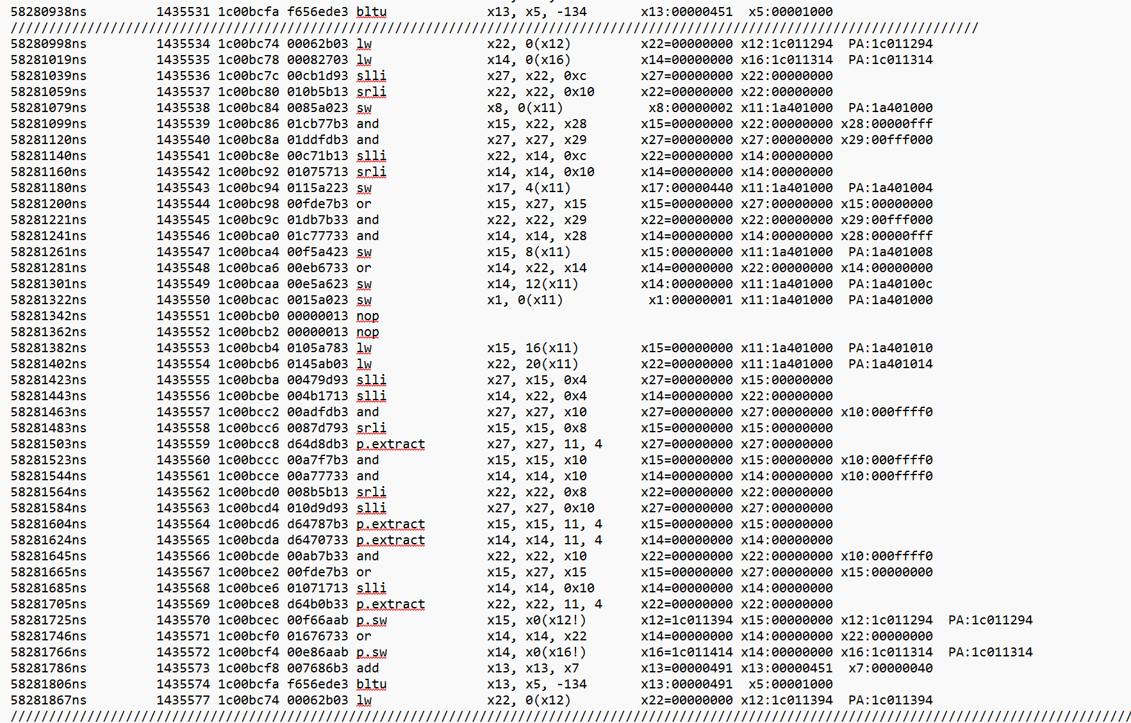
HW Trace Log
Starting From Branch
Time: 58281867 ns
58280998 ns = 869 ns
Cycles: 869 ns / 20 ns
= ~43.5 clock cycles

Slide 30
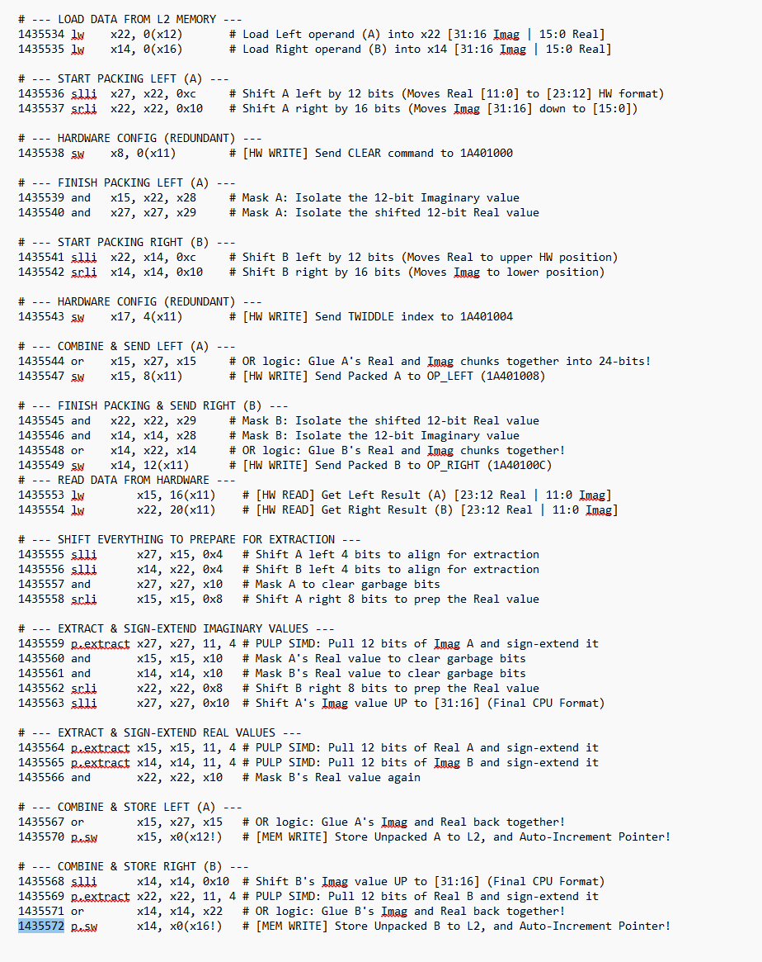
Trace Log Break Down

Slide 31
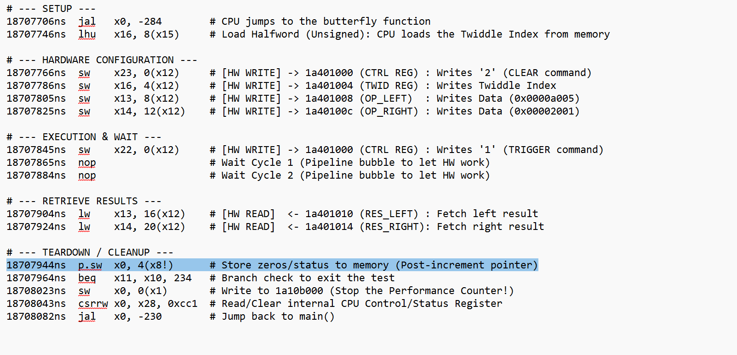
Single Butterfly Trace Log
Cycles: 376 ns / 20 ns
= ~19 clock cycles

Slide 32
Next Steps
Debug TCDM Code (SW)
Optimized FFT Algorithm (Higher Radix)

Slide 33
Multi clusters

Slide 34
Multi Clusters: PULP cluster architecture cont.
Two clusters approachs:
1- Upgrade PULP to have two clusters.
Required: Update/Modify the RTL and PULP runtime envirnoment
Problem: There is no drivers to handle the case of two clusters because the PULP runtime has only the UART driver besides the difficulty.
2- Use a new platform with a standby two cluster configuration.
Required: Search for a reliable platform and clone it.
Problem: It seems to be starting from zero again.

Slide 35
HWPE

Slide 36
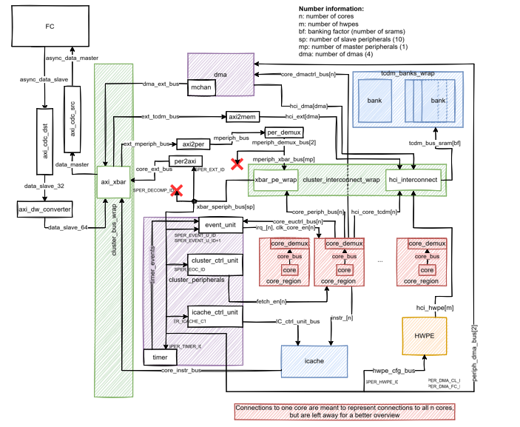
HWPE :Memory expansion
 | old | New
Bank Size | 4kB | 8KB
NO. Banks | 16 | 64
L1 SIZE = NO. Banks * Bank Size (B)
64KB -----> 512KB

Slide 37
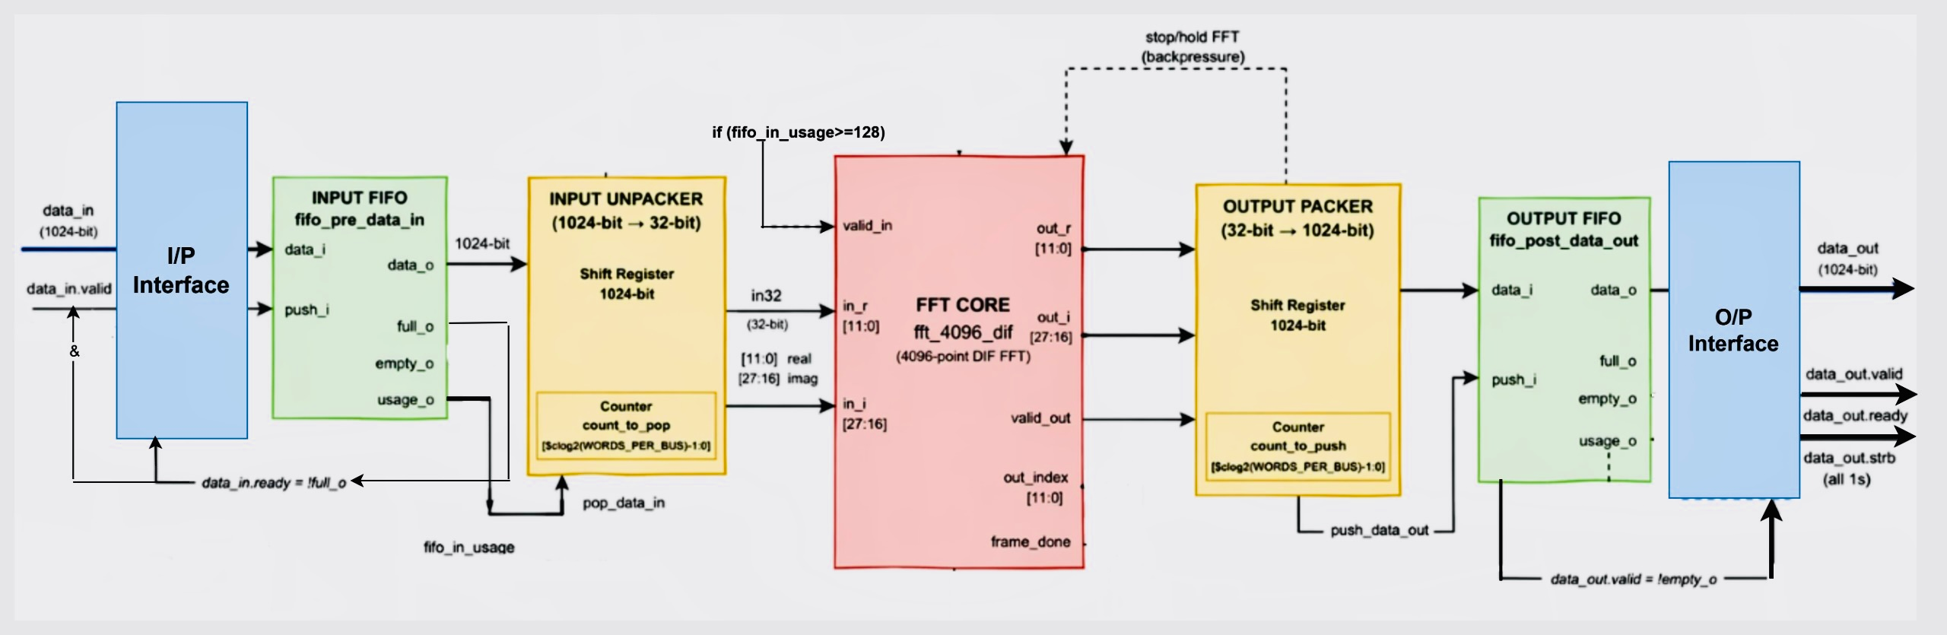
HWPE Engine : FFT 4096-point
BandWidth = 32 word * 32 = 1024-bit

Slide 38
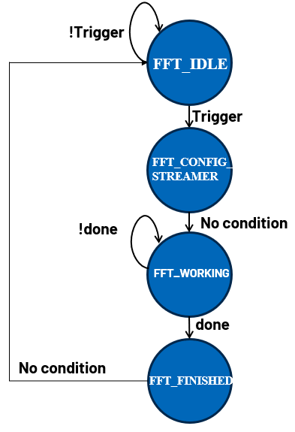
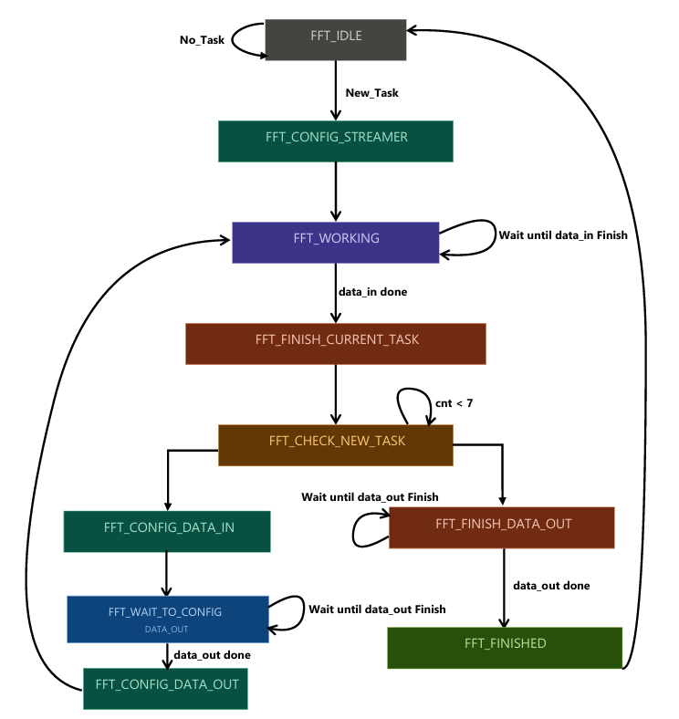
HWPE :Memory management
Before
After

Slide 39
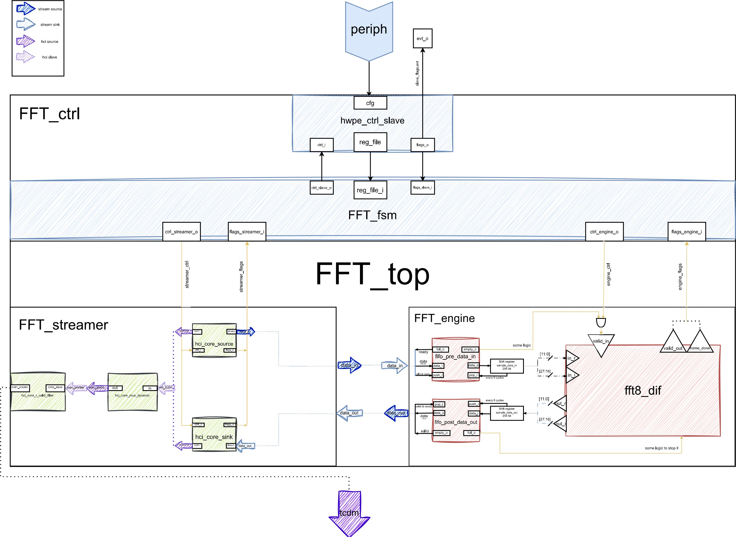
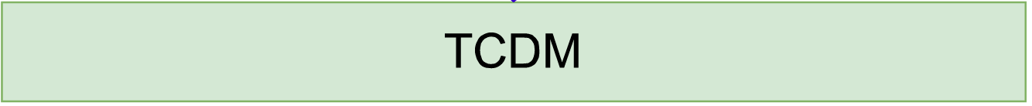
HWPE :Memory management

Slide 40
HWPE :Memory management
Case 1
Case 2

Slide 41
HWPE :Memory management
Place 1
Place 2
4096 word
4096 word

Slide 42
HWPE :Memory management
Place 1
Place 2
4096 word
data_in 1
4096 word
Task 1

Slide 43
HWPE :Memory management
Place 1
Place 2
4096 word
data_in 1
4096 word
Task 1

Slide 44
HWPE :Memory management
Place 1
Place 2
4096 word
data_in 1
data_in 2
4096 word
Task 1
Task 2

Slide 45
HWPE :Memory management
Place 1
Place 2
4096 word
data_out 1
data_in 2
4096 word
Task_finish 1
Task 2

Slide 46
HWPE :Memory management
Place 1
Place 2
4096 word
data_in 3
data_in 2
4096 word
Task 3
Task 2

Slide 47
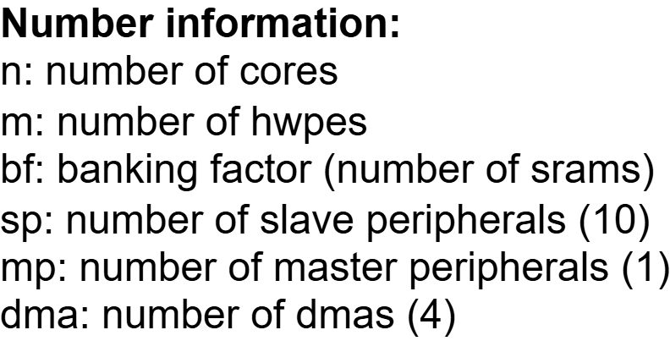


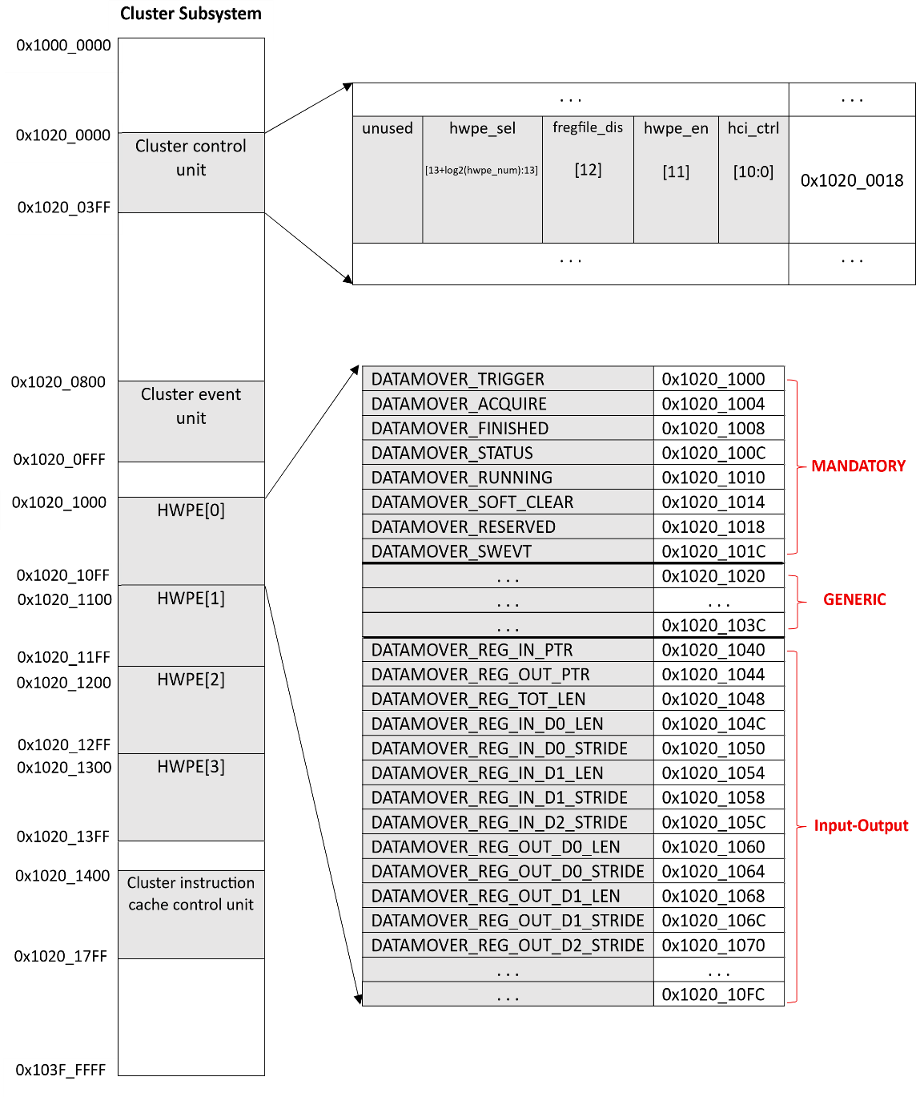




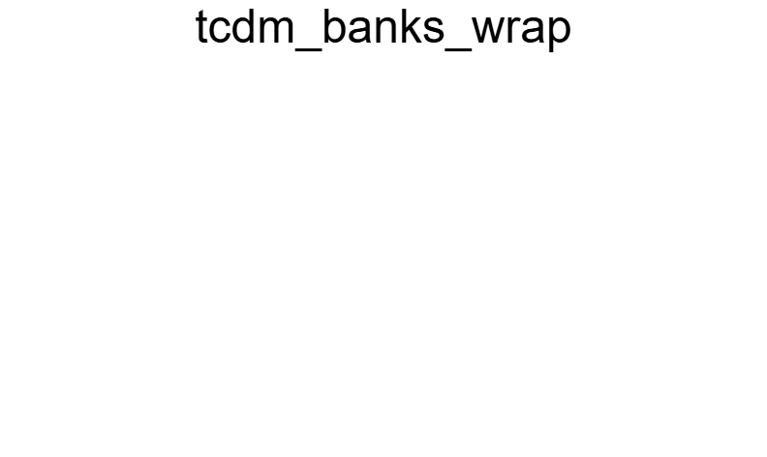



































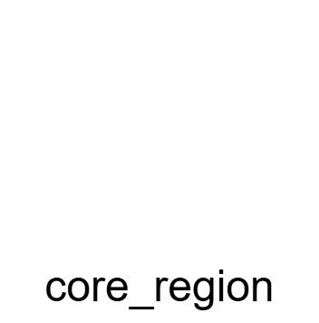


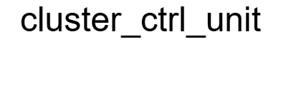




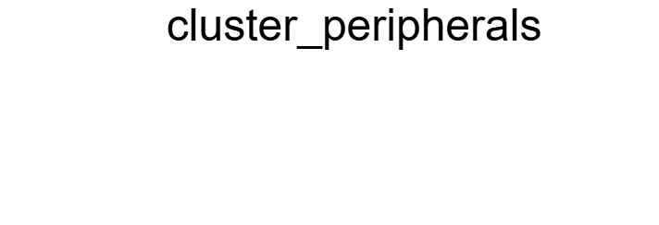


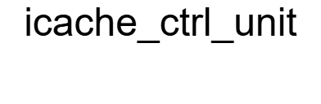











HWPE :8 parallel FFTs
FFT0
FFT1
FFT8
decoder
HWPE [0]
HWPE [1]
HWPE [2]
HWPE [3]
HWPE [4]
Data
HWPE [5]
HWPE [6]
control
HWPE [7]

Slide 48
HWPE :8 parallel FFTs
FFT0
FFT1
FFT8
decoder
Data
FFT0
FFT1
FFT8
decoder

Slide 49
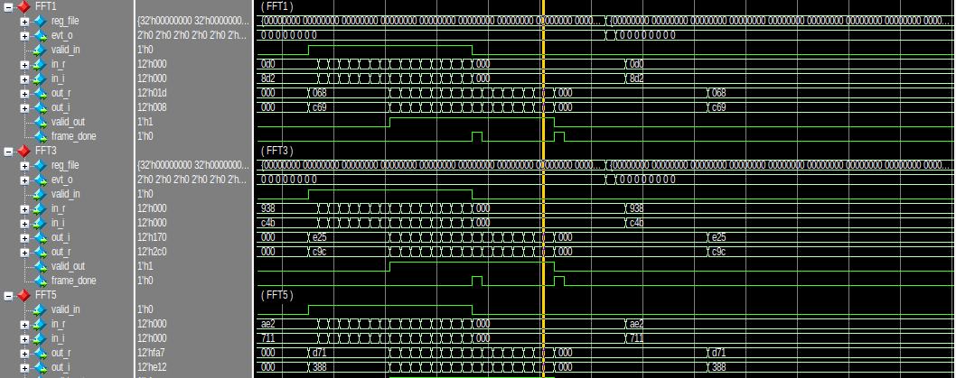
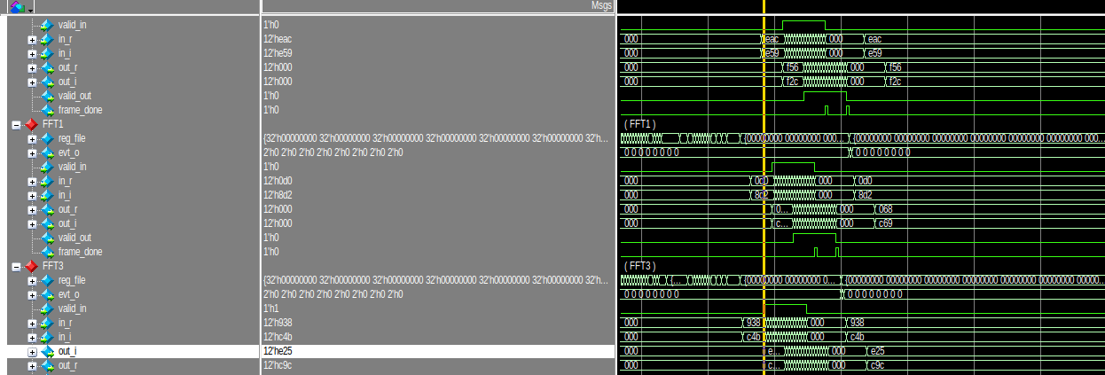
HWPE :8 parallel FFTs
FFT0
FFT1
FFT8
decoder
FFT0
FFT1
FFT8
decoder

Slide 50
HWPE :Next Steps
Implementation of 8 parallel 4096-point using the new Memory management approach
Using the DMA in the cluster domain to overcome the high utilization of cores in transferring data 80%

Slide 51
GitHub Repositories
RTL implementations and Wrapper codes can be found here: (AXI integration part by Mostafa Ahmed)
https://github.com/Mostafa-Yossry/ADI-CU-GP-2025-2026/tree/main/RTL/

Slide 52
References
PULP platform
https://pulp-platform.org/index.html

Slide 53
Thank You!

