Slide 1
Fledgling: Teaching a Flapping Robot how to Fly
Mostafa Ibrahim

Slide 2
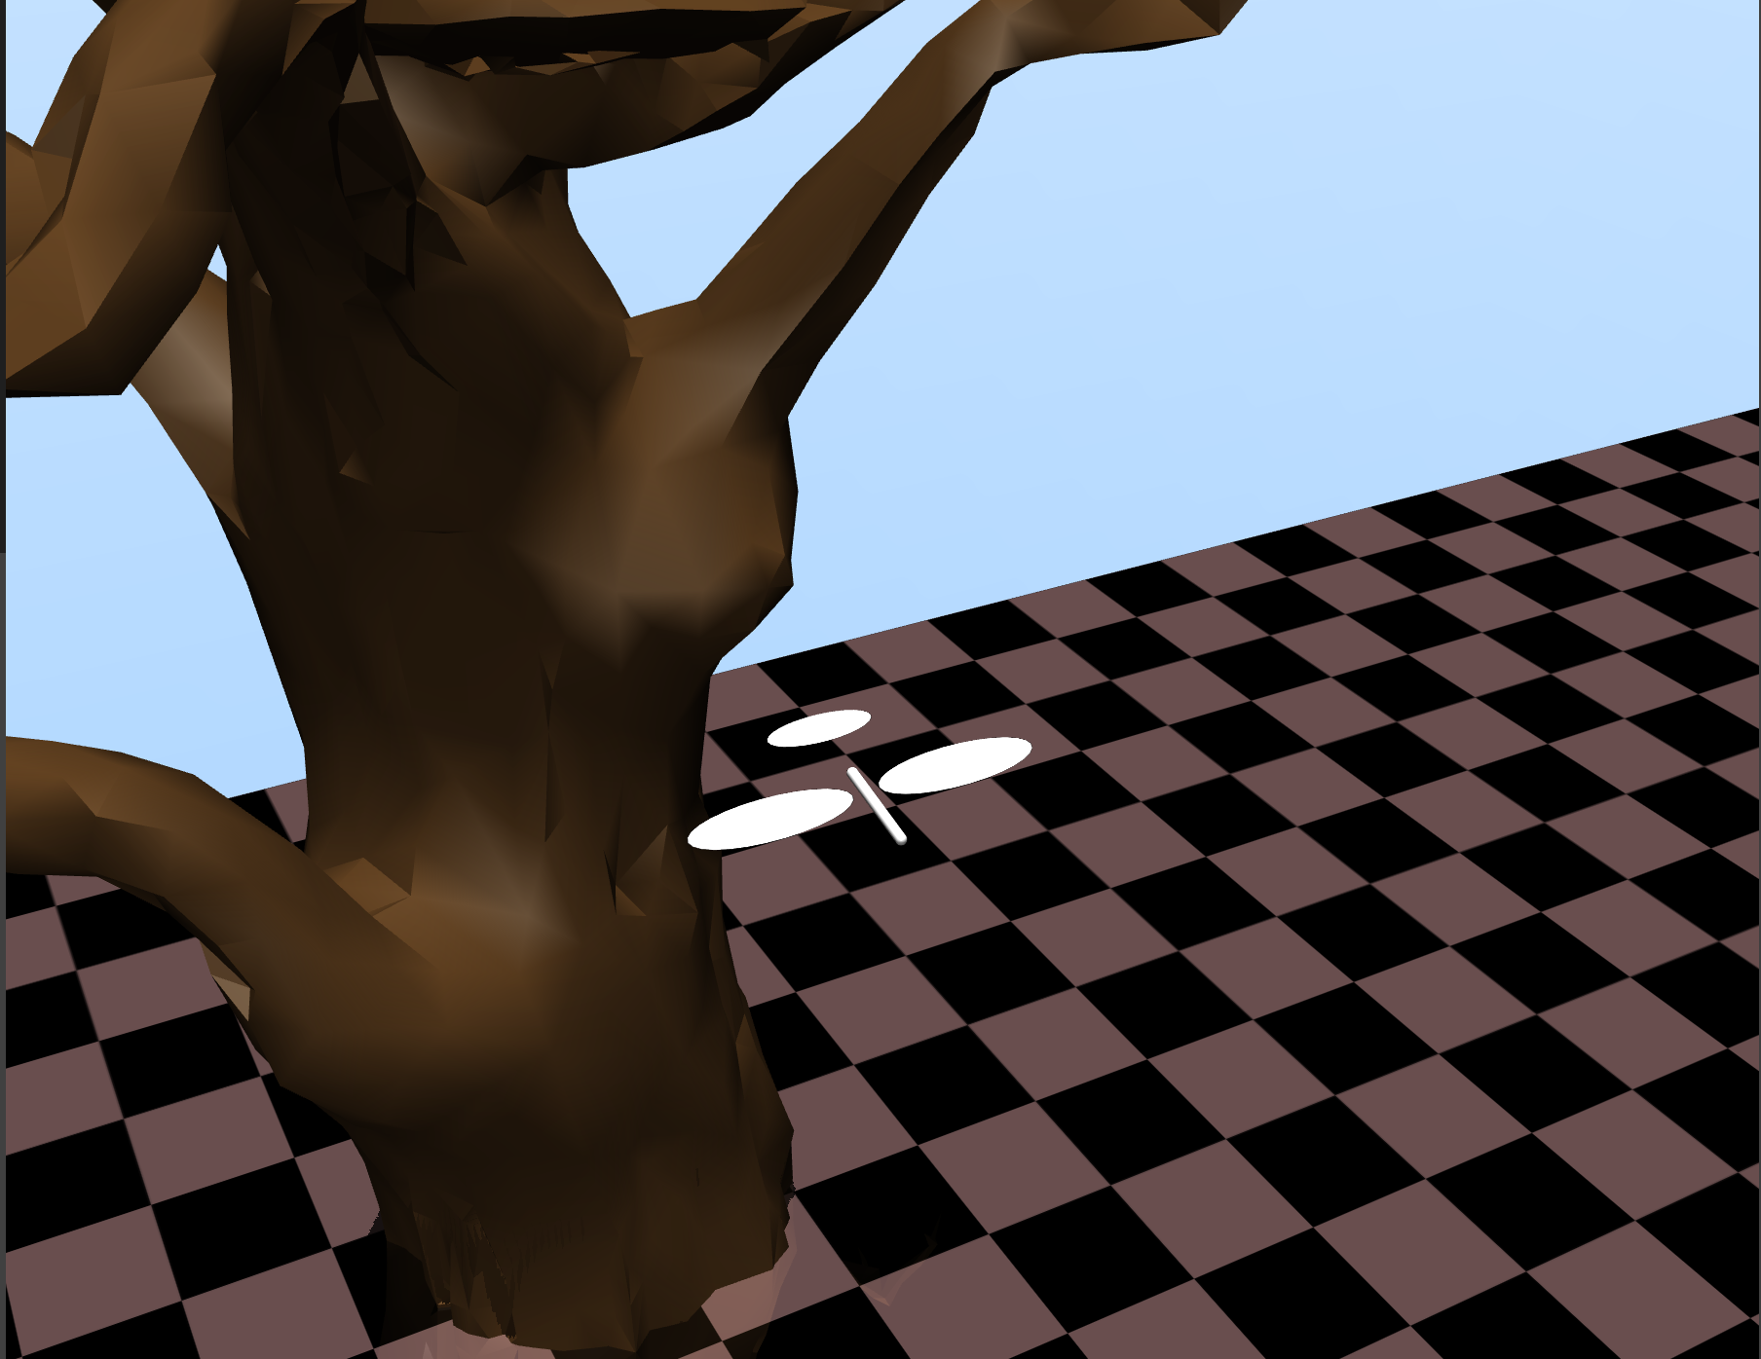
Environment Setup
Observation Space (6D): X, Y, Z, velocity x, z and angular velocity x
Action Space: Left Joint Angle, Right Wing Angle, Tail Angle
Ideal Flapping Follows: $\sin{(2π∗freq∗step) }$
Custom MuJoCo Model of a Flapping Bird

Slide 3
Reward Function
Worse
Better
Learning
Learning
Complex Reward Function
Simple Reward Function
Rewards
Height
Distance Travelled
Velocity
Penalizes
Orientation change
Energy Inefficiency
Unsynchronized Wing Movement
Rewards
Horizontal Distance Travelled
Penalizes
Falling below a certain height

Slide 4
Training
Network Details
TD3
SAC
Policy Network
Architecture
2 Hidden layers
128 neurons each
RELU activation
Policy Network
Architecture
2 Hidden layers
128 neurons each
RELU activation
Q-Networks
Architecture
2 Hidden layers
128 neurons each
RELU activation
Q-Networks
Architecture
2 Hidden layers
64 neurons each
RELU activation

Slide 5
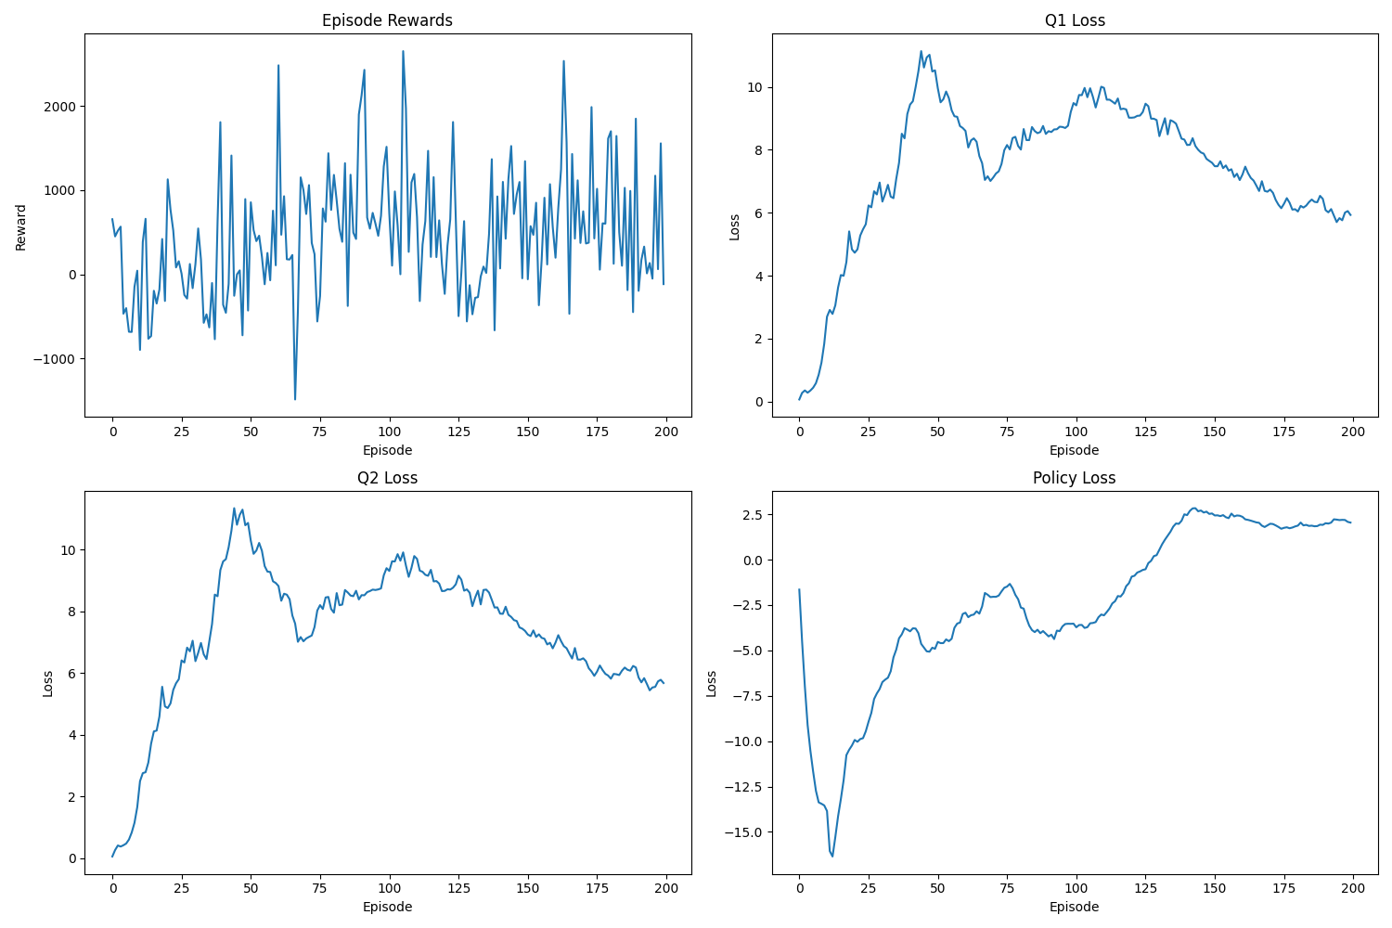
Results: TD3 200 Episodes

Slide 6
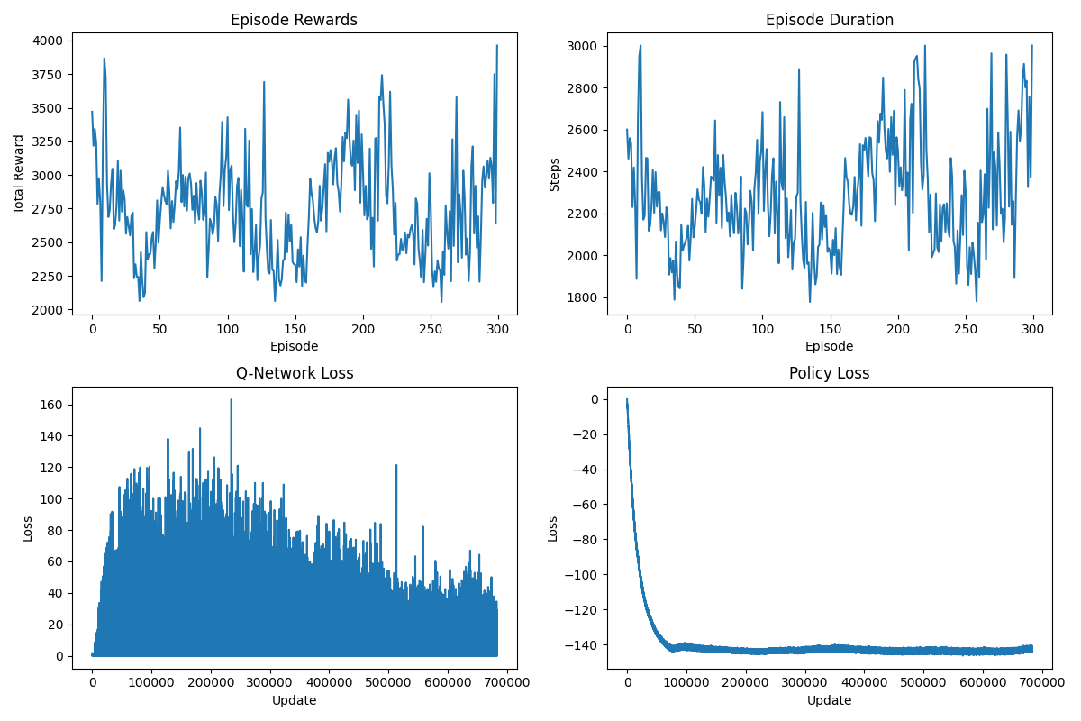
Results: SAC 300 Episodes

