Slide 1

Music Project (Chinook)
Mostafa Rezvani
August 2024

Slide 2
Introduction
We want to analyze a database containing 3503 unique track
from 275 singers in 18 albums
sold to 59 different customers by 3 employees
from the beginning of 2021 to the end of 2025.
Intro
Hypothesis
Confidence

Slide 3
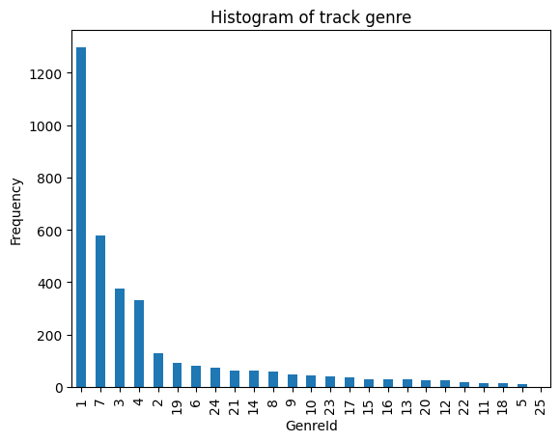
Distribution of the number of songs in each genre
Rock, Latin and Metal are the best selling genres
Intro
Hypothesis
Confidence

Slide 4
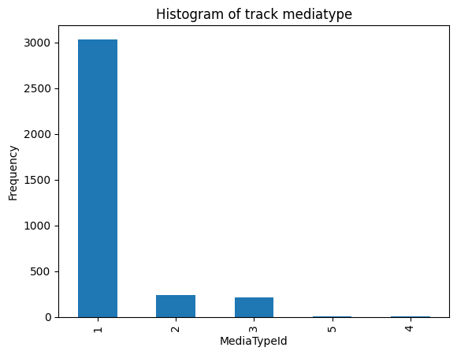
Distribution of the number of songs in each media type
MPEG audio file are the best selling media type
Intro
Hypothesis
Confidence

Slide 5
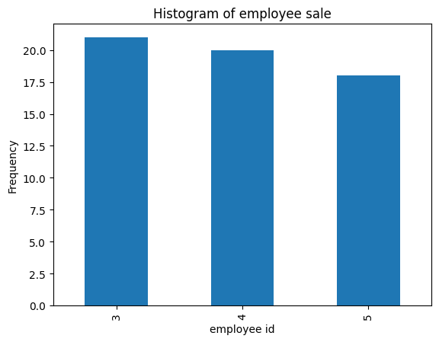
Distribution of the number of songs sold by each employee
Out of 7 employees, only 3 employees have sales
which is almost equal
There last name are Johnson, Park and Peacock
Intro
Hypothesis
Confidence

Slide 6
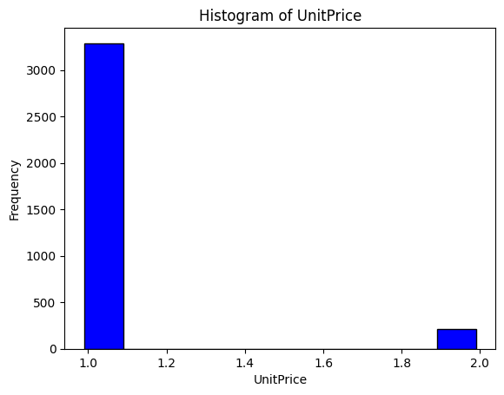
Song price distribution
Most of the songs are sold for 0.99$
Intro
Hypothesis
Confidence

Slide 7
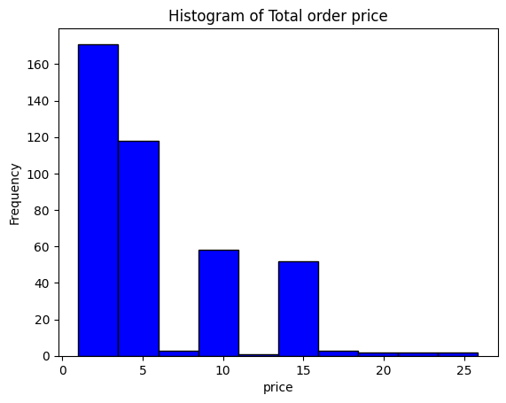
Distribution of total price of orders
Most of the total price of the orders was up to 5$
Intro
Hypothesis
Confidence

Slide 8
Statistical Hypothesis
Intro
Hypothesis
Confidence

Slide 9
Q1.top 3 genre
There is no significant difference
Name | Total sale | Sale mean
Rock | 826.65 | 1.109597
Latin | 382.14 | 1.123941
Metal | 261.36 | 1.131429
Intro
Hypothesis
Confidence

Slide 10
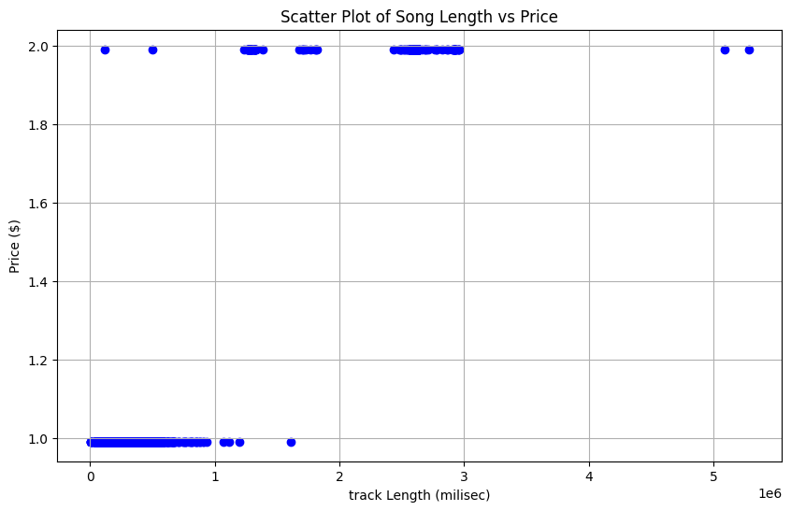
Q2. Song time and price
There is a strong correlation
Intro
Hypothesis
Confidence

Slide 11
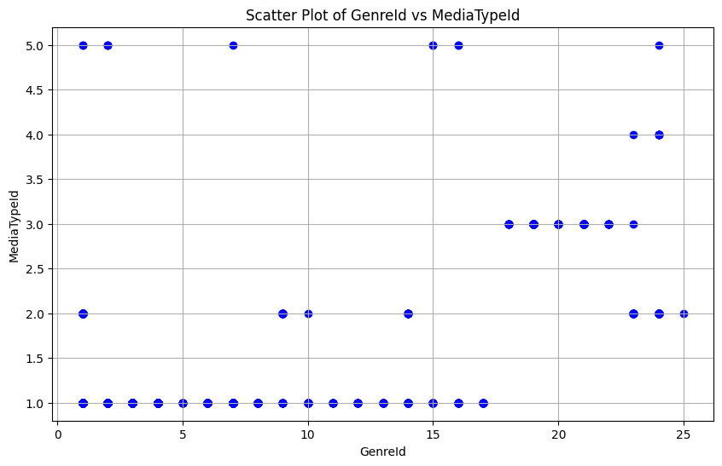
Q4. Song genre and media type
There is a significant relationship.
Intro
Hypothesis
Confidence

Slide 12
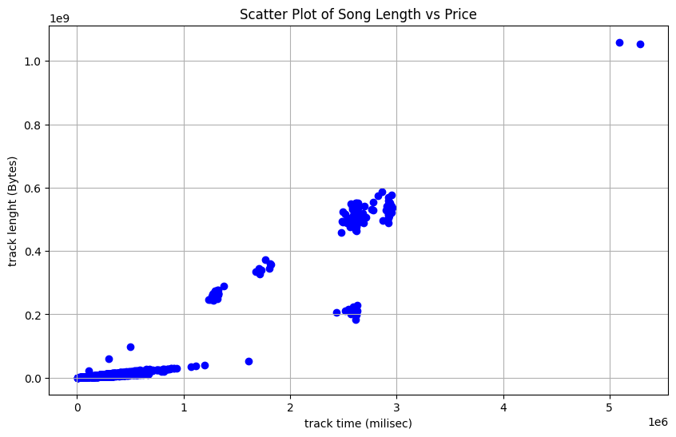
Q5. Volume and time of the song
There is a significant relationship.
Intro
Hypothesis
Confidence

Slide 13
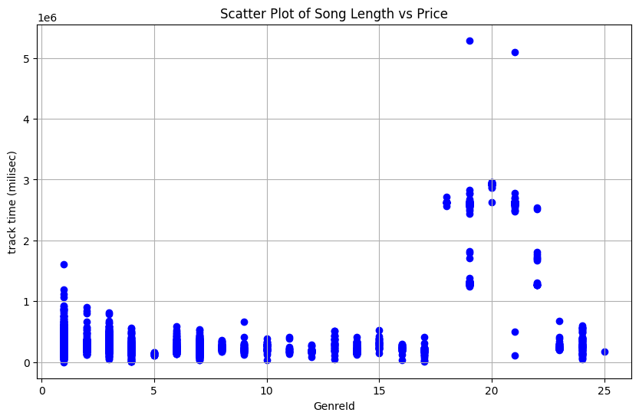
Q6. Genre and time of the song
There is a significant relationship.
Intro
Hypothesis
Confidence

Slide 14
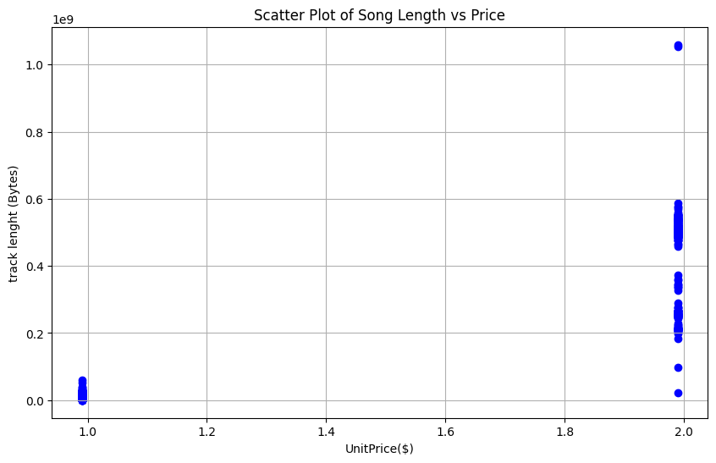
Q7. Price and volume
There is a strong correlation
Intro
Hypothesis
Confidence

Slide 15
Confidence Interval
Intro
Hypothesis
Confidence

Slide 16
Q1average length of songs in different genres the same?
Name | Mean
Rock And Roll | 1.346435e+05
Opera | 1.748130e+05
Hip Hop/Rap | 1.781763e+05
Easy Listening | 1.891642e+05
Bossa Nova | 2.195900e+05
R&B/Soul | 2.200669e+05
World | 2.249238e+05
Pop | 2.290341e+05
Latin | 2.328593e+05
Alternative & Punk | 2.343538e+05
Soundtrack | 2.443709e+05
Reggae | 2.471778e+05
Alternative | 2.640585e+05
Blues | 2.703598e+05
Rock | 2.839100e+05
Jazz | 2.917554e+05
Classical | 2.938676e+05
Heavy Metal | 2.974529e+05
Electronica/Dance | 3.029858e+05
Metal | 3.097494e+05
Comedy | 1.585264e+06
TV Shows | 2.145041e+06
Drama | 2.575284e+06
Science Fiction | 2.625549e+06
Sci Fi & Fantasy | 2.911783e+06
No
Not even with a 95%
confidence interval
Intro
Hypothesis
Confidence

Slide 17
Q2. average sales in different countries?
BillingCountry | mean
Argentina | 0.990000
Australia | 0.990000
Belgium | 0.990000
Denmark | 0.990000
Italy | 0.990000
Poland | 0.990000
Spain | 0.990000
United Kingdom | 0.990000
Canada | 0.999868
Brazil | 1.000526
Portugal | 1.016316
Sweden | 1.016316
India | 1.017027
France | 1.026842
Germany | 1.029474
Norway | 1.042632
USA | 1.058826
Netherlands | 1.068947
Finland | 1.095263
Austria | 1.121579
Czech Republic | 1.187368
Hungary | 1.200526
Ireland | 1.200526
Chile | 1.226842
Intro
Hypothesis
Confidence

Slide 18
Q3. songs purchased by each Customer
They are same quantity of order
CustomerId | mean | std | count
1 | 1.0 | 0.0 | 38
2 | 1.0 | 0.0 | 38
3 | 1.0 | 0.0 | 38
4 | 1.0 | 0.0 | 38
5 | 1.0 | 0.0 | 38
6 | 1.0 | 0.0 | 38
…. | …. | …. | ….
59 | 1.0 | 0.0 | 36
Intro
Hypothesis
Confidence

Slide 19
Thank You For Your Attention
Intro
Hypothesis
Confidence

