Slide 1


Slide 2
3.Which player has the highest number of wins?
match_id | match_winner | player_id
12260075 | away | 254742.0
12260077 | away | 275923.0
12260084 | away | 254742.0
12261530 | away | 106755.0
12261532 | away | 106755.0
... | ... | ...
12384674 | home | 134342.0
12384788 | home | 386338.0
12384806 | home | 342835.0
12384975 | home | 96061.0
12385017 | home | 254281.0
player_id | Number_of_match
253356 | 18
163438 | 14
348712 | 13
255428 | 13
88310. | 13

Slide 3
9.Which player has won the most tournaments in a single month?
You can see player_id above who wins most tournament in this month
253356

Slide 4
16.Which player has the highest winning percentage against top 10 ranked opponents?
top_winner_againt_top_10_id:
228272

Slide 5
Coach
Player win indicators
weight
height
Hosting\ Competition venue
Average match time favors the player with more experience

Slide 6
Coach
Player win indicators
22. Does hosting increases the chance of winning?
weight
height
Hosting\ Competition venue
Average match time favors the player with more experience
Host's win rate 51%
Home chance of winning by almost 1%

Slide 7
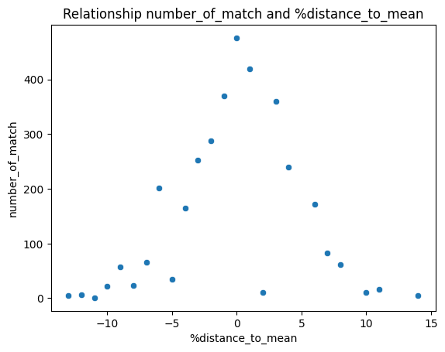
Coach
Player win indicators
24. How much does average height and weight increase a player's winning chances?
weight
height
Hosting\ Competition venue
Average match time favors the player with more experience
میزان برد بالاتر از میانگین
41.16
میزان برد کمتر از میانگین
44.60
شانس پایین از میانگین:
2 %

Slide 8
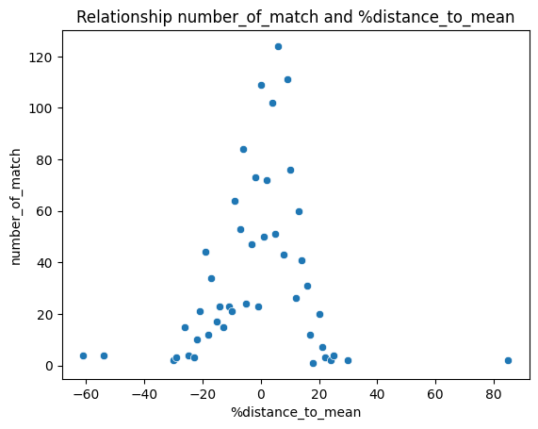
Coach
Player win indicators
24. How much does average height and weight increase a player's winning chances?
weight
height
Hosting\ Competition venue
Average match time favors the player with more experience
میزان برد بالاتر از میانگین
53.43
میزان برد کمتر از میانگین
39.63
شانس برد بالاتر از میانگین:
7.5 %

Slide 9
Organizer
Average match time
Important tournament category
Final rounds
Ground type
rank difference

Slide 10
Organizer
Average match time
Important tournament category
Final rounds
Ground type
rank difference
23. Check how the average match time has a relationship with the rank difference of two players? have the matches of players with close ranks usually longer match time?

Slide 11
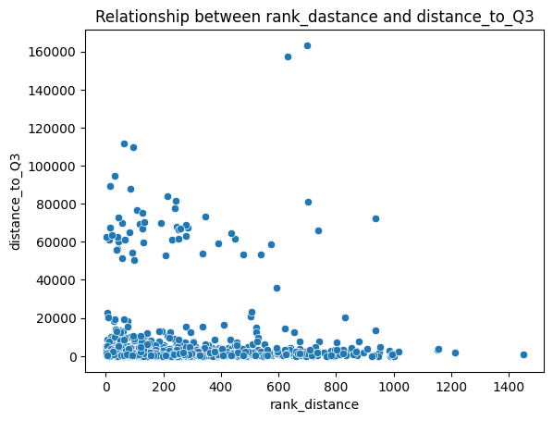
Organizer
Average match time
Important tournament category
Final rounds
Ground type
rank difference
there are 1529 long match (above Q3) / of 6114
most of these long games are in a small rank difference between the players
There is a large density of data in the rank difference range of 200 and we can save that

Slide 12
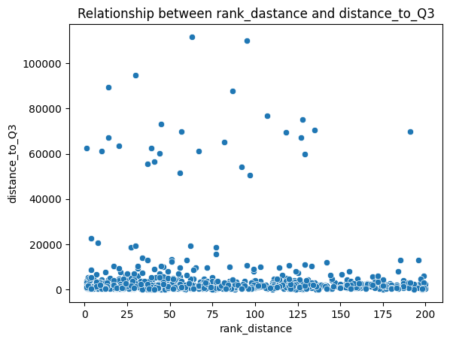
Organizer
Average match time
Important tournament category
Final rounds
Ground type
rank difference
About 50% of these long matches were related to the 200 rank difference
mean of this player match time 72% more than all players match time

Slide 13
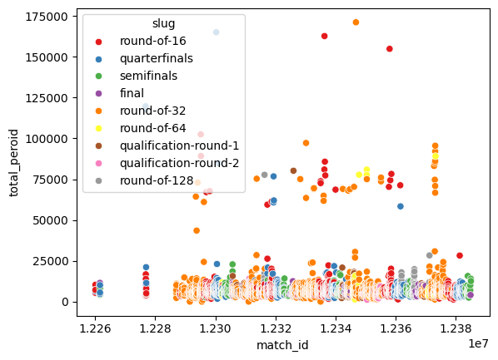
Organizer
Average match time
Important tournament category
Final rounds
Ground type
rank difference
round_type | match_time_mean
qualification-round-2 | 6256.175676
final | 6611.775194
qualification-round-1 | 6665.521053
semifinals | 6708.121951
round-of-32 | 7406.931954
round-of-16 | 7910.159703
quarterfinals | 8054.491857
round-of-128 | 8867.856164
round-of-64 | 9026.789062

Slide 14
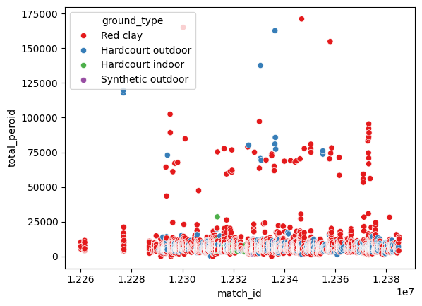
Organizer
Average match time
25.As we get closer to the final round in each tournament, do the matches get longer?
Important tournament category
Final rounds
Ground type
rank difference
ground_type | number | mean
Synthetic outdoor | 45 | 6068.733333
Hardcourt indoor | 68 | 6282.779412
Hardcourt outdoor | 1438 | 7117.796245
Red clay | 4563 | 7434.961867
Because the available data for two levels is very small, it is not possible to correctly analyze with much confidence, but in general, the average for all group_type is upper

