Slide 1
Co Authorship Network Study
By Mostafa Eid

Slide 2
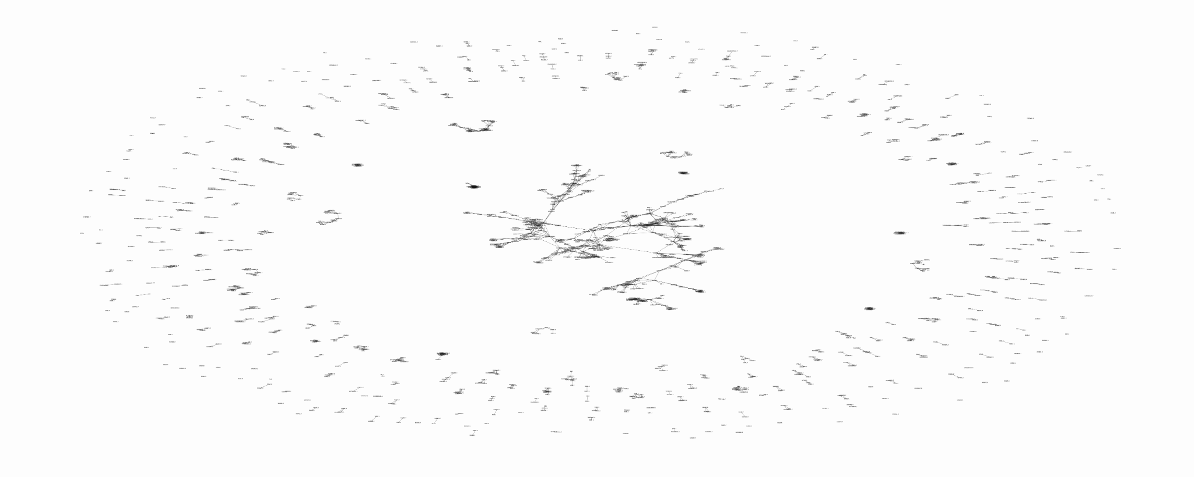
Biggest component has 379 nodes
The number of nodes 1589
Number of components: 396

Slide 3
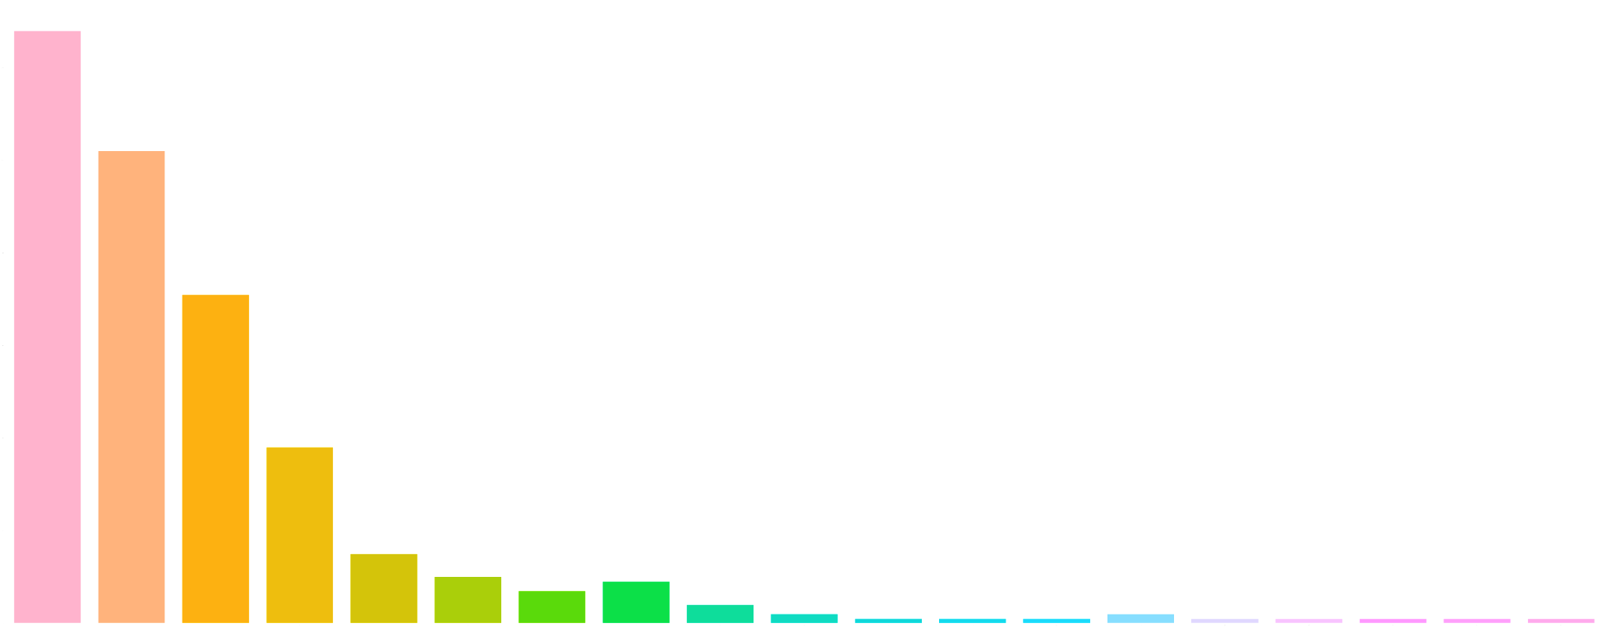
Interesting facts
Connected component size | frequency | Percentage %
1 | 128 | 32.32
2 | 102 | 25.75
3 | 71 | 17.92
4 | 38 | 9.59
5 | 15 | 3.78
6 | 10 | 2.52
7 | 7 | 1.76
8 | 9 | 2.27
9 | 4 | 1.01
10 | 2 | 0.50
frequency
1 2 3 4 5 6 7 8 9 10 11 12 13 14 21 28 31 57 379
Component size

Slide 4
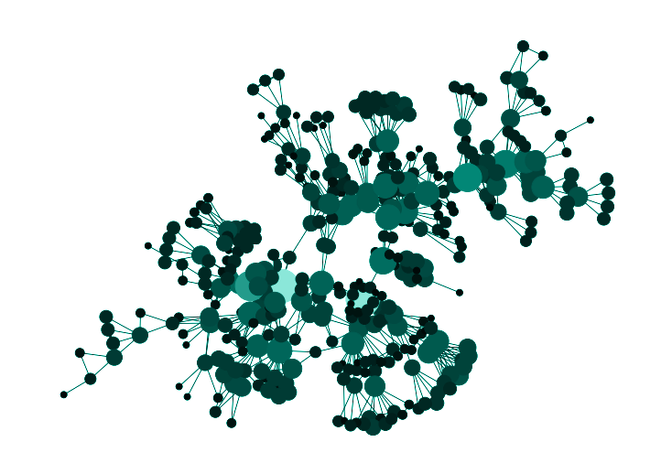
Largest Connected Component

Slide 5
Who is the most important or central person in this network?

Slide 6
Centralities of the network
Degree Centrality
Betweenness Centrality
Eigenvalue Centrality
This is the simplest centrality as it depends on the degree of the node.
In the Graph we are studying it represents the number of scientists one worked with on a paper.
Betweenness centrality measures are used to find nodes that appear in many paths between nodes. What we will have is the scientists who worked with different groups of other scientists
Or what is called prestige centrality where the nodes have high eigenvalue centrality when they are connected with important nodes.

Slide 7
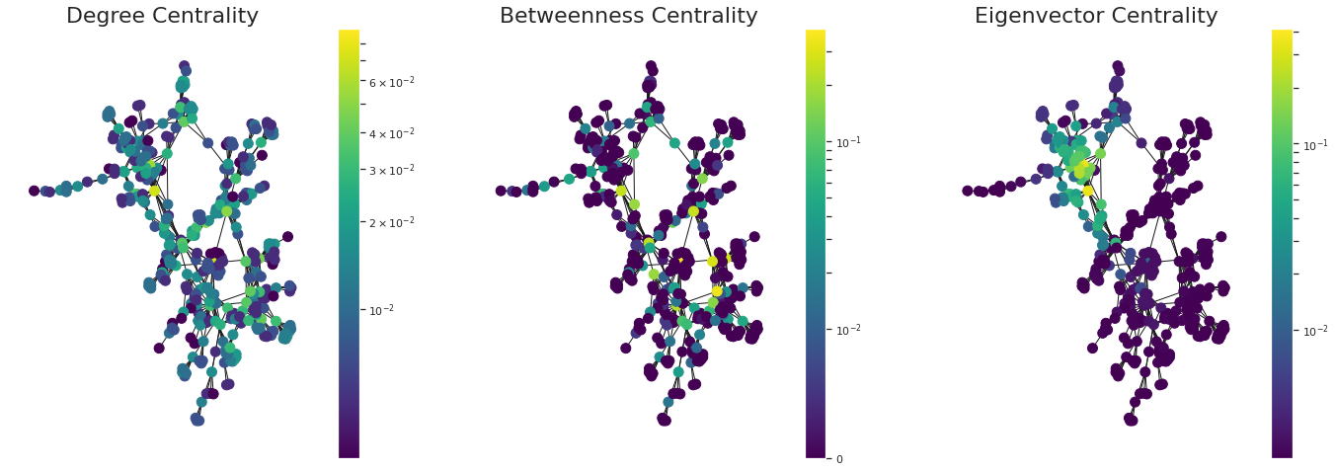
Centralities of the network

Slide 8
Centralities of the network
scientist | Degree centrality value
Barabasi. A | 0.089
Newman. M | 0.071
Jeong. H | 0.071
Oltvai. Z | 0.055
scientist | Betweenness centrality value
Newman. M | 0.39
Pastorsatorras. R | 0.34
Moreno. Y | 0.28
Sole. R | 0.27
scientist | Eigenvalue centrality
Barabasi. A | 0.41
Jeong. H | 0.35
Oltvai. Z | 0.34
Vicsek. T | 0.25

Slide 9
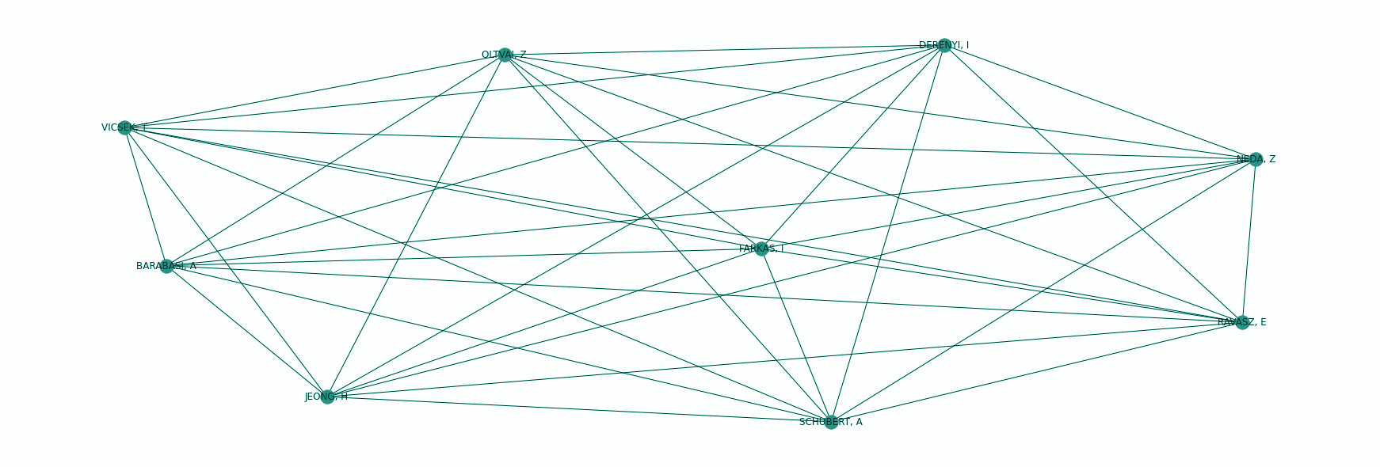
Interesting Facts
Average clique size: 3.5
Number of cliques: 203
Biggest clique size: 9

Slide 10
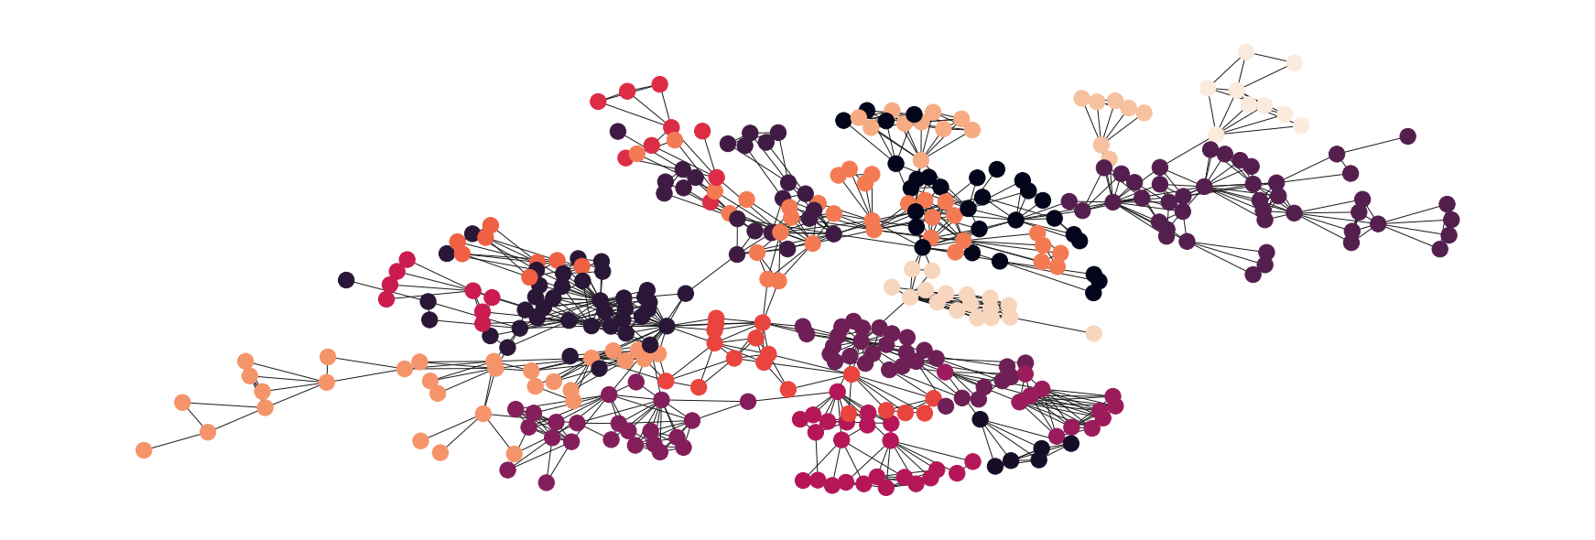
Louvain Community Detection

Slide 11
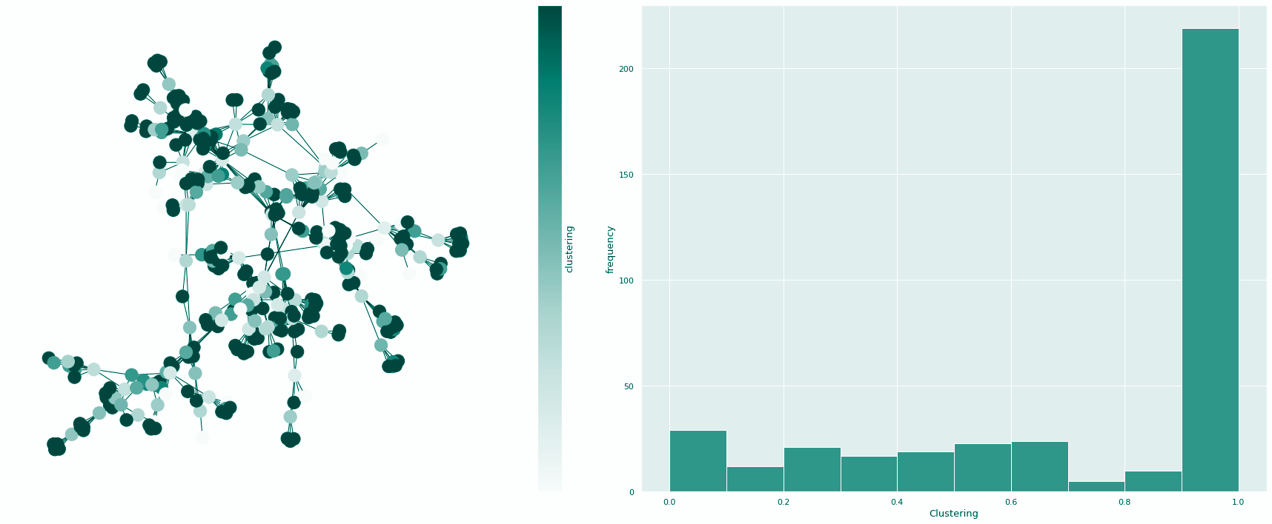
Clustering Coefficient

Slide 12
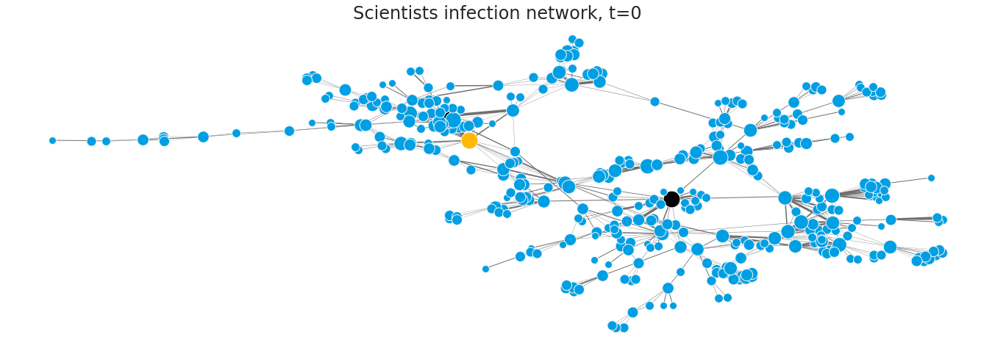

Slide 13
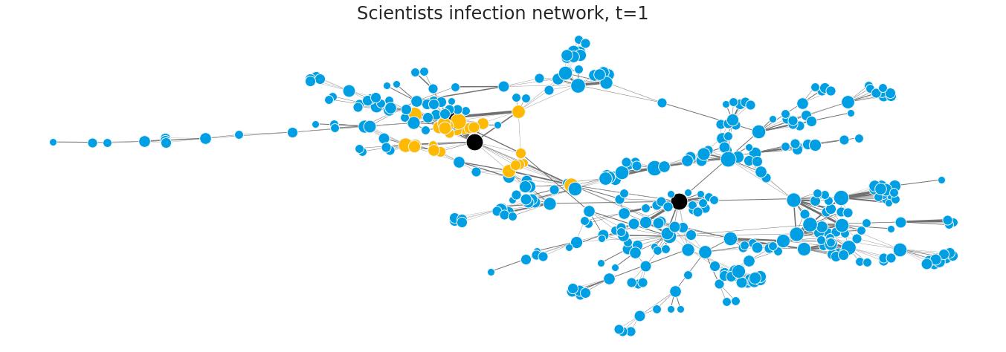

Slide 14
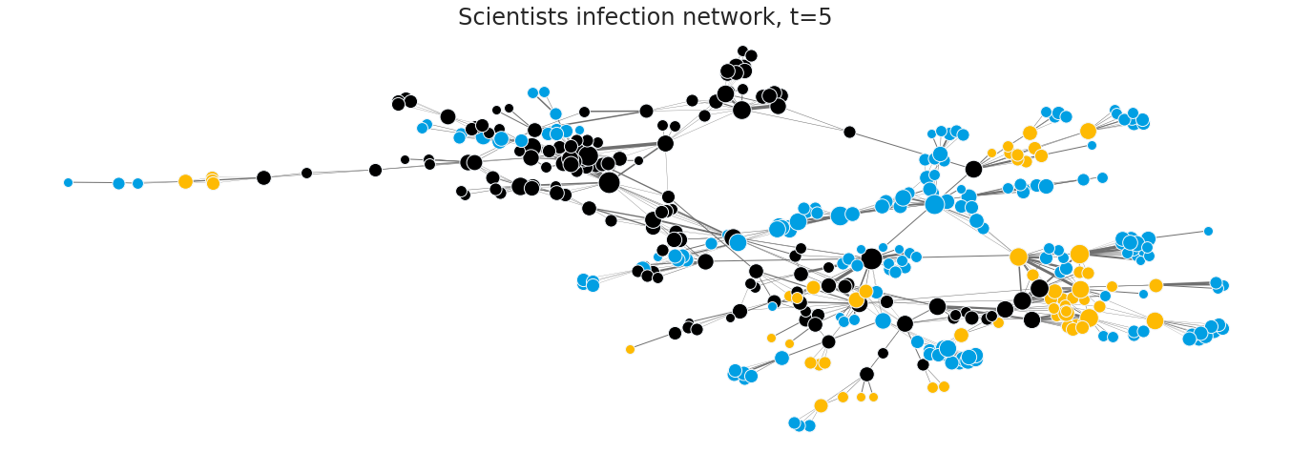

Slide 15
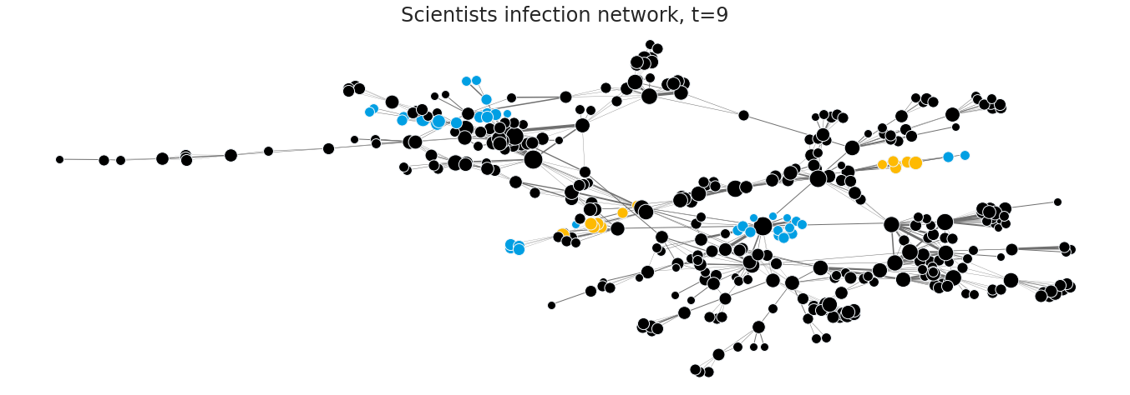

Slide 16
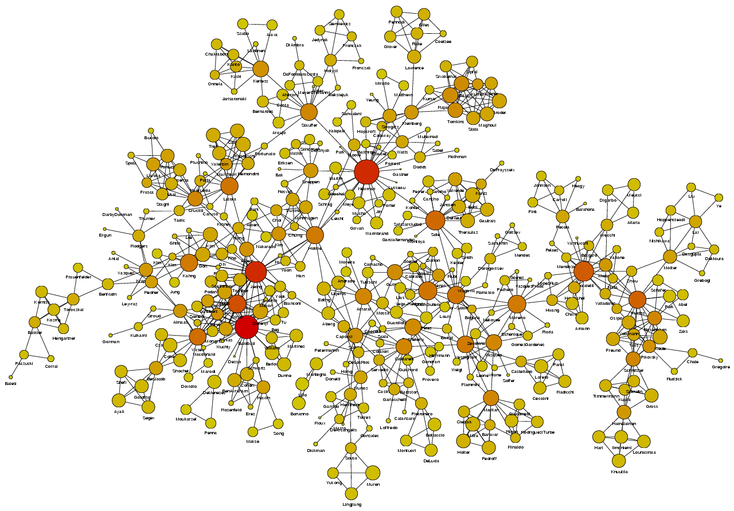
Community Centrality

