Slide 1

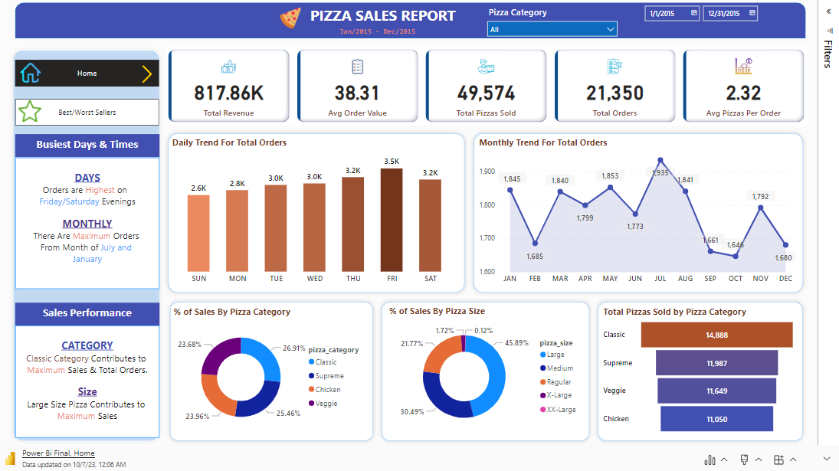
Pizza Resturant

