Slide 1
2025
Courses
Coursack
System
Coursack
System

Slide 2
Table Of Contents
2025
01.
02.
03.
Website
Code
Team
Coursack
Screenshots From
The Website
Snippets From
The Code
The Project
Team

Slide 3
2025
Our Current
Website
Coursack
Here are some screenshots from our site

Slide 4

Welcome To Coursack
2025
Developer‑first platform for building, publishing, and automating online courses.
Idea 1
Modular Content Model
Courses → Lessons, reusable components, content versioning and preview.
Speaker note: Explain content of the website and what you offer.
Idea 2
Teacher & Admin Moderation
Admin panel, teacher panel, courses reviews.
Speaker note: Explain how you offer moderation sides for both the lecturer and the page admin.
Coursack
Idea 3
Student Panel
Student account, explore courses, buy courses, upload homework, post reviews on finished courses.
Speaker note: Explain all parts of the student experience from a customer side.

Slide 5

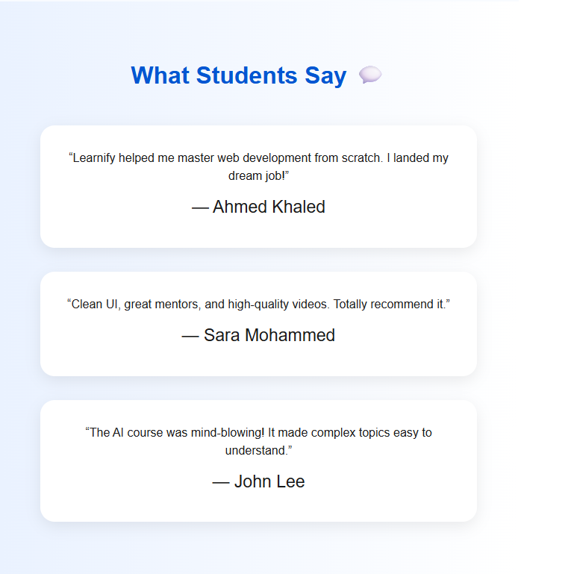

2025
Coursack

Slide 6
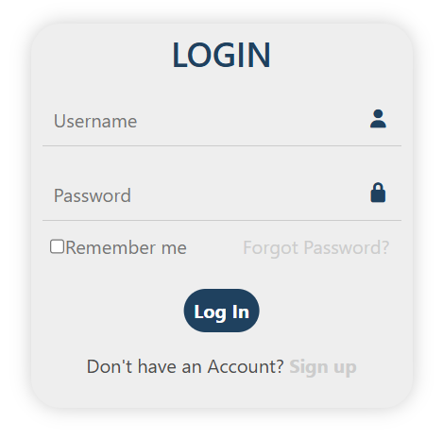
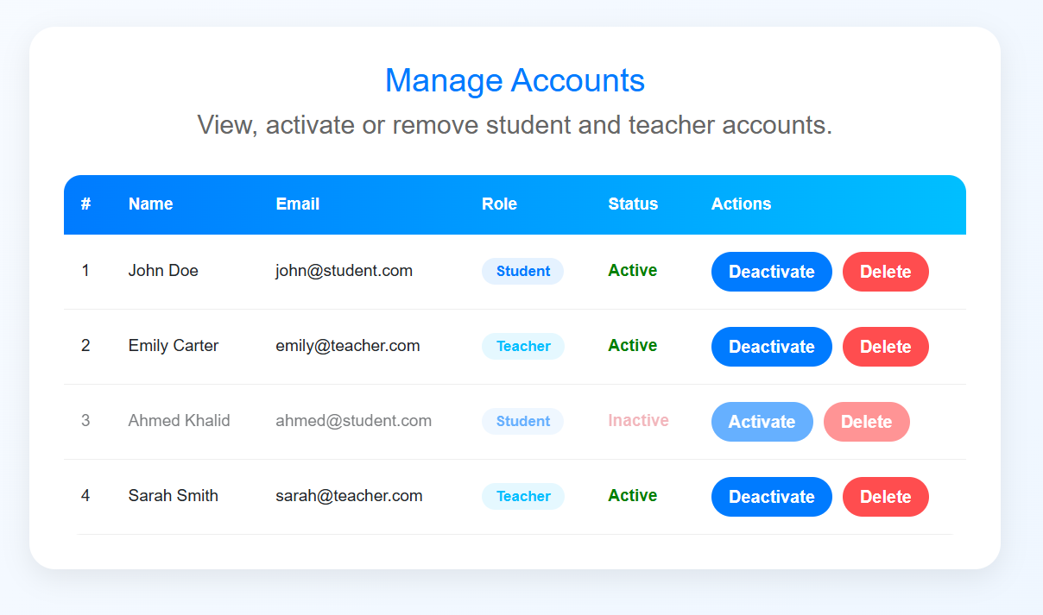
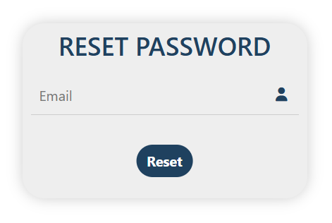
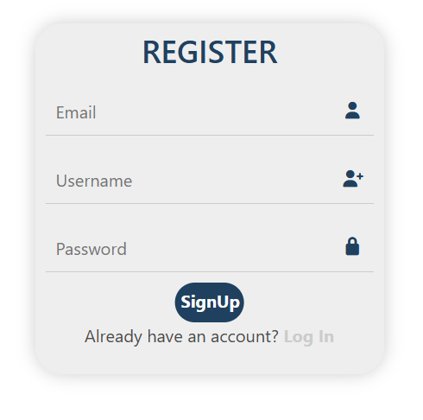
2025
Coursack

Slide 7

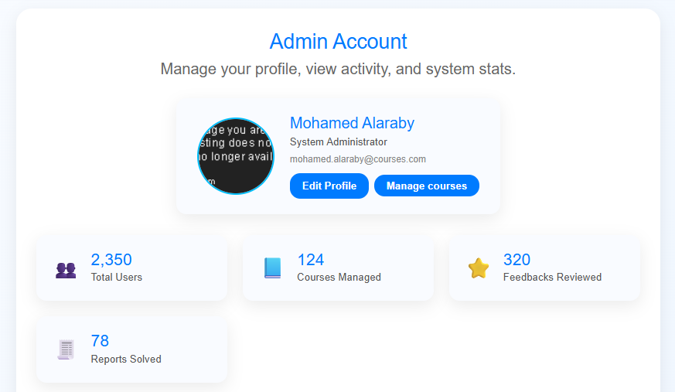
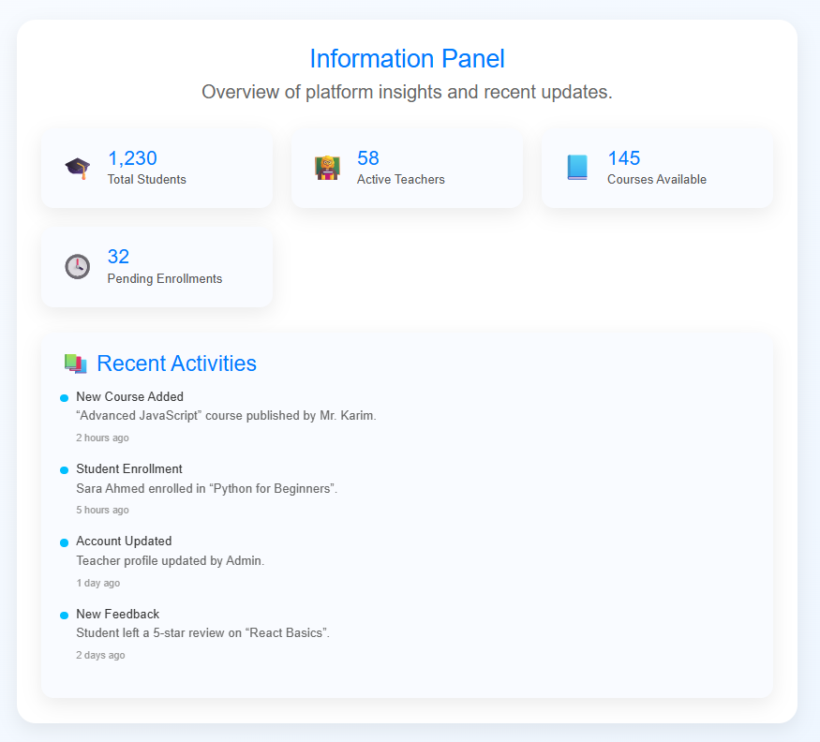

2025
Coursack

Slide 8
2025
Code
Snippets
Coursack

Slide 9
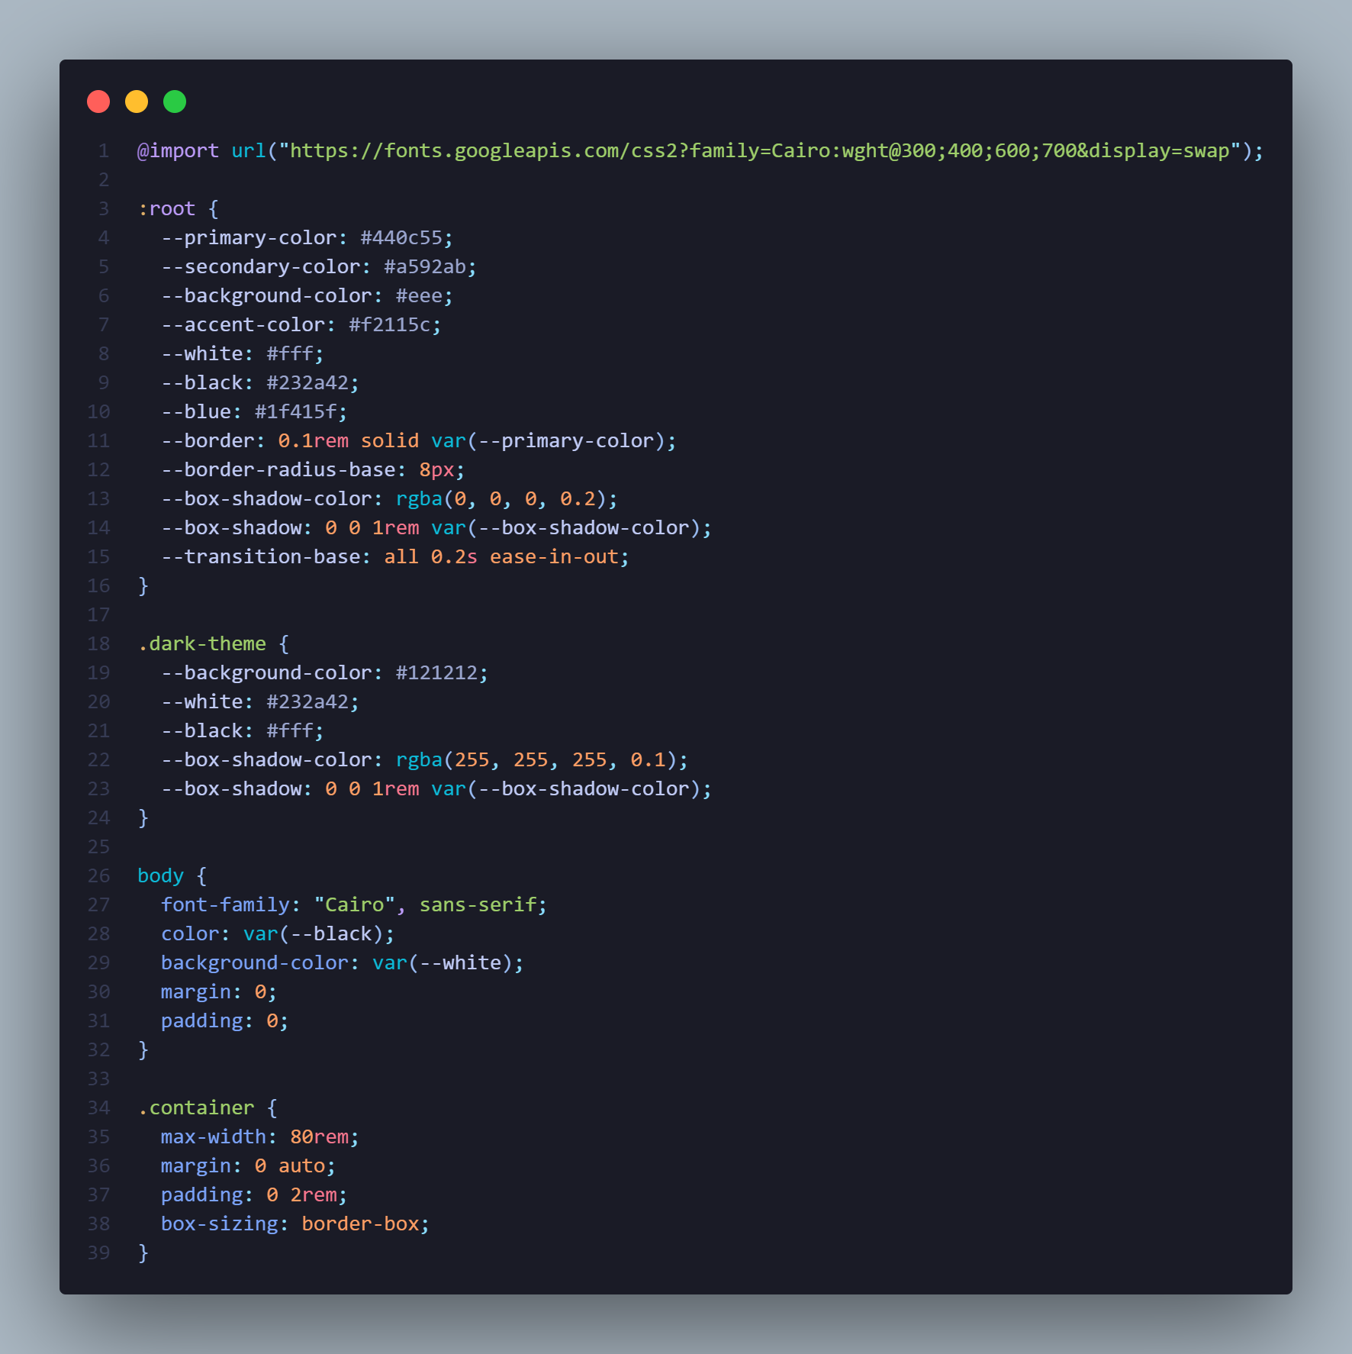
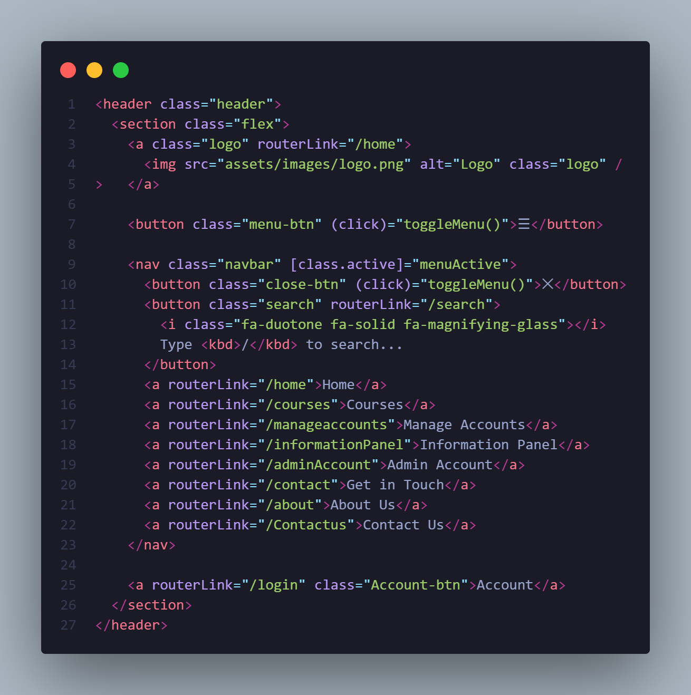
2025
Coursack

Slide 10
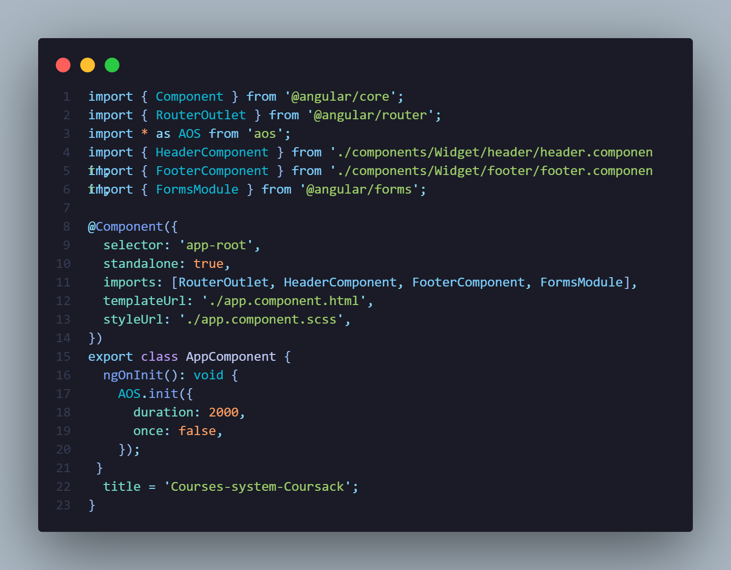
2025
Coursack

Slide 11
2025
Timeline
Coursack

Slide 12
Team Members
2025
Coursack
Mostafa AbuAyash
Mohamed El-Sayed
Marwan Mohamed
AbdElhady Mostafa
Leader

Slide 13
2025
Thank you
Coursack

