Slide 1
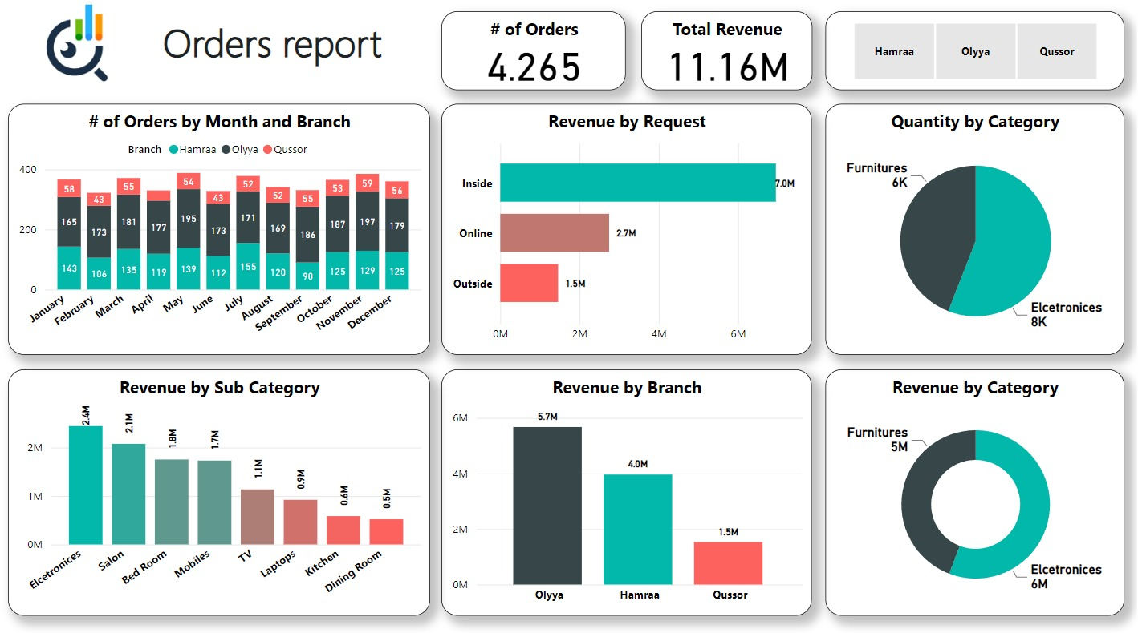
"Unlocking Growth: A Deep Dive into Store Performance Metrics"
I am thrilled to present our analysis of the store's performance, based on a wealth of data capturing our operations. With a total revenue of 11.16 million and an impressive tally of 4265 orders processed, we have a robust dataset at our disposal. Throughout this presentation, we will meticulously dissect various metrics, including revenue by category, branch, and request type, as well as quantity by category. By delving into these insights, we aim to unearth invaluable patterns and opportunities for optimization. Join us on this journey as we leverage data-driven decision-making to propel our store towards continued success and prosperity.

Slide 2
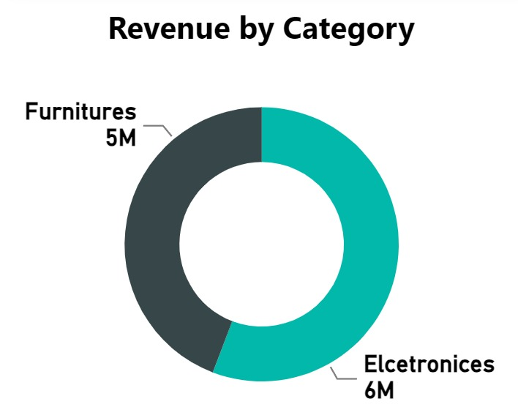
Revenue by Category
In our presentation, the first chart showcases the revenue breakdown by category, highlighting the performance of our electronics and furniture segments.
With furniture generating $5,000,000 and electronics contributing $6,000,000 it's evident that both categories play significant roles in our overall revenue stream.
This chart not only provides insight into our sales performance but also sets the stage for deeper analysis into each category's trends and potential areas for growth.
As we delve further into our data-driven insights, we aim to leverage this information to make informed decisions and drive strategic initiatives that optimize revenue generation and enhance customer satisfaction across our electronics and furniture offerings.

Slide 3
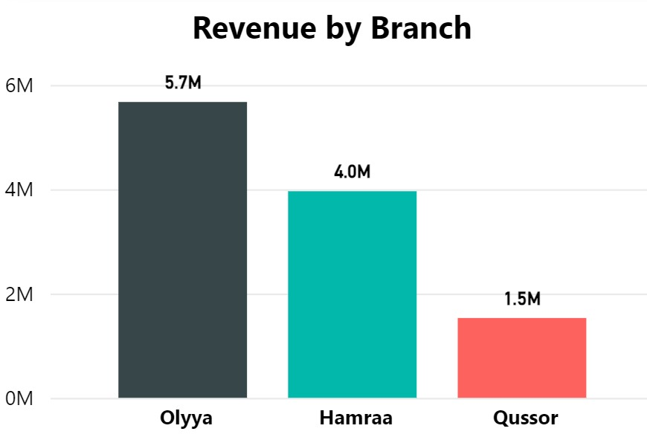
Revenue by Branch
Analyzing revenue by branch reveals distinct performance metrics across our various locations.
Olyya stands out as the top performer, generating $5,700,000 in revenue, followed by Hamraa with $4,000,000 and Qussor with $1,500,000.
This chart offers valuable insights into the revenue contributions of each branch, allowing us to identify areas of strength and opportunities for improvement.

Slide 4
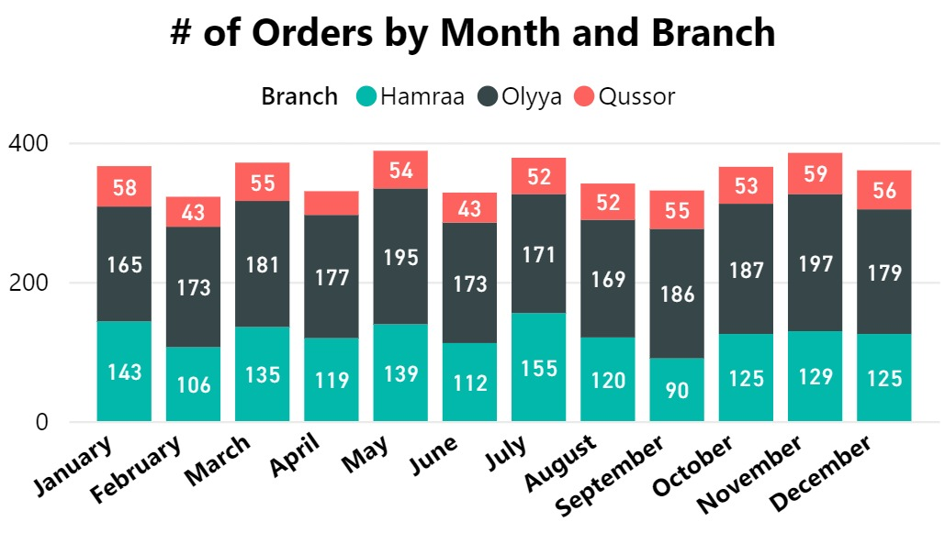
# of Orders by Month and Branch
The chart presents the distribution of orders by branch and month, providing insights into our sales performance across different periods.
Olyya consistently leads in order volume throughout the year, with October and November showing peak performance.
Hamraa maintains steady order numbers, with July marking a notable increase. Meanwhile, Qussor exhibits lower order volumes compared to the other branches, with November being the busiest month.
Understanding these trends allows us to identify opportunities for optimization and resource allocation, ensuring efficient operations and maximizing sales potential across all branches.

Slide 5
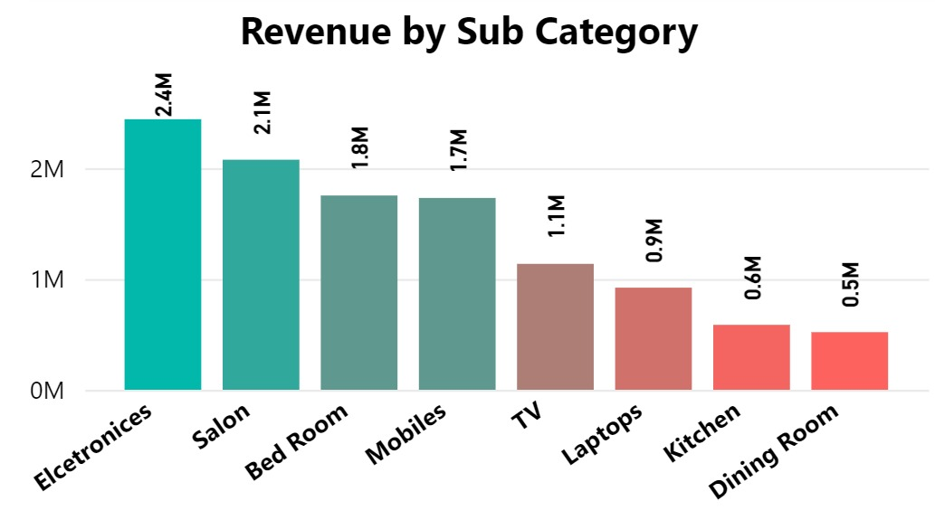
Revenue by Sub Category
The chart illustrates the revenue distribution by category, showcasing the financial performance of our product segments.
Electronics emerges as the top revenue-generating category, accounting for $2,400,000 in sales.
Salon and Bed Room follow closely behind, generating $2,100,000 and $1,800,000 respectively.
TV and Mobiles also contribute significantly to our revenue stream, with $1,100,000 and $1,700,000 in sales respectively.
Laptops, Kitchen, and Dining Room exhibit comparatively lower revenue figures.
Understanding these revenue patterns enables us to prioritize investment and marketing efforts, capitalize on high-performing categories, and identify opportunities for growth in underperforming segments.

Slide 6
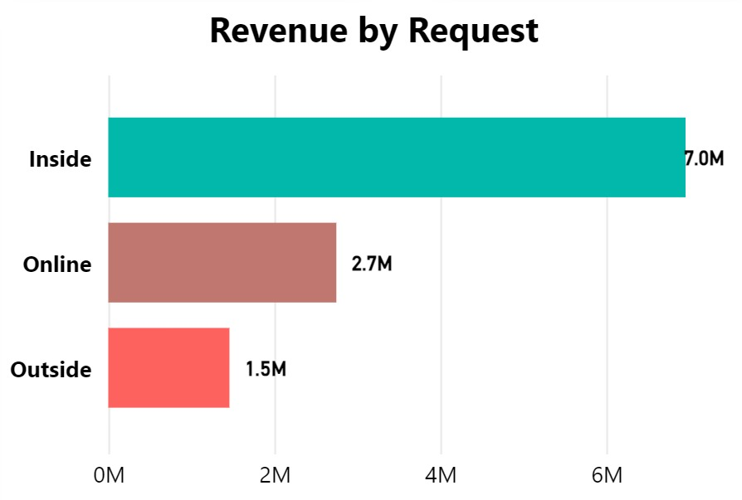
Revenue by Request
The chart depicts revenue distribution by request type, offering insights into how our customers interact with our services.
"Inside" requests account for the majority of our revenue, totaling $7,000,000.
"Online" requests also contribute significantly, generating $2,700,000 in revenue. Conversely, revenue from "Outside" requests is comparatively lower at $1,500,000.
Understanding these patterns enables us to tailor our service offerings and marketing strategies to meet the needs of our customers across different channels.
By leveraging data-driven insights, we can optimize our operations and enhance customer satisfaction, ultimately driving sustainable growth and success.

Slide 7
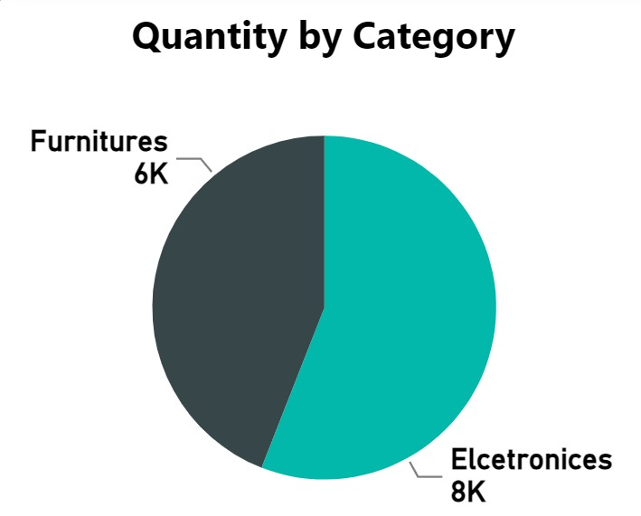
Quantity by Category
The chart presents the quantity distribution by category, providing valuable insights into the demand for our product segments.
Furniture records a total quantity of 5,000 units, indicating a steady demand for these items.
Meanwhile, electronics emerge as the most sought-after category, with a total quantity of 8,000 units sold. Understanding these quantity trends enables us to optimize inventory management, ensure sufficient stock levels, and capitalize on high-demand categories.
By leveraging data-driven insights, we can effectively meet customer demands, enhance operational efficiency, and drive business growth.

Slide 8
Based on the data related to store revenue, quantity, and revenue by request, the final results indicate :
electronics are the top-selling category, both in terms of revenue and quantity sold. Additionally, the majority of revenue is generated from inside requests, highlighting the significance of in-store purchases.
For decision-makers:
it is recommended to prioritize efforts towards optimizing the sales and marketing strategies for electronics, as they demonstrate high demand and profitability. Furthermore, enhancing the in-store shopping experience and promoting special offers or discounts may help capitalize on the majority of revenue generated from inside requests.
Additionally, while online and outside requests contribute to overall revenue, there may be opportunities to further enhance these channels through targeted marketing campaigns and improved online shopping experiences.
Overall, leveraging data-driven insights to focus on high-performing product categories and channels, while also enhancing customer engagement and shopping experiences, will be key for driving sustained revenue growth and maximizing profitability.

