Slide 1




$$\left(1,0\right)$$
$$\left(1,1\right)$$
m₁ (0,0.5)
m₂ (0.5,0.5)
$$\left(0,0\right)$$
$$\left(0,1\right)$$

Slide 2
$$\left(1,0\right)$$
$$\left(1,1\right)$$
m₁ (0,0.5)
m₂ (1.0,0.5)
$$\left(0,0\right)$$
$$\left(0,1\right)$$

Slide 3
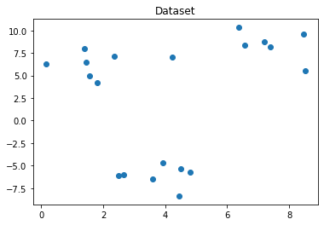

Slide 4
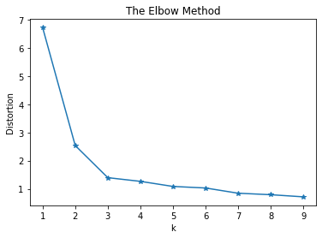

Slide 5
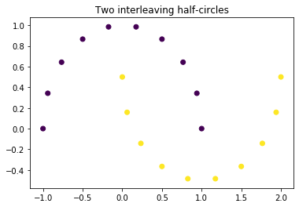

Slide 6
