Slide 1

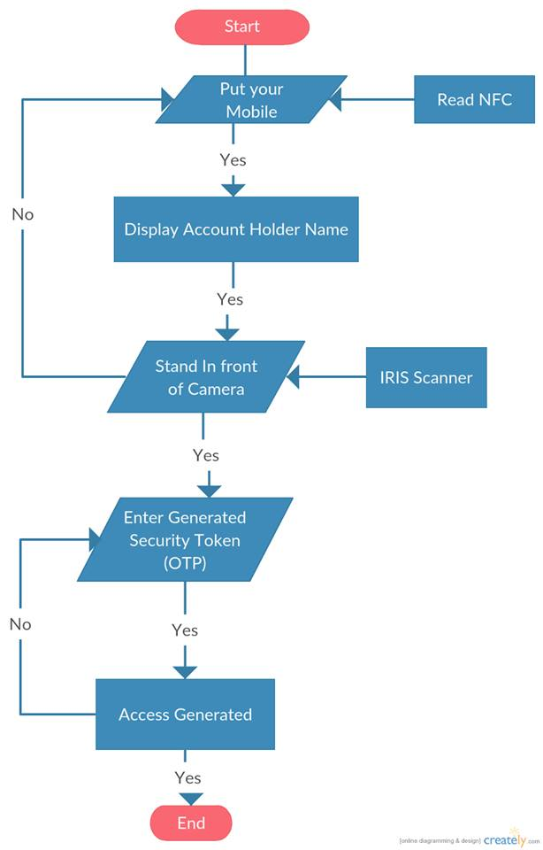
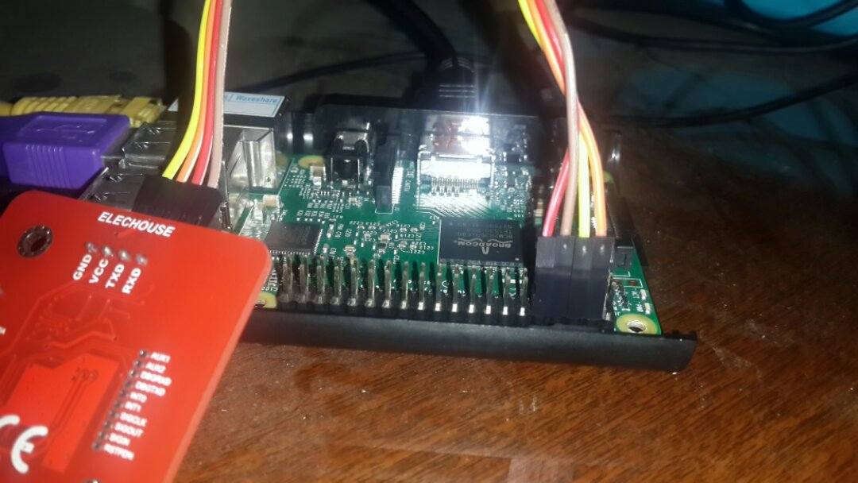
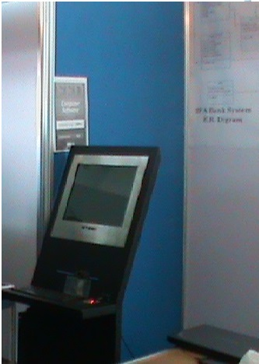
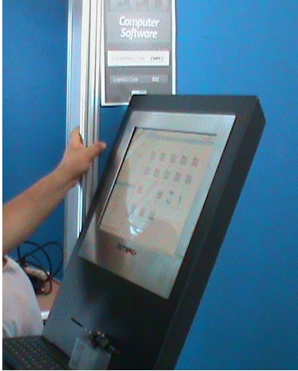
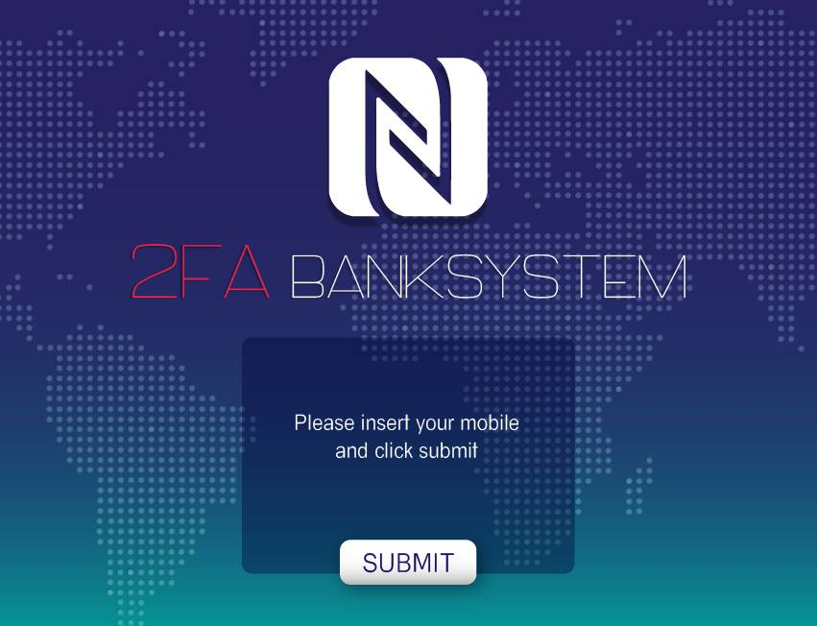
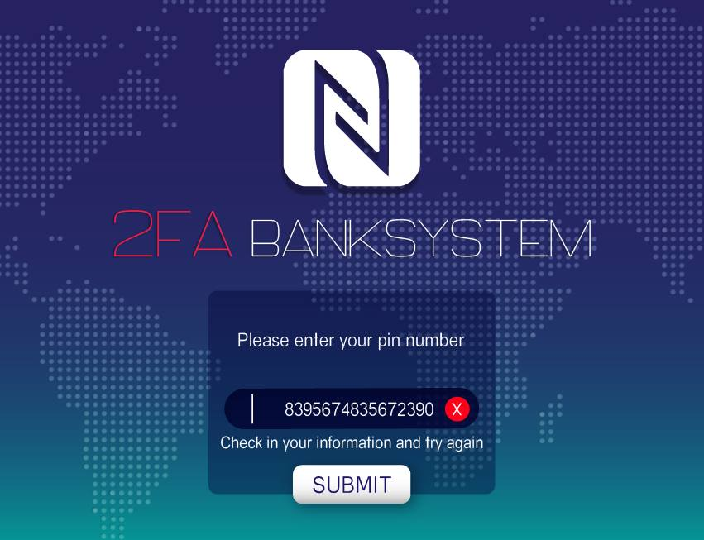
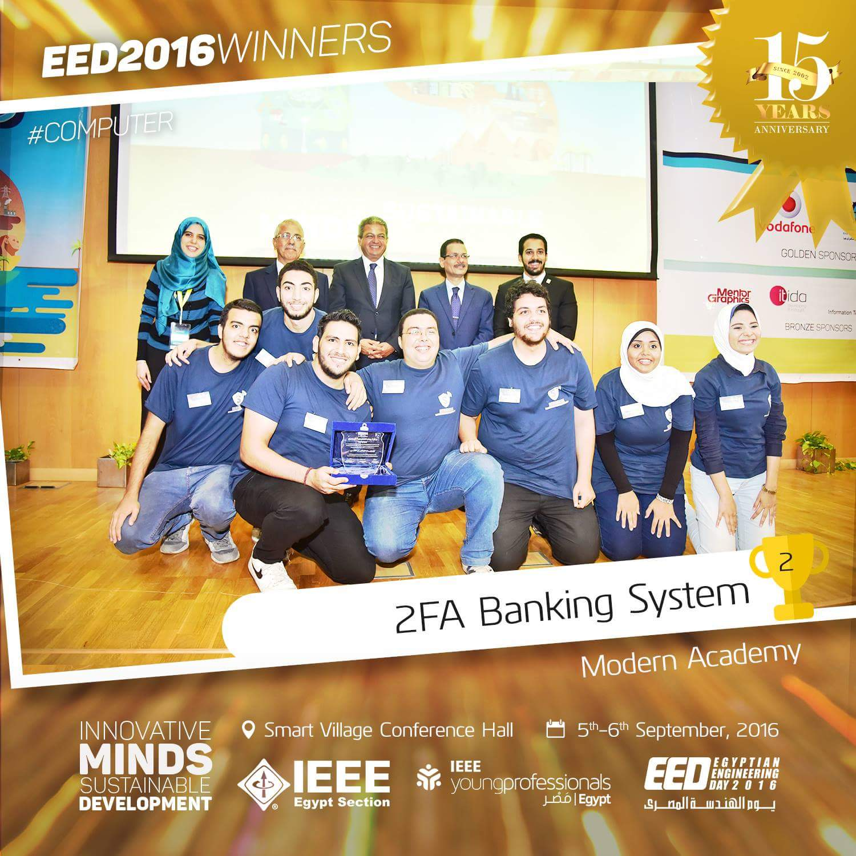
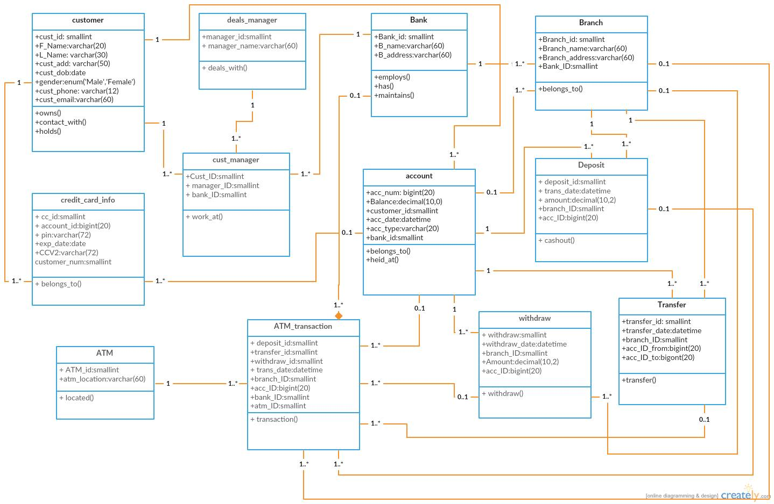
2FA Banking System
Executive Summary
The advancement in new technologies has significantly resulted more perfection in authentication issues. In ATM machine, access permission is usually taking personal identification numbers (PIN) for authentication. Through our project, this old method is
being exhausted by introducing a combination of embedded and bio-metric molding to setup an ATM simulator. iris recognition followed by the onetime password (OTP) will help the user for smart and secured transactions. It will reduced the bank fraud and makes the banking systems more secured compare to current version.
The customer is identified by using a mobile wallet app with NFC Technology using HCE and an One-Time Password (OTP) mechanism mixed with biometric authenticator for facial verification.
Overview of Prototype and Results
Overview:
The ATM system consists of IR camera embedded in machine based on raspberry pi v2 that will recognize the Iris standing about 0.25m in front of system and perform matches against the Supposed he/she dataset.
The user usually starts with putting his mobile on the NFC reader but must also have the OTP Device and its PIN correctly remembered for pre verification before the Iris scanning starts for Last verification before grant account access.
Same Authentication Steps is used for Online-Banking and Mobile Banking from normal Desktop or Laptop with webcam (for NFC reader will be supported in almost every laptop vendor from 2017 ”Desktop users needs NFC Reader”) or any Smart Phone 2016 or later.
Mobile Payments is easier and safer than ever been.
prototype | 1 | 2 | 3 | 4 | 5
Hardware Requirements | Raspberry pi V B+ for the ATM | NFC Reader V3 Module for the ATM | Infrared-camera Module V2 for pi for the ATM | NFC/HCE Compatible Mobile(all 2017 support it) | Embedded OTP Module
Introduction (48 pt. Universe 45 Light)
Technologies Used:
MYSQL 5.6
PHP 5
HTML 5
opencv3.1.0
python 2.7
PyQT Designer
Centos 7
Encryption Algorithms HMACSHA512
OpenSSL/TLS
snort IPS
HCE Android API
NFC API
Problem Statistics
Solution Diagram
Objectives
-1.5 million cardholders number Data
-Within 12 hours , 9 million $ ,through 2100 ATM over 280 cities
-In U.S 54 billion $ robbery and 210 billion$ globally
-400,000 $ Stolen per minute
Minimize Banking Frauds
Applicability and Cost Reducing
Satisfies Market Needs
Availability and ease of use
Online banking and Mobile payments Easier and Safer
Conclusions
This project is developed on the basis of more need of security in ATM banking system. Now-a-day’s ATM is getting less secure with emerging ways to hack/crack ATM PIN or ATM card. Use of OTP and Biometric is best and easy way to deal with these security threats. This project is using SHA-2 algorithm to generate OTP with more randomness provided in proposed system after generation of SHA-2 hash string. The ATM will be safer than having only one way of accessing transactions; that is to say having OTP Device accesses and Iris recognition login credentials creates more security as one has to pass both security barriers before having access to the transactions. Also we are using the Raspberry Pi V2 and IR camera to take the cost to its minimum. Another important point in proposed system is that it demands lesser changes to the present system of Bank and ATM. That means lesser overhead will be required to change the whole system with enhanced security. Changes in Hardware part will be required that is one NFC Reader is required to be attached to ATM machines. This project will needs to explained to end user, to educate the user to use this system. In future work this project can use enhanced and more accurate equipment with better algorithms.
Images
Raspberry pi vB+ & NFC Module V3 ATM Prototype 1 ATM Prototype 2 GUI 1 GUI 2
Entity Relationship Database Diagram
Biography
Mustafa El-Liethy ( System integrator/founder)
Eman Hamada ( Software Engineer Image processing)
Aya Mustafa Kamel ( Database Administrator)
Muhammed Hisham (Python Developer)
Muhammed Abd EL-baset ( GUI Designer)
Mahmoud Adel ( Web Developer)
Amr Mustafa ( Android Developer)
Mandatory Photo
(please resize
as required)
Acknowledgements
As the authors of this paper we would like to acknowledge the Head of Computer Department Modern Academy in Maddi Dr. Mahmoud Gadallah, We would also thank
our family and friends for lending their support and co-operation in the work.
References
1. Rupinder Saini, Narinder Rana,Rayat 'Comparison of various biometric methods', Institute of Engineering and IT, International Journal of
Advances in Science and Technology (IJAST) Vol 2 Issue I (March 2014)
2. Devinaga, R. (2010). ATM risk management and controls. European journal of economic, finance and administrative sciences. ISSN 1450-
2275 issue 21.
3. A.Forouzan, Cryptography and Network Security, Tata McGraw Hill
4. Anil K. Jain and Arun Ross. Introduction to Biometrics. In Anil K. Jain, Patrick Flynn, and Arun. A. Ross, editors, Handbook of Biometrics.
Springer US, 2008.
5. Rafael C. Gonzalez and Richard E.Woods, Addison Wesley, Digital Image Processing.
6. Ekenel HK, Stallkamp J, Gao H, Fischer M, Stiefelhagen R, Face Recognition For Smart Interacations, interact Research, Computer Science
Department, University at Karlsruhe.
7. Sezin Kaymak , “Enhanced Principal Component Analysis Recognition Performance”.
8. Vinay Hiremath and Ashwini Mayakar, Face recognition using Eigenface approach.
9. Aru, Okereke Eze, Ihekweaba Gozie, Facial Verification Technology for Use In Atm Transactions
10. IOSR Journal of Computer Engineering (IOSR-JCE) e-ISSN: 2278-0661, p- ISSN: 2278-8727Volume 15, Issue 1 (Sep. - Oct. 2013),PP 22-29
11. http://www.ics.uci.edu/~smyth/courses/ics178/random_number_generators article.pdf
Mustafa El-Liethy
mostafa.d.elliethy@gmail.com 2fa-banking.ddns.net
Cairo, Egypt

