Slide 1

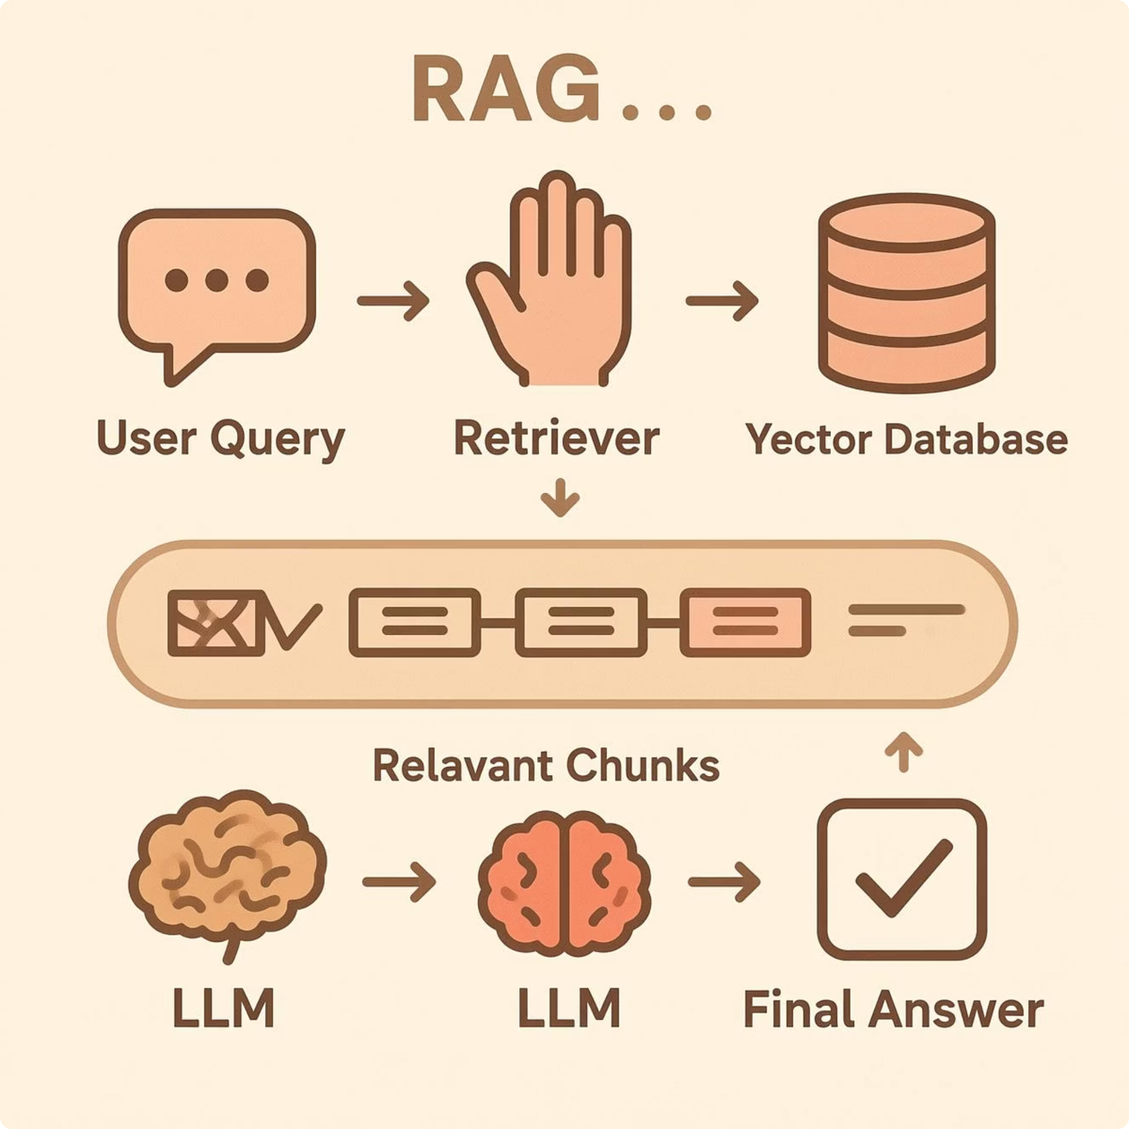

RAG-Based Chatbot for the Egyptian Constitution
Graduation Project | Digital Egypt Pioneers Initiative (DEPI)
Generative AI Track

Slide 2
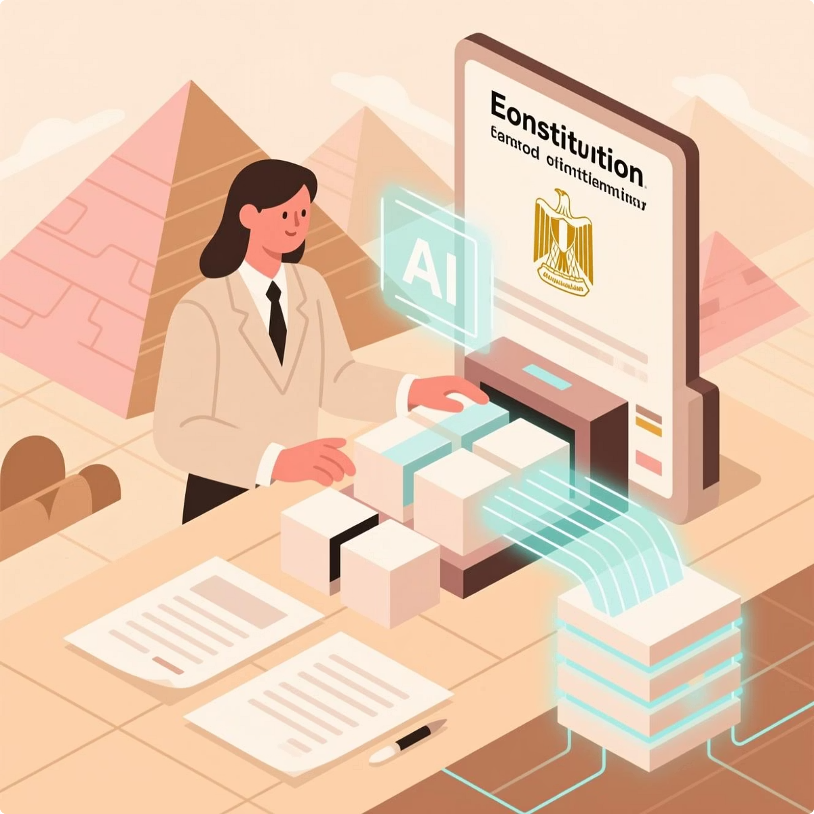
What is the project?
An intelligent chatbot specialized in answering questions related to the Egyptian Constitution.
Built using Retrieval-Augmented Generation (RAG).
Provides accurate, trustworthy, and easy-to-understand legal information.
Designed to improve accessibility to constitutional articles.
Our main goal
Develop a RAG-based chatbot that delivers accurate answers grounded in the Constitution.
Provide a simple and intuitive web interface.
Retrieve relevant articles and cite their sources.
Enhance public awareness of constitutional rights.
DEPI Project

Slide 3

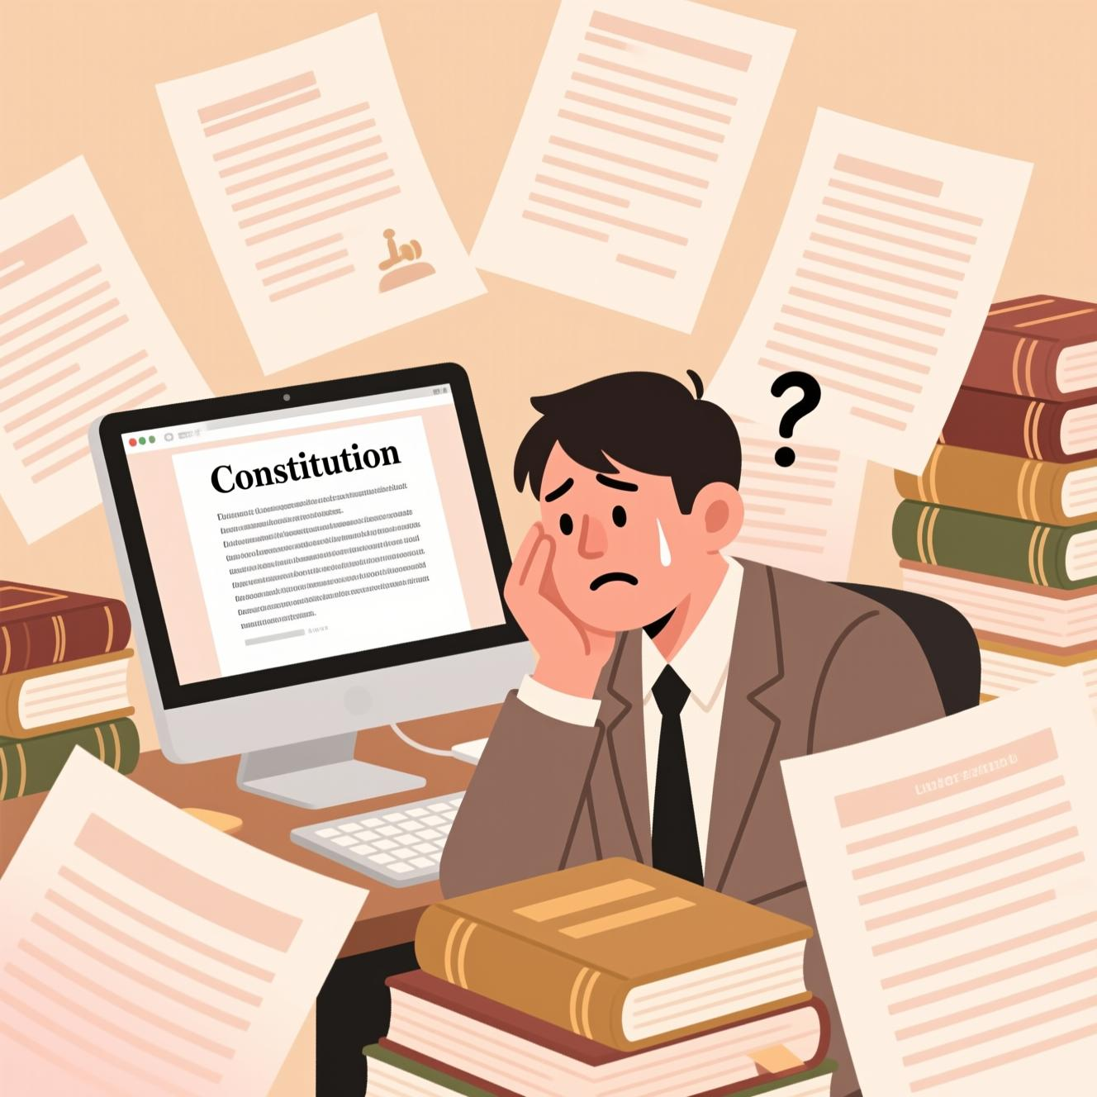
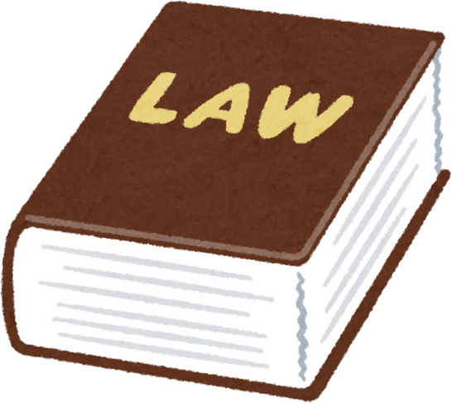
Why a Chatbot for the Egyptian Constitution?
Complexity of Legal Language
Difficulty in Accessing Specific Articles
Lack of a Constitution-Focused AI Assistant
Need for Reliable and User-Friendly Legal Access
DEPI Project

Slide 4





Proposed Solution: RAG Architecture
Why Retrieval-Augmented Generation (RAG)?
Retrieval-Augmented Generation (RAG) is a hybrid approach that combines information retrieval with generative AI, making it ideal for legal use cases where accuracy and reliable sources are essential.
Advantages of Using RAG
Reduces Hallucinations
Ensures Grounded Answers
Handles Long Documents
Improves Accuracy
More Efficient
DEPI Project

Slide 5


Dataset and prepration
Source
1
Official digital text of the Egyptian Constitution.
2
Preprocessing steps:
Text cleaning
Splitting into chunks
Removing Noise and formatting issues
Embedding Generation
3
Convert chunks into vector embeddings.
4
Storage in Chroma Vector
Database
DEPI Project

Slide 6


System Architecture Overview
The RAG-based Chatbot for the Egyptian Constitution operates on a sophisticated architecture designed for efficiency, accuracy, and scalability. This diagram illustrates the flow from a user's query to the chatbot's informed response.
Backend (FastAPI)
RAG Pipeline
The server-side logic and API endpoints.
Retrieval-Augmented Generation processing.
Frontend Interface
Data Storage
The user-facing application layer.
The underlying database and storage systems.
DEPI Project

Slide 7

Architecture Components
Frontend Web Interface
Backend (FastAPI)
Faiss Vector Database
Embedding Model
RAG Pipeline
LLM Model
The integrated process ensuring answers are grounded in the constitutional text:
User Query Initiation
Vector Retrieval from Faiss
Context Injection into LLM prompt
Final Answer Generation
DEPI Project

Slide 8


Backend Implementation
The backend serves as the intelligent core of the RAG chatbot, managing user queries
and orchestrating retrieval and generation processes efficiently.
Backend Features (FastAPI)
FastAPI REST Endpoints: Secure and efficient APIs for handling user questions and document uploads.
RAG Pipeline Orchestration: Combines user queries with retrieved constitutional context before passing them to the LLM.
Vector Retrieval (Faiss DB): Performs fast similarity search over embedded constitutional articles.
LLM Integration (Groq): Generates accurate, context-aware answers grounded in constitutional text.
TOON Data Format Support: Uses Token-Oriented Object Notation (29% lighter than JSON) for faster communication.
Scalable & Lightweight Architecture: Designed for low latency and high request throughput.

Slide 9

Frontend Web Interface
Built A responsive web interface built with HTML5 for structure, CSS3 & Bootstrap 5 for
a modern responsive design, and JavaScript for dynamic interaction and API integration,
with TOON support for efficient client-side data parsing.
User Experience
Clean & Minimal Design
Intuitive Display
A straightforward chatbot-style interface focused on clarity and ease of use, reducing cognitive load.
Clearly presents all key information within the chat window.
1
User Questions: Prominently displayed for context.
2
AI Answers: Generated responses presented clearly.
3
Relevant Constitutional Article(s): Directly cited for transparency and trustworthiness.
DEPI Project

Slide 10


Demo / Use Cases
Example Questions
Women's Rights
Parliament Protection
Prime Minister Eligibility
“ما هي حقوق المرأة في الدستور المصري؟”
“ما هو رقم المادة التي تنص علي أنه لا يجوز لرئيس الجمهورية حل مجلس النواب؟”
“ما الشروط الواجب توافرها في المرشح لرئاسة مجلس الوزراء؟ “
Expected Output
Retrieves Exact Article Text
Generates Clear Explanation
Provides Accurate, Legally Grounded Information
The chatbot will pinpoint and present the precise constitutional articles relevant to the query.
It will provide an easy-to-understand summary or explanation of the retrieved legal provisions.
All responses are verifiable and directly traceable to the official constitutional document, ensuring utmost reliability.
DEPI Project

Slide 11
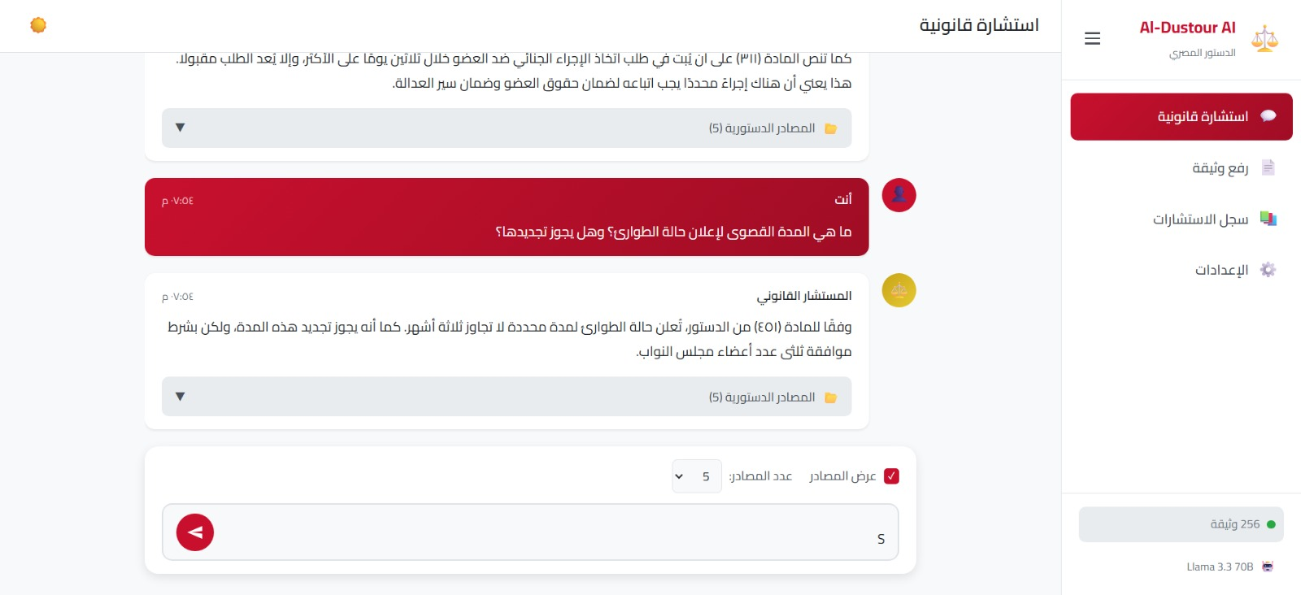
Chatbot Interface Preview ⭐
DEPI Project

Slide 12

Challenges & Solutions
Developing a RAG-based chatbot for legal texts presents unique challenges that require thoughtful solutions to
ensure accuracy and user satisfaction.
Challenges
Long and Dense Legal Articles
Overlapping Concepts
The extensive and often archaic language of legal documents can be difficult for models to process and retrieve accurately.
Similar ideas or legal principles spread across different articles can lead to ambiguity in retrieval.
Ensuring High-Precision Retrieval
Avoiding Ambiguous Answers
Guaranteeing that the chatbot retrieves only the most relevant and precise information, without extraneous data.
Preventing the generation of vague, incomplete, or misleading responses that could misinterpret legal facts.
DEPI Project

Slide 13
Solutions
1
2
Optimal Chunking Strategy
High-Quality Embeddings
Implementing advanced text segmentation techniques to break down legal articles into contextually rich, manageable chunks.
Utilizing or fine-tuning embedding models specifically for legal contexts to better capture semantic nuances.
3
4
RAG Context Injection
LLM Performance Testing
Rigorously integrating retrieved context directly into the LLM's prompt to ensure answers are factually anchored and minimize hallucination.
Conducting extensive testing with various Large Language Models (LLMs) to identify the best performer for legal question answering.
DEPI Project

Slide 14
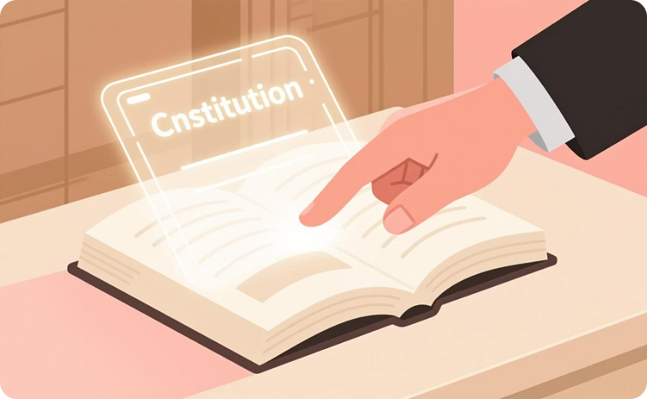
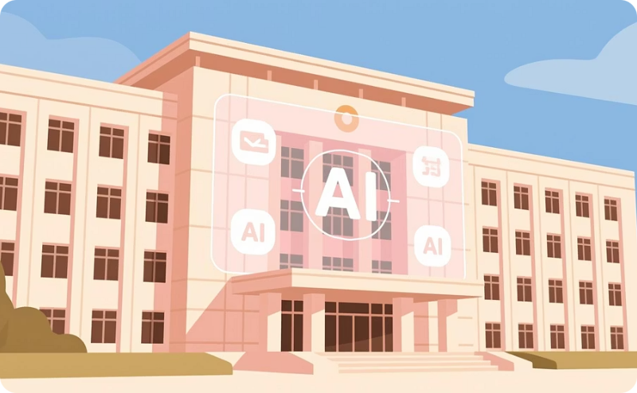
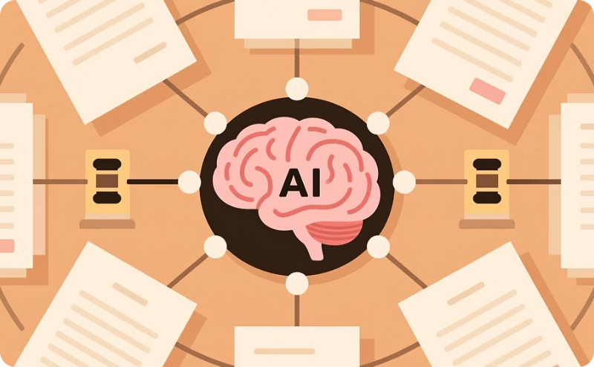
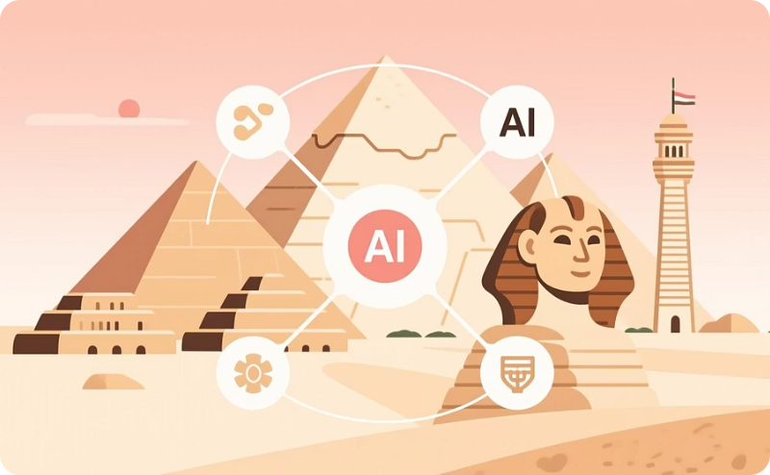
Impact & Future Prospects
Enhanced Legal Literacy
Government Transparency
Domain Expansion
Ecosystem Integration
Significantly enhances citizen access to constitutional knowledge, thereby promoting widespread legal literacy and awareness.
Supports government transparency and administrative reform goals, directly aligning with Egypt's Vision 2030 objectives.
Offers immense potential for expansion into other critical legal domains and a broad spectrum of government services.
Presents a unique opportunity to seamlessly integrate with Egypt’s national AI platforms and the broader Digital Egypt ecosystem.
DEPI Project

Slide 15


Digital Egypt Pioneers Initiative (DEPI) - Generative AI Track
Team Members:
Mostafa Ahmed Elgindy
Abdallah El-Sayed Saad
Mahmoud Ahmed Salah El-Din
Ahmed Ebrahim Elmesery
Hager Ayman Abdullah
DEPI Project

