Slide 1




CYBER SECURITY
Presented to Prof. Mohamed Abdel Hamid
Presented to Eng. Tasneem
PAGE 1

Slide 2
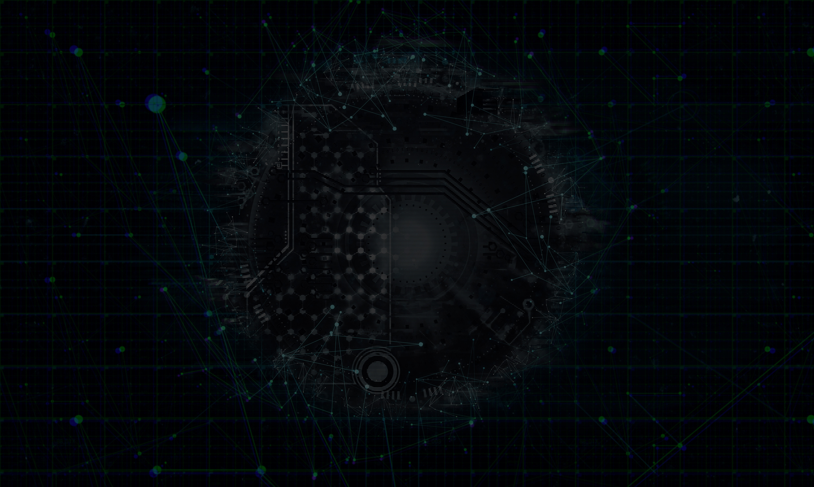
Agenda
Team of Member :
1-Amr Abdelsamea Mahrous
2-Mohamed Mahmoud Saber
3-Mostafa Hany Ahmed
4-Shaza EL-wazzan
5-Youssef Abdelhakim Tayea
Introduction to Ciphers
Types of Classical Ciphers
Examples & Use Cases
Comparison
Modern Impact
Conclusion
www.reallygreatsite.com
PAGE 2

Slide 3
Three New algorithms will discuss in discussion
PAGE 3

Slide 4

WHAT IS CIPHER?
A cipher is a method used to encrypt and decrypt information, transforming readable text (plaintext) into unreadable text (ciphertext) using a specific algorithm and key. Ciphers are a core part of cryptography and are used to protect the privacy and security of data during communication. Unlike codes, which work on the meaning of words, ciphers operate on individual letters or bits. Classical ciphers such as Caesar, Vigenère, and Playfair laid the foundation for modern encryption methods used today in digital security systems.
PAGE 4

Slide 5
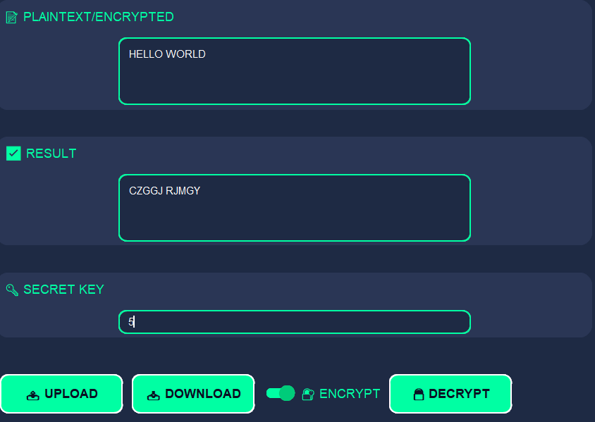
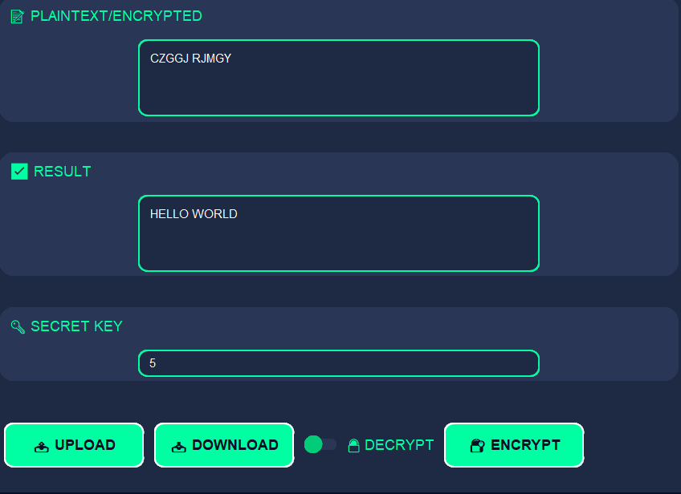
CAESAR CIPHER
1.
🔑 1. Encryption – Turning Plain into Secret
The cipher takes readable text (plaintext) and scrambles it into an unreadable form (ciphertext) using a defined rule or algorithm.
2.
🔓 2. Decryption – Revealing the Message
Using the correct key, the ciphertext is reversed back into the original readable message (plaintext) by applying the cipher in reverse.
3.
🛡 3. Security Through Keys
The strength of a cipher depends on how hard it is to guess or break the key without knowing the encryption method. Stronger keys mean better protection.
www.reallygreatsite.com
PAGE 5

Slide 6
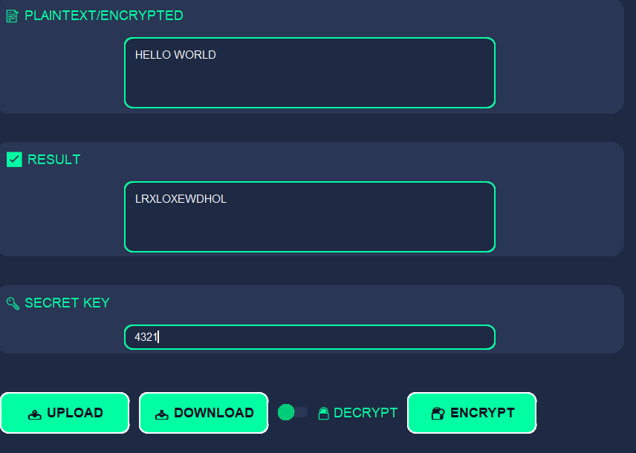
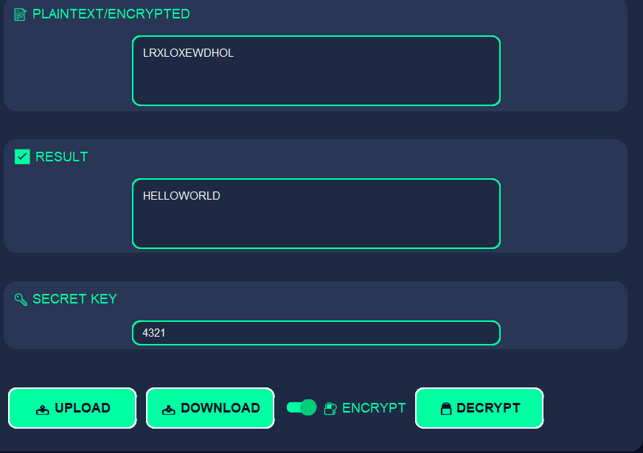
Transposition
1.
🗂 1. Reorders Text in a Table
Text is written in rows under column headers derived from a keyword. The columns are then rearranged based on the alphabetical order of the keyword.
2.
🔒 2. No Substitution, Only Positioning
Characters stay the same but appear in different places, which makes it harder to read without the key.
3.
📉 3. Effective with Long Texts
The longer the message and more complex the keyword, the harder it becomes to crack. Can be layered with substitution for added security.
www.reallygreatsite.com
PAGE 6

Slide 7
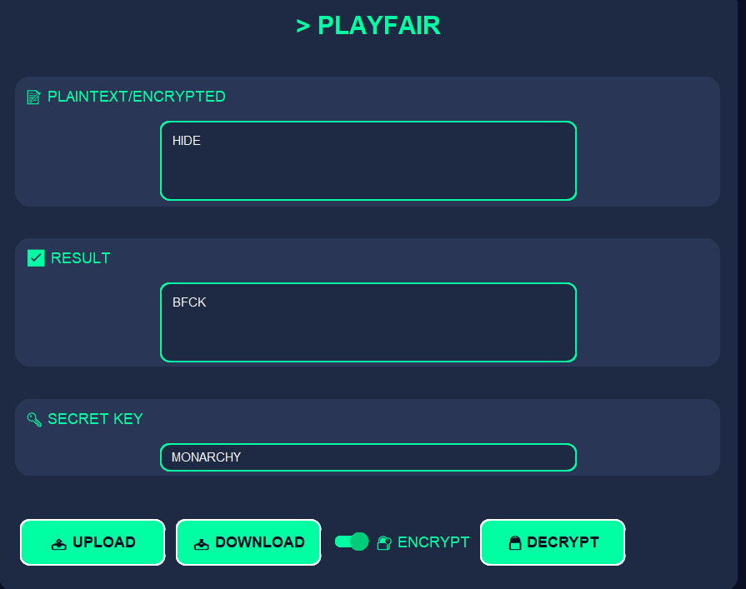
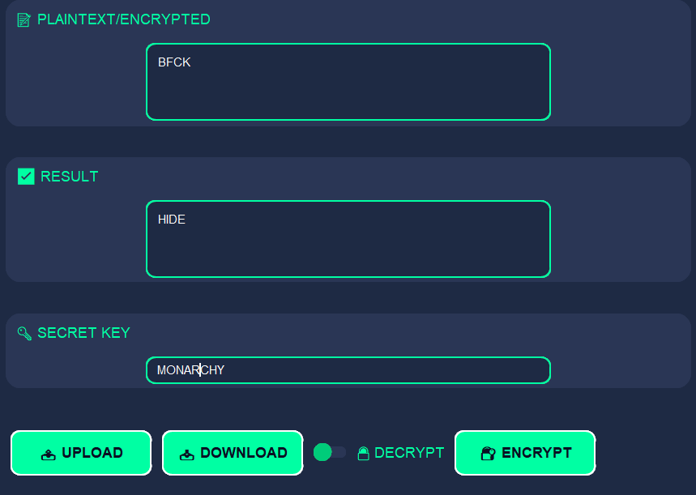
Playfair Cipher
1.
🧩 1. Encrypts in Pairs of Letters
Uses a 5x5 matrix of letters built from a keyword. It encrypts digraphs (letter pairs), making it harder to analyze.
2.
🔐 2. More Secure Than Simple Substitution
By encrypting pairs, it hides common single-letter frequencies and adds structural complexity to ciphertext.
3.
📝 3. Keyword Builds the Matrix
The matrix excludes the letter “J” or merges it with “I”, and the arrangement of the keyword determines how encryption is performed.
www.reallygreatsite.com
PAGE 7

Slide 8
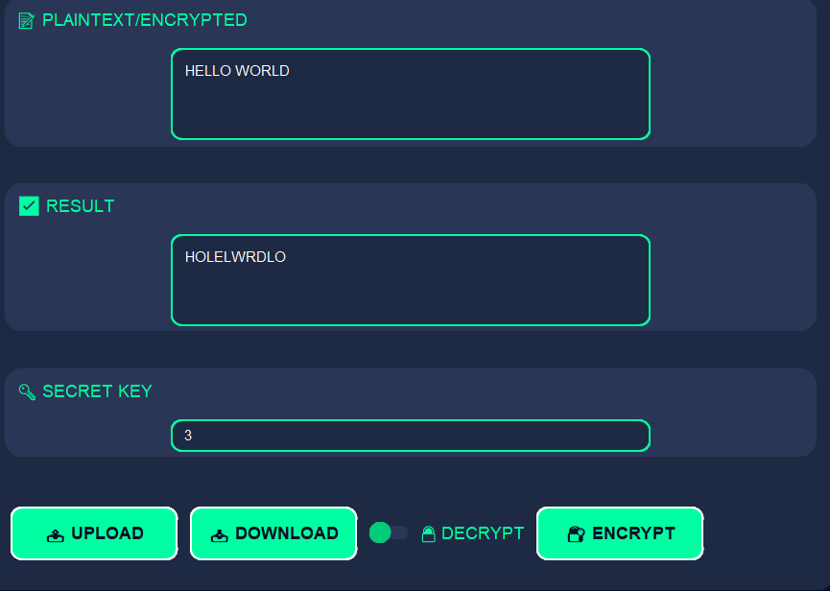
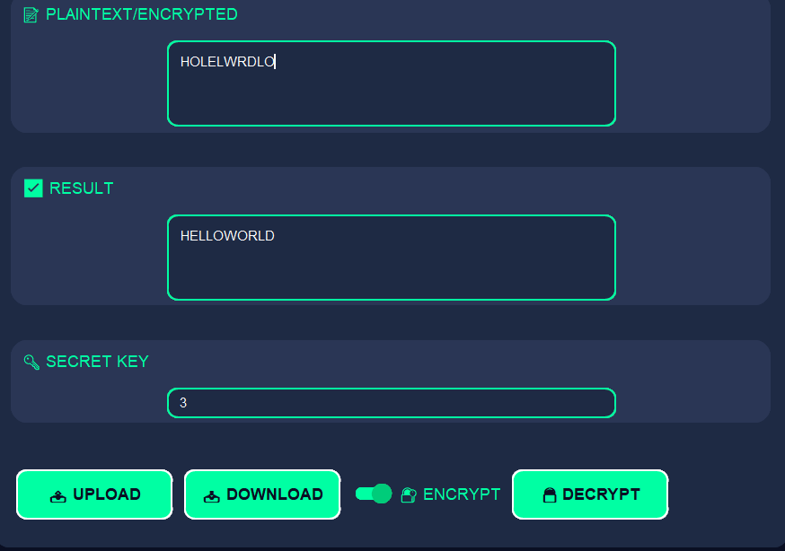
Rail Fence Cipher
1.
🪡 1. Letters Arranged in Zigzag Rows
Plaintext is written in a zigzag pattern across a set number of rows, then read off row by row to form the ciphertext.
2.
📄 2. A Simple Transposition Cipher
No letters are changed, just their positions. It’s easy to encrypt but adds visual confusion to attackers.
3.
🔍 3. Weak Security Without Modification
Can be broken by trying different row depths or looking at character distribution. Best used in combination with other ciphers.
www.reallygreatsite.com
PAGE 8

Slide 9


ROT13 Cipher
1.
🔃 1. Shifts Letters by 13
A special Caesar Cipher that shifts all letters by exactly 13 places. Repeating the process returns the original text.
2.
🔄 2. Common in Online Communities
Used to hide spoilers or jokes in forums, since it’s reversible without knowing a key.
3.
🔓 3. Not Secure for Real Use
As it’s just Caesar with a fixed shift, anyone can decode it instantly — not recommended for protecting information.
PAGE 9

Slide 10


Reverse Cipher
1.
Text Is Reversed End to Start
The Reverse Cipher simply flips the plaintext backward — the last letter becomes the first, and the first becomes the last. For example, HELLO becomes OLLEH.
2.
No Key Needed
It's a very basic form of encryption that doesn't require a key — just reverse the string again to decrypt. This makes it extremely easy to both encrypt and decrypt.
3.
Extremely Weak Security
Anyone can easily recognize and break a reversed message. It is used more for fun, puzzles, or basic obfuscation than for actual data protection.
www.reallygreatsite.com
PAGE 10

Slide 11
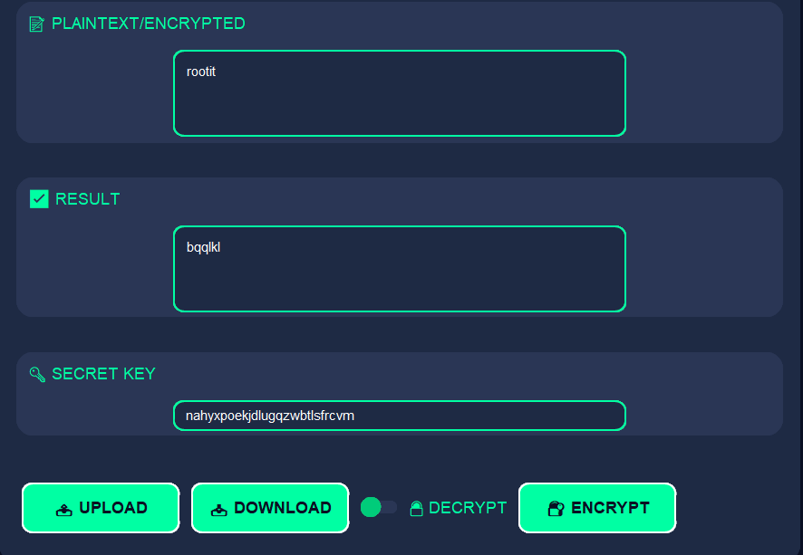
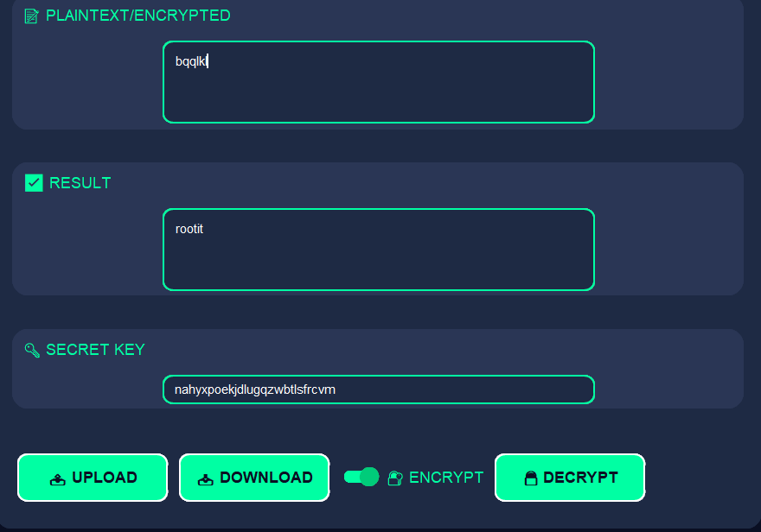
Substitution Cipher
1.
Replaces Letters with Alternatives
Each letter in the plaintext is substituted with another letter or symbol from a defined set. The mapping can be random or follow a rule.
2.
Can Be Simple or Complex
The Caesar, Monoalphabetic, and Atbash are all examples of substitution ciphers. Some use fixed shifts, others use full alphabet reordering.
3.
Vulnerable to Frequency Analysis
Despite appearing scrambled, repeated patterns (like frequent letters) can be analyzed and guessed by attackers, especially in longer texts.
www.reallygreatsite.com
PAGE 11

Slide 12
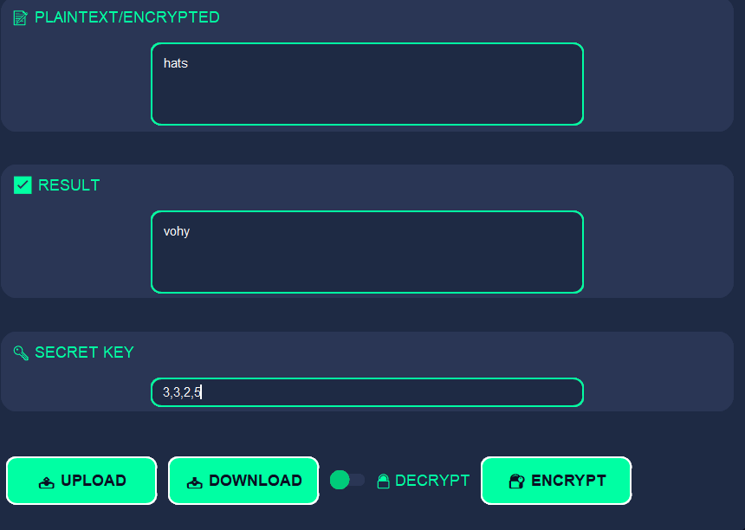
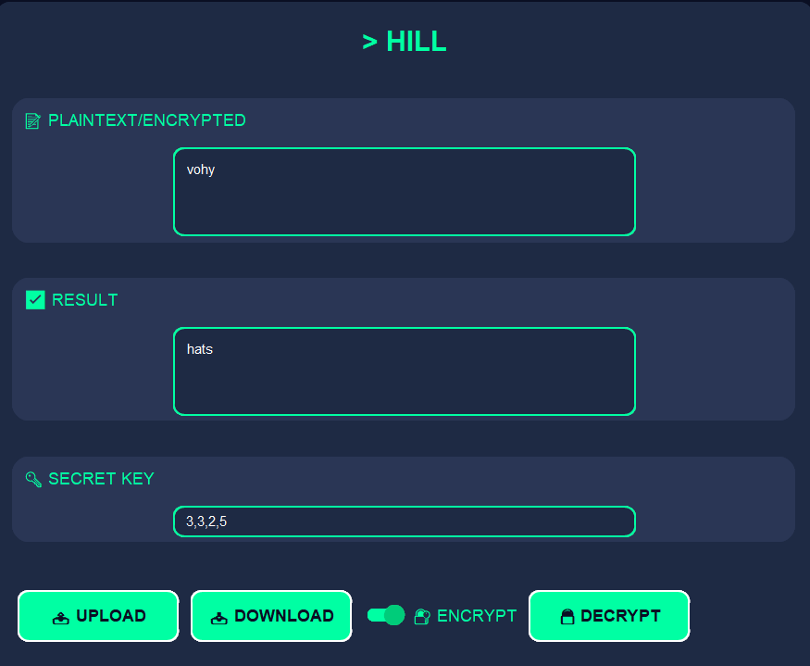
HILL Cipher
1.
Mathematical Encryption Using Matrices
Encrypts plaintext in blocks by converting letters into numbers, forming vectors, then multiplying by a key matrix.
2.
Encrypts Multiple Letters at Once
This method works in blocks like 2 or 3 letters, spreading changes across the entire block — increasing complexity.
3.
Requires Matrix Inversion for Decryption
To decrypt, the inverse of the key matrix modulo 26 is required. Not all matrices work, and decryption can be
PAGE 12

Slide 13
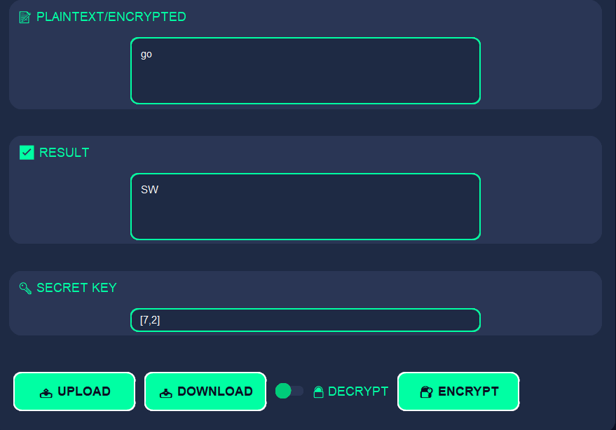
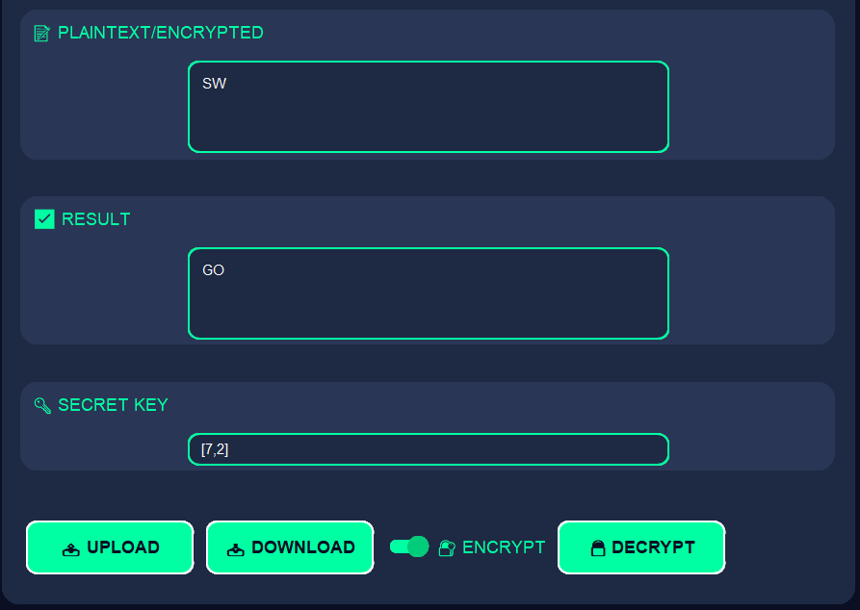
Affine Cipher
1.
Mathematical Formula Used
Each letter is encrypted using the formula: E(x) = (a * x + b) mod 26, where x is the letter’s numeric value.
2.
Two Key Parameters
Both ‘a’ and ‘b’ are needed for encryption. ‘a’ must be coprime with 26 to allow for decryption.
3.
Improves Caesar, Still Vulnerable
More secure than Caesar due to the added multiplication step, but it’s still a monoalphabetic cipher and can be cracked with analysis.
PAGE 13

Slide 14
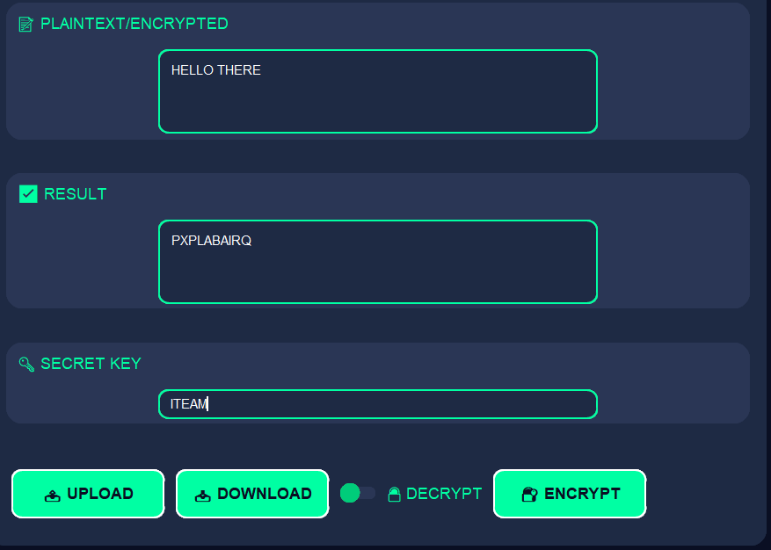
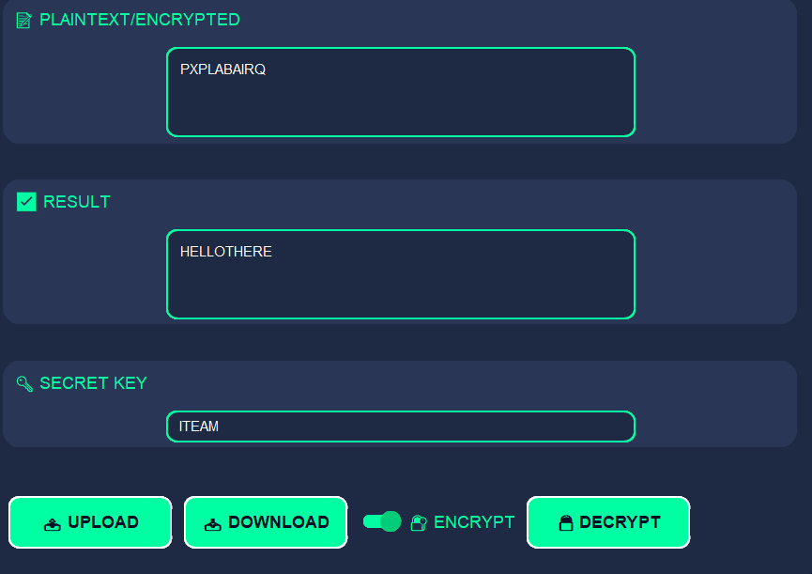
Vigenere Cipher
1.
Keyword-Based Multiple Shifts
Instead of using a single fixed shift like Caesar, the Vigenère Cipher uses a keyword where each letter represents a shift. For example, the key "KEY" means shifting by K (10), E (4), and Y (24), repeated over the plaintext.
2.
Polyalphabetic Substitution
It encrypts the same letter differently depending on its position and the corresponding letter in the key. This breaks common letter frequency patterns found in simple substitution ciphers.
3.
Stronger but Still Breakable
For a long time, it was considered unbreakable. But with methods like the Kasiski examination and frequency analysis of repeating patterns, it can be cracked — especially if the keyword is short or reused.
PAGE 14

Slide 15
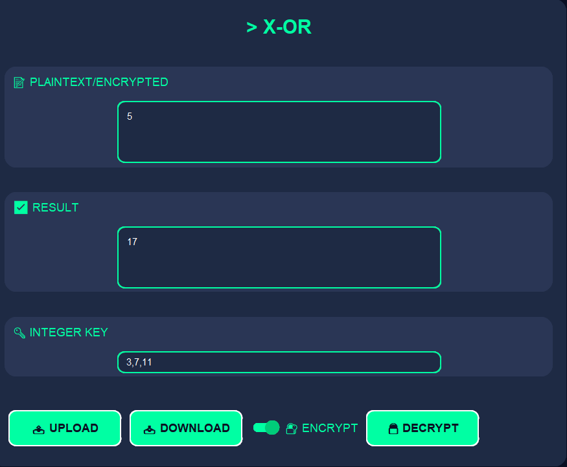
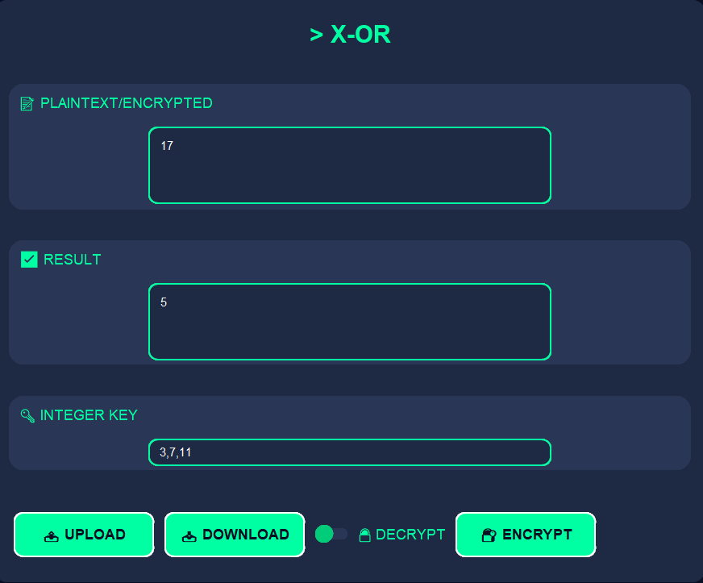
XOR Cipher
1.
Uses Bitwise XOR Operation
The cipher encrypts each bit of the plaintext by performing an XOR operation with a key. If the same key is XORed again, the original text is restored.
2.
Depends on Key Strength
With a truly random one-time pad key that’s as long as the message and used only once, XOR becomes theoretically unbreakable. But short or reused keys make it weak.
3.
Common in Digital Security
XOR is widely used in real-world cryptographic systems, not as a standalone cipher, but as part of larger encryption algorithms thanks to its speed and reversibility.
www.reallygreatsite.com
PAGE 15

Slide 16
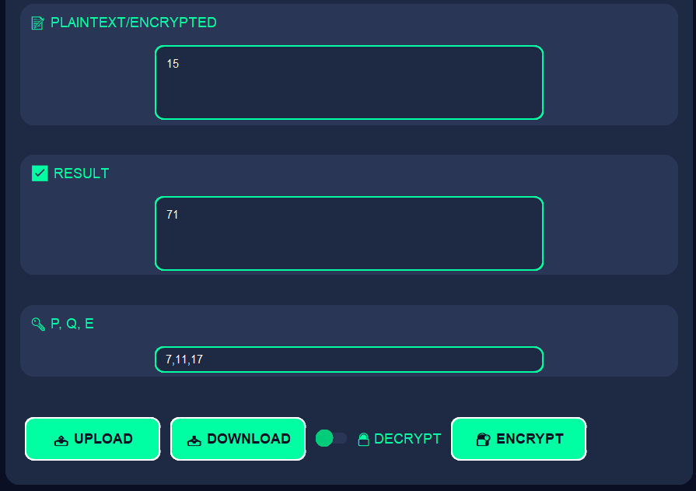
RSA - CIPHER
1.
Encryption – Turning Numbers into Secure Codes
The RSA cipher uses mathematical operations on large prime numbers to encrypt numeric messages using a public key (P,Q,E).The encrypted message becomes unreadable without the private key.
2.
Decryption – Retrieving the Original Message
Using the private key (P,Q,E), the encrypted numeric message can be reversed back to its original form securely.
3.
Security Through Primes
RSA’s strength lies in using large prime numbers and modular arithmetic.The difficulty of factoring large numbers keeps encrypted messages safe from attackers.
www.reallygreatsite.com
PAGE 16

Slide 17
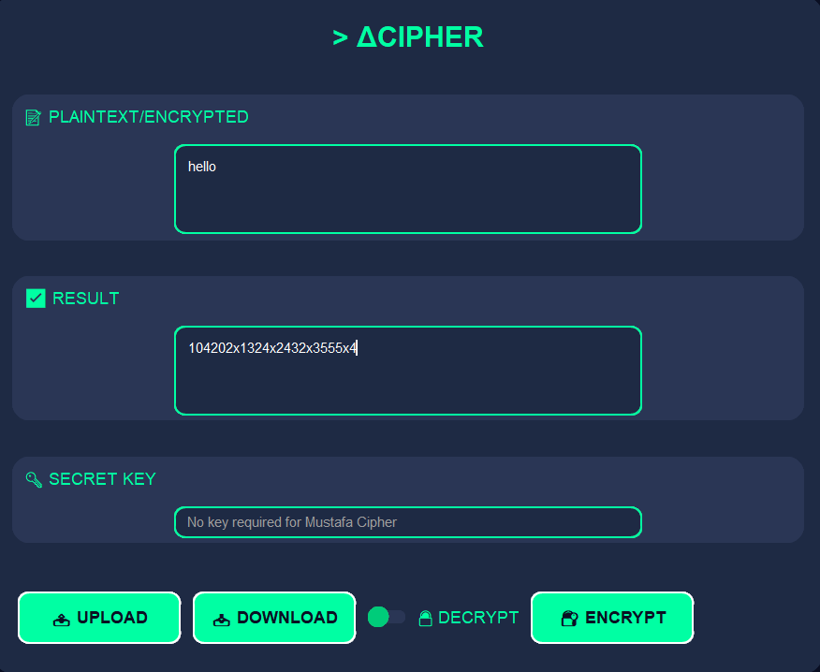
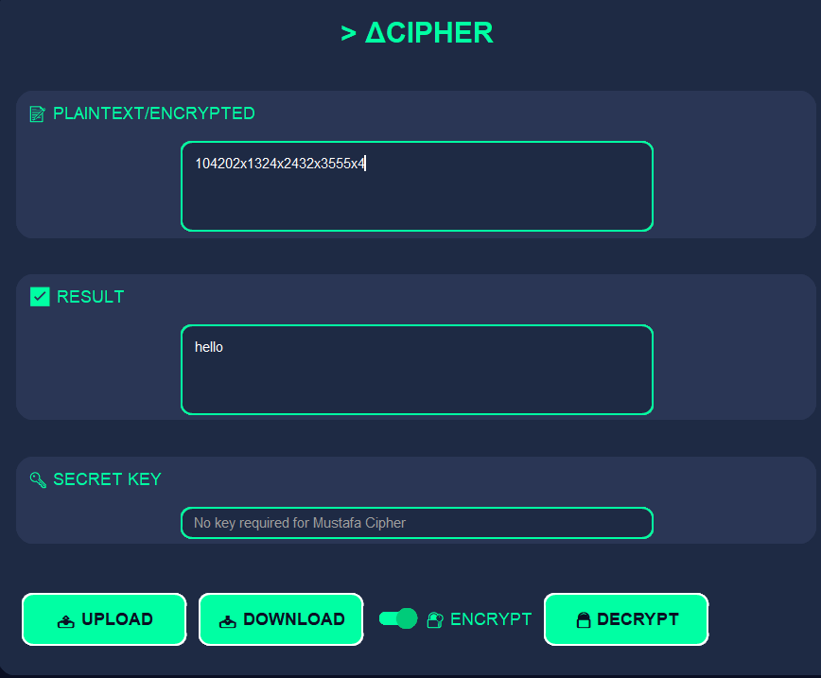
Δcipher -CIPHER
1.
Polynomial Encryption
Each character becomes a polynomial term using its ASCII and position,then the derivative is taken to form the encrypted output.
2.
Derivative-Based Decryption
Reverses encryption by dividing coefficients by their positions,restoring original ASCII values to get the message back.
3.
Math-Like Obfuscation
Produces output that looks like calculus expressions,with position-sensitive logic for added complexity.
www.reallygreatsite.com
PAGE 17

Slide 18
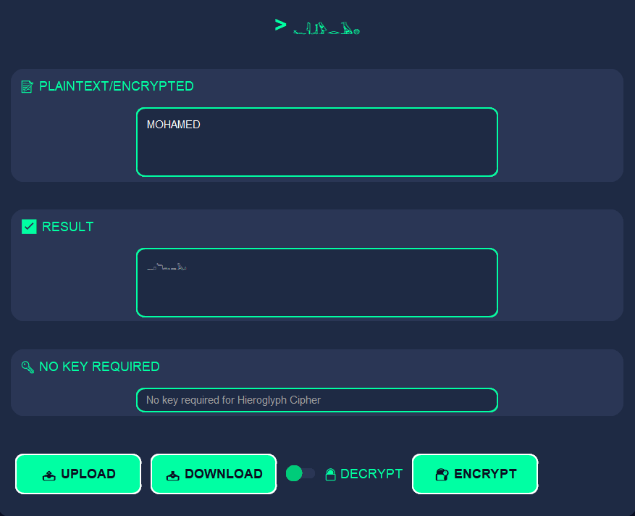
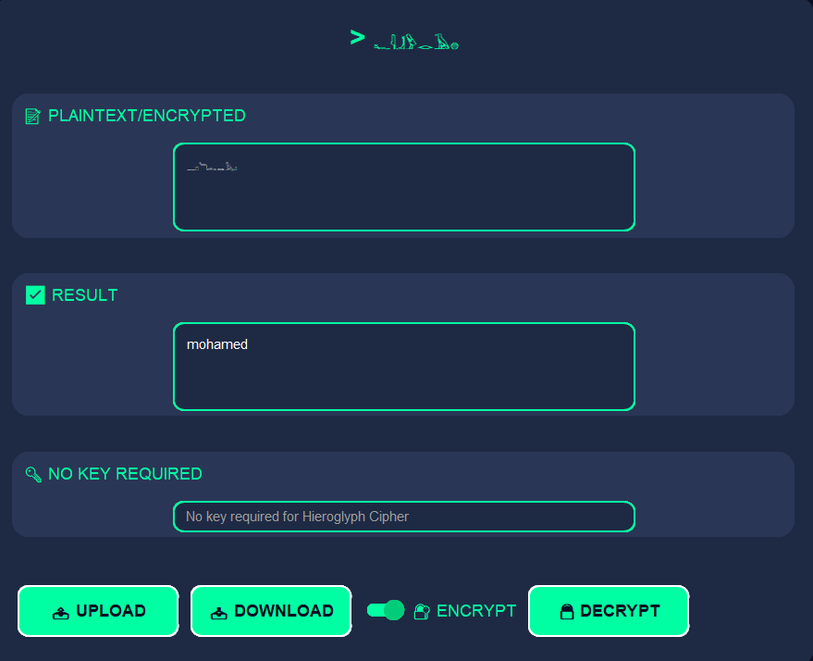
Far3on - CIPHER
1.
Double Encryption Logic
Applies Caesar cipher with position-based Fibonacci shifts,then maps the result into Egyptian hieroglyph symbols.
2.
Layered Decryption Steps
First converts hieroglyphs back to letters,then reverses the Fibonacci Caesar shifts.
3.
Obscure & Cultural Output
The ciphertext blends ancient script with dynamic shifts,making it visually cryptic and hard to guess.
www.reallygreatsite.com
PAGE 18

Slide 19
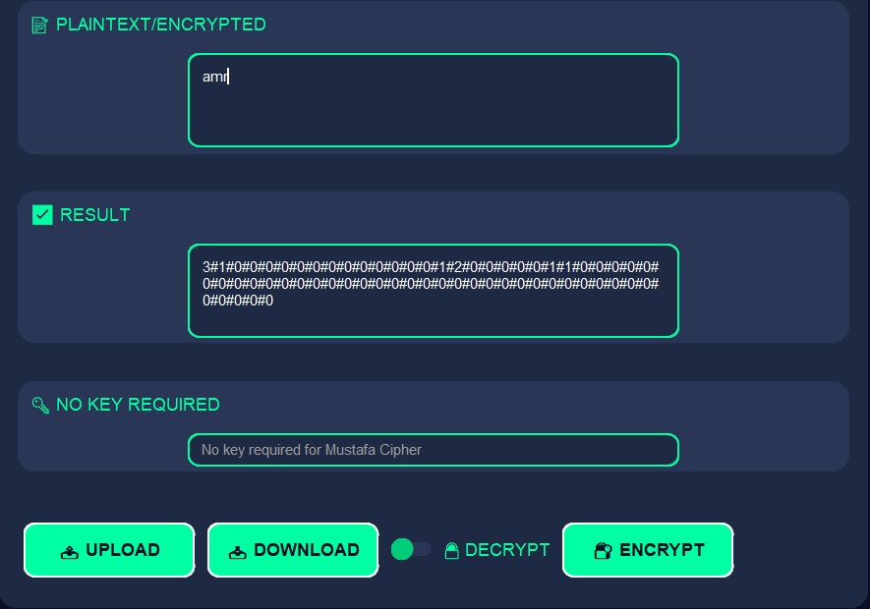
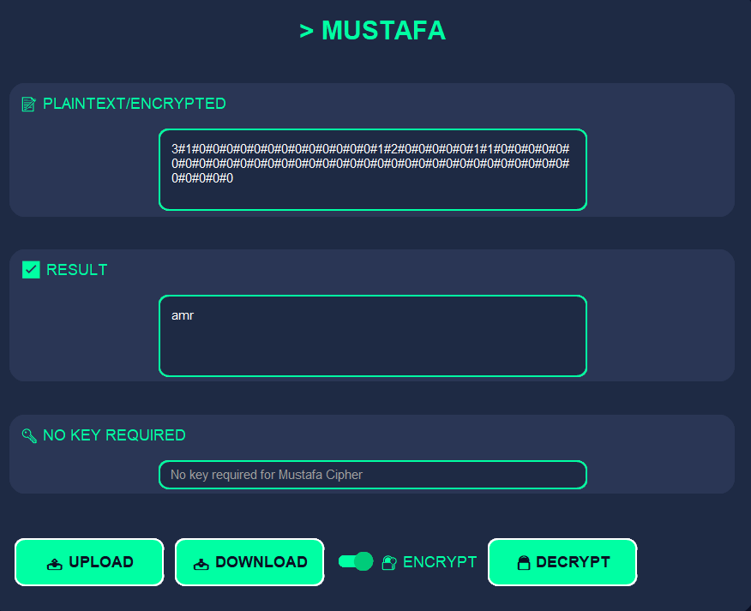
MUSTAFA CIPHER
1.
🔑 1. Encryption – Turning Plain into Secret
The cipher takes readable text (plaintext) and scrambles it into an unreadable form (ciphertext) using a defined rule or algorithm.
2.
🔓 2. Decryption – Revealing the Message
Using the correct key, the ciphertext is reversed back into the original readable message (plaintext) by applying the cipher in reverse.
3.
🛡 3. Security Through Keys
The strength of a cipher depends on how hard it is to guess or break the key without knowing the encryption method. Stronger keys mean better protection.
www.reallygreatsite.com
PAGE 19

Slide 20


CIPHERS & CYBERSECURITY
Classical Ciphers
1.
SAFE BROWSING → SUBSTITUTION CIPHERS
Letters replaced by others using fixed rules. Examples: Caesar, Atbash
2.
RECOGNIZING SCAMS → TRANSPOSITION CIPHERS
Letters rearranged without substitution. Examples: Rail Fence, Columnar
3.
PASSWORD MANAGEMENT → MODERN APPLICATIONS
How classical ciphers inspired algorithms like AES and RSA
PAGE 20

Slide 21
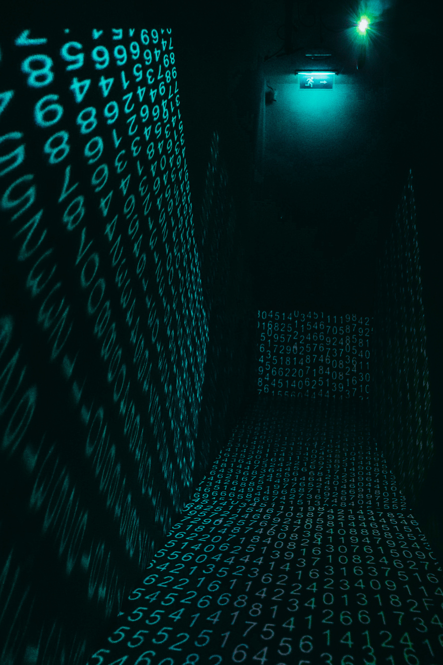

CIPHERS & CYBERSECURITY
SYMMETRIC CIPHERS
1.
SYMMETRIC CIPHERS
Encryption using one key (e.g., AES, DES). Fast but requires secure key exchange.
2.
ASYMMETRIC CIPHERS
Uses public/private keys (e.g., RSA). Ideal for digital signatures.
3.
CLASSICAL CIPHERS
Historical methods (Caesar, Vigenère). Foundation of modern cryptography
PAGE 21

Slide 22

LICERIA & CO.
Thank You
PAGE 22

