Slide 1
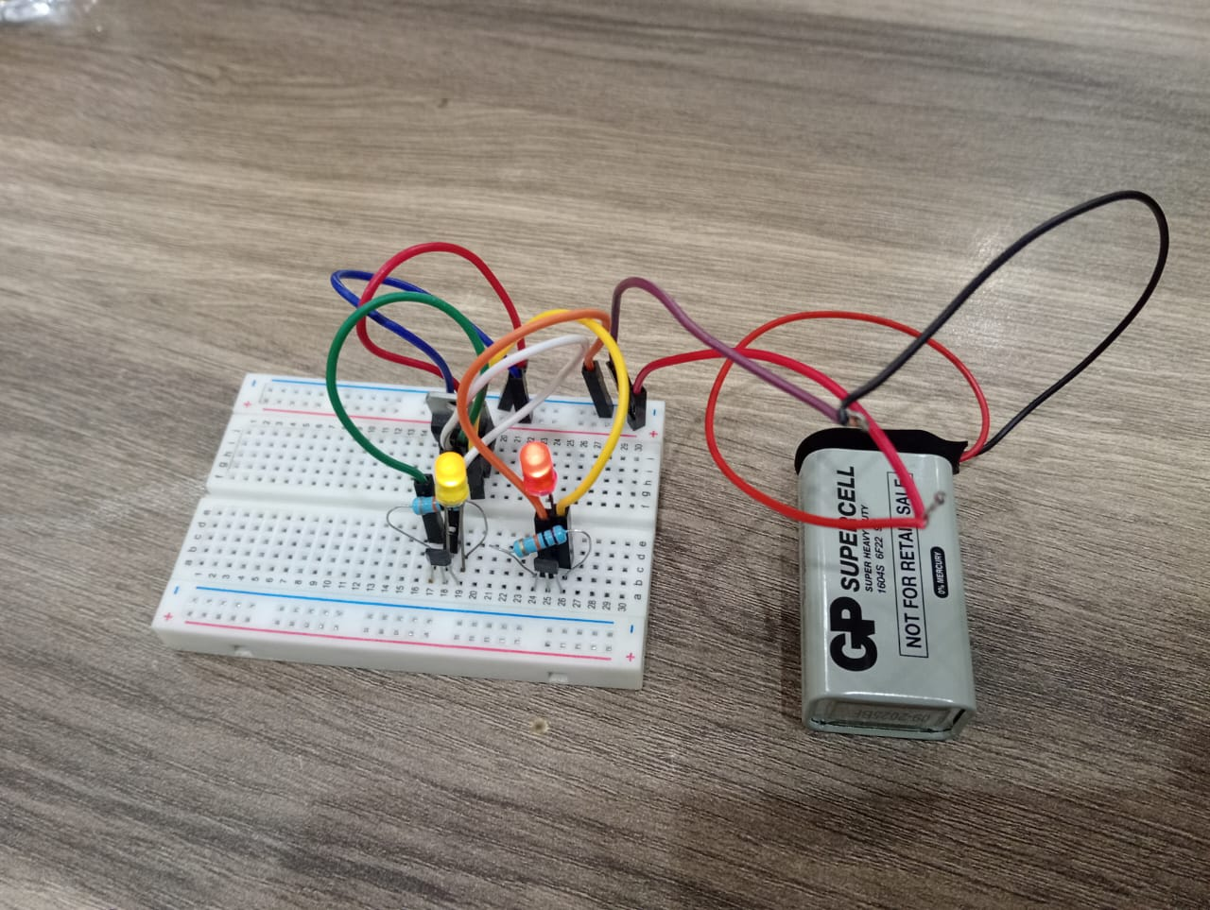
Magnetic Polarity Detector Circuit Using Hall Effect Sensor
Supervised by:
DR. Nour Eldin
Eng. Ehab Ahmed
Team Members:
Mostafa Hatem
Yousef Abdallah
Mriam Mansour
Menna Alrahman Mohamed

Slide 2
Introduction & The Hall Effect
What is a Magnetic Polarity Detector?
An electronic circuit that identifies whether a magnetic field's north or south pole is present near the sensor using the Hall effect principle.
The Hall Effect Principle
Discovered by Edwin Hall in 1879. When current flows through a conductor in a perpendicular magnetic field, charge carriers are deflected, creating a voltage difference (Hall voltage) across the conductor. The polarity of this voltage depends on the magnetic field direction.
Key Applications
Automotive position and speed sensing
Proximity switches and door sensors
Current measurement devices
Industrial automation and robotics

Slide 3
Components Required
Essential Components
Hall Effect Sensor
Power Supply - 9V DC regulated
Resistors - 10kΩ (pull-up),
LEDs - Red and Yellow for polarity indication
7805 Voltage Regulator:
Bread board
Jumper Wires

Slide 4
Hall Effect Sensor
Internal Equivalent Circuit
Hall Element: converts magnetic field into a small voltage
Hall Effect Sensor
Amplifier + Schmitt Trigger: amplifies and stabilizes the signal
NPN Open-Collector Transistor: controls the output pin
Pull-Up Resistor
Required for open-collector output
Sets HIGH level when transistor is OFF
Vcc
|
Pull-up Resistor
|
Output ---- NPN Transistor ---- GND

Slide 5
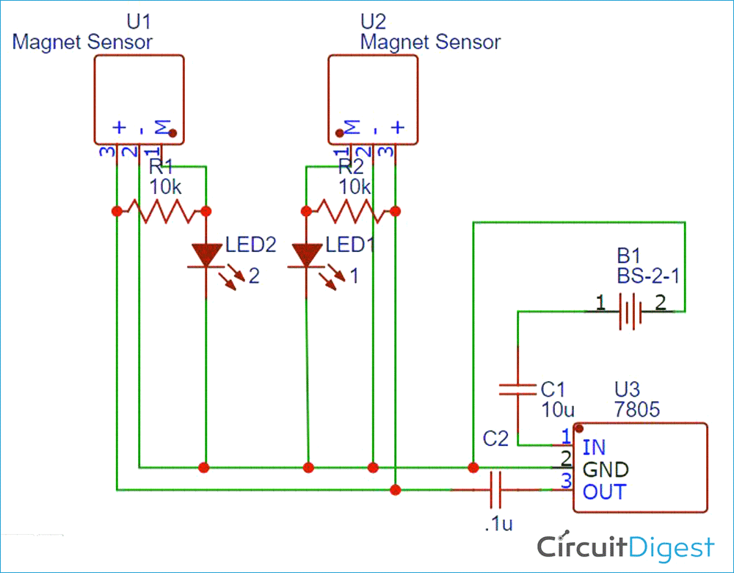
Circuit Connections:
Hall sensor VCC → +5V power supply
Basic Circuit Design
Hall sensor GND → Ground (0V)
Hall sensor Output → Indicator circuit
Output Behavior:
North pole detected: → Yellow LED OFF
South pole detected: → Red LED OFF
No magnetic field: → Both LEDs ON
LED Indicator Circuit: Use current-limiting resistors (220–10K Ω) in series with each LED to control brightness and protect the LED.

Slide 6
Working Principle
01
02
Magnetic Field Interaction
Hall Voltage Generation
Magnet approaches the Hall sensor and magnetic flux lines pass through the sensor element.
Current flows through the sensor, Lorentz force deflects charge carriers, and voltage appears across the sensor proportional to field strength and polarity.
03
04
Signal Processing
Output Indication
Positive voltage shift → North pole detected. Negative voltage shift → South pole detected. Voltage magnitude indicates magnetic field strength.
The digital Hall sensor switches its output LOW when a magnetic pole is detected, turning ON the corresponding LED through a current-limiting resistor.

Slide 7
Design Considerations & PCB Layout
Power Supply:
Stable 9V regulated power supply recommended
Separate analog and digital grounds if using microcontroller
Sensor Placement:
Position away from high-current traces
Ensure proper orientation for field detection
Allow space for magnet approach (typically 5-20mm gap)
Noise Reduction:
Keep sensor leads short (<10cm)
Use ground plane for shielding
Add RC filter if needed (100Ω + 1µF)
Sensitivity Adjustment
Add a potentiometer in the comparator reference voltage circuit to adjust detection thresholds for different magnet strengths.

Slide 8
Calibration, Testing & Troubleshooting
Calibration Procedure
Power up circuit without magnetic field
Verify midpoint voltage (~2.5V for 5V supply)
Test with North pole - verify Green LED lights
Test with South pole - verify Red LED lights
Adjust thresholds if needed
Testing Methods
Use permanent magnets of known polarity
Test at various distances (0-30mm)
Verify response time and LED indication
Check for stable operation
Common Issues & Solutions
No output: Check power supply, connections, and sensor orientation
Incorrect polarity: Verify sensor pinout and magnet polarity
Unstable readings: Add 0.1µF capacitor across VCC-GND, increase distance from noise sources
Weak detection: Use stronger magnet or adjust sensitivity threshold

Slide 9
Applications & Advantages
Real-World Applications
Key Advantages
Automotive: Wheel speed sensors, crankshaft position detection, gear position sensing
✓ Non-contact operation (no mechanical wear)
✓ Solid-state reliability (no moving parts)
Industrial: Conveyor position detection, rotary encoders, proximity switches, limit switches
✓ Fast response time (microseconds)
✓ Low power consumption
Consumer Electronics: Smartphone flip cover detection, laptop lid sensing, washing machine switches
✓ Directional sensitivity for polarity detection
✓ Wide temperature range (-40°C to +150°C)
Measurement: Current clamp meters, non-contact voltage detection, magnetometers
✓ Long lifespan and maintenance-free

Slide 10
Conclusion & Next Steps
Key Takeaways
Hall effect sensors provide simple, reliable magnetic polarity detection
Basic circuit requires minimal components (sensor, resistors, LEDs, power supply)
Wide range of practical applications across multiple industries
Can be enhanced with microcontrollers for advanced features
Design Improvements
Add microcontroller for digital processing and data logging
Integrate wireless connectivity (Bluetooth/WiFi) for IoT applications
Use 3D Hall sensors for position and orientation tracking
Implement temperature compensation for precision applications
Next Steps for Implementation
Select appropriate Hall sensor based on application requirements
Build and test prototype on breadboard
Design PCB for permanent installation
Experiment with different magnet types and distances
Consider integration with Arduino or other microcontroller platforms

Slide 11

Thank You!
We appreciate your time and attention.
Questions & Discussion

