Slide 1
Algeria fire

Slide 2
Team members
مصطفي أنور محمد قناوي - 5
Moustafa.17295691@compit.aun.edu.eg
محمود علي عشور - 6
m.ali16.172@compit.aun.edu.eg
محمود رجب مهدي - 4
mahmud.20367873@compit.aun.edu.eg

Slide 3



Link to the dataset
https://aunedu-my.sharepoint.com/:x:/g/personal/moustafa_17295691_compit_aun_edu_eg/EbpRBQoQrAZLiu_XRnq9lhkBkJXyP_ZkoE9NBjffkMzDfw?e=l63MLj
Notes:
https://github.com/MostafaKenawy/Algeria-fire

Slide 4
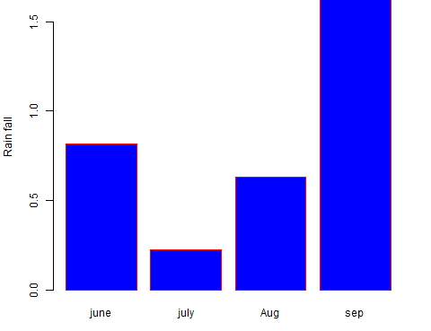
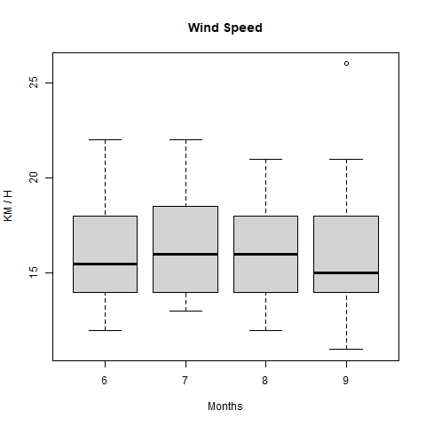
Results of visualization

Slide 5
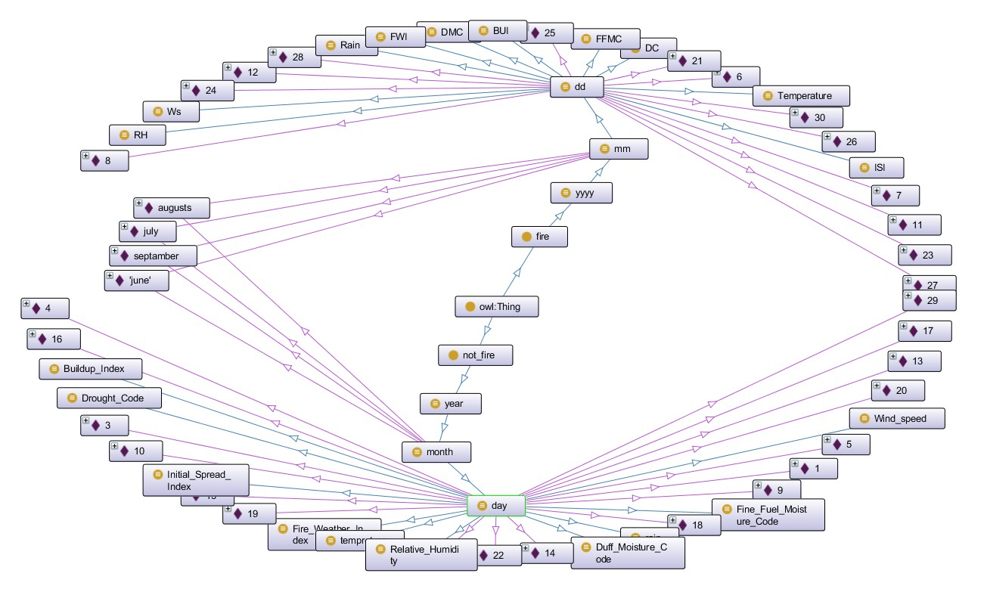
Results of visualization

