Slide 1

Linear Control System
Final project
Dr. Hamidreza Taghirad
Student: Mostafa Latifian - 40122193

Slide 2
Question 1
Bode Plot of System
Question 2
System Information
Question 3
System Transfer Function
Question 4
Routh–Hurwitz Stability Criterion
Question 5
Root Locus of system
Question 6
Controller Design
Question 7
Sensitivity Controller Design

Slide 3
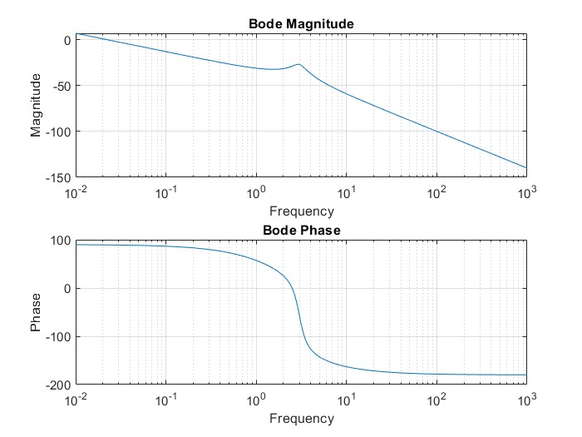
Q1
Bode plot of system based on information which exist in Data.mat

Slide 4
Q2
System is type one.
The system is of order three.
The system hasn't any time delay
The system is non minimum phase

Slide 5
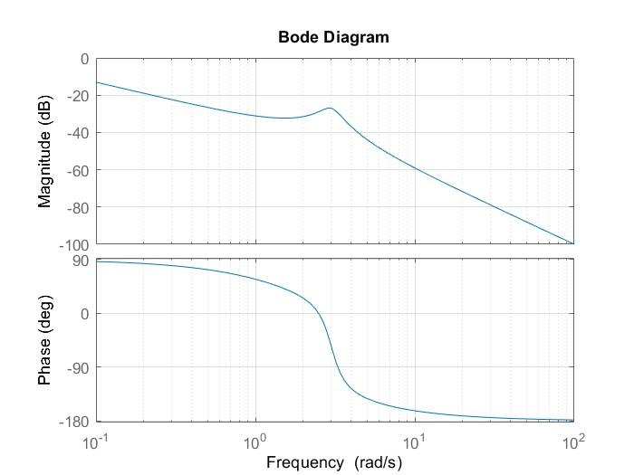

Q3
Here is the system's transfer function and bode diagram that has been obtained using the System-Identification command:
$$G(s)=\frac{0.1s−0.2}{s\left(s^{2}+0.9s+9\right)}$$

Slide 6
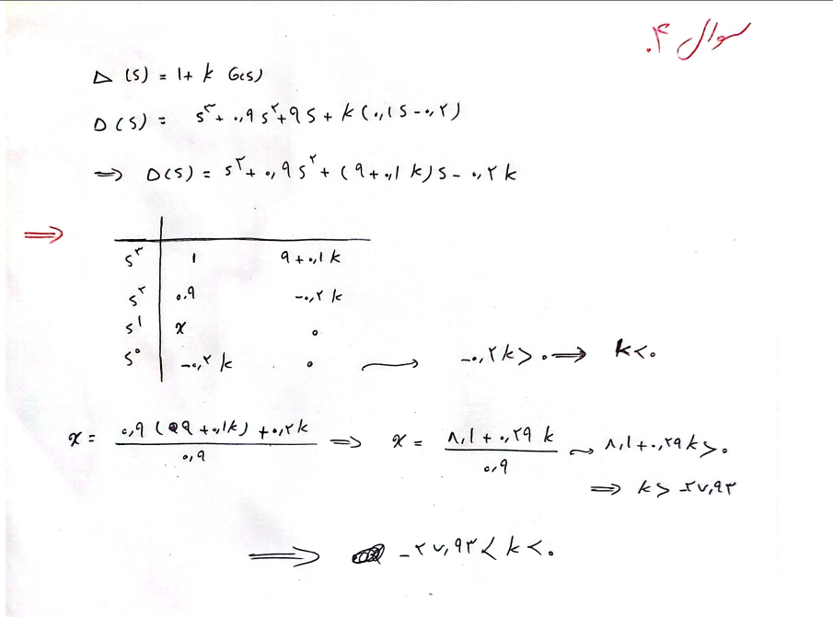
Q4
We obtain the stability range of the gain using the Routh-Hurwitz method, and we have:

Slide 7
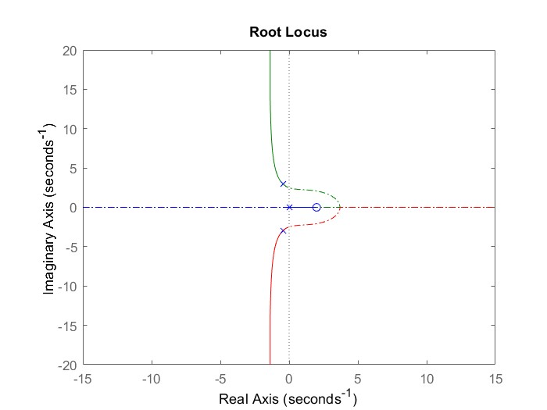
Q5
Here, the root locus plot is observable. The positive gain is specified with - and the negative gain is specified by -. .

Slide 8
Q5
Effect of PD controller:
Adding a PD controller can help shift the poles toward the left half-plane. If properly tuned, it can improve system stability by increasing damping and pushing the dominant poles away from the RHP.
Effect of PI controller:
The PI controller can reduce SteadyState error. However, it does not significantly shift the root locus leftward and may not be sufficient to stabilize the system.

Slide 9
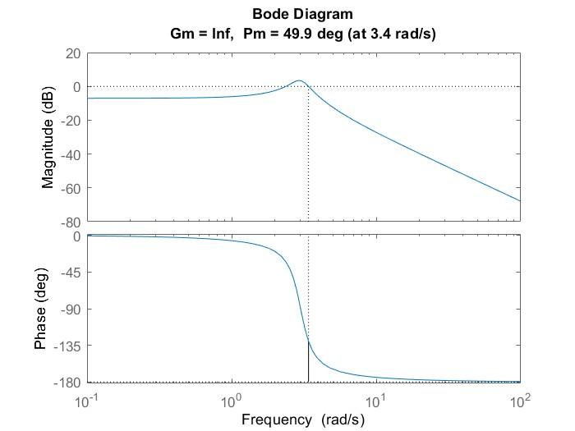
Q6
First, we carry out the problem's requirement and plot the bodel diagram:

Slide 10
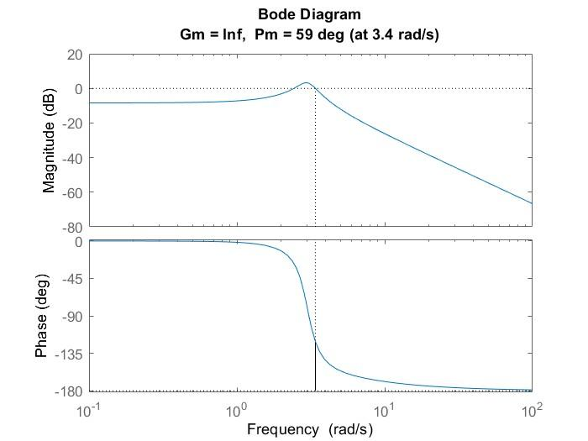
Q6
By increasing the gain, we slightly elevate the diagram and we have:

Slide 11
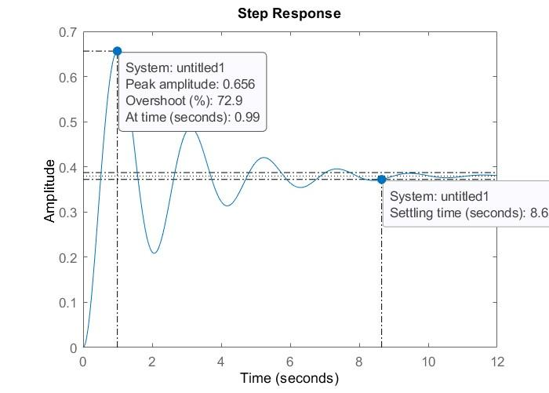
Q6
Step response after applying Lead controller:

Slide 12
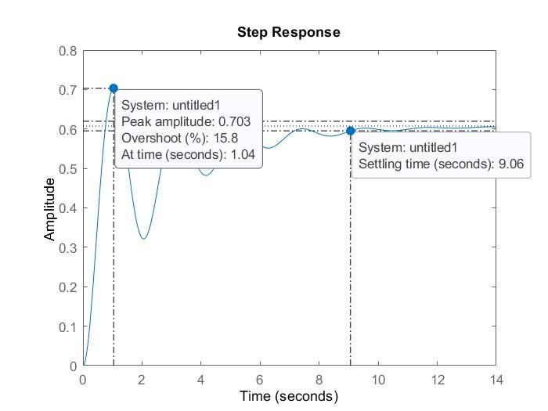
Q6
Because of settling time we have to adding a Lag controller and now we have:

Slide 13
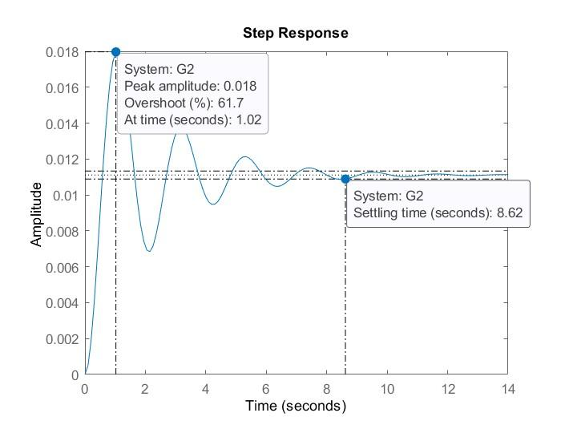
Q6
comparison of step response before and after adding controllers:

Slide 14
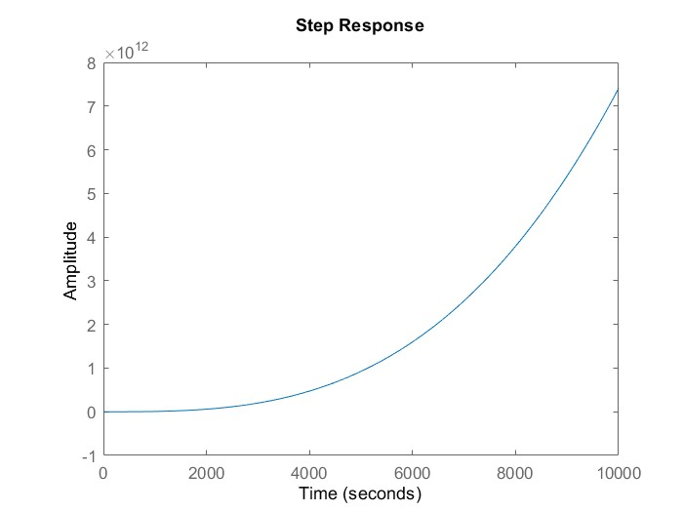


Q7 Part 1
Here we use a PI controller to make the ramp input error equal to zero:
$$C\left(s\right)=−200×\frac{s+10}{s}$$

Slide 15
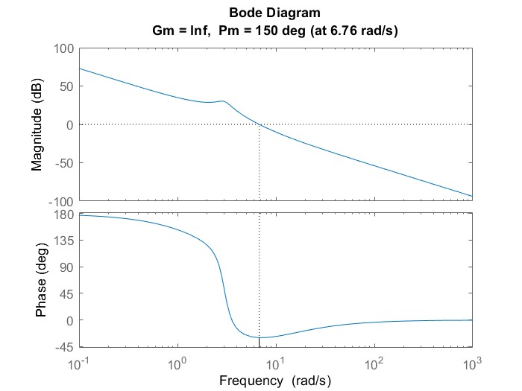
Q7 Part 1
The stability of the system is proven using the Bode plot.

Slide 16


Q7 Part 2
In this part, we will design the controller using the sensitivity function.
$$T_{d}=\frac{\frac{s}{τ}+1}{{\left(s+1\right)}^{3}}$$
$$T_{d}\left(2\right)=0→τ=−2$$
$$S_{d}=1{−T}_{d}=\frac{s^{3}+3s^{2}+3.5s}{{(s+1)}^{3}}$$
$$C\left(s\right)=\frac{T_{d}}{S_{d}×P}=\frac{−5s(s^{2}+0.9s+9s)}{s^{3}+3s^{2}+3.5s}$$
The loop gain is:
$$L=C×G=\frac{−0.5(s−2)}{{s(s}^{2}+3s+3.5)}$$

Slide 17
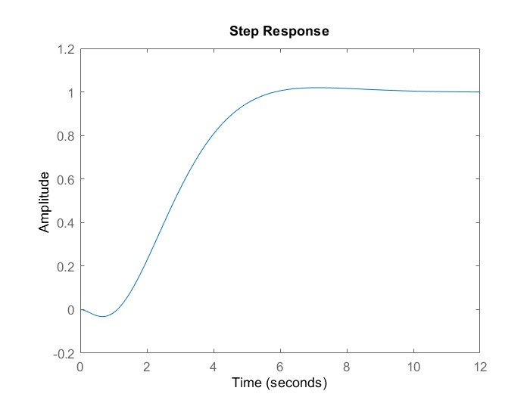
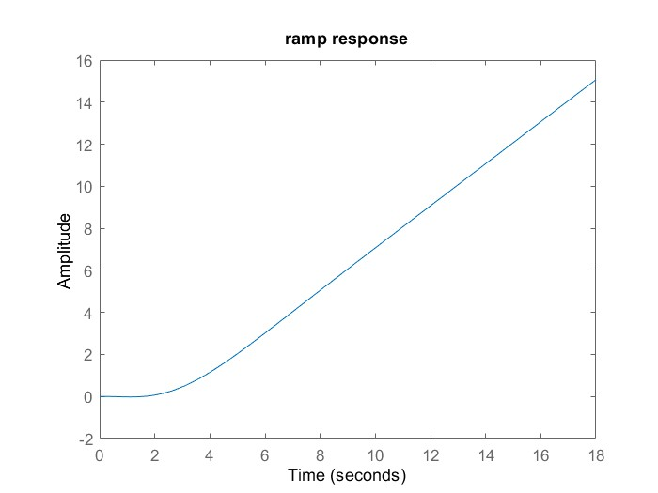
Q7 Part 2
After adding K=1.195 we have Under shoot = 3.2% & Settling Time = 5.4s
We now move on to the system's response to step and ramp inputs:

Slide 18
Thanks' for your patience

