Slide 1

Project 4: data visualization E- commerce sales analysis
Prepared by: Mostafa Mansour
Decodelabs internships program

Slide 2
Business Overview
The business generated over 1.26M in revenue across 1,200 orders.
Total Revenue: 1,264,761.96
Total Orders: 1,200
Average Order Value: 1,053.97
Insight:
The business shows strong overall performance with a stable average order value.

Slide 3
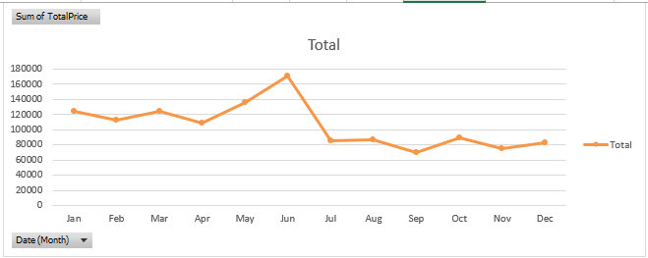
Sales Trend Analysis
Sales consistently peak during May–June, indicating seasonal demand patterns.
Insight:
Revenue follows a clear seasonal pattern, with the highest performance during late spring and early summer.
So What:
Marketing efforts should be increased before peak months to maximize revenue.

Slide 4
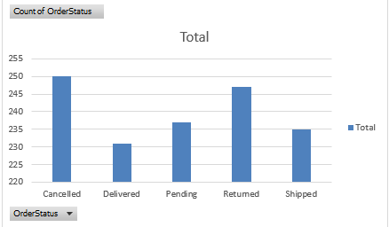
Order Status Analysis
Cancelled and returned orders highlight opportunities for operational improvement.
Insight:
Order statuses are distributed across all stages, with a noticeable number of cancellations and returns.
So What:
Improving fulfillment processes can reduce lost revenue and improve customer satisfaction.

Slide 5
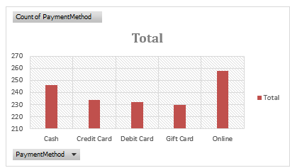
Payment Method Analysis
Customers use a balanced mix of payment methods with no dominant option.
Insight:
Payment preferences are evenly distributed across all available methods.
So What:
Maintaining multiple payment options is important for customer convenience.

Slide 6
Conclusion & Recommendations
Key Findings:
Revenue exceeded 1.26M
Clear seasonal sales pattern (May–June peak)
Balanced payment behavior
Noticeable cancellations and returns
Recommendations
Focus marketing before peak season (May–June)
Run promotions during low-sales months
Reduce cancellations and returns
Maintain diverse payment options
Improve data tracking for better insights
Final Insight
Focusing on seasonality and operational efficiency can significantly improve revenue stability and growth.

