Slide 1



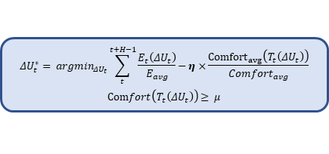

rewards
Reinforcement Learning Agent
Environment
$$η$$
Adapt parameters
Optimization formulation
$$ΔU_{t}^{∗}= argmin_{ΔU_{t}}\sum_{t}^{t+H−1}{\frac{E_{t}\left(ΔU_{t}\right)}{E_{avg}}−η×\frac{{Comfort}_{avg}\left(T_{t}\left(ΔU_{t}\right)\right)}{Comfort_{avg}}}$$
$$Comfort\left(T_{t}\left(ΔU_{t}\right)\right)≥ μ$$
Actions
$$ΔU_{t}^{∗}$$

