Slide 1

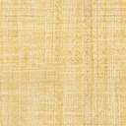

















$$h_{gw}$$
$$W$$
$$σ_{n}=ρg(h+\frac{H}{2})$$
$$h$$
$$T$$
$$T/2$$
Fault
$$h−h_{gw}$$
Right surface
injection
$$p_{init }=ρ_{f}g(h−h_{gw})$$
$$H$$
Back surface
$u_{y}$=0
$$g$$
Top surface
$$σ_{n}=ρg(h−\frac{H}{2})$$
Left surface
$u_{x}$=0
Right surface
Front surface
$$z$$
Bottom surface $u_{z}$=0
$$x$$
$$y$$

Slide 2

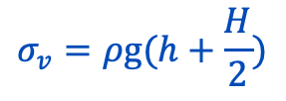



$$h_{gw}$$
$$W$$
$$σ_{v}=ρg(h+\frac{H}{2})$$
$$h$$
$$T$$
$$T/2$$
$$h−h_{gw}$$
Fault
injection
$$σ_{H}$$
$$p_{init }=ρ_{f}g(h−h_{gw})$$
$$H$$
Back surface
$u_{y}$=0
$$g$$
Top surface
Left surface
$u_{x}$=0
Right surface
Front surface
$$z$$
Bottom surface $u_{z}$=0
$$x$$
$$σ_{h}$$
$$y$$

