Slide 1
Calculator

Slide 2
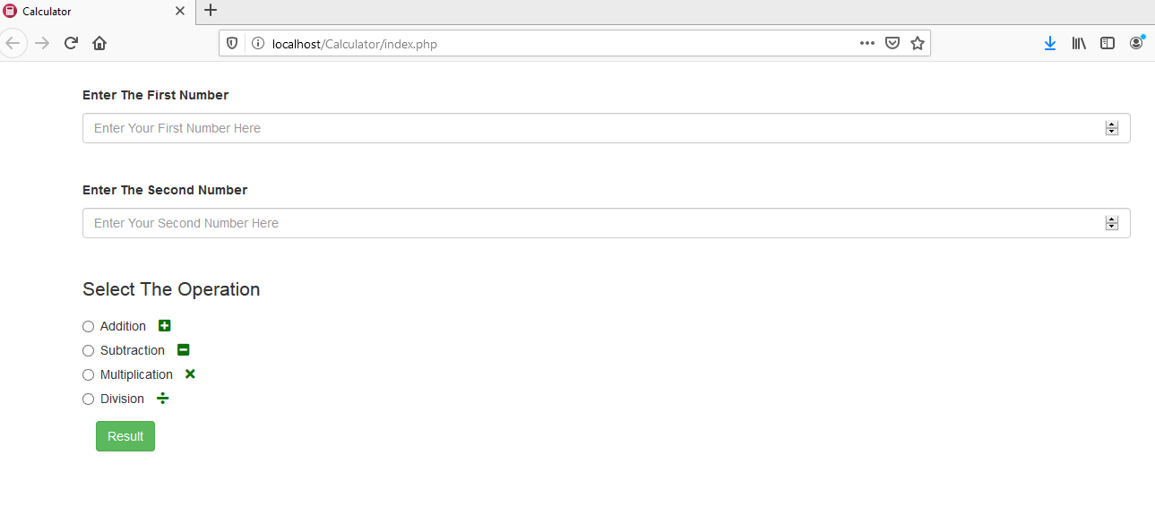
Calculator

Slide 3
Introduction
This Is A Simple Calculator Which Provides The Four Basic Arithmetic Operations (Addition, Subtraction, Multiplication & Division).
The Used Technologies
HTML
HTML5
CSS
CSS3
Font Awesome Library
Bootstrap
PHP

Slide 4
The Features
Providing Favorite Icon For The App.
The Simple & Classic Design Of The App.
The App Is Responsive, Hence It Can Be Displayed On All Different Sizes Of Screens Without Any Problems.
The Usage Of The Font Icons Gives The Form A Beautiful View and Also Make Users Easily Respond To It.
There Is Full Validation For All Of The Input Fields Of The App.
This Validation Is Divided Into Two Basic Categories (Client Side & Server Side Validations).
The Form Of The App Can Not Be Submitted Without Entering Values For All Of It’s Input Fields Correctly.

