Slide 1
Contact Form

Slide 2
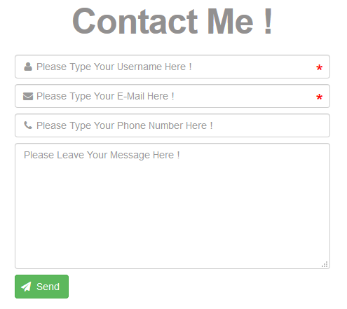
Contact Form

Slide 3
Introduction
This Is A Simple Contact Form Which Provides Full Validation For All It’s Input Fields Including Username, E-Mail, Phone Number & Message.
The Used Technologies
HTML
CSS
Font Awesome Library
Java Script
jQuery
Bootstrap
PHP

Slide 4
The Features
The Simple & Classic Design Of The Form.
The Form Is Responsive, Hence It Can Be Displayed On All Different Sizes Of Screens Without Any Problems.
The Usage Of The Font Icons Gives The Form A Beautiful View and Also Make Users Easily Respond To It.
There Is Full Validation For All Of The Input Fields Of The Form.
The Form Can Not Be Submitted Without Entering Values For All Of It’s Input Fields Correctly.

