Slide 1
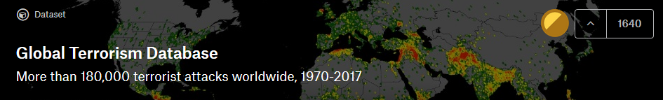
Terrorist Group Prediction in Middle East and North Africa
Amr Mustafa – Mostafa Mahmoud

Slide 2
Binary Classification vs. Multiclass Classification

Slide 3
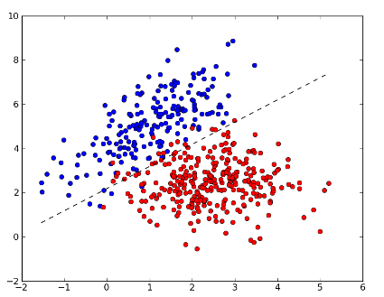
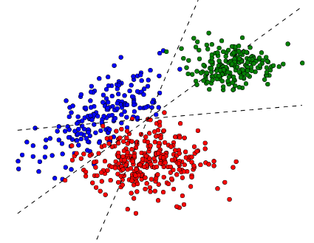
one vs all
Binary Classification
Multiclass Classification
one vs one

Slide 4
Classifiers

Slide 5
Classifiers
Quadratic Discriminant Analysis
K-Nearest Neighbors
Random Forest
Decision Tree
Naïve Bayes
AdaBoost
SVM

Slide 6
Feature Selection

Slide 7
Feature Selection Intuition-Based Approach
weapon_type
attack_type
country
suicide
target
city
weapon_type
attack_type
target
city

Slide 8
Data Preprocessing

Slide 9
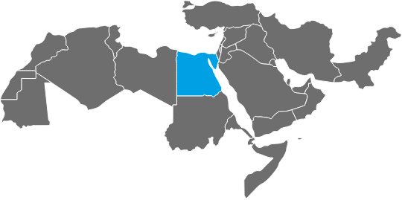
Data Preprocessing Filtering Given Tuples
2000 - 2017

Slide 10
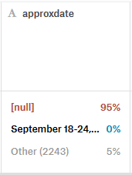
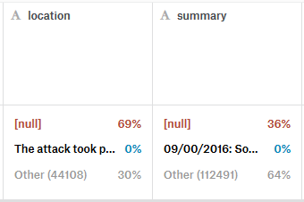
Data Preprocessing Handling Missing Values
NaN Values

Slide 11
Data Preprocessing Handling Missing Values
First Option
Drop Record
Information Loss!

Slide 12
Data Preprocessing Handling Missing Values
Second Option
Imputation
Mean
Mode

Slide 13
Data Preprocessing Handling Missing Values
First Option
Second Option
0.5877
0.5856
kNN
Decision Tree
0.6238
0.6277

Slide 14
Data Preprocessing Encoding Categorical Attributes
We need to encode the categorical attributes in the data before training our models!
from sklearn.preprocessing import LabelEncoder

Slide 15
Data Preprocessing Thresholding
Keep only the 5 groups with max number of attacks!

Slide 16
Results

Slide 17
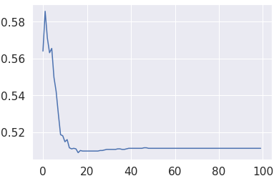
Data Preprocessing K Nearest Neighbors
GTD Only
GTD + WHR
0.5856
0.5856

Slide 18
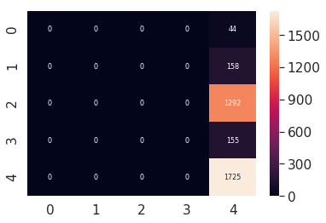
Data Preprocessing K Nearest Neighbors
GTD Only
GTD + WHR

Slide 19
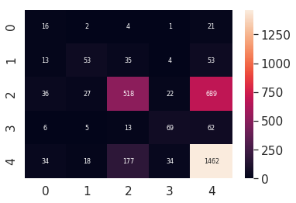
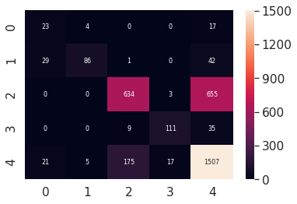
Data Preprocessing Decision Tree
GTD Only
GTD + WHR
0.6277
0.6997

Slide 20
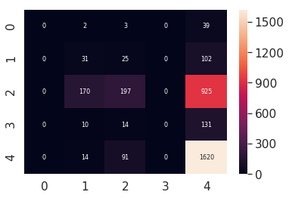
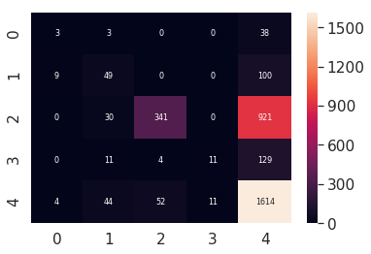
Data Preprocessing Naïve Bayes
GTD Only
GTD + WHR
0.5477
0.5981

Slide 21
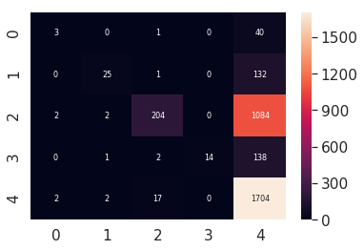

Data Preprocessing SVM
GTD Only
GTD + WHR
0.5779
0.5820

Slide 22
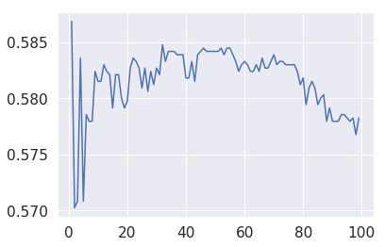
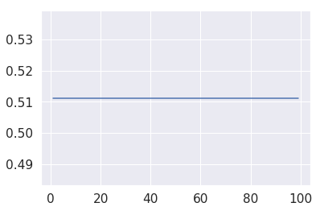
Data Preprocessing Adaboost
GTD Only
GTD + WHR
0.5868
0.5112

Slide 23
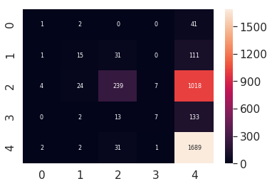
Data Preprocessing Adaboost
GTD Only
GTD + WHR
0.5868
0.5112

Slide 24
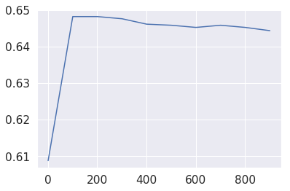
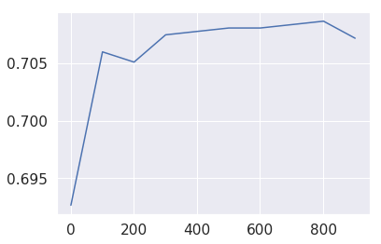
Data Preprocessing Random Forest
GTD Only
GTD + WHR
0.6481
0.7086

Slide 25

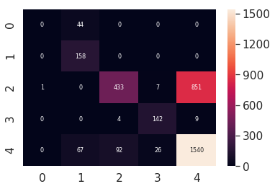
Data Preprocessing QDA
GTD Only
GTD + WHR
0.5809
0.6736

Slide 26
Data Preprocessing Random Forest With Extra Features
0.7196

Slide 27
Data Preprocessing Random Forest With All Features
0.9943

Slide 28
Thank You!

