Slide 1

Diabetes Prediction Using Machine Learning
By:
Mostafa Ayman
Mohamed Hamed
Mohamed Adel
Yasser Ahmed
Mohamed Ali

Slide 2
What is Diabetes?
Diabetes is one of the most common chronic diseases worldwide.
It occurs when the body cannot regulate blood glucose properly because insulin production is insufficient or insulin cannot be used effectively.
Types
Type 1 Diabetes
Type 2 Diabetes
Prediabetes
Why It Matters
Over 500 million people are affected worldwide.
Early diagnosis can prevent severe complications.
Machine Learning can assist physicians by identifying high-risk patients before complications occur.

Slide 3
Problem Statement
The Problem
Traditional diabetes diagnosis depends mainly on laboratory tests such as:
HbA1c
Fasting Glucose
Postprandial Glucose
These tests:
require blood samples,
require hospital visits,
are not always available,
increase healthcare costs.

Slide 4
Project Objectives
Primary Objectives
Build a reliable diabetes prediction model.
Compare multiple Machine Learning algorithms.
Select the best-performing model.
Analyze feature importance.
Deploy the model as a web application.
Secondary Objectives
Investigate whether lifestyle variables contribute meaningfully.
Study the effect of removing highly dominant clinical variables like HbA1c.

Slide 5
Dataset
Dataset Overview
Dataset:
Diabetes Health Indicators Dataset
Source:
Kaggle):Diabetes Health Indicators Dataset(
Size:) 15MB)
Approximately 100,000 patient records
.
Information Included
Demographic information
Lifestyle habits
Medical history
Blood pressure
Cholesterol
Glucose measurements
HbA1c
BMI
Heart rate
Target diagnosis
Target Variable
diagnosed_diabetes
Binary Classification
0 → No Diabetes
1 → Diabetes

Slide 6
Features & Tools
Feature Categories
Demographic
Age
Gender
Ethnicity
Lifestyle
Diet Score
Physical Activity
Sleep
Smoking
Screen Time
Medical History
Family History
Hypertension
Cardiovascular Disease
Clinical Measurements
BMI
Blood Pressure
Cholesterol
HbA1c
Glucose

Slide 7
Tools Used
Programming Language
Python
Libraries
Pandas
NumPy
Matplotlib
Seaborn
Machine Learning
Scikit-Learn
XGBoost
CatBoost
Deployment
Streamlit
Version Control
GitHub
8/7/26

Slide 8
Exploratory Data Analysis (EDA)
Before training the machine learning models, we explored the dataset to:
Understand the distribution of the data.
Detect class imbalance.
Identify outliers.
Analyze relationships between features.

Slide 9
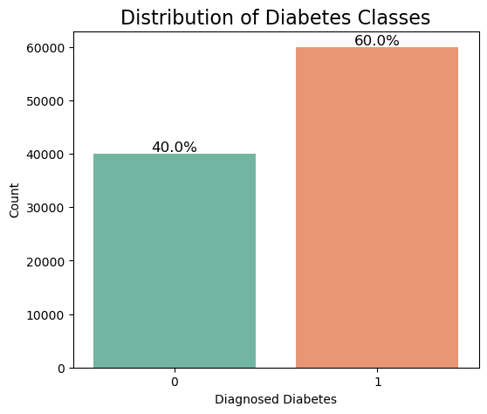
Target Distribution
Key Findings
The dataset contains 100,000 patient records.
Around 60% of patients are diagnosed with diabetes.
Around 40% are non-diabetic.
The class distribution is reasonably balanced, making it suitable for binary classification.

Slide 10
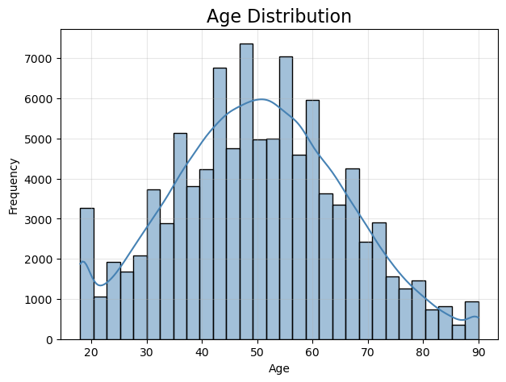
Age Distribution
Key Findings
Most patients are between 40 and 60 years old.
The distribution is approximately bell-shaped.
Fewer patients are observed at very young and very old ages.
Age is expected to be an important predictor of diabetes risk.

Slide 11
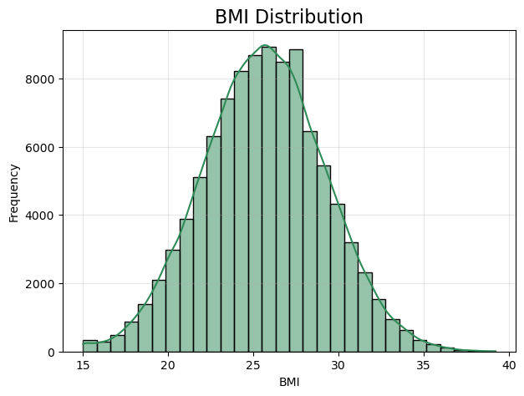
BMI Distribution
Key Findings
BMI follows an approximately normal distribution.
Most patients have BMI values between 22 and 30.
Higher BMI values may indicate increased diabetes risk.
Only a small number of extreme BMI values are observed.

Slide 12
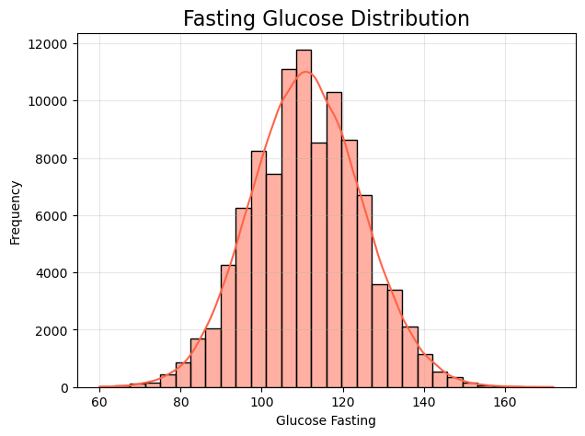
Fasting Glucose Distribution
Key Findings
Fasting glucose values are centered around normal clinical ranges.
The distribution is close to normal with a slight right skew.
Elevated glucose levels are strongly associated with diabetes.
Glucose is expected to be one of the most influential features.

Slide 13
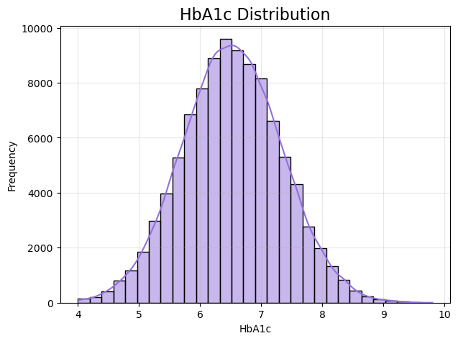
HbA1c Distribution
Key Findings
HbA1c values show a near-normal distribution.
Most patients fall between 6 and 7.
Higher HbA1c values indicate poorer long-term blood glucose control.
HbA1c is one of the strongest indicators of diabetes.

Slide 14
Outlier Detection
Key Findings
Several numerical variables contain outliers.
Most outliers are observed in glucose, cholesterol, triglycerides, and insulin.
Outliers were retained because they may represent real clinical cases.
RobustScaler was later applied to reduce the impact of extreme values.

Slide 15
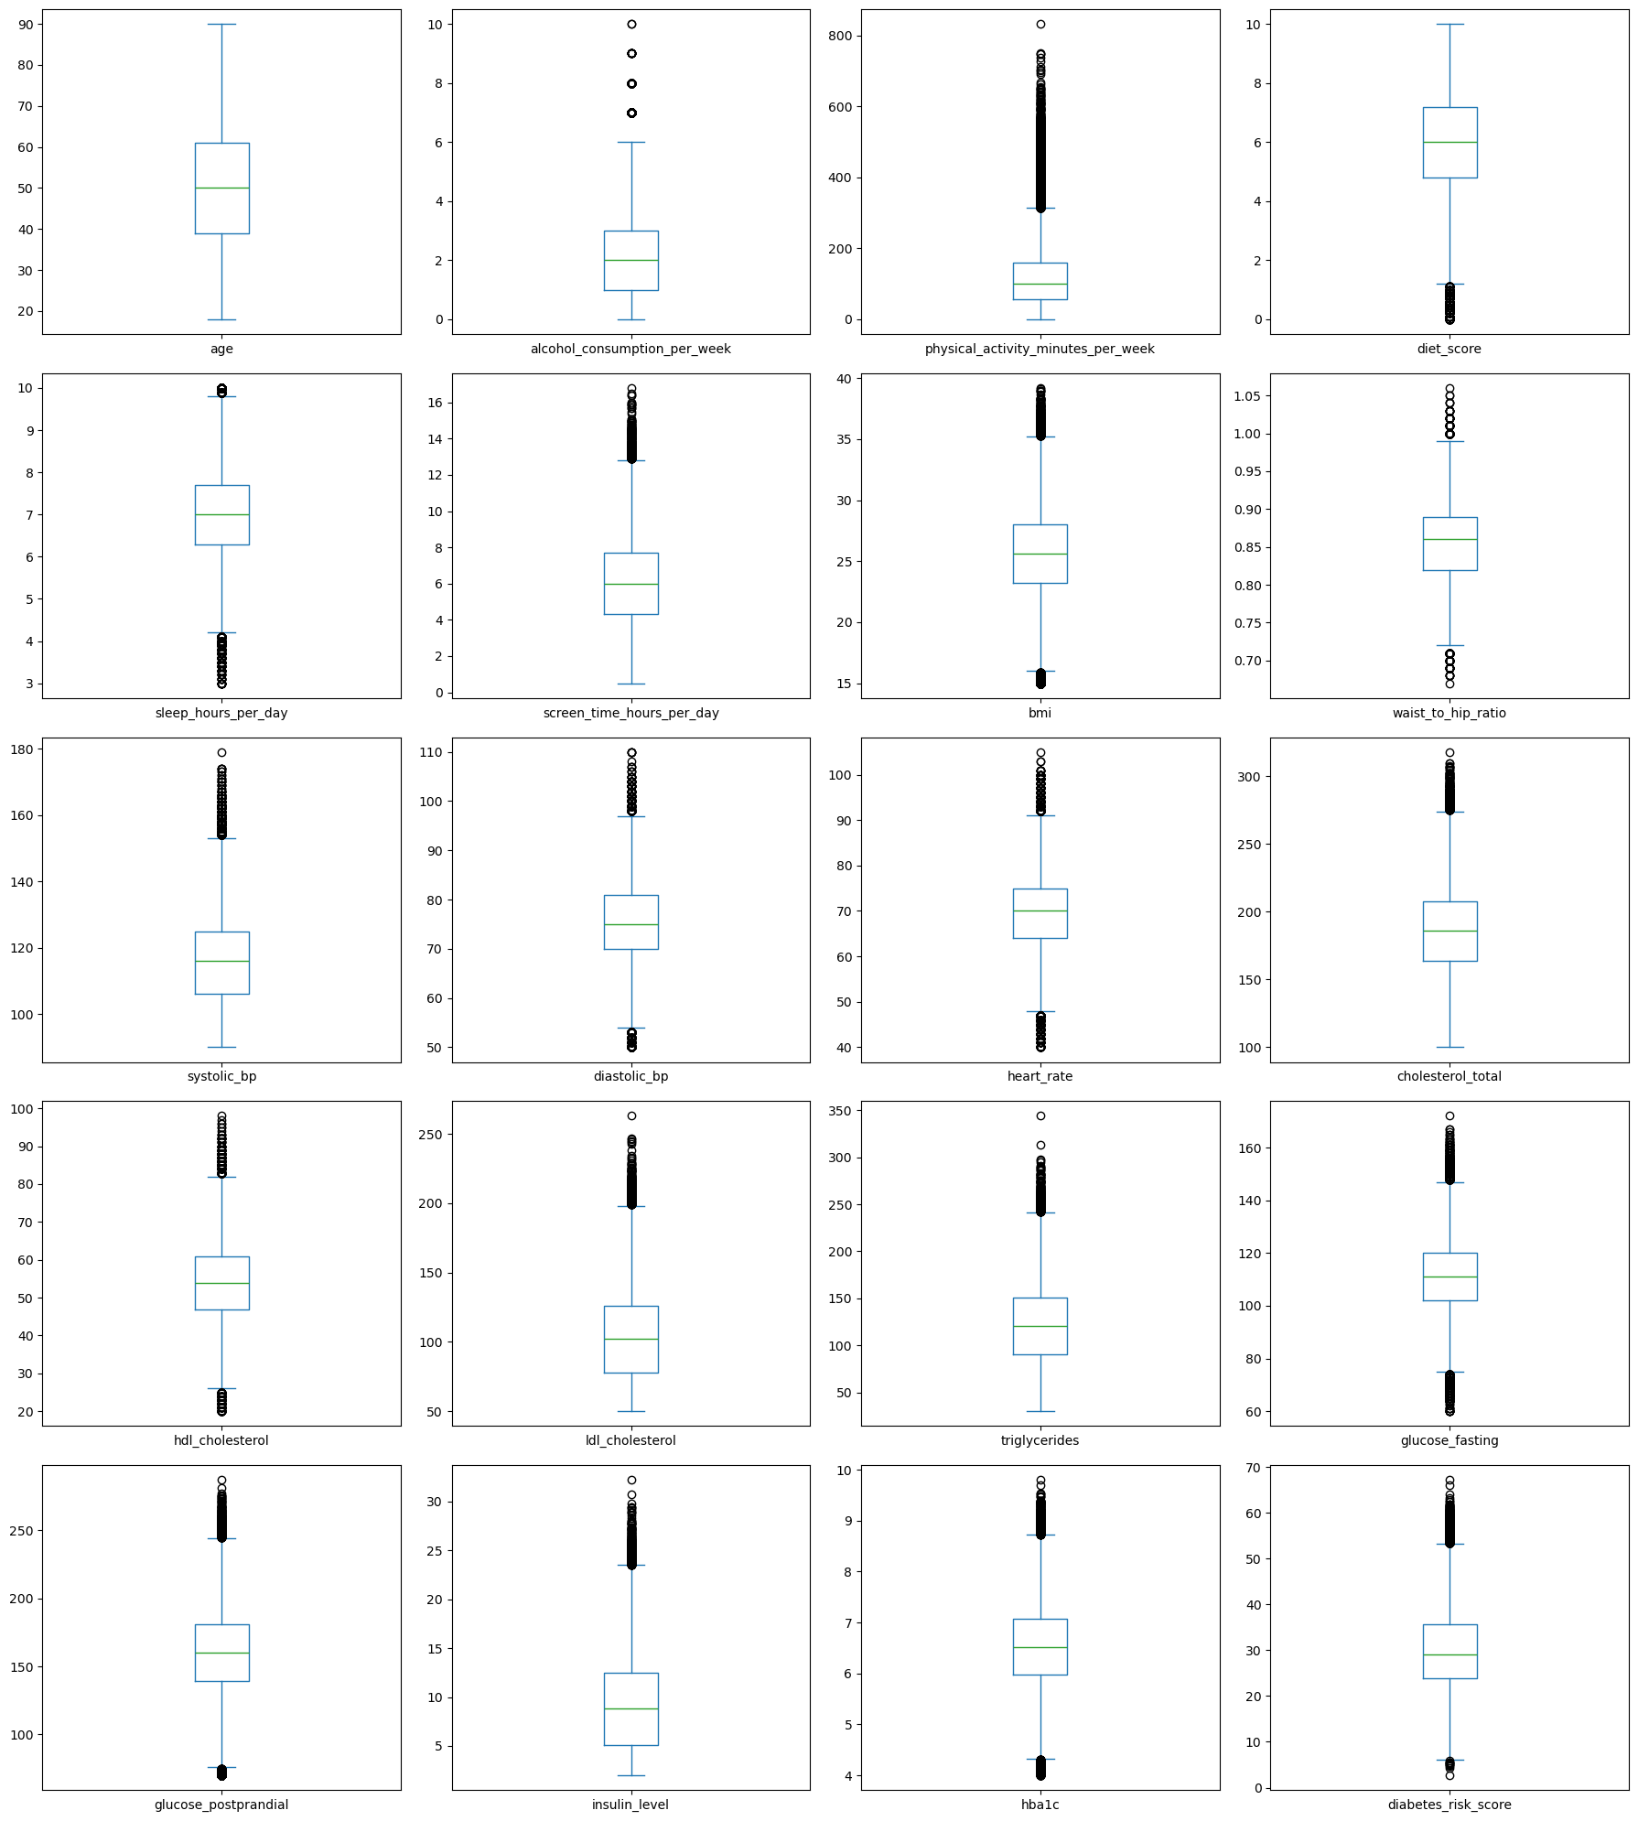

Slide 16
The exploratory analysis helped us understand the data distribution, detect outliers, verify the class balance, and identify the most informative variables before training the machine learning models.

Slide 17
Data Preprocessing
Data Inspection
Loaded dataset
Examined columns
Checked missing values
Checked duplicate records
Encoding
Gender → Binary Encoding
Ethnicity → One-Hot Encoding
Education → One-Hot Encoding
Employment → One-Hot Encoding
Smoking Status → One-Hot Encoding
Income Level → Ordinal Mapping

Slide 18
Feature Removal
Removed:
patient_id
diabetes_risk_score
diabetes_stage
Reason:
These variables either uniquely identify patients or could introduce data leakage into the model.

Slide 19
Feature Scaling & Train/Test Split
Why Scaling?
Machine learning algorithms calculate distances between observations.Large numerical ranges may dominate smaller ones.Therefore,RobustScaler was used because it is resistant to outliers.
Train-Test Split
80% Training20% TestingUsingStratified Samplingto preserve class distribution and Random State = 42 for reproducibility.

Slide 20
Machine Learning Workflow
Flowchart
dataset
↓
Data Cleaning
↓
Encoding
↓
Scaling
↓
Train/Test Split
↓
Model Training
↓
Prediction
↓
Evaluation
↓
Feature Importance
↓
Deployment

Slide 21
Models Evaluated
Model | Purpose | Accuracy
Logistic Regression | Baseline linear classifier | 86%
KNN | Distance-based classification | 80.8%
Decision Tree | Rule-based decisions | 86%
Random Forest | Ensemble of trees | 91%
SVM | Maximum margin classifier | 89.5%
XGBoost | Gradient boosting | 91.8
CatBoost | Gradient boosting optimized for categorical data | 92%
8/7/26

Slide 22
Deployment
The final CatBoost model was deployed using Streamlit.
Workflow:
User Inputs
↓
Data Preprocessing
↓
CatBoost Prediction
↓
Risk Classification
↓
Prediction Display
Benefits:
Easy to use
Real-time prediction
Accessible through a web browser
8/7/26

Slide 23
Conclusion
Key Takeaways
Successfully developed a diabetes prediction system.
Compared seven classification algorithms.
CatBoost achieved the highest performance.
Feature importance analysis revealed the dominance of HbA1c and glucose measurements.
A second experiment demonstrated the impact of removing HbA1c to create a more behavior-focused model.
The project was successfully deployed as an interactive Streamlit application.
Final Closing
Machine Learning should not replace medical professionals, but it can serve as a powerful decision-support tool that enables earlier screening, more efficient resource allocation, and improved preventive healthcare.
8/7/26

Slide 24
Thank you

