Slide 1
DriveShare
Peer-to-Peer Car Rental Platform
CIS 476 Software Architecture and Design Patterns
Mostafa Mohamed | University of Michigan Dearborn
6 GoF Design Patterns

Slide 2
What is DriveShare?
DriveShare is a desktop car rental app modeled after Turo.com.
Car Owners
List vehicles, set price, manage availability, receive payments
Renters
Browse cars, watch listings, book & pay, view rental history
Messaging
Built-in messaging between owners and renters
Notifications
Renters get alerts when a watched car's price drops or becomes available
Forgot Password
Security question chain to recover account access
Built with Python 3 + tkinter | In-memory storage | 10 UI screens

Slide 3
Six GoF Design Patterns
1
Singleton
4
Builder
Creational
Creational
One active session (SessionManager)
Step-by-step car listing creation
2
Observer
5
Proxy
Behavioral
Structural
Car watch list notifications
Payment validation before processing
3
Mediator
6
Chain of Responsibility
Behavioral
Behavioral
Screen navigation between UI frames
Password recovery with 3 security questions

Slide 4
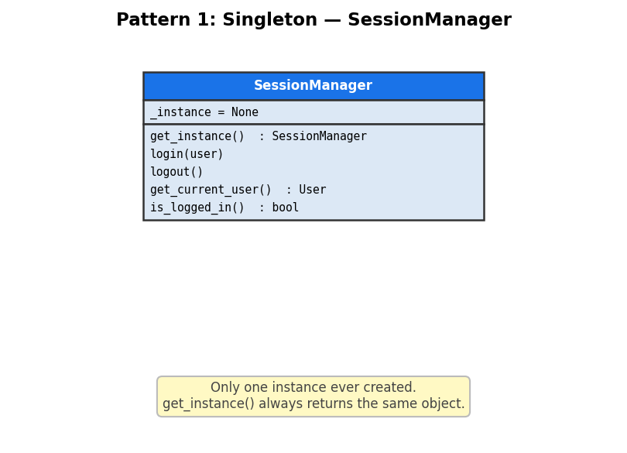
Pattern 1: Singleton — SessionManager
Ensures only one user session exists at a time.
Class:
SessionManager
Key field:
_instance = None (class variable)
Control:
__new__() checks if instance already exists
Access:
get_instance() returns the one object
How it works in DriveShare:
Any screen calls SessionManager.get_instance() to get the current user. login() and logout() control who is active.

Slide 5
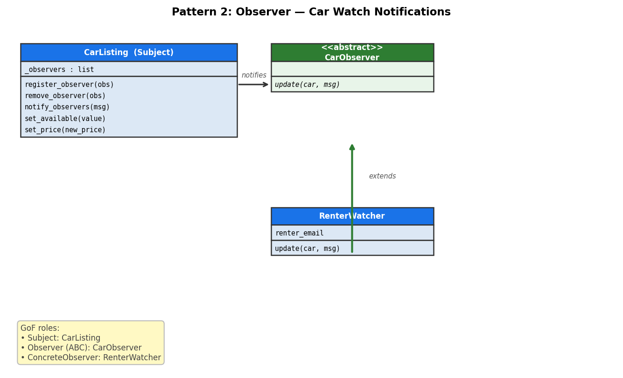
Pattern 2: Observer — Car Watch Notifications
Renters subscribe to a car. The car notifies them automatically when price drops or availability changes.
Subject:
CarListing
Observer (ABC):
CarObserver → update(car, msg)
ConcreteObserver:
RenterWatcher
Register:
register_observer() / remove_observer()
How it works in DriveShare:
Renter clicks Watch → RenterWatcher registered. Owner lowers price → notify_observers() calls update() on every watcher → notification stored in renter inbox.

Slide 6
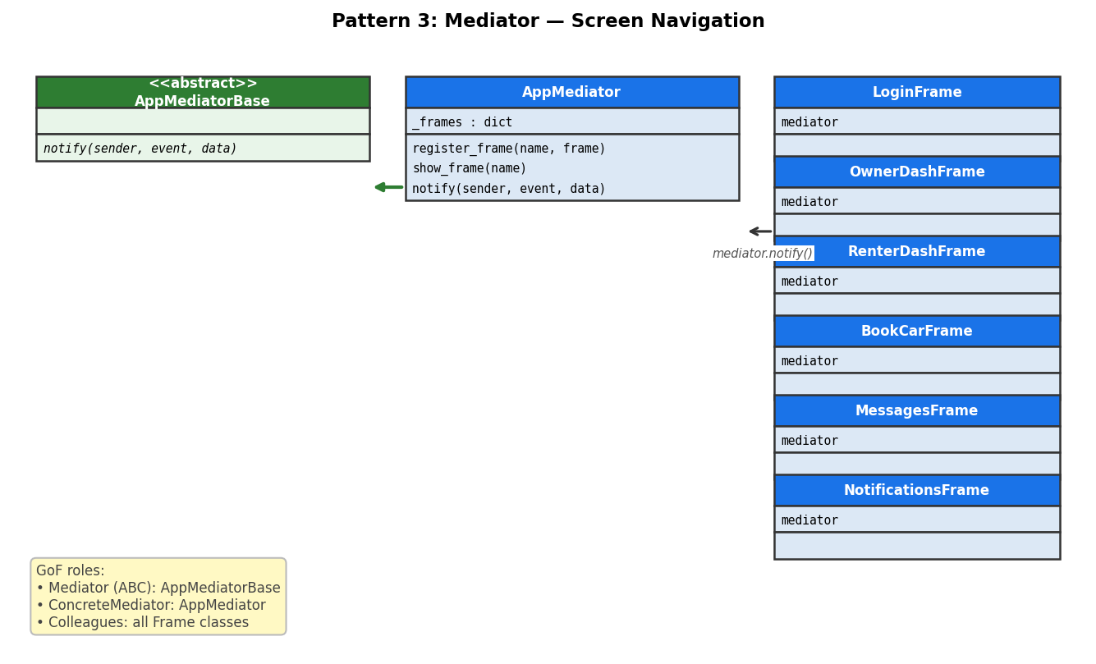
Pattern 3: Mediator — Screen Navigation
All 10 screens communicate through AppMediator. No screen knows or imports another screen.
Mediator (ABC):
AppMediatorBase
ConcreteMediator:
AppMediator
Colleagues:
All Frame classes (LoginFrame, OwnerDashFrame, …)
Navigate:
self.mediator.notify(self, 'show_X')
How it works in DriveShare:
When login succeeds, LoginFrame calls mediator.notify(self, 'show_owner_dash'). AppMediator hides all frames and shows the requested one.

Slide 7
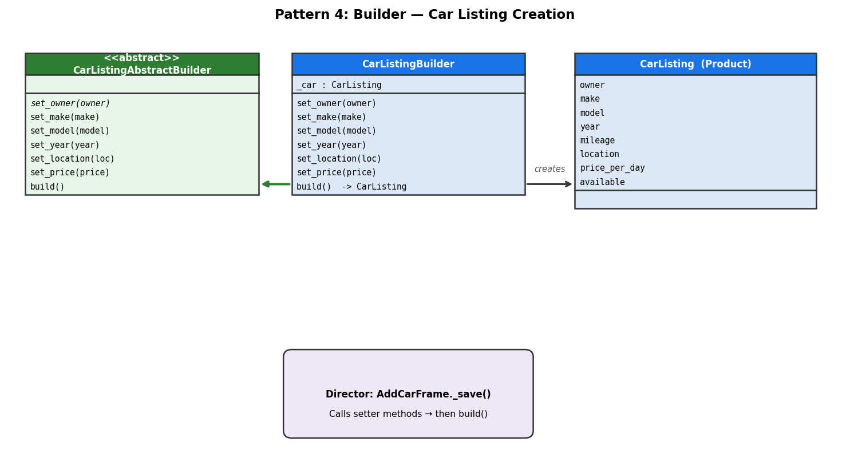
Pattern 4: Builder — Car Listing Creation
Building a car listing object step by step instead of one big constructor call.
AbstractBuilder:
CarListingAbstractBuilder
ConcreteBuilder:
CarListingBuilder (method chaining)
Director:
AddCarFrame._save() — calls setters in order
Product:
CarListing
How it works in DriveShare:
Director calls: builder.set_make(x).set_model(y).set_price(z).build() and gets back the finished CarListing object.

Slide 8
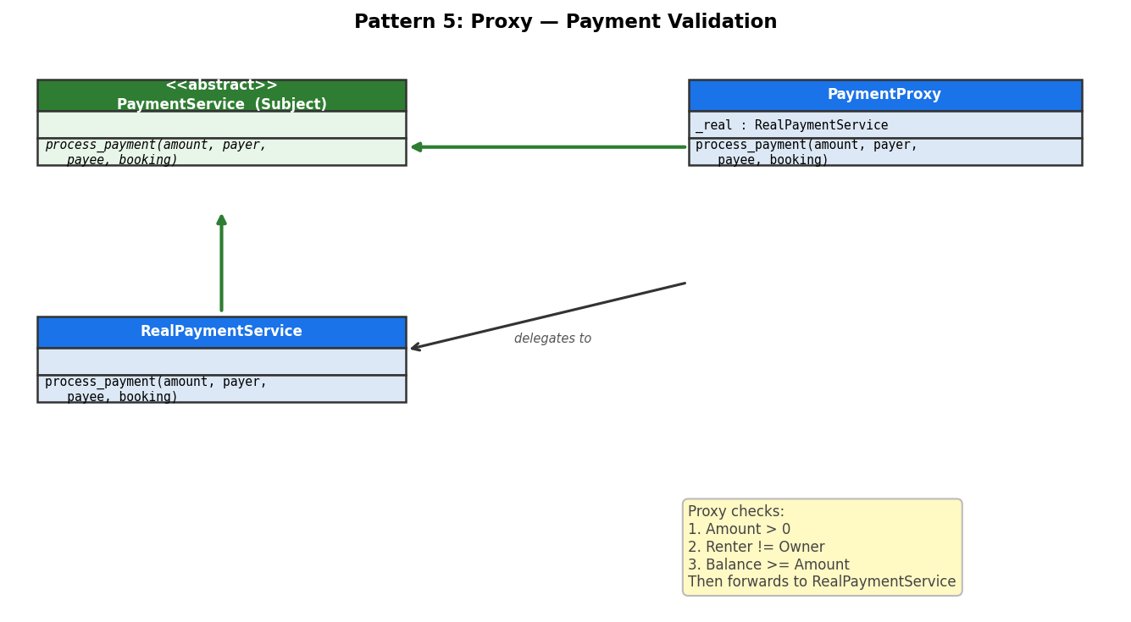
Pattern 5: Proxy — Payment Validation
PaymentProxy sits between the booking screen and the real payment service. It validates before forwarding.
Subject (ABC):
PaymentService
RealSubject:
RealPaymentService
Proxy:
PaymentProxy
Checks:
amount > 0 | renter ≠ owner | balance sufficient
How it works in DriveShare:
Renter clicks Confirm and Pay → BookCarFrame calls PaymentProxy → proxy validates → if ok, forwards to RealPaymentService to update balances.

Slide 9
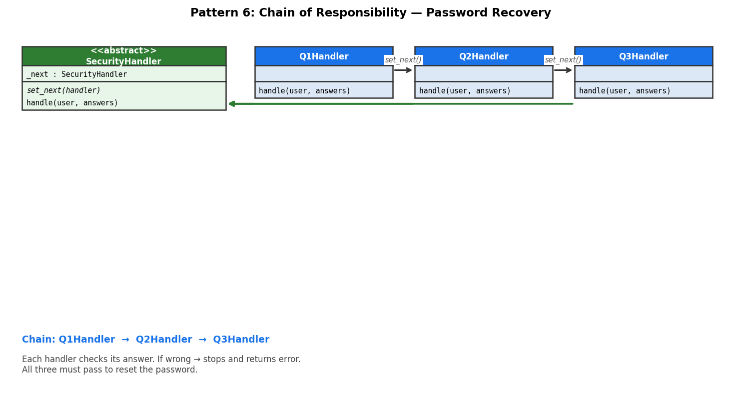
Pattern 6: Chain of Responsibility — Password Recovery
Three security question handlers are linked in a chain. All three must be answered correctly.
Handler (ABC):
SecurityHandler → _next, set_next(), handle()
ConcreteHandlers:
Q1Handler → Q2Handler → Q3Handler
Client:
ForgotPasswordFrame._reset()
Result:
All correct → reset allowed | Any wrong → stops with error
How it works in DriveShare:
ForgotPasswordFrame builds the chain: q1.set_next(q2).set_next(q3), then calls chain.handle(user, answers). Each handler checks its own answer and either stops or forwards.

Slide 10
Demo Walkthrough
1
Login & Session
Log in as owner@demo.com → SessionManager tracks the session (Singleton)
2
Add a Car
Click Add New Car Listing, fill the form → Builder assembles the CarListing step by step
3
Watch a Car
Log in as renter, click Watch → RenterWatcher registered as Observer on CarListing
4
Price Drop Alert
Owner lowers price → notify_observers() fires → renter sees notification (Observer)
5
Book & Pay
Renter books, PaymentProxy validates then processes (Proxy)
6
Forgot Password
Enter email, answer 3 security questions → Q1→Q2→Q3 chain (Chain of Responsibility)
★
Navigation
Every screen switch goes through AppMediator.notify() (Mediator)

Slide 11
Summary
DriveShare is a working Python + tkinter desktop app for peer-to-peer car rentals
Six GoF design patterns implemented: Singleton, Observer, Mediator, Builder, Proxy, Chain of Responsibility
10 fully functional UI screens with demo accounts and in-memory data
All patterns traceable back to GoF roles in code comments
No database required data stored in Python dicts and lists
Thank you

